Slide 1
Jet Identification in QCD Samples at DØ
Zachary D. Hodge
Austin Peay State University
Columbia University
Nevis Laboratories
August 1st , 2008

Slide 2

Abstract
The jets of b-hadrons and gluons in QCD Monte Carlo samples can be identified and separated from light-quark jets other background jets with the use of the ROOT toolkit TMVA and the Neural Network and Boosted Decision Tree algorithms contained within it.

Slide 3
Contents
Introduction to the Tevatron
The DØ Experiment at Fermilab
Hadronization and Jets
Variable Algorithms and KS Test
TMVA and Classifiers BDT and MLP
BDT vs. MLP
BDT on MC samples

Slide 4
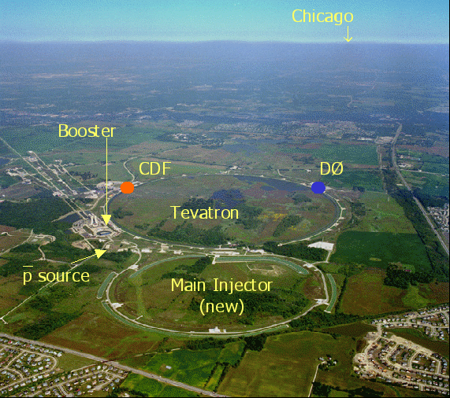
Tevatron at Fermilab
Fermilab Tevatron Collider located outside Batavia, Illinois
Proton/Antiproton
6.3 km Circumference
1.96 TeV Center of Mass Energy

Slide 5
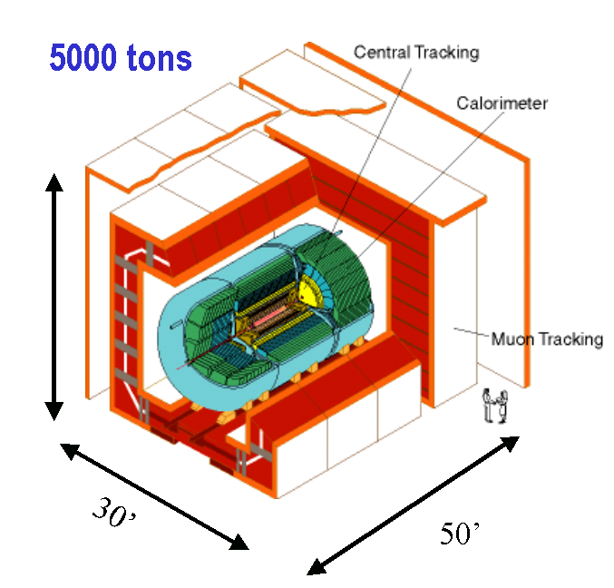
The DØ Experiment

Slide 6
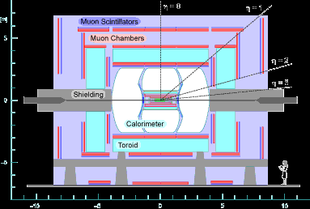
The DØ Experiment

Slide 7
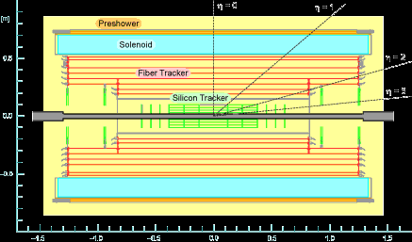
The DØ Experiment

Slide 8
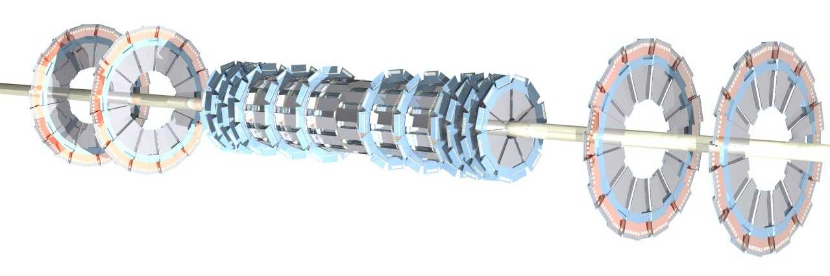
The DØ Experiment
The DØ detector has four main regions of tracking and detection
Silicon Microstrip Detector (SMT)
Measures charged particles position from PV

Slide 9
The DØ Experiment
The DØ detector has four main regions of tracking and detection
Silicon Microstrip Detector (SMT)
Central Fiber Tracker (CFT)
Determines charged particles momentum and charge
Both use a 2T solenoid magnetic field to bend particle path

Slide 10
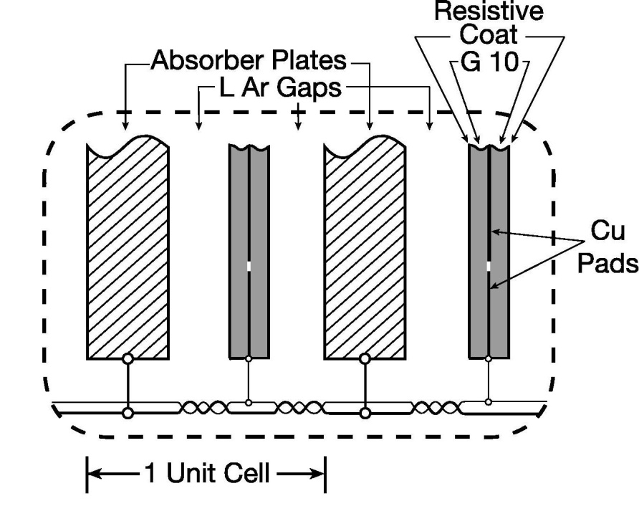
The DØ Experiment
The DØ detector has four main regions of tracking and detection
Silicon Microstrip Detector (SMT)
Central Fiber Tracker (CFT)
Liquid Argon Calorimeter
3 separate, fully enclosed regions (temp. at 90K)
Uses depleted uranium and copper plates to cause showers
Uses Liquid Ar to measure electromagnetically and strongly interacting particles
Notes:
Add absorber plate pic

Slide 11
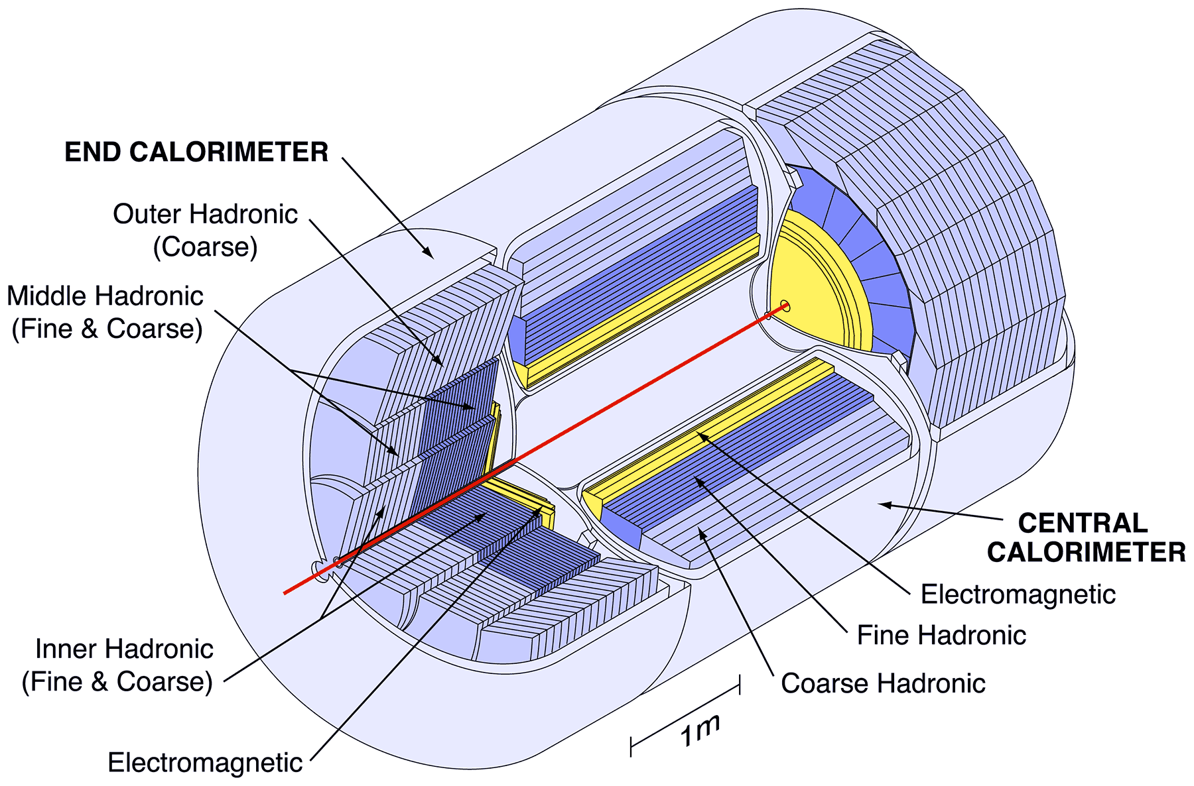
The DØ Experiment
Liquid Argon Calorimeter

Slide 12
The DØ Experiment
The DØ detector has four main regions of tracking and detection
Silicon Microstrip Detector (SMT)
Central Fiber Tracker (CFT)
Liquid Argon Calorimeter
Muon Tracking System
Outer most tracking system
Uses 2T magnetic field and drift chambers to measure muon momentum and position

Slide 13
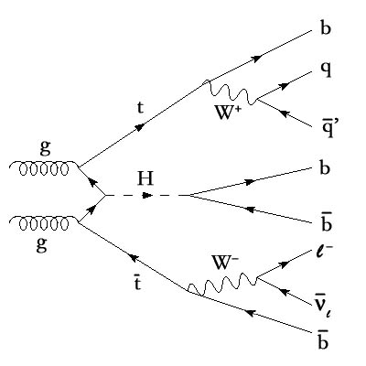
The DØ Experiment
What to look for at DØ?
Top quark production
Higgs boson?
How do we detect these particles?
From what they decay to

Slide 14
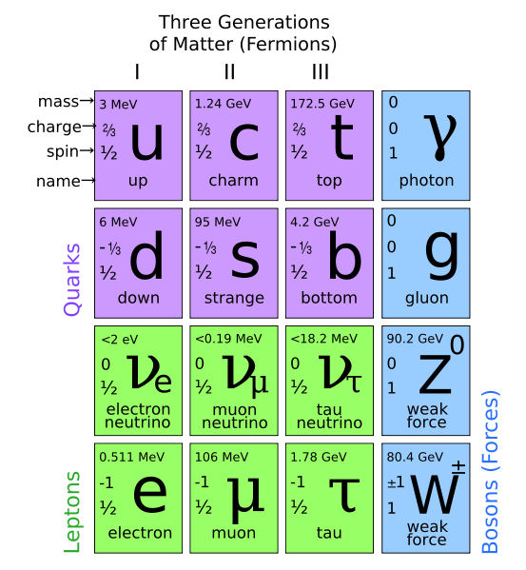
Bottom Quarks
Third Generation quark (third set discovered)
Second Highest mass of the quarks (4.2GeV). Below the Top quark’s
Carry -1/3e electric charge

Slide 15
Bottom Quarks
Quarks cannot exists freely (color confinement)
Quarks carry color charge (interact with gluons)
Immediately form a hadron once being separated
Either a meson (2 quark configurations)
Or a baryon (3 quark configuration)
B-hadrons have a longer lifetime than other light-quark hadrons (10⁻¹²s and 500µm)

Slide 16
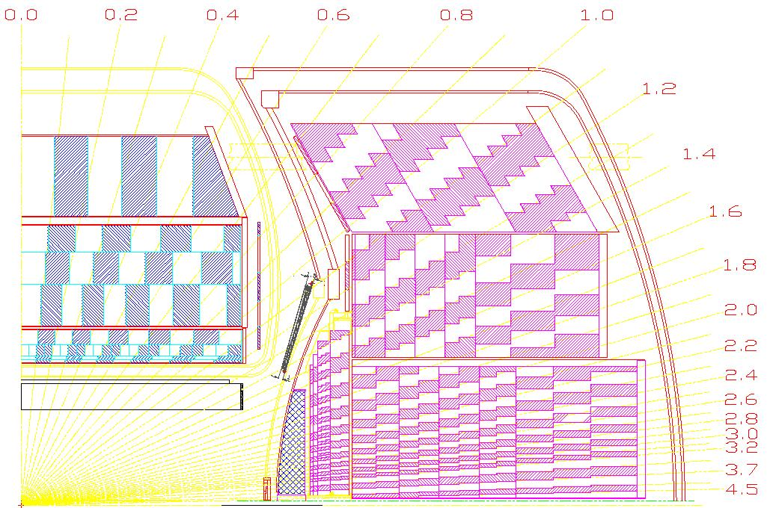
Bottom Quarks
Once forming the bound state hadron, the B-hadron will fragment in the detector
Deposits energy in the Hadronic Calorimeter
This B-hadron will shower particles in the detector
Shower is fairly collimated
Use an algorithm to construct a cone like area
This is called a jet

Slide 17
Bottom Quarks
The jet will deposit almost all of its energy in the E&M and Hadronic Calorimeter
Prominent features of a jet help to distinguish what particle it came from
The key feature of a b-jet is found in its displaced (secondary) vertex
PV
SV
p
pbar

Slide 18
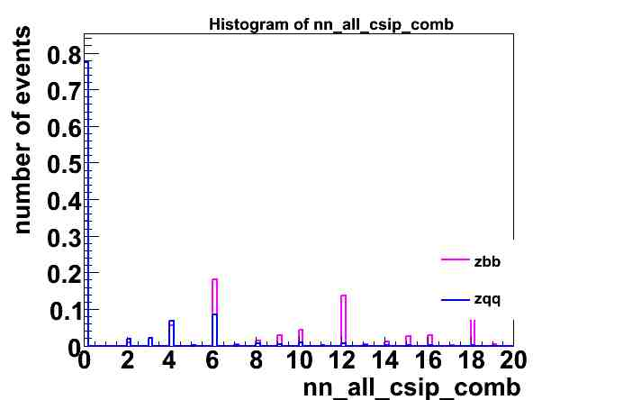
Jet Tagging Algorithms
Counting Signed Impact Parameters (CSIP)
Counts jets with a large impact parameter
Requires at least 2 tracks with IP > 3 (< -3)
Or at least 3 tracks with IP > 2 (< -2)
Jet Axis
Track
θ
IP
Primary Vertex

Slide 19
Jet Tagging Algorithms
Counting Signed Impact Parameters (CSIP)
Jet LIfetime Probability Tagger (JLIP)
Combines impact parameter information from all tracks in a jets into one variable
JLIP Prob is the probability that all tracks originate from a primary vertex
Probability close to 0 indicate a likely b-jet

Slide 20
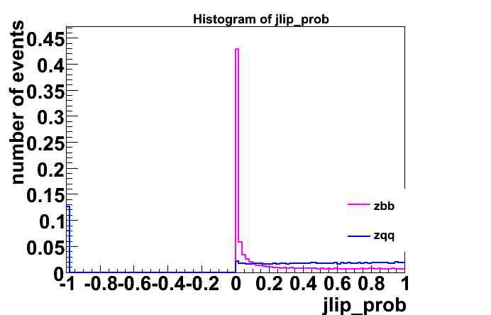
Jet Tagging Algorithms
jlip_prob peaks near zero for b-jets

Slide 21
Jet Tagging Algorithms
Counting Signed Impact Parameters (CSIP)
Jet LIfetime Probability Tagger (JLIP)
Secondary Vertex Tagger (SVT)
Selects tracks with high IP to build secondary vertices
Tracks with high IP form vertices with high decay length significance (dlsig)
Jets are tagged when a secondary vertex is within dR < .5

Slide 22
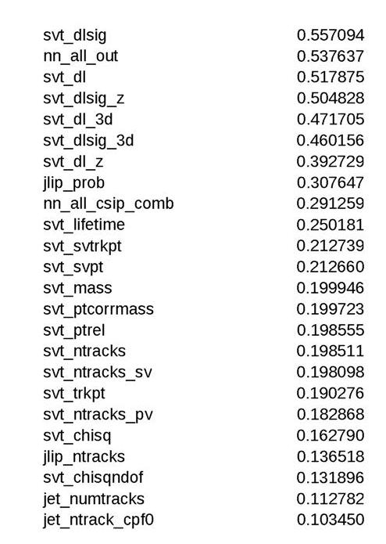
Variable Selection
Determine which of all these variables have the greatest power of separation
Use a Kolmogorov-Smirnov Test
KS Test measures the distance between two empirical cumulative distribution functions
Gives a list of good variables
We chose 24 of which to use

Slide 23
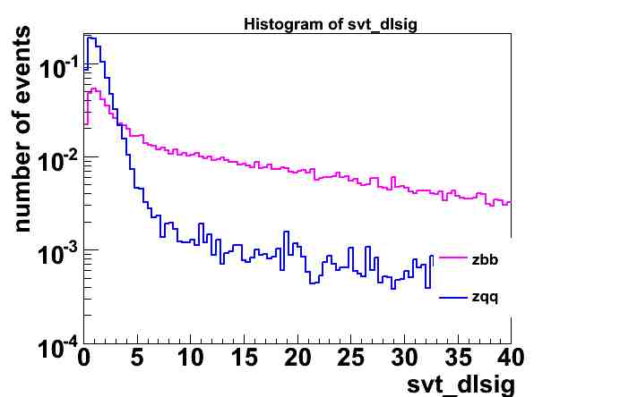
Variable Selection
From the SVT tagging algorithm
Decay Length Significance
It’s related to the Impact Parameter
High IP results in a high dlsig

Slide 24
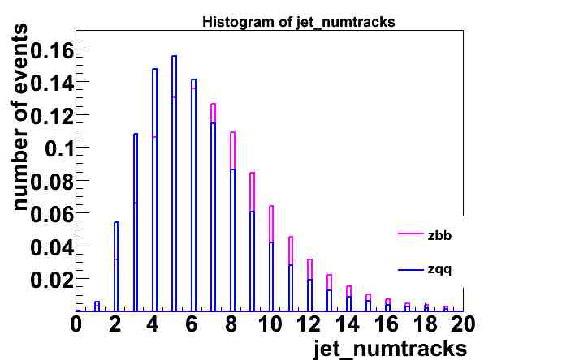
Variable Selection
jet_numtracks is the number of tracks associated with a known jet
This variable is available from the MC simulation
Shows a decent, but not great separation

Slide 25
ROOT and TMVA
Toolkit for Multivariate Analysis (TMVA)
Uses multiple variables to test, train and evaluate an event classifier
Two event classifiers were used
Multi-layer Perceptron (MLP)
A Neural Network algorithm
Boosted Decision Tree (BDT)
Decision tree algorithm

Slide 26
Multi-layer Perceptron
The MLP is a neural network based algorithm
Data is fed into the first layer (input layer)
Hidden layers inside calculate a linear combination of the variables and decide how they are related
MLP uses what it learns in one layer and passes it on to the next

Slide 27
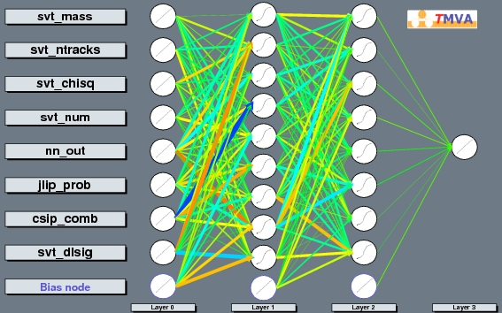
Multi-layer Perceptron

Slide 28
Boosted Decision Tree
A BDT is a form of decision tree but where events are boosted
Decision trees operate on a yes/no architecture
Misclassification can occur due to statistical fluctuations
Boosting helps overcome misclassifications

Slide 29
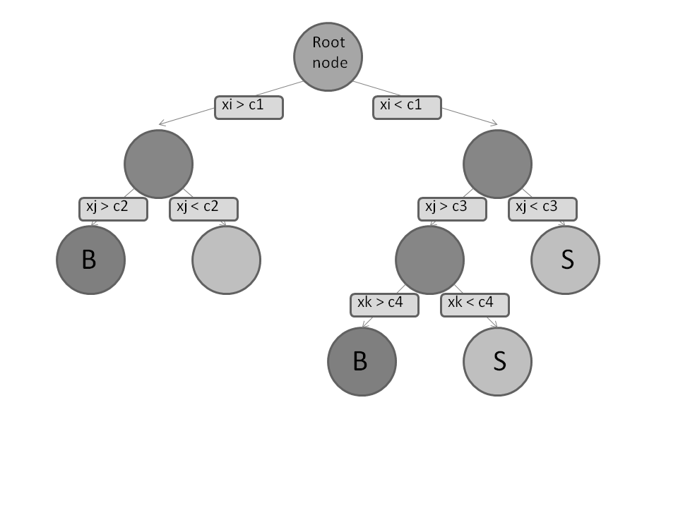
Boosted Decision Tree
Terminal Node for a background event
Terminal Node for a signal event
Decision Tree Architecture

Slide 30
Boosted Decision Tree
Misclassification occurs when a known signal event lands on background terminal node or vice versa
Boosting is the process of reweighting variables to account for misclassification
Each time a variable is misclassified it is reweighted, then repeated in the BDT
Helps decrease statistical fluctuation in the response

Slide 31
MLP vs BDT
Comparison of background rejection versus signal efficiency (BgrejvsSigeff) curves for both the MLP and BDT
Shows the effectiveness of the classifier algorithm
Comparison was done using b-jet signal and light-quark background

Slide 32
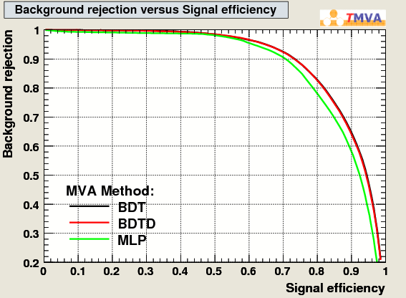
MLP vs BDT
The BDT classifier showed a ~3% performance gain over the MLP

Slide 33
BDT Optimization
Now that the BDT has been identified as a more powerful classifier
The optimum setting for the BDT must be found
This was done by systematically changing individual setting in the BDT algorithm

Slide 34
BDT Optimization
Greatest performance gains were achieved by changing the boosting type and pruning method
Boosting Type was set to AdaBoost (adaptive boost)
AdaBoost gives higher event weight to misclassified events on the next tree
Pruning Method was set to ExpectedError
ExpectedError recursively deletes daughter nodes that have a higher statistical error than their parent node

Slide 35
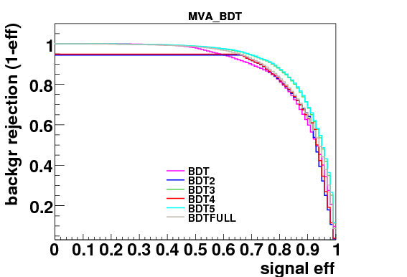
BDT Optimization

Slide 36
BDT on Z→bbar MC Sample
The BDT was then tested on a Z->bb Monte Carlo Sample
This was intended to test the capability of the BDT to separate b-jets from light-quark jets
Signal like events will be shifted to +1 and background will be shifted to -1

Slide 37
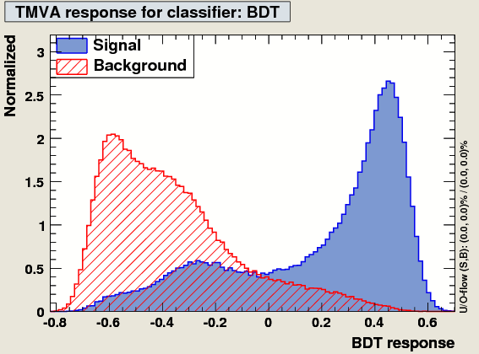
BDT on Z→bbar MC Sample

Slide 38
BDT on Z→bbar MC Sample
The BDT showed good response in separating b-jets from light-quark jets
There is a little overlap, but nothing unexpected as the two jet types do have similar characteristics

Slide 39
BDT with QCD MC Sample
The BDT was then tested on a more complex Monte Carlo sample
The first test was to separate quark jets from other jets
The second test was to separate quark jets from gluon jets
The sample was preprocessed to artificially separate the jets in the event

Slide 40
BDT with QCD MC Sample
The BDT showed fairly good capability in separating quark jets from other jets
The BgrejvsSigeff Curve shows a decrease in efficiency but this can be attributed to the way cuts were applied
Cuts of >=2 tracks resulted in other jets taking on characteristics like that of quark jets

Slide 41
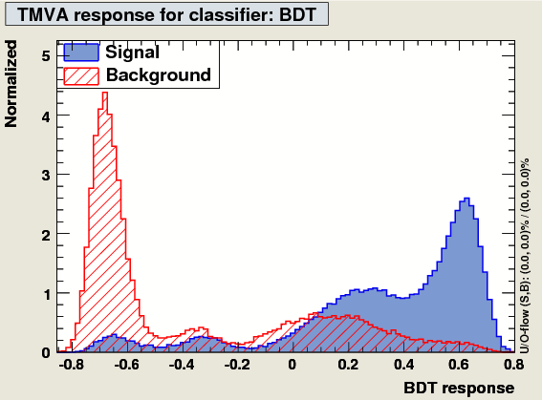
BDT with QCD MC Sample

Slide 42
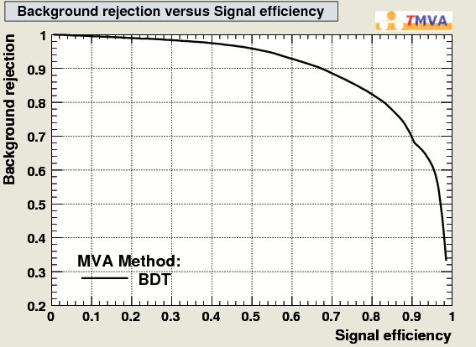
BDT with QCD MC Sample

Slide 43
BDT with QCD MC Sample
The BDT had a significantly lower performance on quark jet gluon jet separation
The two response distributions are nearly overlapping
The BgrejvsSigeff curve is significantly lower than all previous tests
But.. This is not entirely unexpected, as the quark and gluon jets had similar variable values

Slide 44
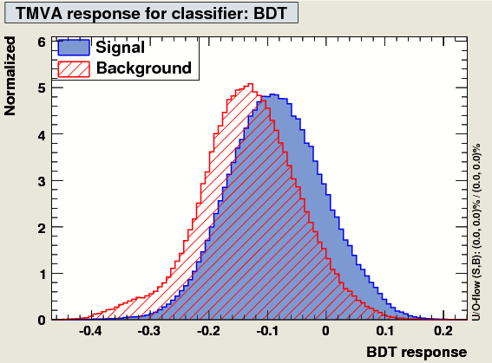
BDT with QCD MC Sample

Slide 45
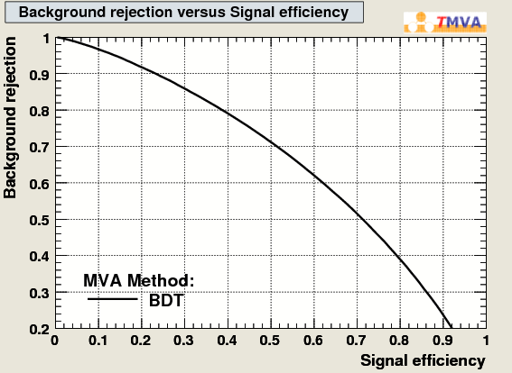
BDT with QCD MC Sample

Slide 46
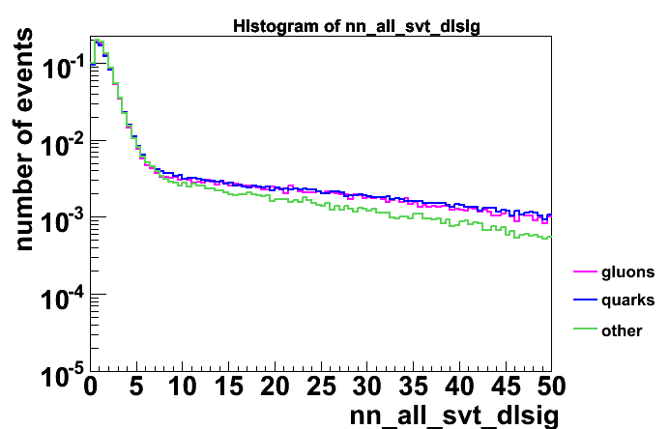
BDT with QCD MC Sample

Slide 47
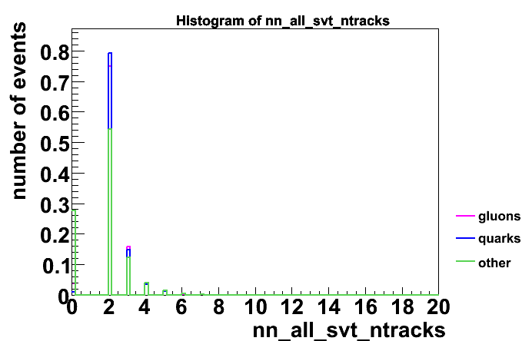
BDT with QCD MC Sample

Slide 48
Conclusions
BDT showed significant performance over the MLP on MC samples
BDT showed great ability in separating b-jets from quark jets and quark jets from other jets
BDT slacked on the ability to distinguish quark jets from gluon jets

Slide 49
Acknowledgements

