Slide 1
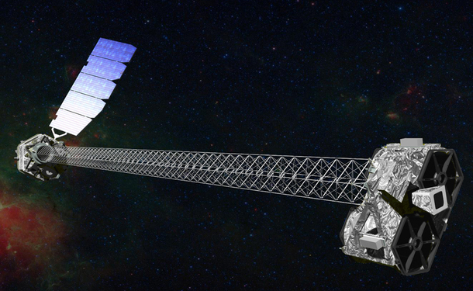
NuSTAR View of the Galactic Center: Chuck Hailey, Columbia University

Slide 2
Outline
Non-thermal filaments in the Galactic Center
NuSTAR – Nuclear Spectroscopic Telescope Array
NuSTAR’s view of the Galactic Center
The Galactic Center at > 20 keV:
Discovery of diffuse hard X-ray emission (DHXE)
in the inner ~10 pc
The Galactic Center at > 40 keV:
“Cusp” of hard X-ray emission in the inner ~1 pc
Non-thermal filaments in the Galactic Center

Slide 3
First high-energy X-ray focusing telescope in orbit
1. Two co-aligned,
multilayer coated, grazing incidence focusing optics
2. Deployable 10 m mast
3. CdZnTe pixel detector spectrometers
Notes:
The observatory consists of two co-aligned grazing-incidence X-ray telescopes pointed at celestial targets by a three-axis
stabilized spacecraft. Deployed into a 600 km, near-circular, 6 inclination orbit, the Observatory has
now completed commissioning, and is performing consistent with pre-launch expectations. NuSTAR
is now executing its primary science mission, and with an expected orbit lifetime of ten years, we
anticipate proposing a guest investigator program, to begin in Fall 2014.
extending the sensitivity of focusing far beyond the 10 keV high-energy cuto achieved by all previous
X-ray satellites. The inherently low-background associated with concentrating the X-ray light
enables NuSTAR to probe the hard X-ray sky with a more than one-hundred-fold improvement in
sensitivity over the collimated or coded-mask instruments that have operated in this bandpass.

Slide 4
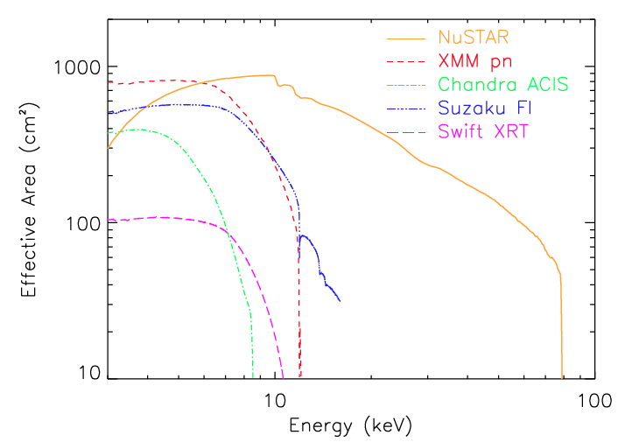
NuSTAR telescope performance
Harrison et al. (2013)
Energy Band: 3-79 keV
Angular Resolution:
58” (HPD), 18” (PSF)
Field-of-view: 12’ x 12’
Energy resolution (FWHM):
0.4 keV at 6 keV,
0.9 keV at 60 keV
Temporal resolution: 0.1 ms
Maximum Flux Rate: 10k cts/s
ToO response: <24 hours

Slide 5
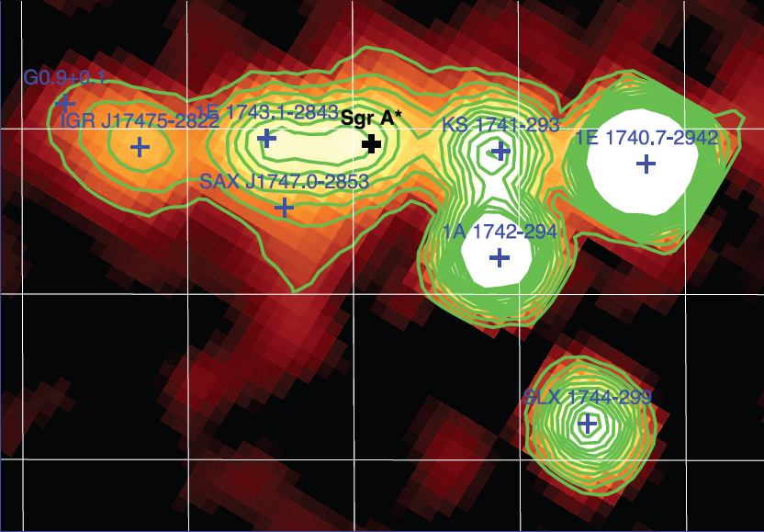
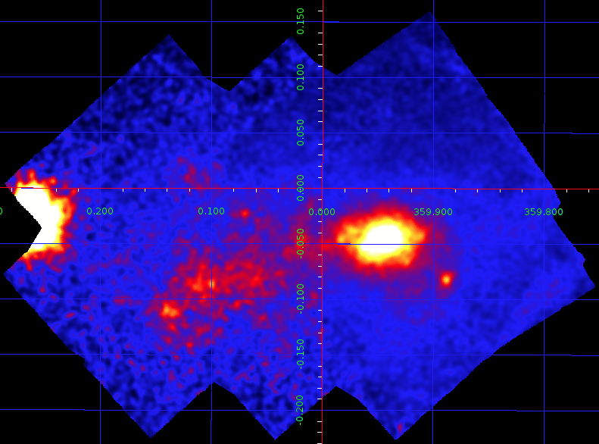
NuSTAR’s View of the Galactic Center
Observed the central ~0.5° of the Galaxy for ~700 ks in July through October 2012
Part of larger, ~2 Ms survey of the Galactic Center region
700 ks
INTEGRAL: 20-40 keV
NuSTAR: 10-40 keV
Belanger et al. 2006
Will focus in this talk on the ~300 ks effective exposure time covering the central 5’ x 5’
Notes:
58” (NuSTAR HPD) vs 720” (INTEGRAL HPD)

Slide 6
Non-thermal X-ray filaments
High-energy X-ray detection of G359.88-0.08 (Sgr A-E):
Magnetic flux tube emission powered by cosmic-rays?
S. Zhang et.al., Astrophysical Journal, 784, 6 (2014)
High-Energy X-ray detection of G359.97-0.038
M., Nynka et al. (to be submitted)
,

Slide 7
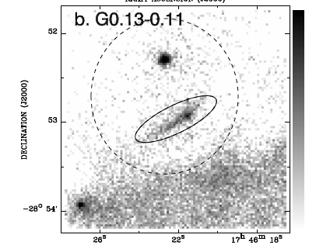
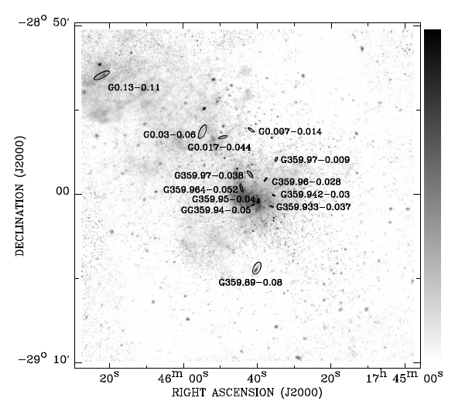
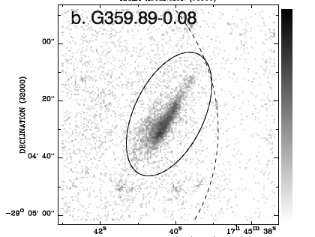
Non-thermal X-ray Filaments (NTF) observed by Chandra
Dozens of filamentary structure with power-law spectra in X-ray were observed near Galactic Center, most, if not all, believed to be PWNe
Chandra NTF Survey (Johnson et al. 2009)

Slide 8
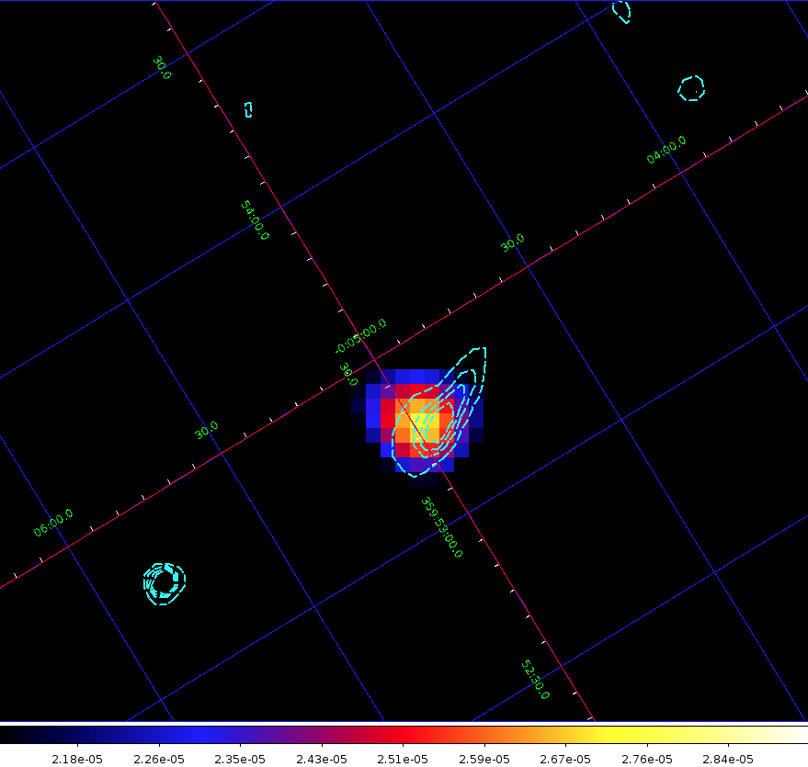
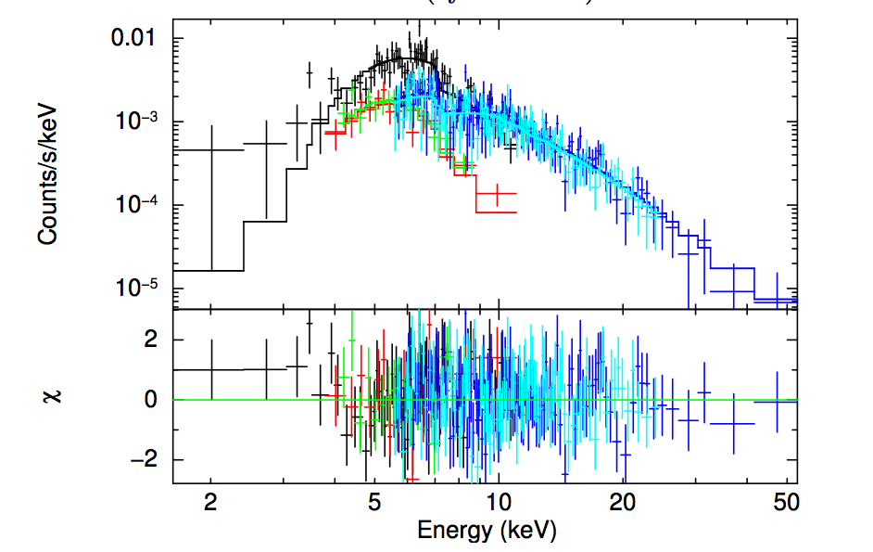
Sgr A-E (G 359.88-0.08) is the brightest hard X-ray sources detected in the GC by NuSTAR
Brightest GC non-thermal filament (NTF) detected by NuSTAR up to ~ 50 keV.
Spectra best fitted with a simple absorbed power-law with photon index of ~2.3 +/- 0.2 (previous measurements range from 1.1 to 3.1).
Detected by NuSTAR as an extended source in 3-10 keV and a point-like source 10-50 keV bands.
The high energy (>10keV) centroid sits closer to the south-eastern end.
NuSTAR 10-50 keV image overlaid with Chandra 2-8 keV contour.
Joint NuSTAR+XMM-Newton spectra.

Slide 9
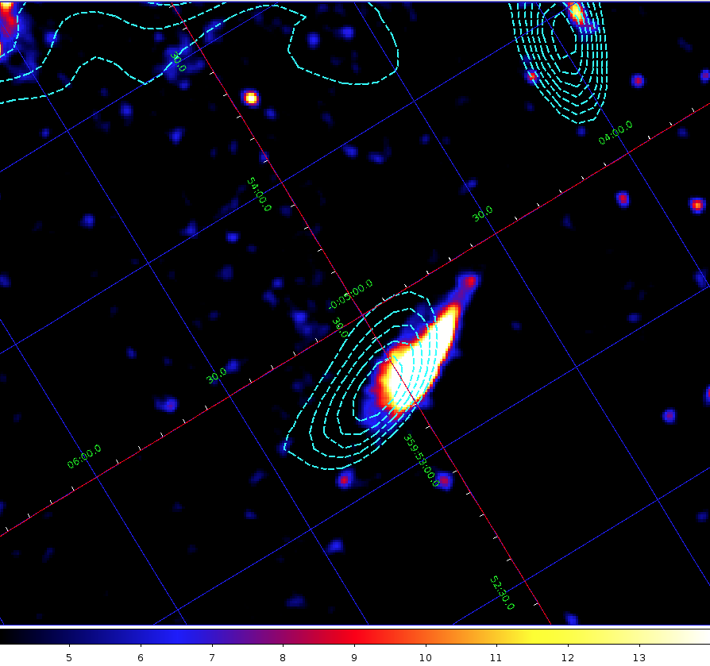
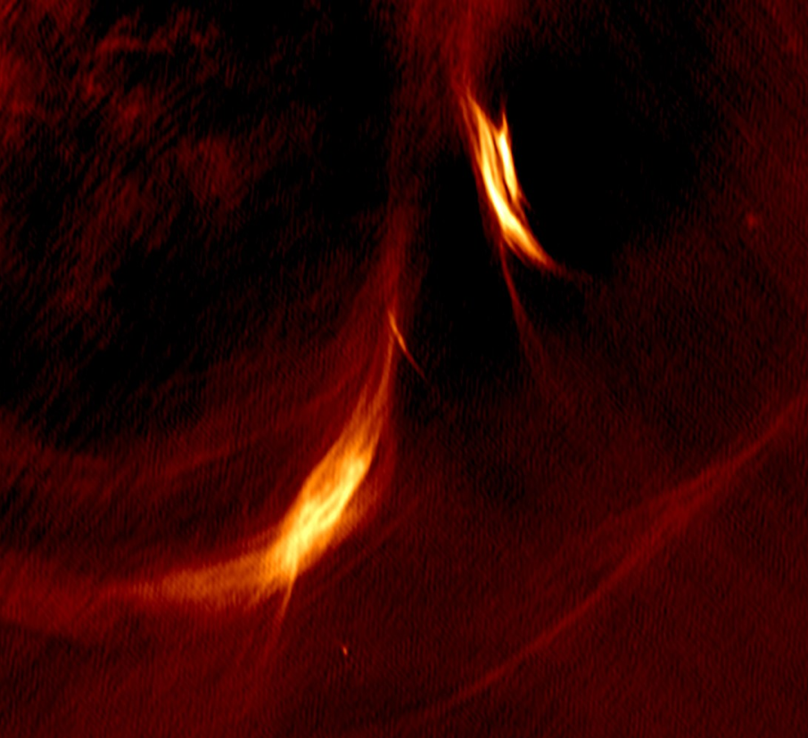
Sgr A-E source nature - PWN?
Scenario 1: PWN (Lu et al. 2003, Johnson et al. 2009).
Challenges:
X-ray: Hard to explain the 10” offset between X-ray and radio emission.
Radio: High resolution radio morphology does not support the PWN picture.
Sgr A-F
(Not detected by NuSTAR)
Sgr A-F
~10” offset between X-ray and radio emission.
Sgr A-E
Sgr A-E
Chandra 2-8 keV image overlaid with VLA 20-cm contour.
JVLA (B and C arrays) 6-cm continuum map (Morris et al.).

Slide 10
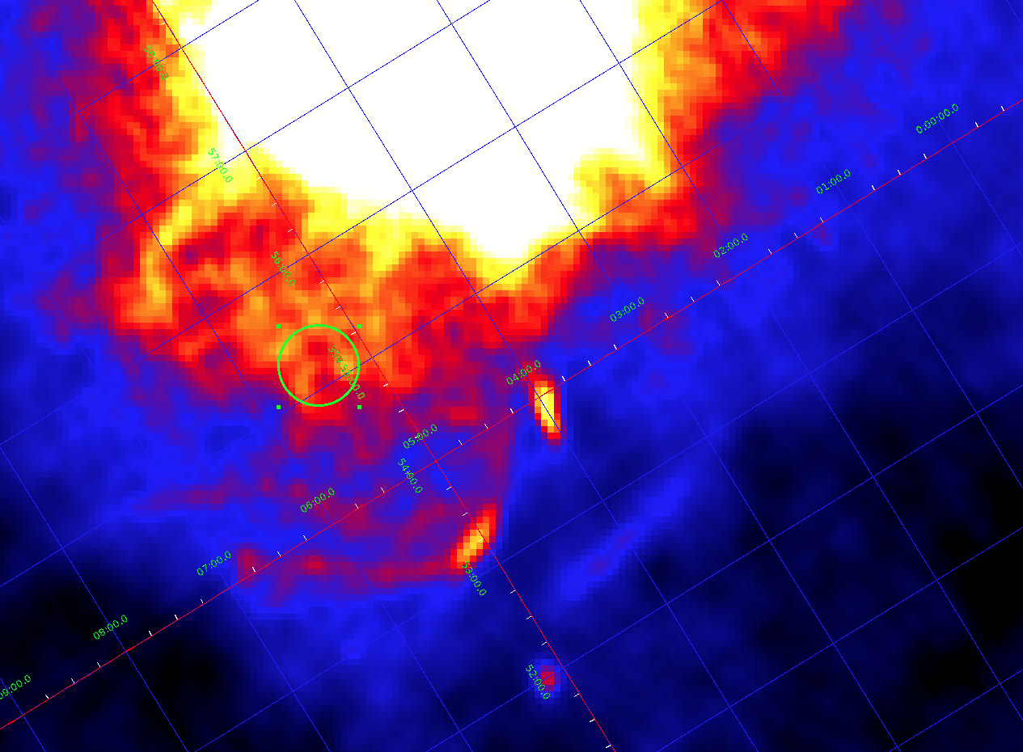
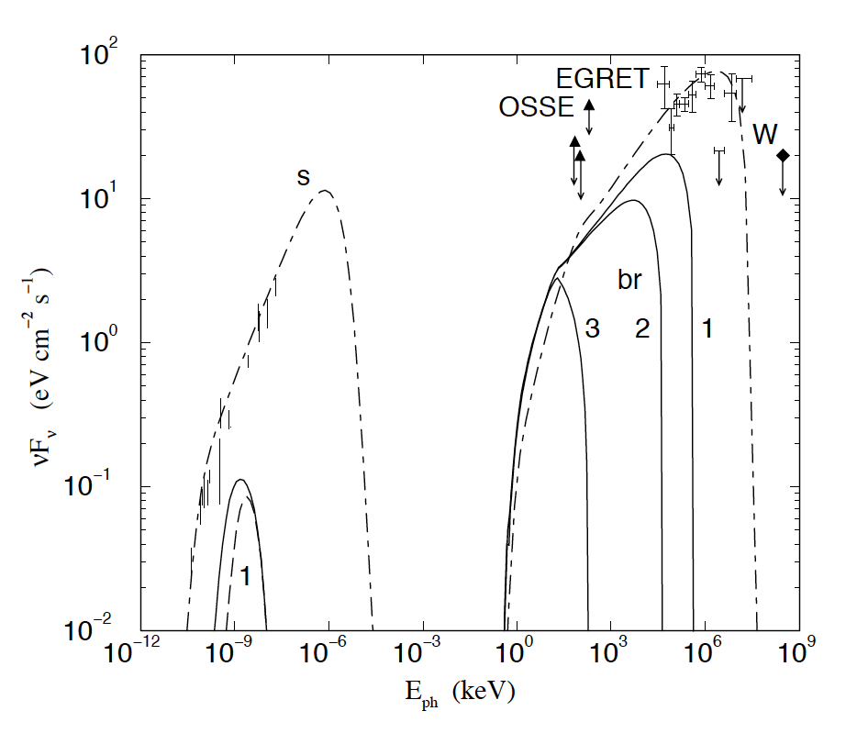
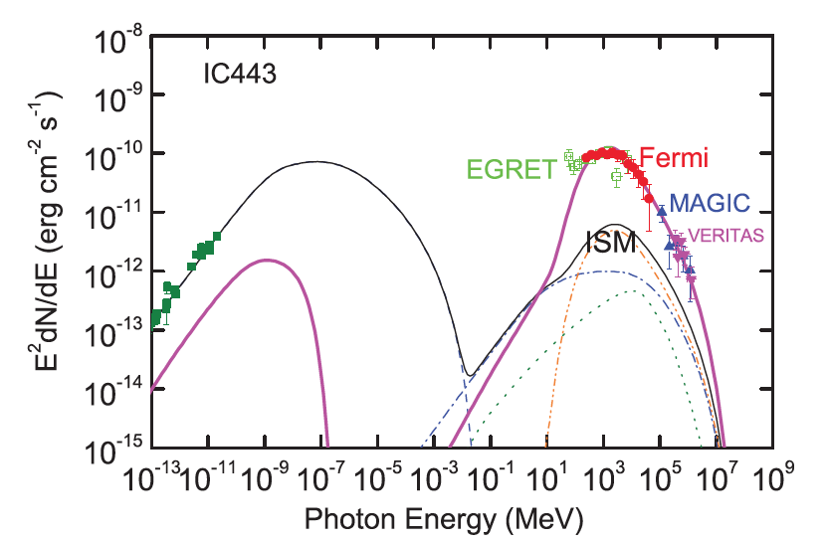
Sgr A-E source nature – SNR-MC Interaction?
VLA 20-cm continuum map
Scenario 2: SNR G359.92-0.09 shell interacting with the 20 km/s cloud (Ho et al. 1985, Yusef-Zadeh et al. 2005).
Challenges:
No applicable SNR-MC interaction theories can explain the X-ray emission (photon index ~2.3) up to 50 keV (e.g. Bykov et al. 2000, Tang et al. 2011) .
No sharp filaments at one spot of the shell observed in confirmed SNR-MC interaction cases such as W28, W44, W51C and IC443.
SNR G359.92-0.09
Sgr A-F
Sgr A-E
Also, no GeV point source reported consistent with this position
Bykov model
Tang model

Slide 11
Sgr A-E – A Magnetic Flux Tube?
Scenario 3:
Magnetic Flux Tube: Relativistic electrons trapped in locally enhanced magnetic fields (e.g. Yusef-Zadeh et al. 1984, Tsuboi et al. 1986).
Possible TeV electrons source 1:
Old PWNe with ages up to ~100 kyr extending up to ~10 pc observed by Suzaku.
PWN magnetic field must decease with time.
Electrons accelerated up to ~80 TeV can survive and extend up to 20-30 pc without losing most energies if magnetic filed decays to a few microGauss(Bamba et al. 2010).
Possible TeV electron source 2:
Cosmic-ray protons diffuse from SMBH or SNe in GC
Secondary electrons produced by cosmic-ray-molecular cloud interaction
For energies <~ 100 TeV, electrons can escape typical size molecular cloud
Predicts positional correlation between bright, hard X-ray filaments and molecular clouds

Slide 12
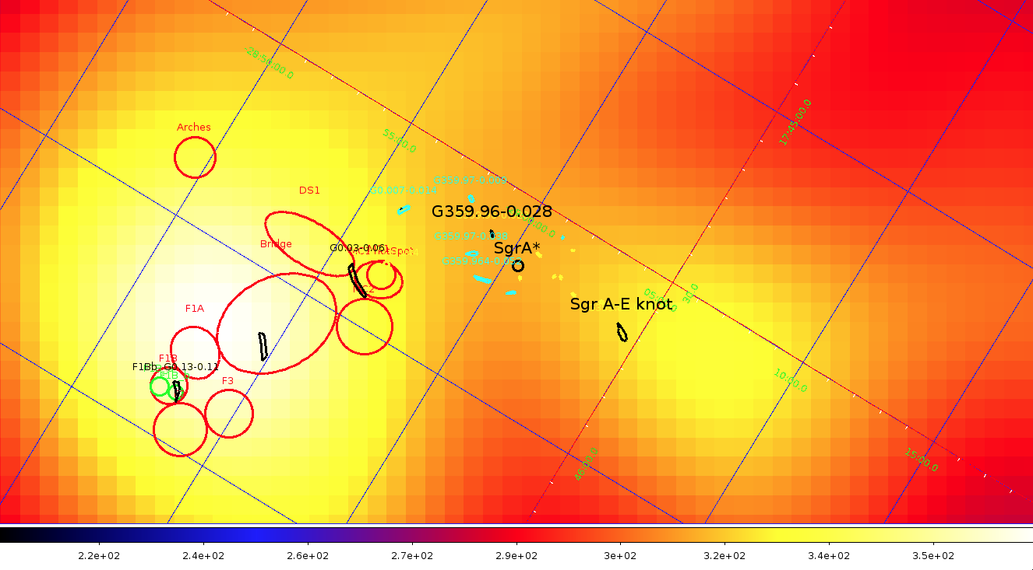
GC filaments and clouds overlaid with HESS residual map
Aharonian et al. 2006 (diffuse, ridge)
Filaments are associated with molecular clouds.

Slide 13
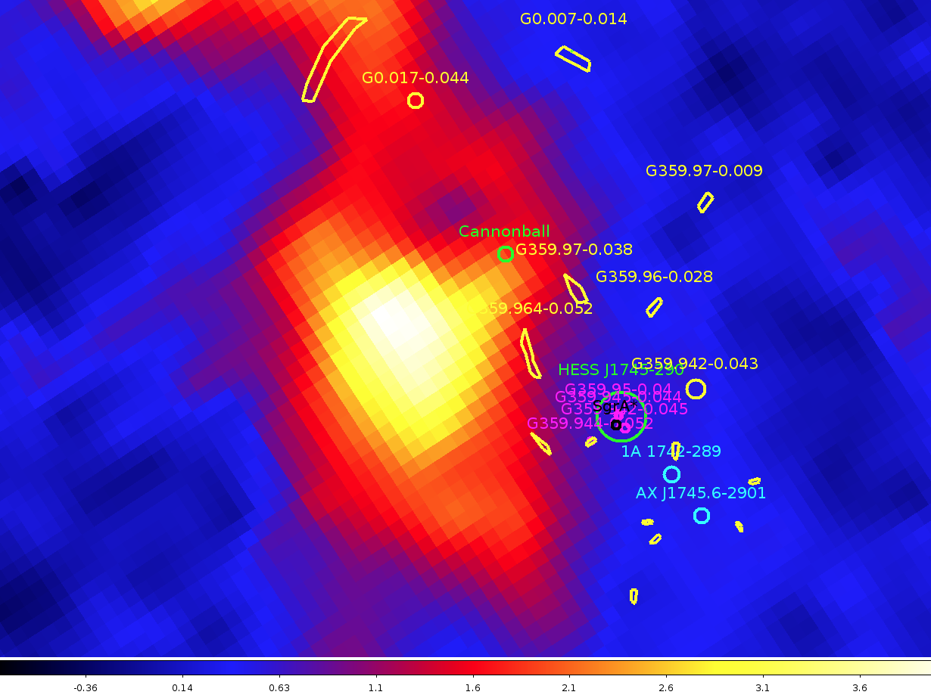
Hard X-ray filaments are adjacent to 50 km/s molecular cloud (CS map)
Tsuboi 1999 CS map

Slide 14
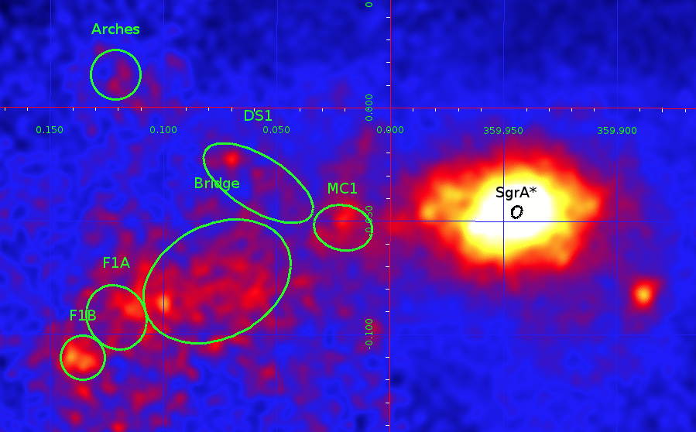
NuSTAR detected hard X-ray emission from Sgr A and B2
NuSTAR detected Sgr A clouds above 10 keV.
Arches cluster (Krivonos et al. ApJ, 2013)
Analysis of Sgr A clouds in progress
Sgr B2 rapidly fading but was detected above 10 keV by NuSTAR
NuSTAR 10-40 keV image showing Sgr A clouds (naming follows Ponti et al.)

Slide 15
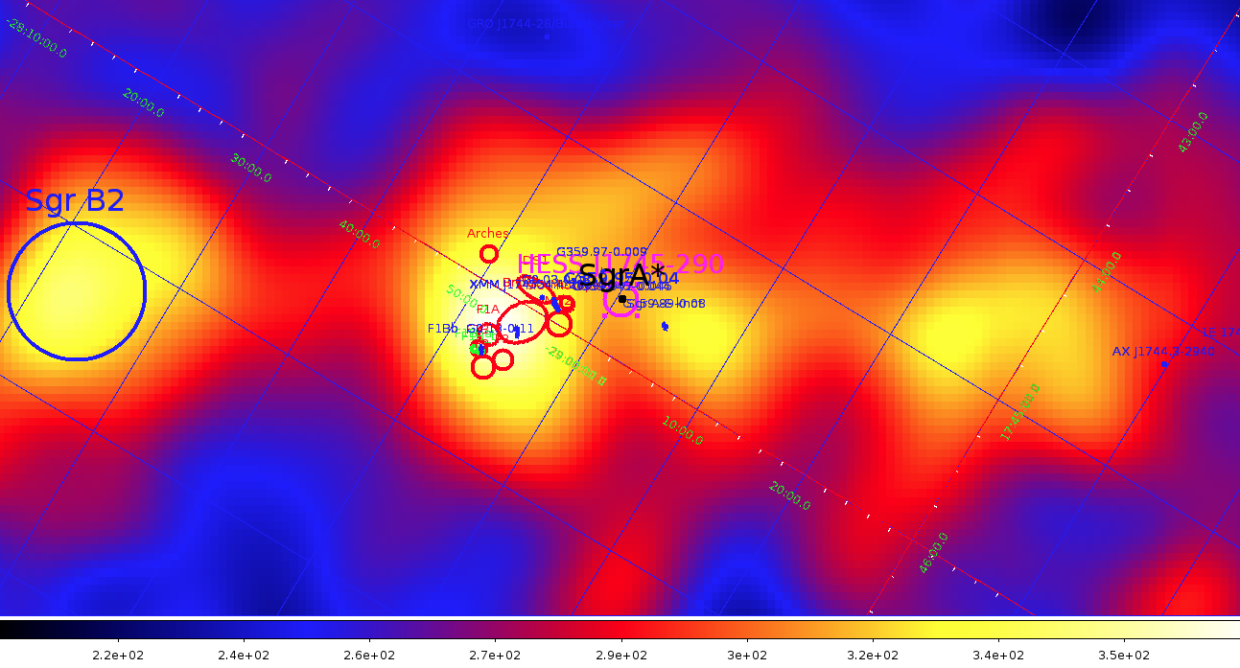
Our sources of interest overlaid on HESS GC map with HESS GC source subtracted
Aharonian et al. 2006 (diffuse, ridge)
GC Molecular clouds are hard X-ray and TeV emitters.

Slide 16
Discovery of Extended Hard X-ray Emission in the Galactic Center
K. Perez et. al.
(submitted today)

Slide 17
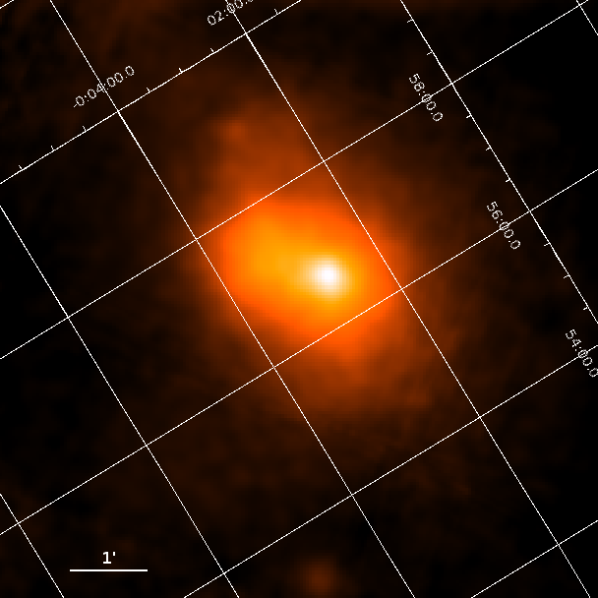
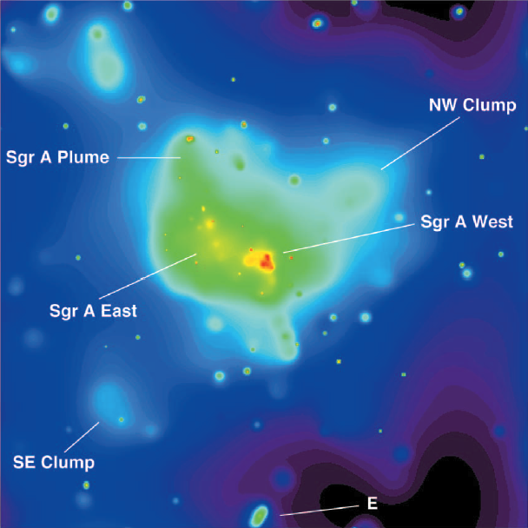
NuSTAR’s View of the Galactic Center
NuSTAR 3-79 keV
CHANDRA 2-10 keV
Sgr A*
Sgr A Plume
Sgr A East
E
Same sources of emission observed by CHANDRA dominate the NuSTAR 3-79 keV view

Slide 18
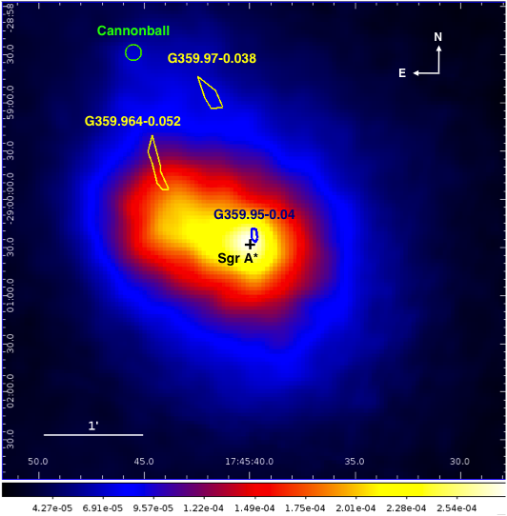
Inner 5’ x 5’: 3-10 keV
The brightest emission (white) comes from the hot plasma surrounding Sgr A* and the PWN G359.95-0.04
The surrounding emission (red and yellow) fills the shell of supernova remnant Sgr A East
To the north-east lies the extended emission of the Sgr A-East “plume” (bright blue)
The entire region sits in a field of diffuse and unresolved point source emission (dark blue)

Slide 19
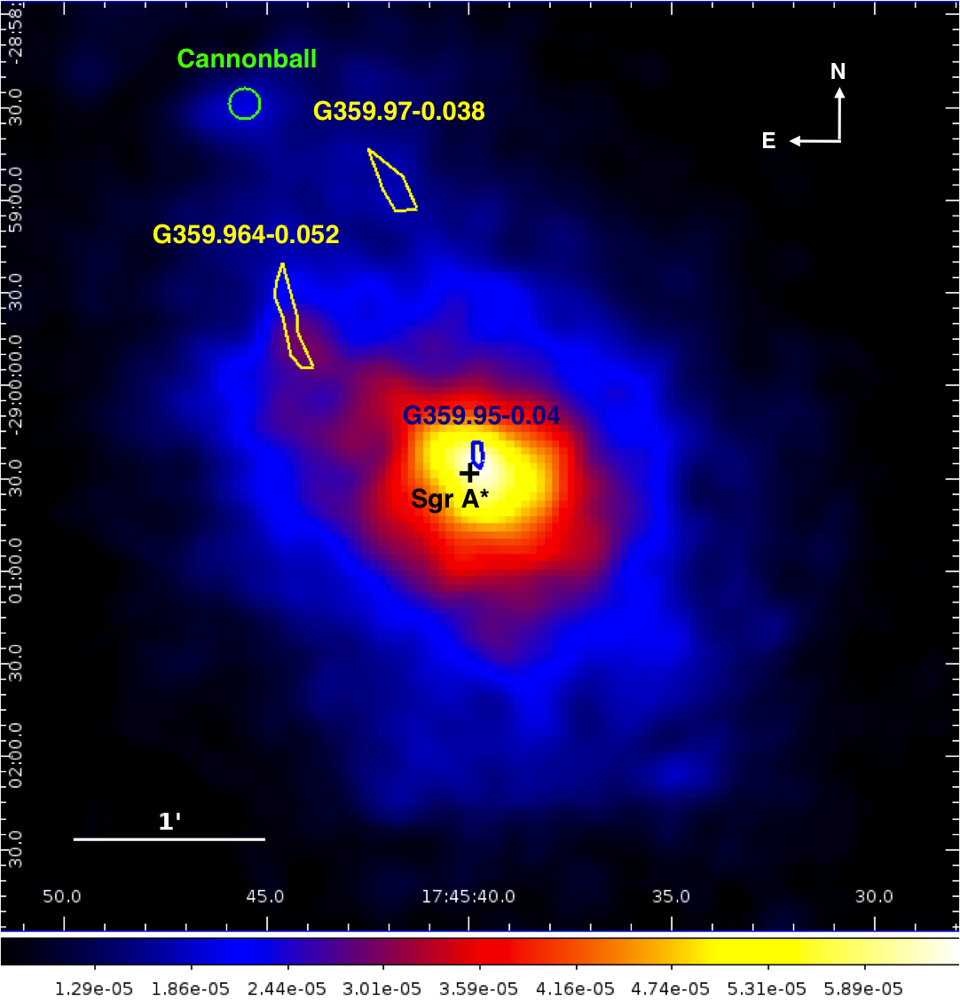
Inner 5’ x 5’: 10-20 keV
Emission from near Sgr A* and G359.95-0.04 still dominates
Dimmer, but persistent emission inside the Sgr A-East shell
The “Cannonball” neutron star (Nynka 2013) and the non-thermal filaments G359.954-0.052 and G359.97-0.038 (Nynka 2014)

Slide 20
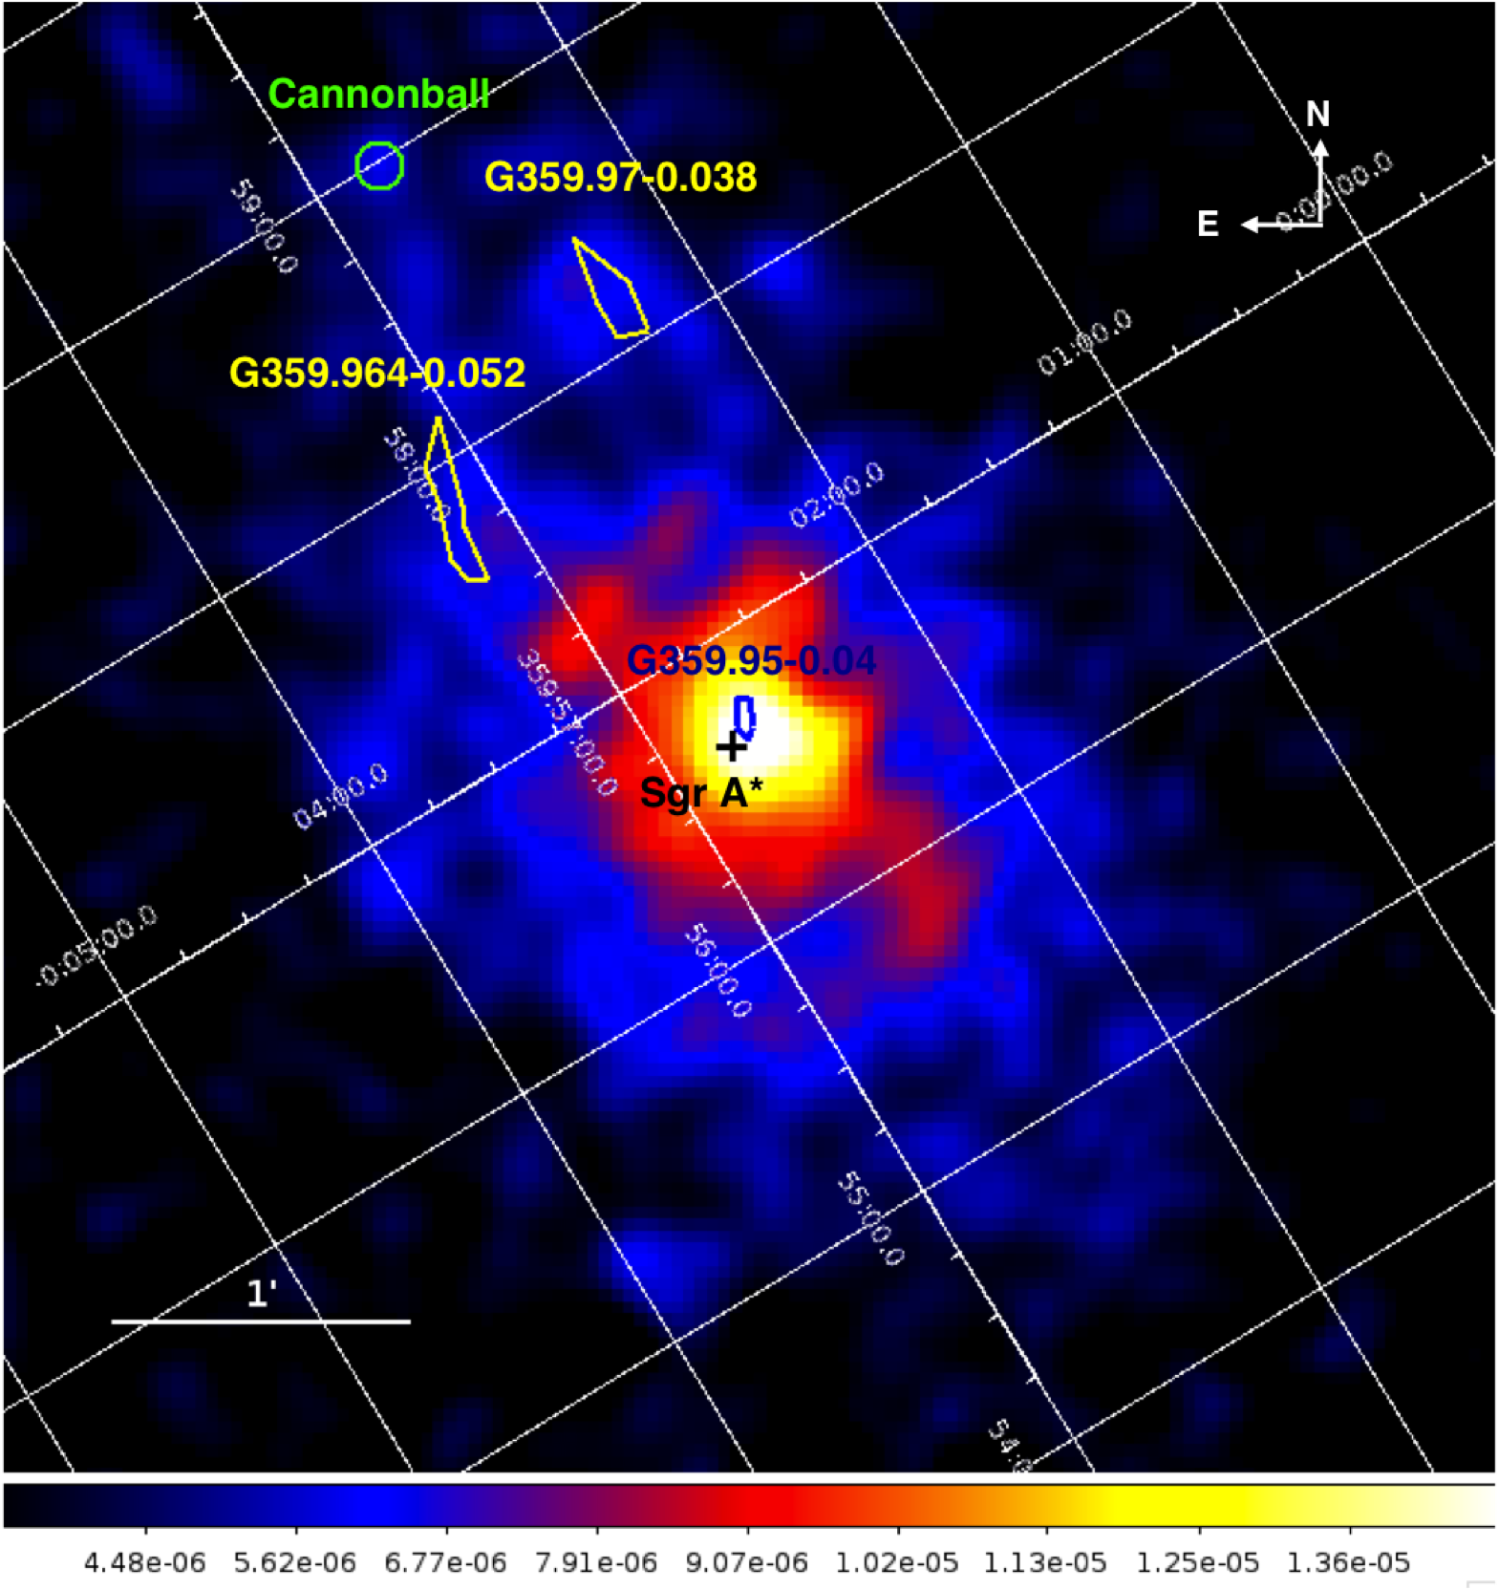
The Galactic Center at 20-40 keV
There is a pervasive, diffuse
>20 keV X-ray emission from the Galactic Center
Thermal emission from Sgr A East is no longer present
Only non-thermal filament, Cannonball, and bright central emission remain

Slide 21
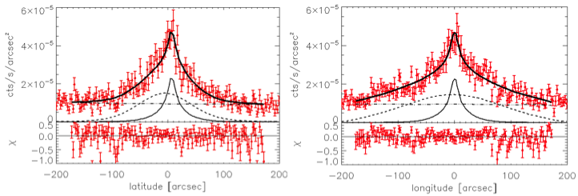
Spatial Model of 20-40 keV Emission
Fit 20-40 keV image [cts/s] to:
(Symmetric Gaussian + Asymmetric Gaussian) ✕ PSF + detector bkgd
a “point-like” source, spatially consistent with both Sgr A* and the PWN G359.95-0.04
an extended source, with FWHM = 8 pc x 4 pc
20-40 keV data
Extended
Pt-source
Background
Notes:
emphasize that this is the *simplest* best-fit model

Slide 22
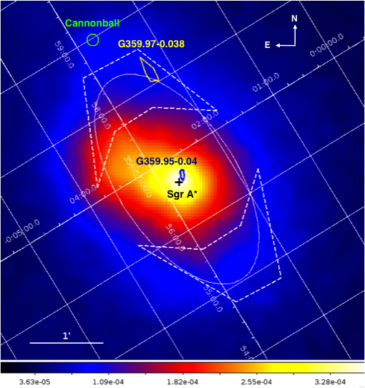
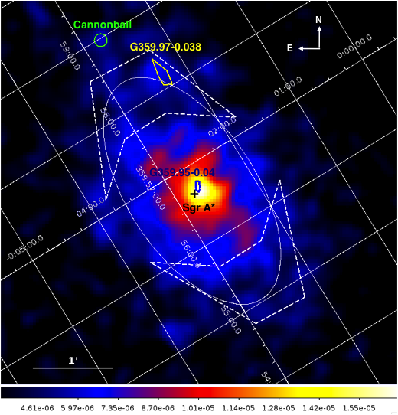
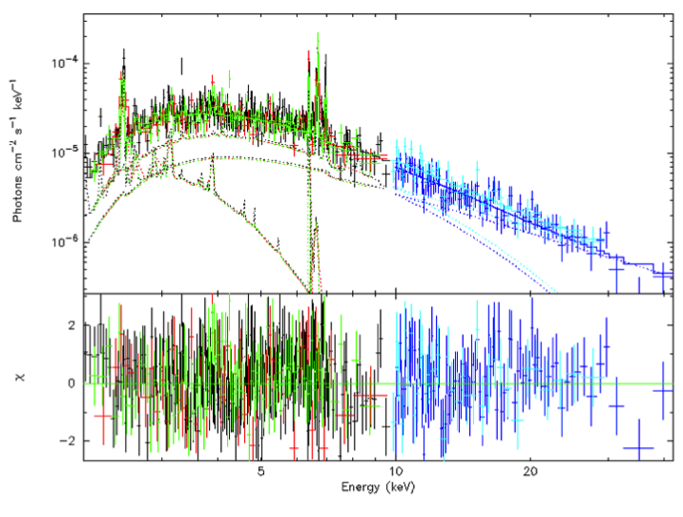
Spectrum of “Southwest” region
Below 20 keV dominated by:
k_{T,1} = 1.0 ^{+0.3}_{-0.4} keV
Z₁ = 5.0
k_{T,2} = 7.5 ^{+1.6}_{-1.3} keV
Z₂ = 1.7
L₂₋₁₀/M of low-energy thermal component in this region (|r| ~ 3 pc) consistent with that measured by XMM-Newton at |R| ~ 4 pc (Heard and Warwick 2012; Launhardt 2002)
Above 20 keV dominated by:
Γ = 1.5^{+0.3}_{-0.2}
F(20-40 keV) = 6.7e-13 erg s⁻¹ cm⁻²
low-energy unresolved emission
SW
SW
3- 10 keV
20-40 keV
Notes:
increase font on spectrum

Slide 23
Origins of Diffuse Hard X-ray Emission (DHXE)
Consistent 20-40 keV spectral and flux values in both regions indicates that the DHXE is:
symmetric along the Galactic plane around Sgr A*
non-thermal with Γ ≈ 1.6 or thermal with kT ≈ 60 keV
L(20-40 keV) ≈ 2.4×10³⁴ ergs/s within the 8 pc × 4 pc FWHM
Any possible explanation of the DHXE must account for:
observed spatial distribution
constraints from previous X-ray observations
spectral characteristics
Leading candidates are stellar populations whose densities are expected to trace the near-infrared light distribution

Slide 24
Hot Intermediate Polars ?
Scenario 1: Anomalously hot Intermediate Polars (IPs) with kT ≈ 60 keV
much hotter than the kT ≈ 8 keV in the inner arcminutes (Muno 2004; Heard and Warwick 2012) or kT ≈15 keV observed in the inner Galactic bulge (Yuasa 2012)
Swift, INTEGRAL, Suzaku, and XMM-Newton measurements of individual IPs show an average temperature of kT ≈ 20 keV, but exhibit a range in temperature from kT ≈ 10 keV to kT ≈ 90 keV
Assume L_{min}(2-10 keV) ≈ 10³⁰ – 10³¹ erg/s
L_{max}(2-10 keV) ≈ 10³³ erg/s
α ≈ 1.0-1.5
800 – 8000 IPs in 8 pc × 4 pc
6-60 IPs pc⁻³
Observed spectrum implies white dwarf mass M_{WD} > 1.0 M
Ensemble mass is significantly higher than that measured for mCVs in either the Galactic Center or bulge, though individual IPs with similar masses have been observed in the local solar neighborhood
Notes:
This possibly reflects a sharply increased binarity as the result of dynamical formation of CVs in the dense GC environment, as has been argued to occur in M31 (32) and the
Milky Way (18

Slide 25
Black hole low-mass X-ray binaries ?
Scenario 2: Quiescent black hole low-mass X-ray binaries (qBH-LMXB)
Knowledge of the luminosity of qBH-LMXBs is limited to 10 known systems
For L_{min}(2-10 keV) ≈ 2-4 × 10³¹ erg/s → 600-1200 qBH-LMXBs
In the last decade, X-ray monitoring surveys uncovered virtually all transient systems within the inner 50 pc of the Galaxy with
recurrence times of < 5-10 years
outburst durations longer than a few days
outburst L(2-10 keV) > 10³⁴ erg/s
Typical qBH-LMXB with T_{r} ~ 50-100 years could make up at most 10% of DHXE
Long T_{r}, long outburst BH-LMXB such as GRS 1915+105 also cannot dominate
Fainter, non-transient BH-LMXB have been proposed (Menou 1999)(Casares 2014): the transition radius between the advection dominated accretion flow and the normal thin accretion disk is at large enough radius that the outer disk is always cool
Notes:
High-mass X-ray binaries (HMXBs) have already been ruled out as a prominent component
of the GC population. The lack of X-ray sources with bright (K < 15) near-infrared counterparts,
a signature of a massive companion star, indicates that less than 5% of the sources in the
central arcminutes are HMXBs
However, both black hole and neutron star quiescent
low-mass X-ray binary (qBH-LMXB and qNS-LMXB) systems could produce the observed
power-law spectral index and have luminosities low enough to avoid detection as point sources
by NuSTAR
Assuming a qBH-LMXB outburst recurrence time of Tr 50 􀀀 100 yr and durations ranging
from weeks to months (39), and using the integrated Swift monitoring time of the GC since
2006, this would imply 12 􀀀 50 detected transient events. However, only two new transient
sources that could plausibly be attributed to BH-LMXB systems have been observed in that
time.
The recent discovery of a low-luminosity X-ray system composed of a Be-type star with
a black hole companion has been argued to be evidence of such suppressed transient activity
due to the low mass transfer rates

Slide 26
Millisecond pulsars?
Scenario 3: millisecond pulsars; old rotation-powered neutron stars spun up in period to ~ 10 msec
typical photon index of 1-2 in the hard X-ray band
For L_{min}(2-10 keV) ≈ 10^30-10^33 erg/s; black body emission ~ 0.1-0.3 keV too soft to be observed at Galactic Center
spin down powers range from ~4x10^32 – 2x10^36 erg/s and with L(2-10 keV) ~ 10^-4 * spin down power >> L(2-10 keV) ~ 6x10^30 erg/s
Require ~ 3000 MSP to explain entire emission
~ 96% of these MSP would be below Chandra detection limit and the remaining < 4% are a very small fraction of the resolved Chandra sources in the hard X-ray observed regions
Notes:
High-mass X-ray binaries (HMXBs) have already been ruled out as a prominent component
of the GC population. The lack of X-ray sources with bright (K < 15) near-infrared counterparts,
a signature of a massive companion star, indicates that less than 5% of the sources in the
central arcminutes are HMXBs
However, both black hole and neutron star quiescent
low-mass X-ray binary (qBH-LMXB and qNS-LMXB) systems could produce the observed
power-law spectral index and have luminosities low enough to avoid detection as point sources
by NuSTAR
Assuming a qBH-LMXB outburst recurrence time of Tr 50 􀀀 100 yr and durations ranging
from weeks to months (39), and using the integrated Swift monitoring time of the GC since
2006, this would imply 12 􀀀 50 detected transient events. However, only two new transient
sources that could plausibly be attributed to BH-LMXB systems have been observed in that
time.
The recent discovery of a low-luminosity X-ray system composed of a Be-type star with
a black hole companion has been argued to be evidence of such suppressed transient activity
due to the low mass transfer rates

Slide 27
Alternate populations
Although explanations in terms of hot IPs, qBH-LMXBs, or MSPs present challenges, other possible populations have been ruled out as majority contributors to the DHXE.
Neutron star LMXBs have typical T_{r} ~ 5-10 years, would have been detected by Swift monitoring
Magnetars with consistent spectra (soft gamma repeaters) have typical T_{r} ~ 10 years
A large enough population of non-thermal filaments is not supported by Chandra or radio mapping of the Galactic center
Low surface brightness PWN would require at least x10 higher PWN birth rate
Inverse Compton from electrons injected from PWN, Sgr A*, colliding winds etc. scattering in the high radiation density of the center has a luminosity too low
Dark matter does not reproduce spatial extent

Slide 28

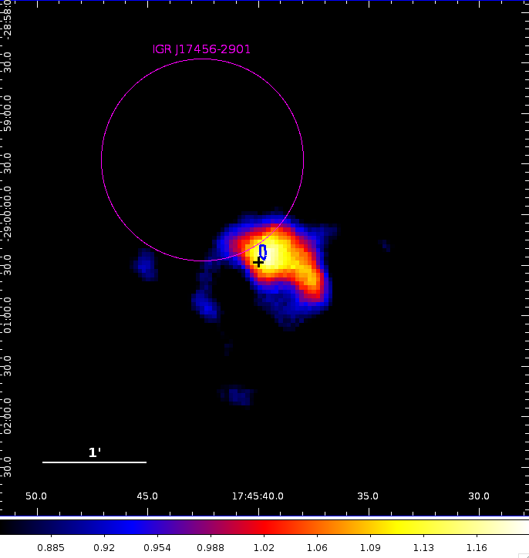
The Galactic Center at >40 keV
One strong source dominates, consistent with both the Chandra Pulsar Wind Nebula G359.95-0.04 and the HESS TeV source J1745-290
The INTEGRAL >20 keV source IGR J17456-2901 is not visible
A marginal-significance “protrusion” to the south-west extends beyond the circumnuclear disk but not associated with obvious radio features
Notes:
overlay HESS
indicate NuSTAR PSF
how many photons is this?

Slide 29
Summary
NuSTAR is revealing a (more) complicated story concerning the nature of the Chandra X-ray emitting non-thermal filaments, import to combine with GeV and TeV observations to identify their nature.
NuSTAR has clarified the nature of the INTEGRAL soft gamma-ray sources in the Galactic Center, and detected the pulsar wind nebula closest to the supermassive black hole
Emission from Sgr A-East at hard X-rays is entirely thermal
NuSTAR Galactic Plane survey has discovered many point sources and detected many molecular clouds in hard X-rays, such as the rapidly fading Sgr B2. TeV observations are useful to the molecular clouds study.
A hitherto unknown and pervasive diffuse hard X-ray emission has been detected by NuSTAR. Its origin is probably due to undetected point sources such as LMXB, mCVs or MSPs.

Slide 30
THE END: thanks to the NuSTAR Galactic Survey Team and collaborators
Nicolas Barriere, Steve Boggs, Bill Craig, Roman Krivonos, John Tomsick (UC Berkeley)
Fiona Harrison (PI), Kristin Madsen, Brian Grefenstette (Caltech)
Eric Gotthelf, Kaya Mori, Melanie Nynka, Kerstin Perez, Shuo Zhang (Columbia University)
Finn Christensen (Danish Technical University)
Josh Grindlay, Jaesub Hong (Harvard-SAO)
Fred Baganoff (MIT)
Daniel Stern (NASA JPL); Daniel Wik, Will Zhang (NASA GSFC)
Franz Bauer (Universidad Catolica);
J. Zhao (Harvard-SAO), M. Morris (UCLA) and W. Goss (NRAO)

