Slide 1
Building Electronics for High Energy Nuclear and Particle Physics Experiments
Discuss several systems I have built in the past
  PHENIX experiment Hadron Blind detector digitizer readout system
  Data Collection Module upgrade for the PHENIX experiment
  MicroBooNE Neutrino Liquid Argon TPC Front End Board
Some discussion on
  Future sPHENIX experiment calorimeter electronics
Lessons learnt in building electronics projects.

Slide 2
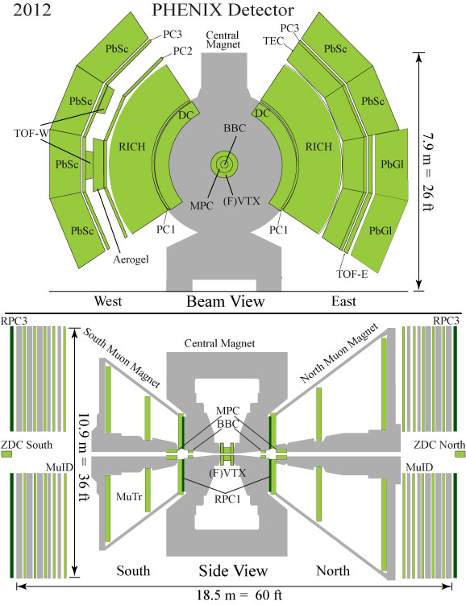
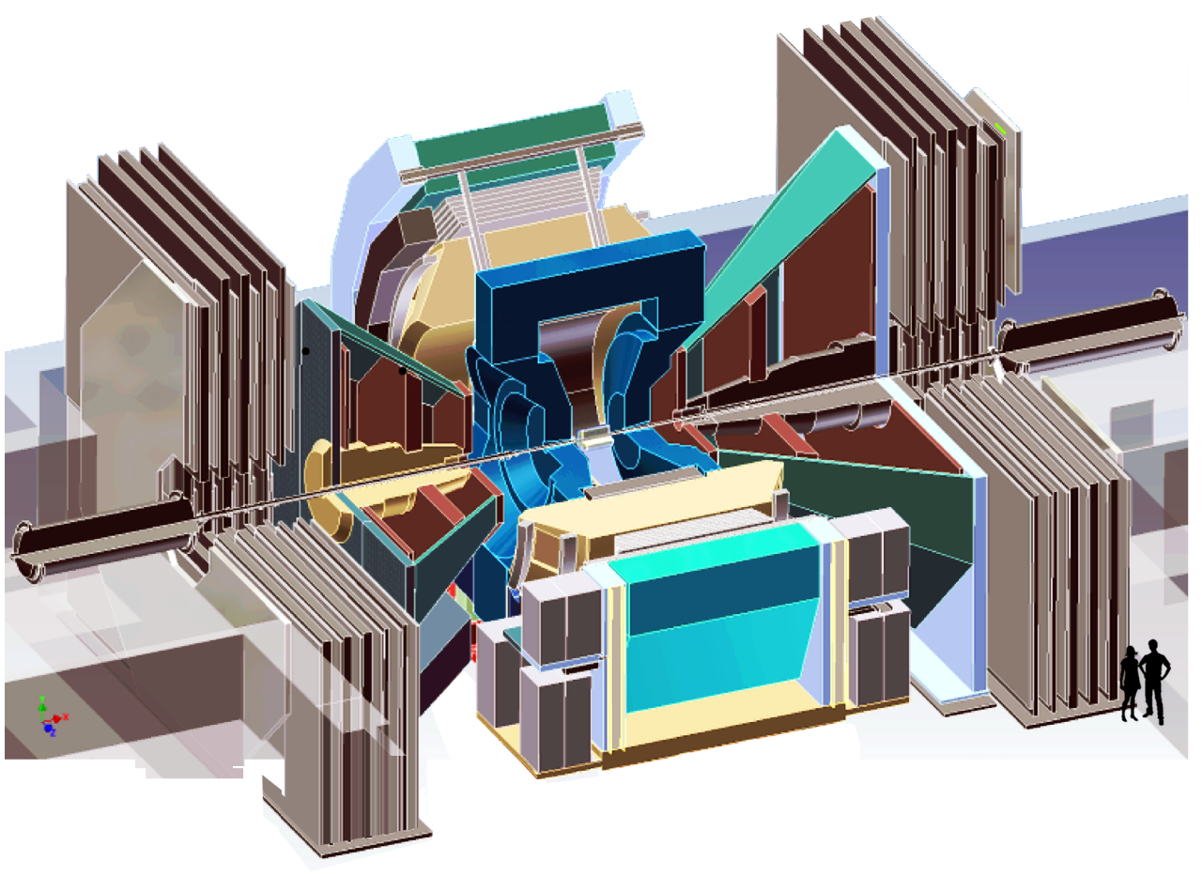
PHENIX experiment in RHIC at BrookHaven National Lab.
Heavy Ion Physics
p + p Spin Physics
HBD
2006-2009

Slide 3
PHENIX Online System
(baseline)
(upgrade)
on
detector
Front-End
Module (FEM)
L1 trigger
Front-End
Module (FEM)
RHIC clock is about 9.8 MHz
depend on collision specs.
Level 1 trigger delay is 40 beam crossing
L1 trigger rate is 10 KHz.
To keep system live time near ~100%,
FEMs store 5 L1 triggered events
Frontend are built by various groups.
DCM & DCM II are used to interface
with all the FEMs.
(first stage of the event builder)
off
detector
Data Collection
Module(DCM)
Data Collection
Module II(DCM II)
JSEB
JSEB II
Sub-Event
Buffer
Sub-Event
Buffer
Ethernet Switch
Assembly Trigger processor (ATP)
Assembly Trigger processor (ATP)
Archive

Slide 4
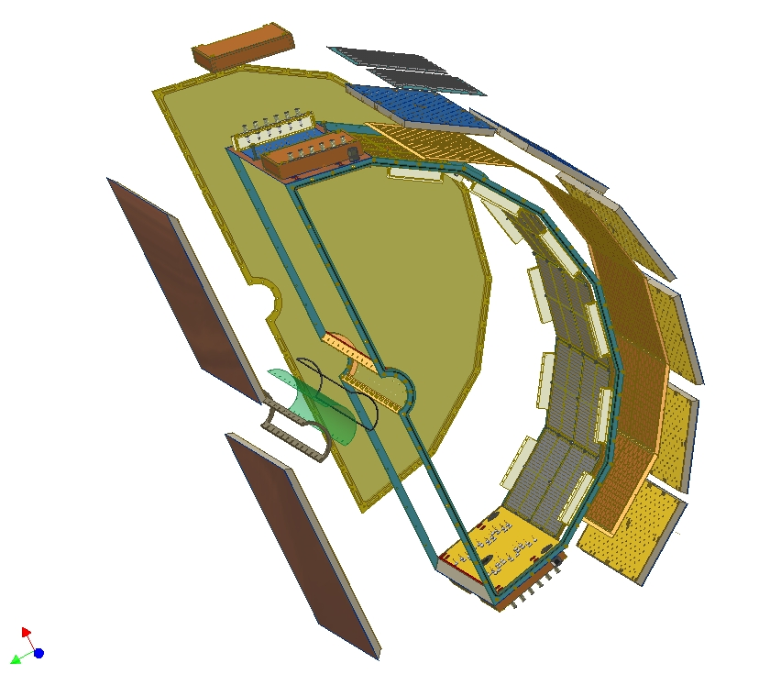
HADRON BLIND
DETECTOR
Proximity focus Cherenkov counter. (sensitive only to electron)
Use CsI to convert photon to electron.
GEM is used for amplify the electron from CsI.
Measure time and charge
2006 - 2009
HV panel
Triple GEM module with mesh grid
Pad readout plane
g
Primary ionization
Mesh
Mylar entrance window
HV
e⁻
CsI layer
Honeycomb panels
Triple
GEM
HV panel
Readout Pads

Slide 5
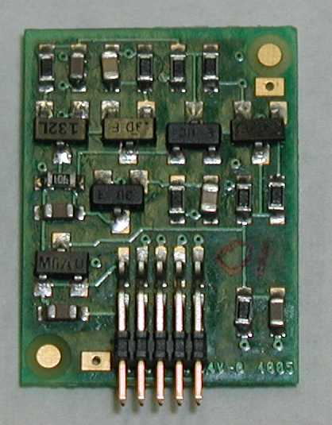
Charge Preamp with On-Board Cable Driver
(IO1195-1-REVA)
15 mm
Features:
+/- 5V power supply.
165 mW power dissipation.
Bipolar operation (Q_input = +/- )
Differential outputs for driving 100 ohm twisted pair cable.
Large output voltage swing -- +/- 1.5V (cable terminated at both ends)
        (+/- 3V at driver output)
Low noise: Q_noise = 345e (C_external = 5pF, shaping = .25us)
        (Cf = 1pF, Rf = 1meg)
Size = 15mm x 19mm
Preamp output (internal) will operate +/- 2.5V to handle large pile-up.
19 mm
Preamp (BNL IO-1195)
2304 channels total

Slide 6
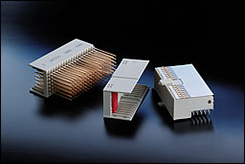
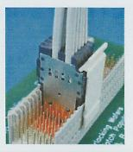
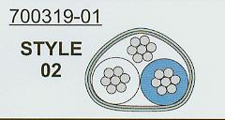
Use 2MM Hard Metric cable to move signals between preamp/FEM
2mm HM connector has 5 pins per row and 2mm spacing between pins and rows
There are two types of cable configuration:
*100 ohms parallel shielded cable
50 ohms coaxial cable
Signal arrangement
S-
S+
G
S-
S+
MERITEC
Our choice is
This gives us signal density 2mm x 10mm for every 2 signals.
Same type of cables will be used for L1 trigger data.

Slide 7
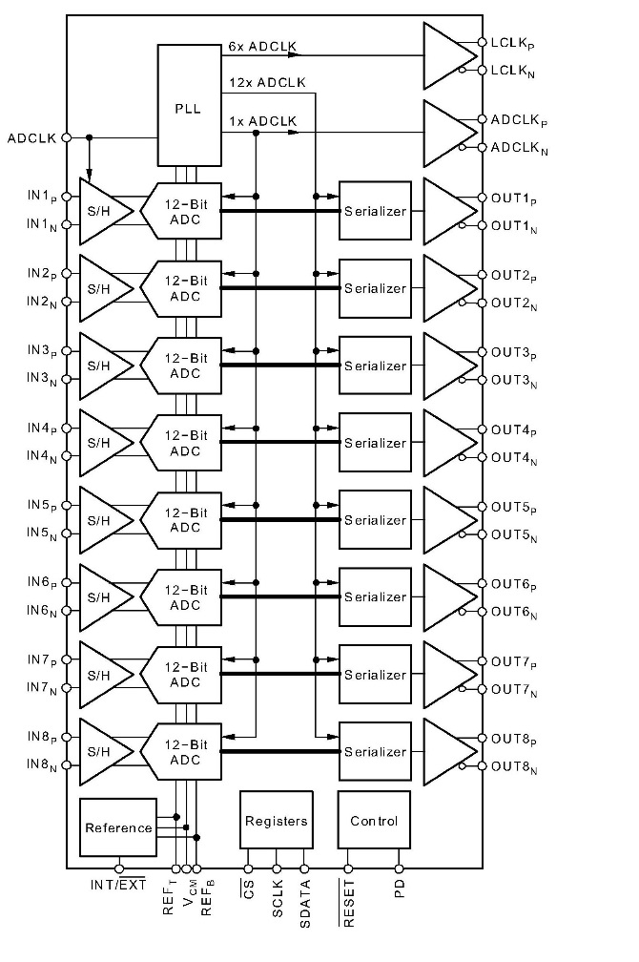
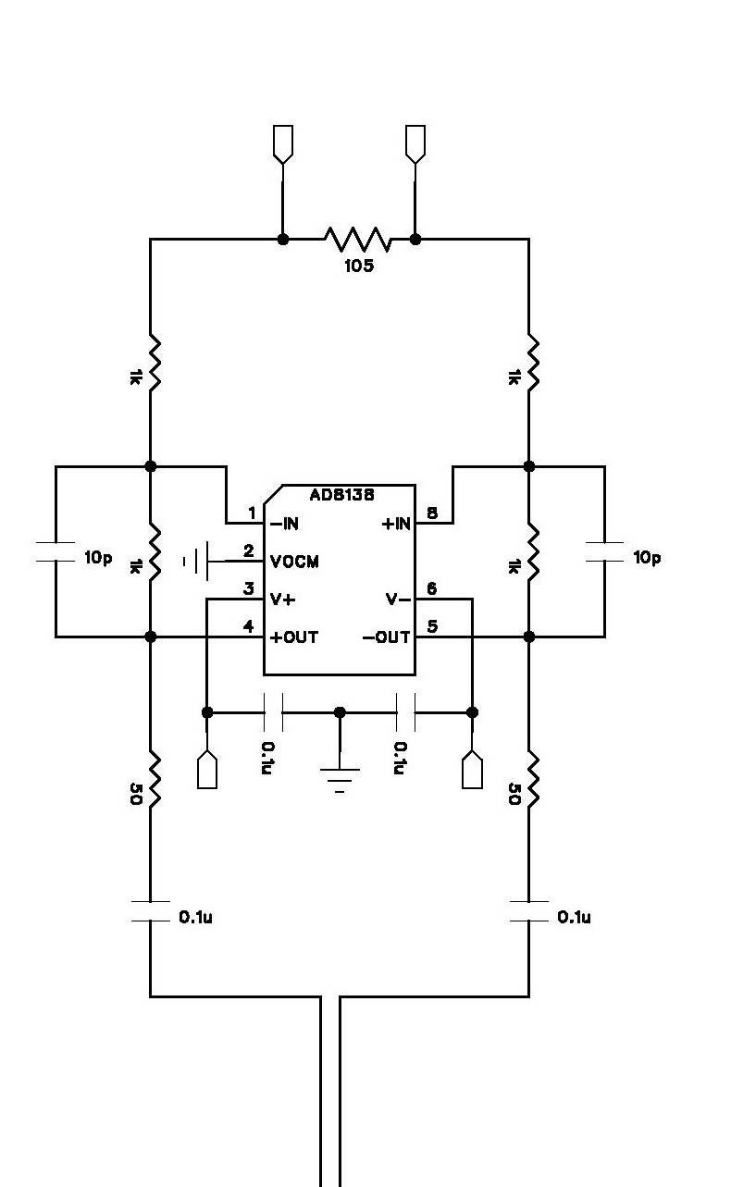
FEM receiver + ADC
Preamp
Cable driver
Differential
Receiver
ADC
FPGA
TI ADS5272
Based on AD8138 receiver
Unity gain
8 CHANNEL 65 MHz 12 bits ADC (80 TQFP)
The +/- input can swing from 1V to 2V, V_{cm}=1.5V
+ side 2V, - side 1V -> highest count
- side 2V, + side 1V -> lowest count
Our +/- input will swing from 1.5 to 2V/ 1.5 to 1V
we will only get 11 bits out of 12 bits
16fc will be roughly sitting at 200 count
We will run the ADC at 6X beam crossing clock
6X9.4 MHz = 56.4 MHz or ~17.7ns per samples
ADC data are serialized LVDS at 12*56.4 MHz= 678 MHz

Slide 8
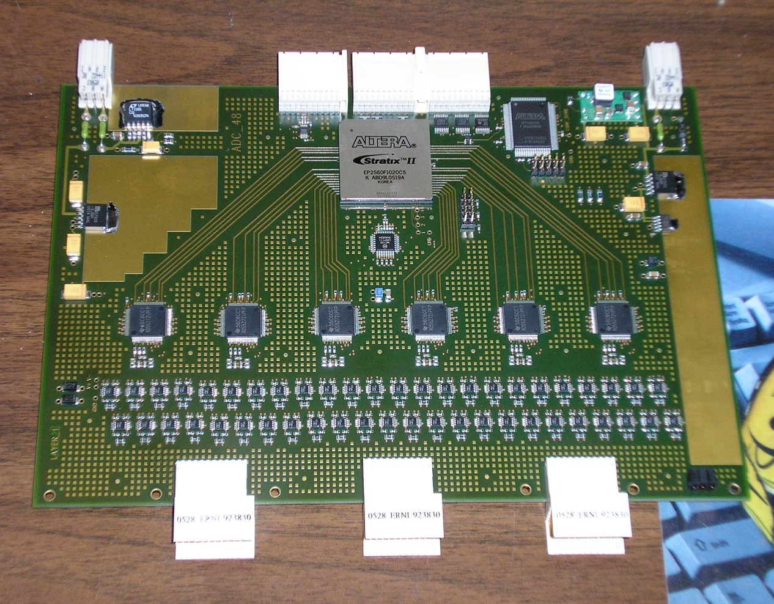
HBD ADC board
We use ALTERA STRATIX II 60 FPGA to receive the 6 ADC’s data (8 channel per ADC)
It has 8 SERDES blocks. ALTERA provides de-serializer Mega function block.
6XADC clock → SERDES clock
→ data de-serialized as 6 bit 120 MHZ
→ Regroup to 12 bits at 60 MHz , 45 degree phase adjustment step. Timing Margin → 270 degree.
The FPGA also provides
L1 delay (up to 240 samples)
8 events buffer
ADC setting download
Offline slow readback
7 threshold levels for L1
trigger primitives per channel.
ALTERA
FPGA
ADC
Differential
receiver
48 channels per board
6U X160 mm size
Signals from Preamp

Slide 9
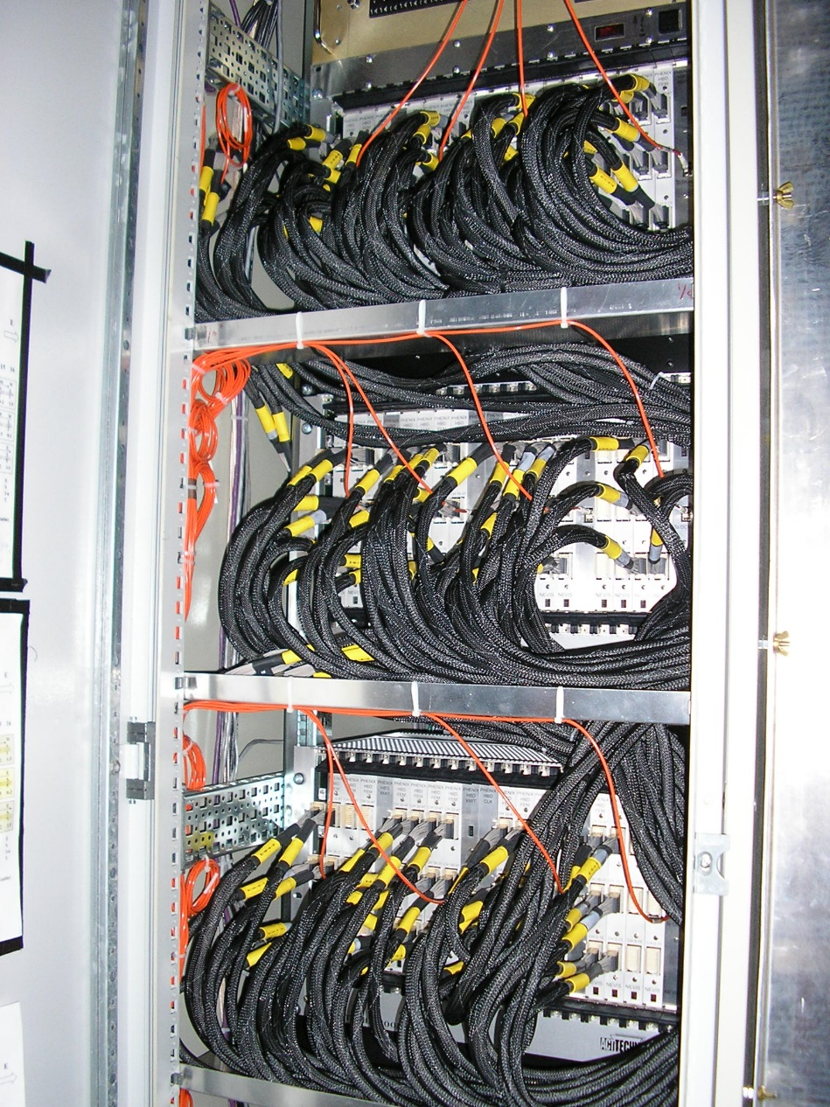
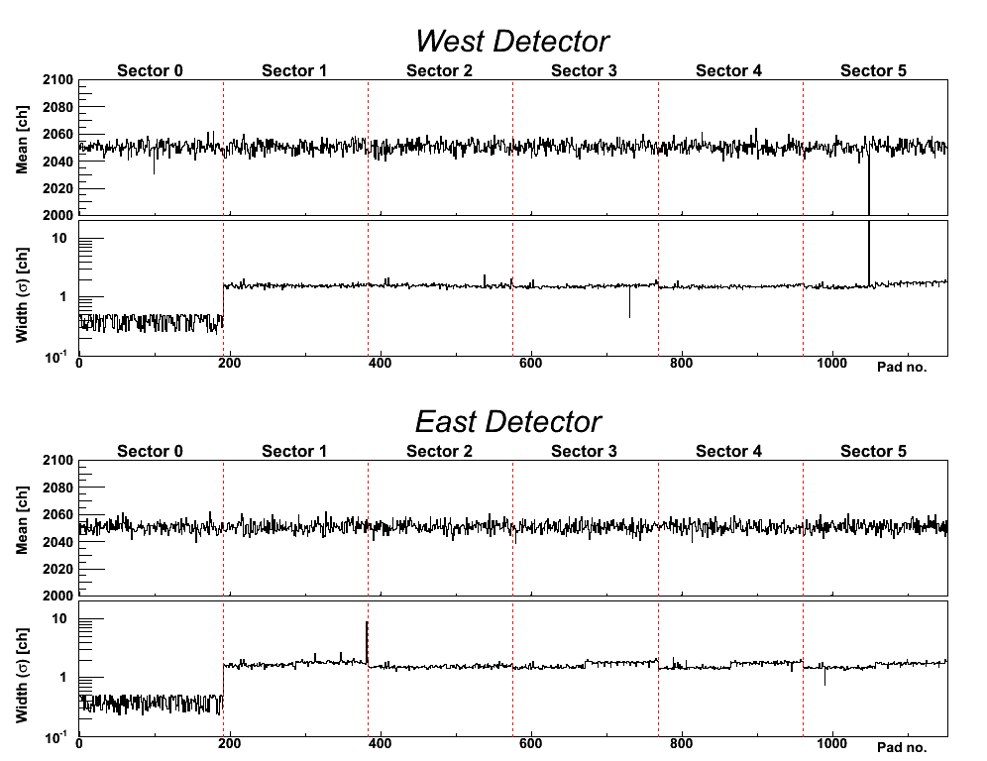
Electronics Rack
Pedestal Run
Mean (ch)
Width σ (ch)
Channel #
Mean (ch)
Width σ (ch)
Channel #

Slide 10
Data Collection Module II (DCM II)
Receives all the data from the upgrade detectors frontend modules
Provide 5 event buffers for the FEMs.
  Data transmission time is based on average trigger rate.
  to achieve minimum trigger deadtime.
FEM’s data are not compressed. DCM II compresses the raw data and formats the data for the Event builder.
Collects the compressed FEM data to the event builder
Error monitoring.
Provides slow readback path for detector readout without the event builder.

Slide 11
Test
data
detector
dependent
DATA COLLECTION MODULE II
(DCM II)
32KX32
Dual port
Stratix III
1.6 Gbits/sec
Optical link
TLK
2501
65kx18
FIFO
compressor
M
U
X
Interface to the frontend electronics
Compress/Merge/5 events bufferError checking data packet
Used in VTX (strip and Pixel), FVTX
80 M words
( 16bits wide)
busy
Event number
Memory address
Word counts
256X45
Header
FIFO
(FIFO has more
than 16K words)
9bits X 4
at 120 MHz
busy
256X45
Header FIFO
1.6 Gbits/sec
Optical link
TLK
2501
65kx18
FIFO
compressor
Demux
Align
16Kx32
FIFO
9bits X 4
at 120 MHz
Test
data
32KX32
Dual port
hold
M
U
X
Demux
Align
16Kx32
FIFO
64KX32
Dual port
Link
port
Data
In/out
(LVDS)
8 1.6 Gbits/sec optical ports per module
Individual ports can be enabled or disabled
8 80 MHz 16bits words in → 80 MHz 32 bits word out
Demux
Align
16Kx32
FIFO
256X60
Header
FIFO
Token
In/out
Test
data
detector
dependent
hold
32KX32
Dual port
Demux
Align
16Kx32
FIFO
1.6 Gbits/sec
Optical link
Test
data
TLK
2501
65kx18
FIFO
compressor
M
U
X
80 M words
( 16bits wide)
busy
Event number
Memory address
Word counts
256X45
Header
FIFO
(FIFO has more
than 16K words)
9bits X 4
at 120 MHz
FPGA
Download
control/
readback
busy
256X45
Header FIFO
48 V
on/off
1.6 Gbits/sec
Optical link
TLK
2501
65kx18
FIFO
compressor
slow control
/download
Test
data
32KX32
Dual port

Slide 12
DCM II DATA
FLOW DIAGRAM
DCM II
DCM II
DCM II
token,hold
40 MHz 8 bits data
+ 2 bits control
data, busy
data, busy
token,hold
Partition module output data with 2 3.125 Gbits optical link to JSEB module. The hold is returned via optical link.
Controller allows us to:
Download FPGA code and setup system parameters.
Readback system status and provide a data readback path during detector commissioning.
Mux/demux
Token/demux/align/busy/hold
busy
controller
Partitioner III
Buffer
Buffer
Timing
System
optical
transceiver
optical
transceiver
optical
transceiver
L1 System
optical
transceiver
optical
transceiver
optical
transceiver
optical
transceiver
buffer
buffer
buffer
buffer
JSEB II
JSEB II
PCI express
IP core
PCI express
IP core

Slide 13
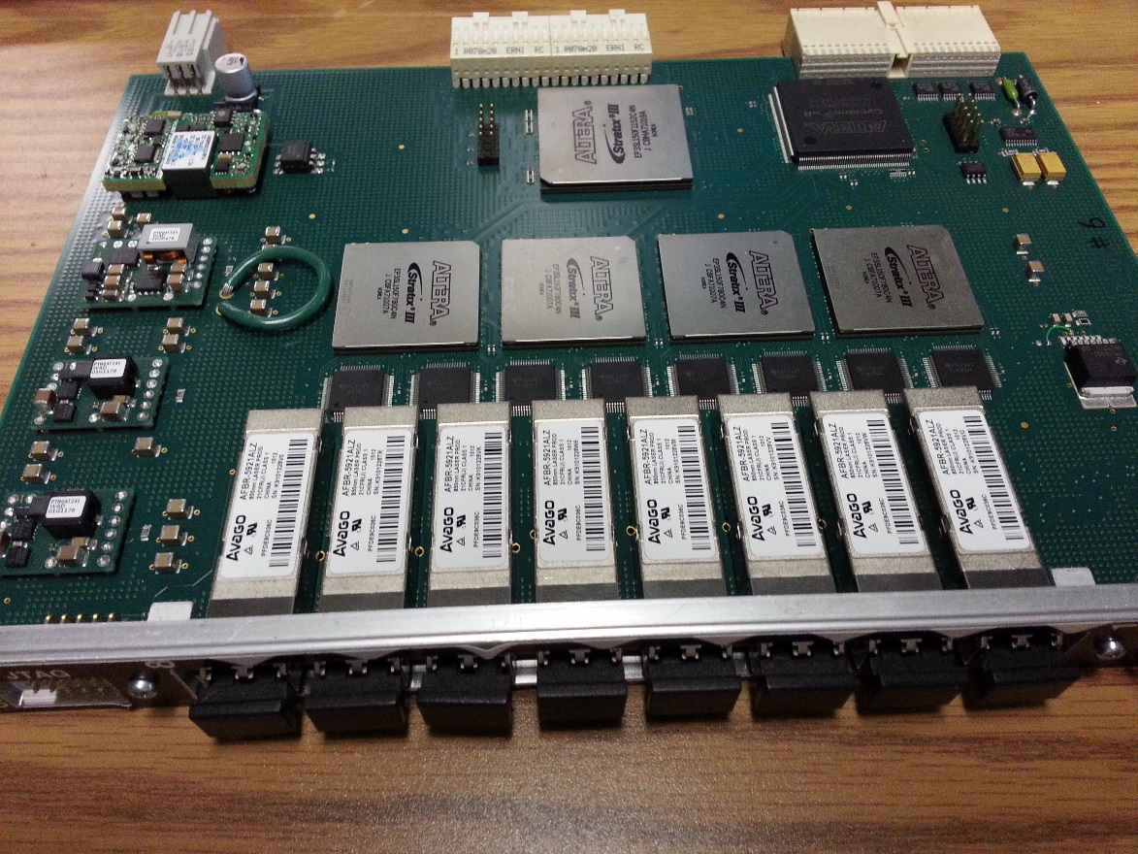
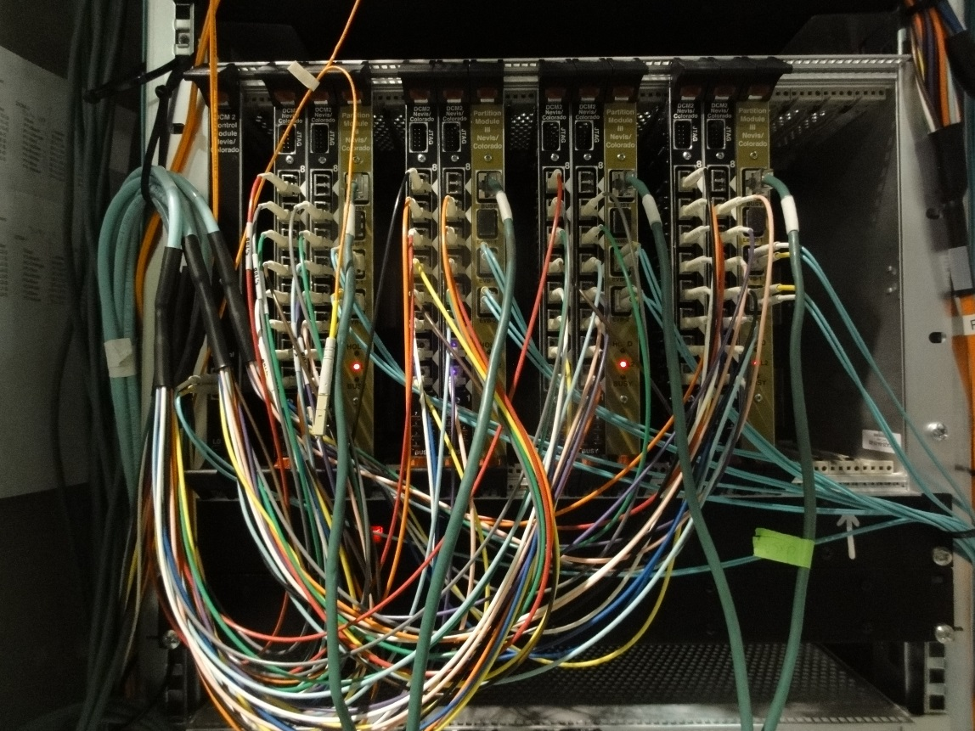
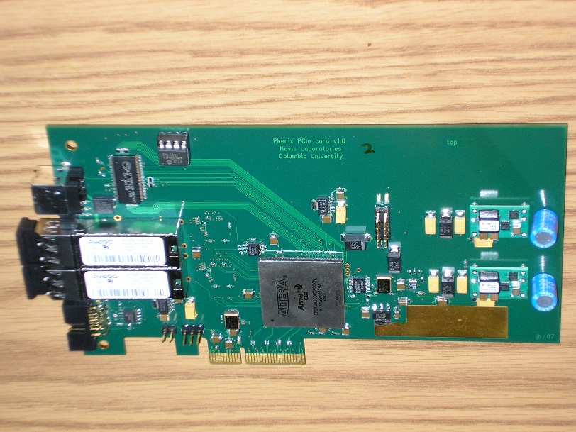
DCM II system first production was done for
vertex strip and pixel detector &
forward vertex in 2010
DCM modules
JSEB II Module
DCM crate
In
PHENIX

Slide 14
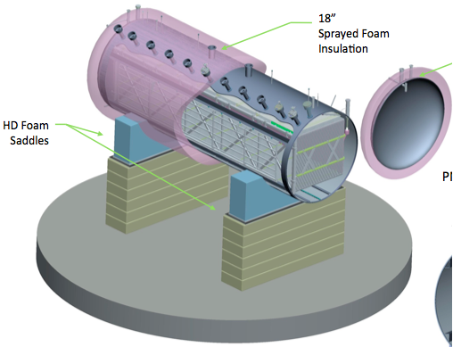

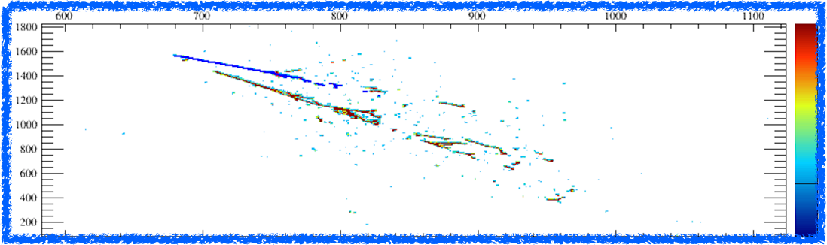
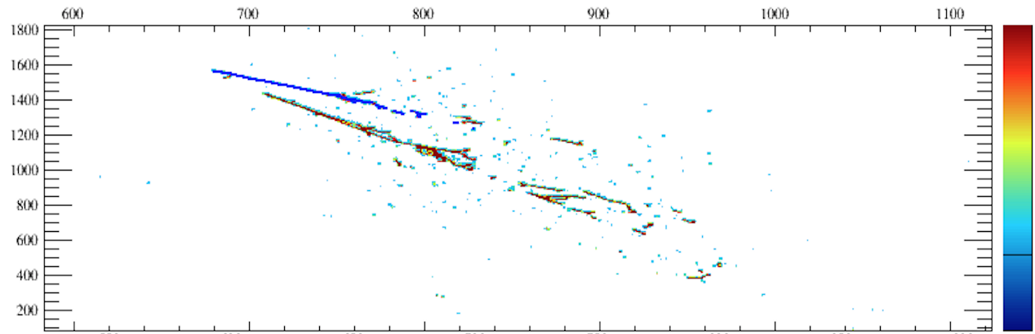
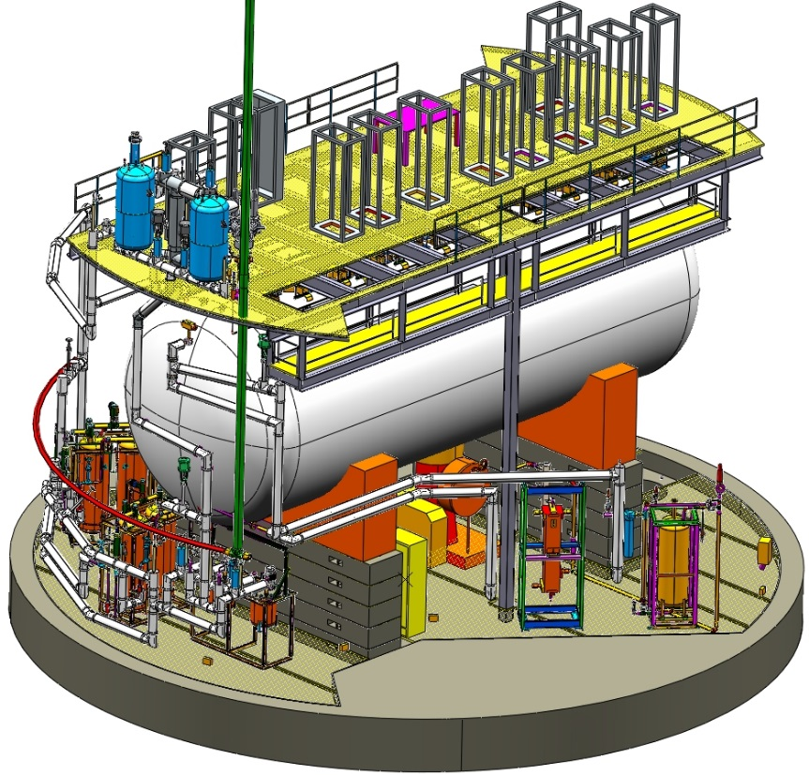
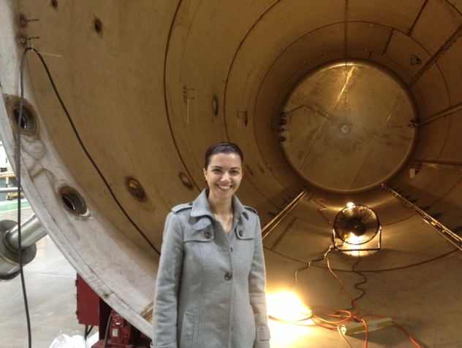
Cryostat: Keeps Ar liquid < 87.3ºK
MicroBoone Experiment
Liquid Argon TPC detector
For Neutrino Physics
Welded
π⁰ → γγ
simulation
Drift
Electronics Platform
Cryostat
Cryostat

Slide 15
Overall Electronics scheme
8256 Time Projection Chamber wires
32 PMT’s provide a neutrino trigger
in time with beam gate
Blue → Nevis

Slide 16
FEM Concept
Build a system that can take both triggered data (lossless compression) and continuous recording (lossy compression).
  System is running continuously.
  Record both Neutrino events / SuperNova events.
The FEM (frontend module) organizes ADC data as frames.
  Grouping/processing of the frame depends on whether there is trigger or not.
  The neutrino event will consist of several frames.
  If no trigger, the frames will be continuously recorded.
Once the data is processed, the events will flow to the computer in separate paths.
  Keep neutrino and SuperNova events’ flows as independent as possible
  → easier to prioritize the event flow.

Slide 17
Data Sample memory
Arrange the sample memory into 4 frames
Each frame can store up 2ms of data
(currently set at 1.6ms)
Sampling speed set a 2MHz maximum
→ 2MHz* 64 channel =128MHz 16 bits word
→ 64 MHz 32 bits word (2 ADC’s / word)
(sampling frequency drive memory speed)
Use alternate cycle for write/read (100% live)
frame
write
pointer
frame
frame
read
pointer
frame
trigger
M
U
X
Neutrino
ADC
decimation
128MHz
1M X 36
SRAM
supernova
ADC
decimation
Frame
Data
16 MHz ADC
→ 2 MHz sample
Time
ADC
decimation
The system clock is free running.
It is not synch with the accelerator.
16MHZ
ADC clock
ADC
decimation
16 MHz
clock
FPGA
PLL
Downsampling +
anti-aliasing filter
r/w
address
Init(/Run)
trigger
Frame
synch
128 MHz Frame
buffer clock

Slide 18
Event number
Word count
memory address
TPC DATA PROCESSING
Huffman code by
(Jin-Yuan Wu)
Difference 0 assign code 0
+1 assign code 1
-1 assign code 2 etc
3 16 bits word →
2 24 bits word →
2 30 bits ECC words
(5+1 parity)
Slow
Control
readback
Pointer FIFO
DRAM
2 sample per cycles
Read/write every
other cycle
SRAM
Neutrino token
Has priority over
Supernova token
Hamming code/packing
Pre-buffer
16KX40 FIFO
LINK
Neutrino
Token
Neutrino
compressor
header
Neutrino
Data
demux
/align
/decimation
Frame generator
SRAM write/read
Neutrino Path
Link data
ADC
SuperNova Path
header
LINK
SuperNoa
Data
fake
data
SuperNovacompressor
Hamming code/packing
Pre-buffer
16KX40 FIFO
SuperNova
Token
trigger
Need compression factor 20 to 80
Probably will use some threshold plus
Huffman coding
(remove as much noise as possible)
Pointer FIFO
DRAM
Slow
Control
readback
Read has priority over
Write on DRAM access
DATA FLOW

Slide 19
Pack 2 samples
into one word
PMT DATA PROCESSING
Frame number
sample number
PMT DATA PROCESSING
packetize
1KX33 FIFO
PMT
shaper
ADC
S
R
A
M
wr
Neutrino
gates
64 MHz
clock
Post-pre
compare
Beam
Cosmic
Michel
diff(i) =
Ph(i+n)- ph(i)
diff(i) >
Threshold(ch)
Trigger Logic
Trigger
Module
40 channels
PH(max) & width
diff(i) =
Ph(i+n)- ph(i)
diff(i) >
Threshold(ch)
NHITS,
PHSUM
64 MHz
clock
Post-pre
compare
Neutrino
gates
PMT
shaper
ADC
packetize
1KX33 FIFO
DATA FLOW
PMT data is sampled at 64 MHz. It is not possible to write all this data into SRAM with the available frame space
Only keep the data associated with discriminator firings (neutrino data + cosmic rays).
(* data compression before buffer*)

Slide 20
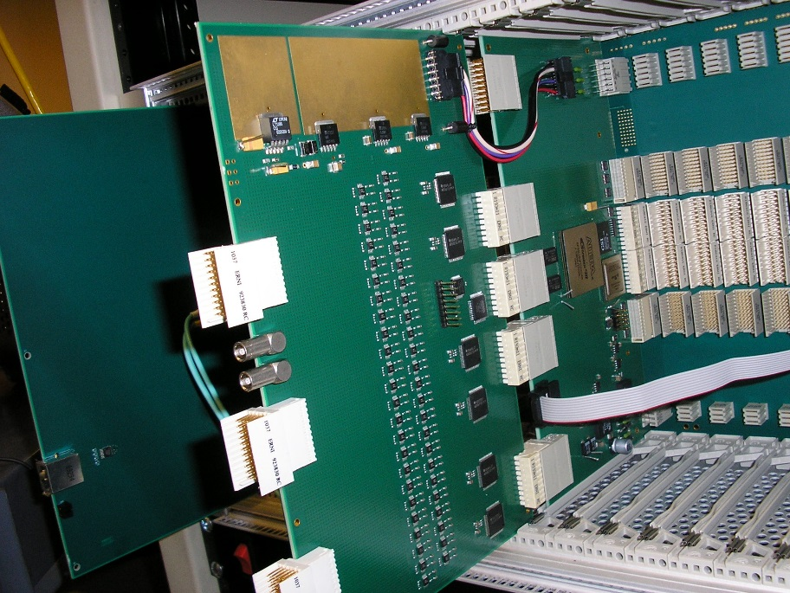
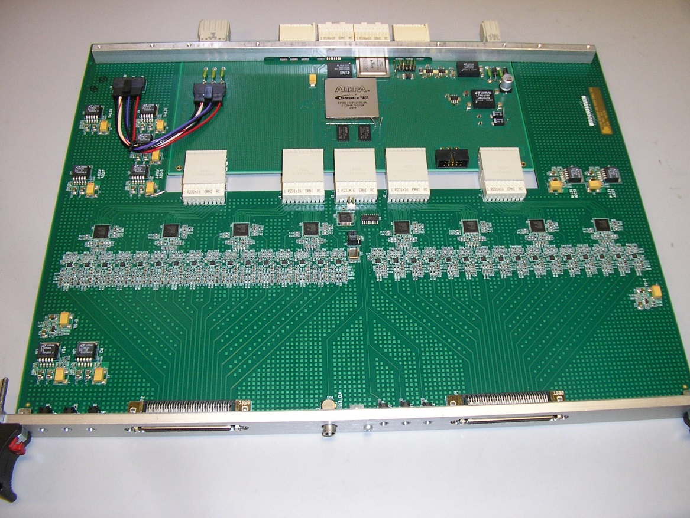
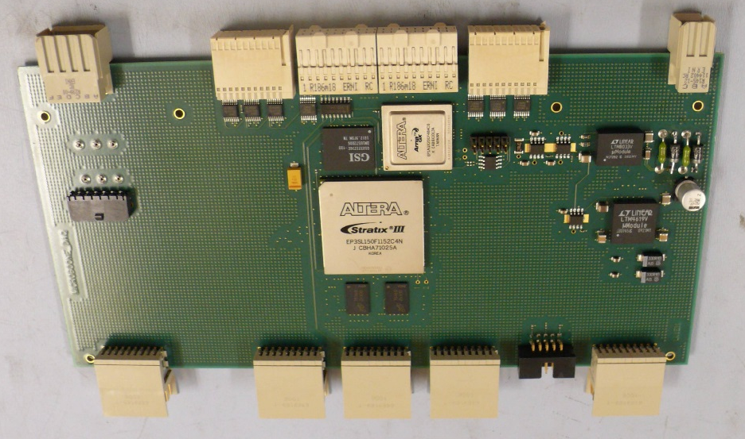
We went through two production cycle:
1) For Microboone ( early last year)
147 FEM modules
5 PMT ADC modules
and supporting modules for 10 crates
2) For LANL (late last year)
54 FEM modules
and supporting modules for 5 crates
PMT ADC
+ FEM board
SRAM
Stratix III
DRAM
FEM Board
TPC ADC
+ FEM board

Slide 21
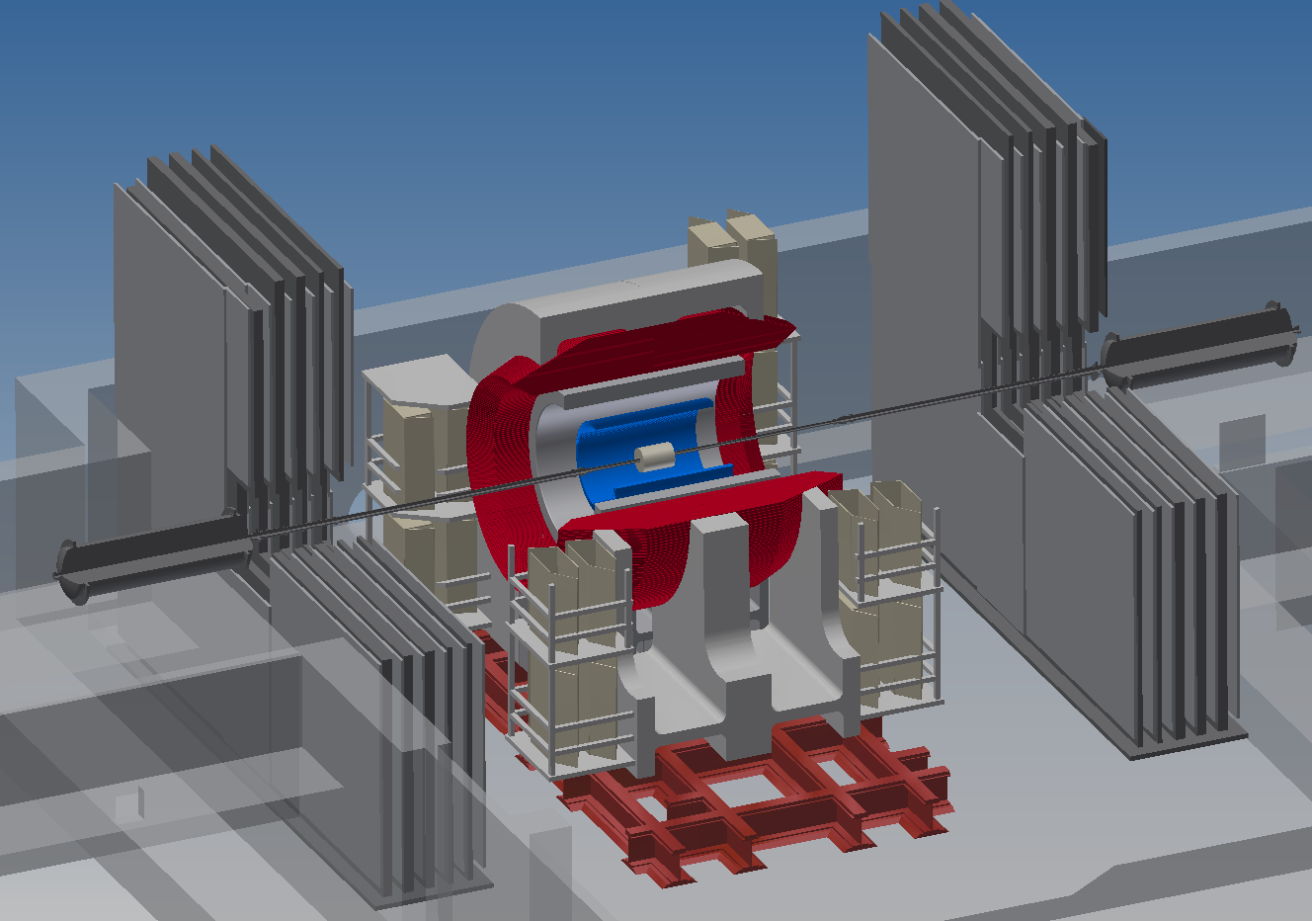

The sPHENIX Detector
Solenoid
Magnet
HCAL
EMCAL
Solenoid
VTX
PS 1-40
The SuperPHENIX Upgrade of the PHENIX Experiment at the Relativistic Heavy Ion Collider
M. Purschke

Slide 22
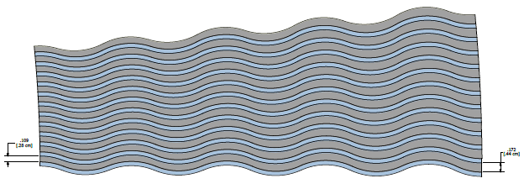
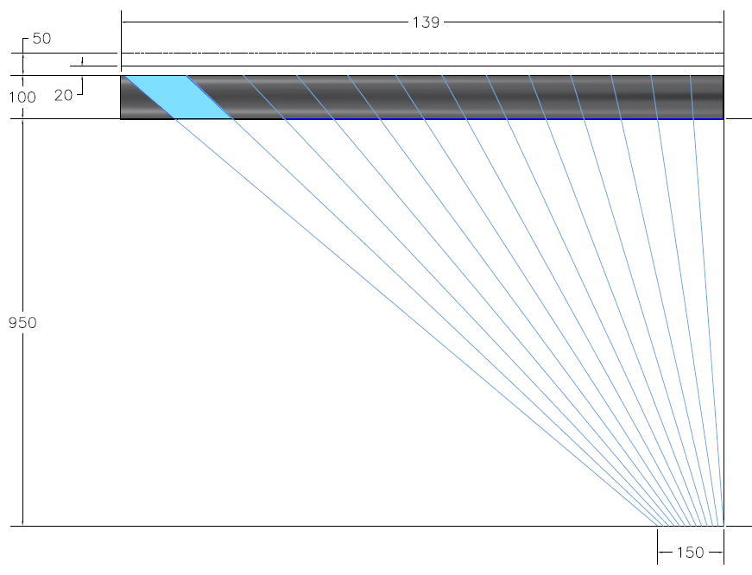
Original Concept: Optical Accordion (EM section)
Accordion design similar to ATLAS Liquid Argon Calorimeter
Readout
Towers
Plates
Fibers
Particle
Accordion prevents channeling
and allows readout on the front
or back of the absorber stack
Can make projective in r-φ by
tapering thickness of tungsten
plates
Can make projective in η by
fanning out fibers
Oscillations must be kept small
because of minimum bending
radius of fibers and plates
Want to be projective
in both r-φ and η

Slide 23
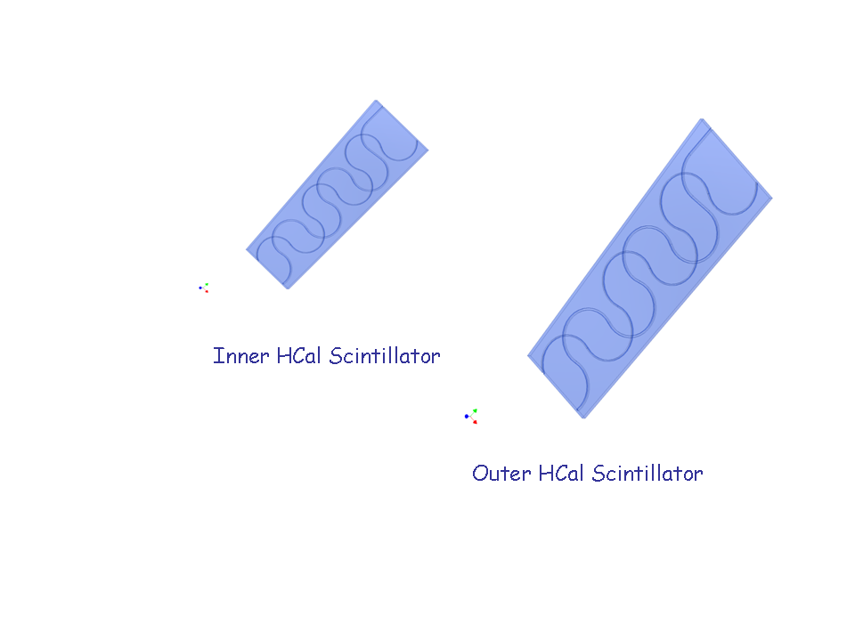
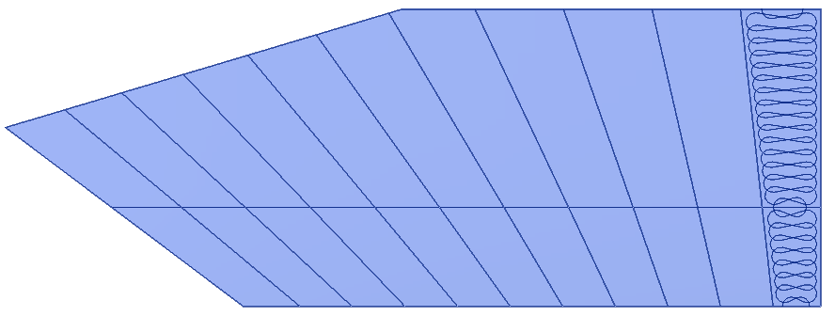
HCAL Readout
Scintillating tiles with WLS fibers embedded in grooves
Fibers read out with SiPMs
T
8 readout fibers per tower
2x11 scintillator tile shapes
Outer readout
SiPMs + mixers
Inner readout
(~10x10 cm²)
2x11 segments in η (Δη =0.1)
64 segments in φ (Δφ =0.1)
1408 x 2(inner,outer) = 2816 towers
Outer
Inner

Slide 24
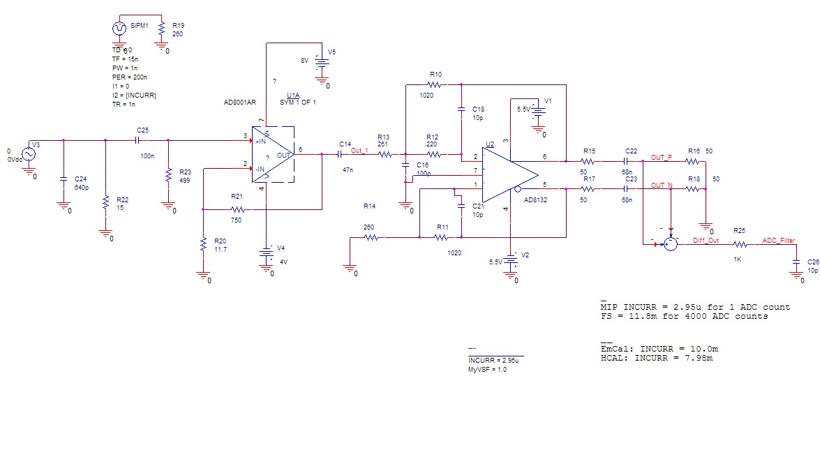

Discrete Preamp
Cd = 640pF for dual SiPM, Ist stage Av = 65, multi-pole differential output filter

Slide 25
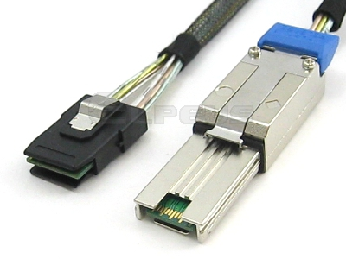
sPHENIX Calorimeter digitizer electronics
Similar to HBD ADC system.
  We will use 14 bits ADC instead of 12 bits ADC while maintaining speed at 60 MHz
    Including offset to deal with signal only swing one side
  Better cables and connector arrangement.
    Instead of ~ 2400 channel → 30,000 channel
    48 channels/board → 64 channel board
  Add optical output for L1 trigger primitives output.
  Add secondary path for short trigger summary output.
  Instead of using LVDS to multiplex data between modules, we will use multiple Gbits transceivers to pass the data between the modules.
Mini SAS

Slide 26
Cost & Schedule
Understand the major cost of the system.
  Most of the majors components, ADC, FPGA etc. Past printed circuit board and assembly cost.
Estimate the cost of the system within some margins.
  You have to cover some unknown cost that could happen down the road.
  Boss always pushes initial cost lower and will be much more unhappy if you have to ask more fund at the tail end of the project:
    This is the time when the project has less money and less freedom of where to spend it.
Estimate the schedule conservatively
  Prototype has lots of unknown both technically or surprise from detector group.
  Testing always takes longer
  Production has to deal with real world schedule, like part shortage….
  Surprise in the production..

Slide 27
Design Specification
Carefully discuss the specification of the readout electronics
  In the proposal stage, detector specification almost always idealized.
    Always try to build more than they ask.
    Occupancy of the detectors are under-estimated.
    Don’t be surprised, if they come back ask for more after the initial design is done.
  Try to have a conservative design.
Don’t under estimate number of prototype modules needed
  Before production, prototypes are needed for detector group, DAQ group, your lab.
  Don’t give out the prototype system freely.
    It needs lot of support.
  PCB manufacture produce boards with a minimum lot. The cost of one board and 10 boards may be exactly the same.
    For a small system, the extra boards could be used for the productions if it is successful.

Slide 28
Prototype
We have done the last 4 readout systems where the prototype is the production design with only pre-cautionary modification except for 1 module. This is achieved by
  Don’t fabricate anything till all the boards are designed.
  Finish the FPGA design enough till all the I/O pins are done.
  Work out the testing method and all testing features that are needed.
  Our engineers design/layout the board. I independently check the board.
    I normally read all the data sheets carefully. Check the layout compared to the data sheets.
    Check the FPGA pin out against the layout. Read the small footprints.
    Check the mechanical dimensions. Mounting holes placement.
    Get parts. Put parts on the layout printout to check footprint.
    Figure out the power up state of the board.
      Check the pull up and pull down of lines critical during the startup.
    Talk to board assembler about the component placement restrictions near the connectors.
    When the design is revised, re-check everything again.
    Look at the checkplot.

Slide 29
The past decade
Because we only work on small projects without extended reviews. It allows us to use up-to-date technologies.
  We spend most of time just on building electronics and make sure it will run smoothly in the experiments.
  It is a continuous design/prototype/fabrication cycle during the past decade.
Helped by the our engineers, we have built 4 readout systems for PHENIX and MicroBooNE experiements.
  MicroBoone will fill the tank with liquid Argon sometime around the summer.
We will proceed to prototype the sPHENIX EM & Hadron calorimeters digitize system in the next 1.5 years.

