Slide 1
sPHENIX DOE-SC CD-1/3a Review
WBS 1.5.3: CalElec Digitizers
Cheng-Yi Chi
May 23-25, 2018
BNL

Slide 2
The WBS 1.5.3 Component
W 1.5.3 The calorimeter digitizer system
  Off detector ADC system for both EM and Hadronic calorimeter.
  Received the amplified signal from on-detector amplify through cables
  Digitize the signal at 6x beam crossing rate, ~ 60 MHz, with 14 bits ADC
    Offset the baseline to use most of the ADC range.
  Provide at least 40 beam crossing of data buffers to cover L1 trigger latency
  Provide Level 1 trigger primitives.
  Minimum 4 Level 1 events buffer.
    Maximum 31 ADC samples per channel per events, 16 samples planned.
  15 KHz Level 1 trigger rate (16 Samples/channel/Event).
  Send Level 1 trigger events to the DAQ system.

Slide 3
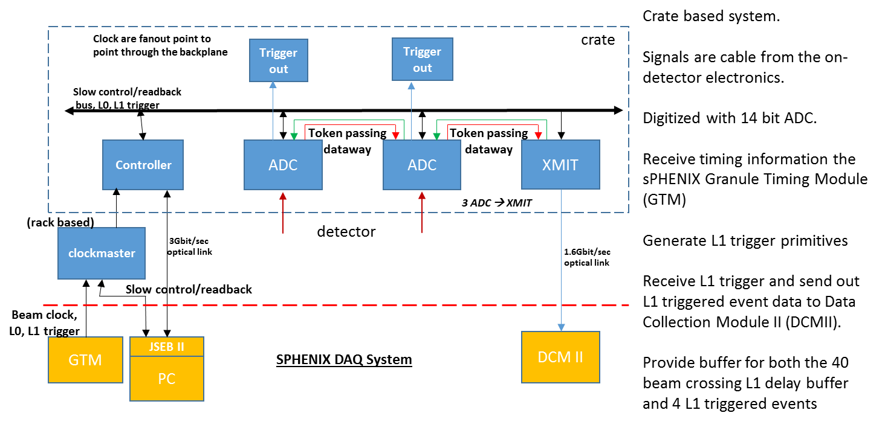
WBS 1.5.3 Technical Overview
2nd round
prototype
1st round
prototype
WBS 1.5.3

Slide 4
WBS 1.5.3 Collaborators
The sub-system consists of
  276 ADC boards w/ Trigger Transmitter
  92 XMIT modules
  23 crates: 22 for EMCal, 1 for HCal
  Power supplies/Patch fibers/Power cables
  10 clock master modules (1 per Rack)
Analog cables from detector to digitizers are part of WBS 1.5.2
Fibers from IR to Rack Room are part of infrastructure.

Slide 5
WBS 1.5.3 Collaborators
The digitizer system has been design by Nevis, Columbia University. We have being doing the standalone testing.
Have been working with BNL sPHENIX Calorimeter group on the integration testing.
  John Haggerty, Eric Mannel etc.
Working with sPHENIX DAQ group on the control software.
  Martin Purschke, Ed Desmond etc.
Other groups can help us when the time ready for production or further long term testing.

Slide 6
Schedule Drivers
The most of the design, crate, ADC, backplane and XMIT modules has been tested and performed well.
  Analog performance work meet design requirements (RMS 2-3 ADC counts in the baseline)
The 2nd round crate controller module and 1st round clock fanout modules has been designed and being prototyped in summer of 2018.
  To interface with timing system.
  Not expected to be problem.
Altera, FPGA manufacture, has obsolete series of configuration memories that we are using
  16 Mbits memory for the XMIT, crate controller and 256 Mbits memory for ADC board.
  Use Winbond flash memory to replace 16 Mbits ALTERA flash memory.
    Obsoleted. But has more than enough. Also have Cypress flash memory.
  Use Micron flash memory device to replace 256 Mbits Altera flash memory.
    Faster and cheaper.

Slide 7
Cost Drivers
The cost drivers are on the ADC board, 276 production boards.
  The 8 channel Analog Device ADC AD9257 ($84 per chip)
    64 channel board → 8 ADCs per board
  The Altera Arria 5 FPGA ($322.10 per chip)
    receive the ADC data and data manipulation, L1 delay, 5 events buffer and generating trigger primitives.
  The differential receiver, AD8132 ($2.10 per chip)
    Receiver the differential signals from the cable. One per channel.
  The PCB board ($210 per board)
  The PCB assembly ($285 per board)

Slide 8
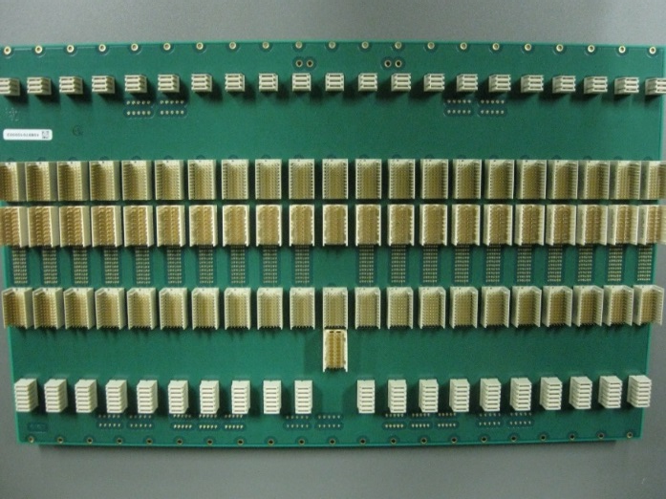
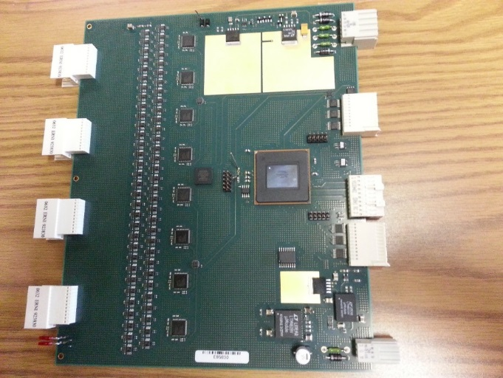
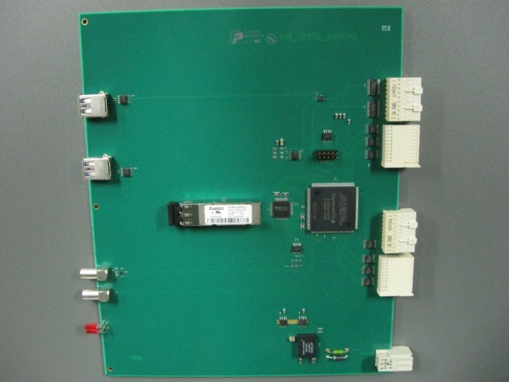
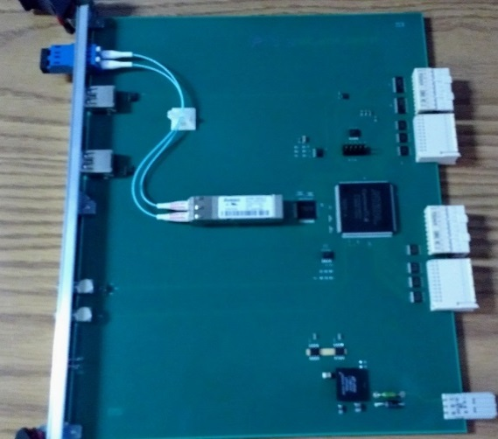
Status and Highlights
Custom ADC system backplane
ADC board
ADC crate controller
1st round
ADC XMIT board

Slide 9
Issues and Concerns
The hardest issue to fix is the analog performance and system problem
  So far we have none of those problems as far we can tell.
    Low baseline noise (2-3 ADC counts with 14 bits ADC).
Discontinuation of components:
  Have enough 16 Mbts flash memory on hand.
    Need 120+, have more than 500 of Winbond version and 1000+ cypress eproms in hand
  Micron memory can replace the Altera 256 Mbits flash memory
There could have surprises come along in the project.
  Hopefully the design is solid and conservative enough we can deal with the surprise.

Slide 10
Summary
Digitizer system is in an advance state of design
  First round of prototype complete
  System was used in the Spring 2018 Test Beam run at FNAL, 192 channels
  Reasonable analog performance.
  System issues like level 1 trigger primitives generator, FPGA image update are addressed
We have done several electronics productions before.
Cost and Schedule well understood based on early prototype rounds and conservative.
WBS 1.5.3 is not in critical path.
Ready for CD1.

Slide 11
Back Up

Slide 12
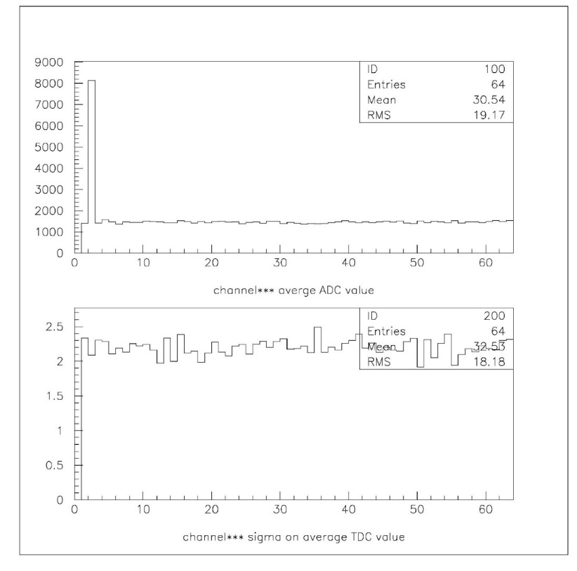
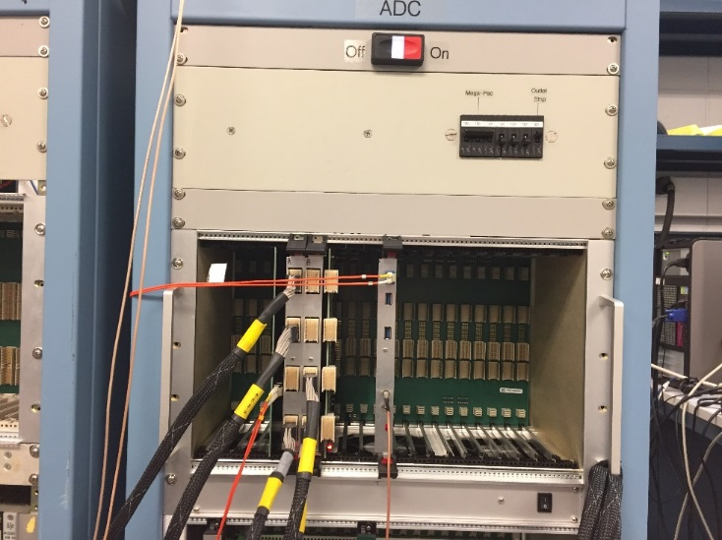
Status and Highlights
ADC baseline histogram (without signal cables)
14 bits ADC system (16384 ADC counts)
Without baseline shifting
Test stand in BNL
3 ADCs boards
Average
ADC counts
channel
ADC counts
Sigma
channel

Slide 13
sPHENIX ADC Module Block Diagram
RHIC beam clock 9.6MHz
Analog
Device
AD9257
8 channel
14bits
65 MHz
ADC
7X ADC clock
+- 3.5V, -2.5V
Differential
receiver power
+1.8V analog
ADC power
+1.8V digital
ADC power
+4V, -3.5V, +2.5V
Power
F
R
A
M
E
Differential
receiver
Serialized ADC DATA
ALTERA Arria V GX
BB1D4F35
1152 pins FPGA
6x beam clock
Beam phase,
init, L1
De-serializer
2 mm
Hard Metric
or mini-SAS
Connector
D
P
U
Token
Passing
Data
two transceivers
64 channel
ADC board
6 X beam
clock
Clock
Fanout
Serial
command
L1
Delay
Buffer
5 L1
Accepted
Event
buffer
Serialized
Token
Passing
two transceivers
2 mm
Hard Metric
or min-SAS
Connector
L1 trigger primitives
transceiver out
De-serializer
command/
offline data read
F
R
A
M
E
Differential
receiver
Serialized ADC DATA
Bused command
Serial data
Analog
Device
AD9257
8 channel
14 bits
65 MHz
ADC
3.3V
LDO
3.3V
LDO
DC/DC
switch regulator
4V
+12V
Power
7X ADC clock
2.5V FPGA I/O
DC/DC
switch regulator
1.5V
LDO
1.1V
core

Slide 14
BC & L1 event
numbers
Sphenix
64 channel ADC
Data Flow Diagram
Beam clock
number
Header
512X16
Header
8 x 32
6x RHIC
clock
L1
trigger
6x RHIC
clock
14 bits ADC
serialized data
840 Mbits/sec
LVDS
De-serialize
/alignment
Input
control
L1 Delay memory
512X128
8 events buffer
256 X
1024
FIFO
2048 *
34 bits
(first, data,
Last)
Alignment
16bits
FIFO
Gbits
receiver
8b/10b
encoding
Serialized
data
from down
Stream board
1-8
16bits
FIFO
Gbits
receiver
Fake data
512X16
wadd
1-64 channels
radd = wadd
- delay
Token in
Link control
Gbits
transmitter
8b/10b
encoding
Serialized
data
L1 trigger
Primitives
generators
Token out
120 MHz
Reference
clock
80 MHz
Reference
clock
Write address
3 bits events,
5 bits samples
Gbits transmitter
read address
3 bits events,
5 bits samples
write =
valid & token
Read =
!empty
LVDS repeater
Slow control
readback
backplane
Daughter card
Optical
transceiver
Lemo out

Slide 15
Cal trigger primitive Generator (preliminary)
6X BC clock
12X BC Clock
120 MHz clock
delay
+1
+2
+1
+ 1 BC + 2 12X
4 bits trigger phase
Dual port memory
Baseline
subtraction
Lookup memory
(1024X10)
10 bits
2X2 SUM
(12 bits output)
only use
upper 8 bits
Choose one of the of of the 12X BC clock phas for trigger primitive
MUX
128 bits
To 8 16 bits
10X16 bits FIFO
Transceiver
IP
Read
Address
(upper 10 bits)
Read address = write address -delay
Load lookup
Memory from
Slow control
Sub = ADC – ADCpre
If (adcpre > adc) sub=0
64 channels
16 2X2 8 bits sum
Delay a parameter
Probably has 2 clocks offset
1 | 2 | 3 | 4 | 5 | 6 | 7 | 8 | 9 | 10
header | Mod + clock | Sum 1+2 | Sum 3+4 | Sum 5+6 | Sum 7+8 | Sum 9+10 | Sum 11+12 | Sum 13+14 | Sum 15+16
Monitor Delay dual port memory
5 events buffer
To controller
readout
Delay and
# of Sample
adjustable
L1
trigger

Slide 16
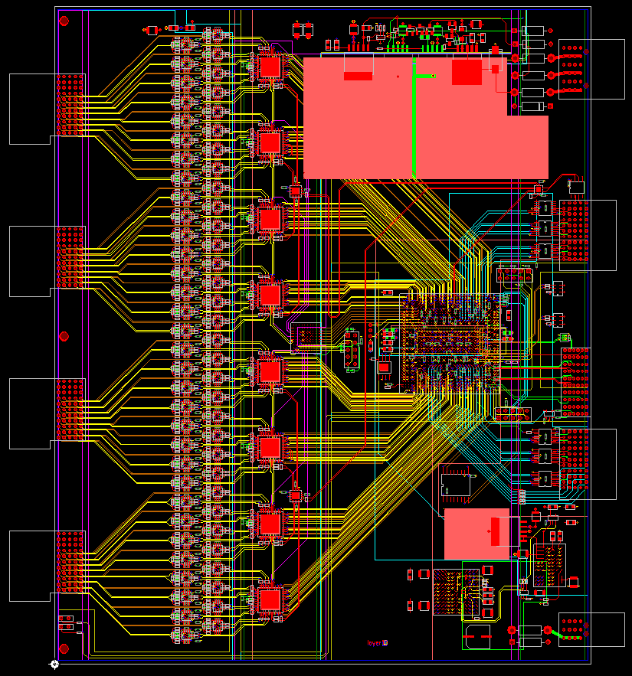
SPHENIX ADC board
Analog
Power
64 channel inputs
2mm HM connectors
160mm by 190mm (6U board)
The 8 channel 14 bits ADC will be running at 6x beam crossing rate ~ 60 MHz
Altera Arria 5GX FPGA de-serialize data, provide 5 events buffer, 40 beam crossing L1 delay, token passing data, L1 trigger primitives output
2mm HM
Input
connector
Clock in
L0/L1
Serial
Command
output
Differential
receivers
Trigger
Primitives
output
Token
Passing
Data
In/out
Analog
Device
AD9257
14 bits
ADC
Serial
Command
input
ALTERA
Arria 5GX
FPGA
Digital
Power

Slide 17
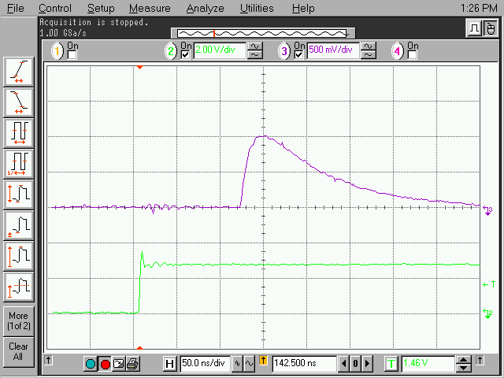
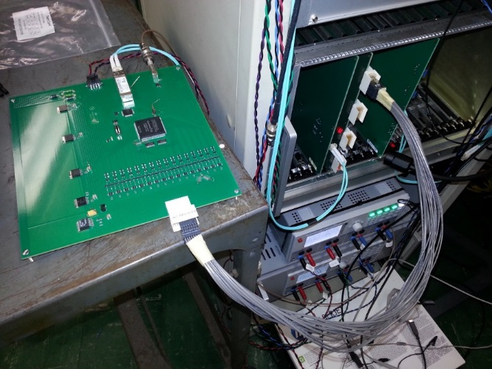
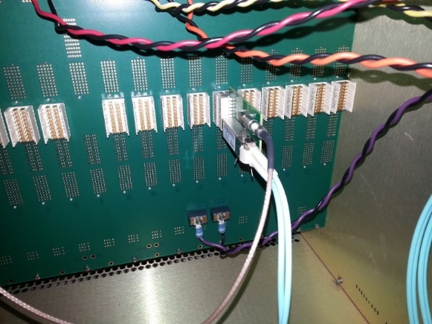

Slide 18
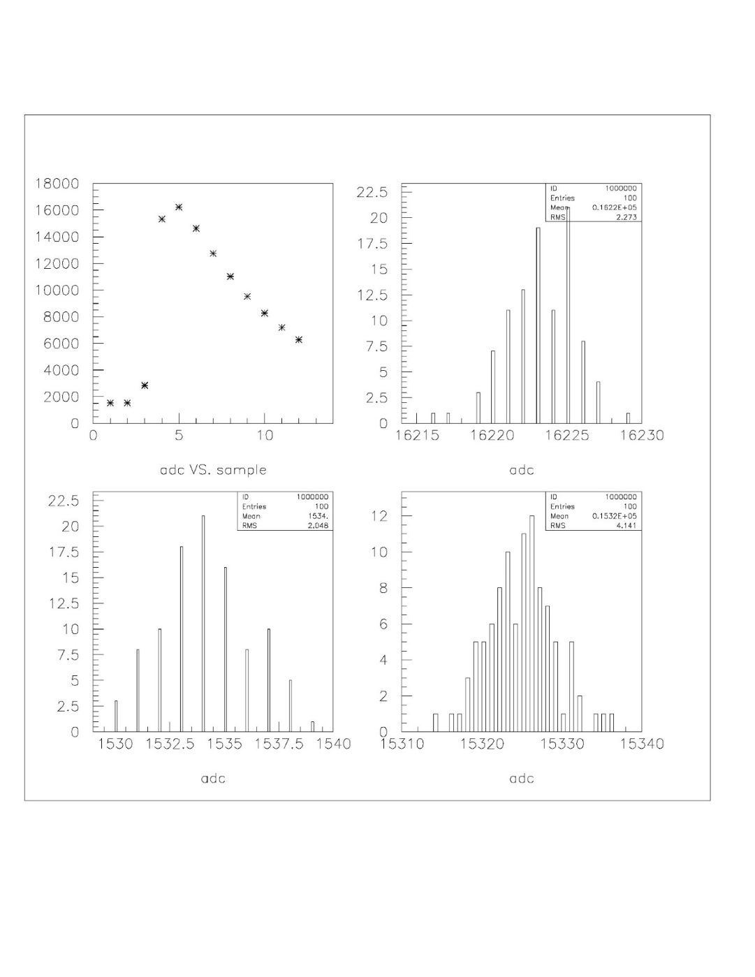
Pulse shape channel 40
rms
ADC
Sample number
ADC
ADC
ADC

