Slide 1
Local Level 1 trigger Hardware and data flow
Cheng-Yi Chi
Columbia University

Slide 2
Outline
The Calorimeter electronics.
Function block diagram
Trigger hardware and data path
Calorimeter
Beam beam
Local level 1 trigger
Hardware spec
PHENIX trigger timing diagram
Possible hardware architecture.
Advantage and Drawback
Task forward

Slide 3
BC & L1 event
numbers
Sphenix
64 channel ADC
Data Flow Diagram
Beam clock
number
Header
512X16
Header
8 x 32
6x RHIC
clock
L1
trigger
6x RHIC
clock
14 bits ADC
serialized data
840 Mbits/sec
LVDS
De-serialize
/alignment
Input
control
L1 Delay memory
512X128
8 events buffer
256 X
1024
FIFO
2048 *
34 bits
(first, data,
Last)
Alignment
16bits
FIFO
Gbits
receiver
8b/10b
encoding
Serialized
data
from down
Stream board
1-8
16bits
FIFO
Gbits
receiver
Fake data
512X16
wadd
1-64 channels
radd = wadd
- delay
Token in
Link control
Gbits
transmitter
8b/10b
encoding
Serialized
data
L1 trigger
Primitives
generators
Token out
120 MHz
Reference
clock
80 MHz
Reference
clock
Write address
3 bits events,
5 bits samples
Gbits transmitter
read address
3 bits events,
5 bits samples
write =
valid & token
Read =
!empty
LVDS repeater
Slow control
readback
backplane
Daughter card
Optical
transceiver
Lemo out

Slide 4
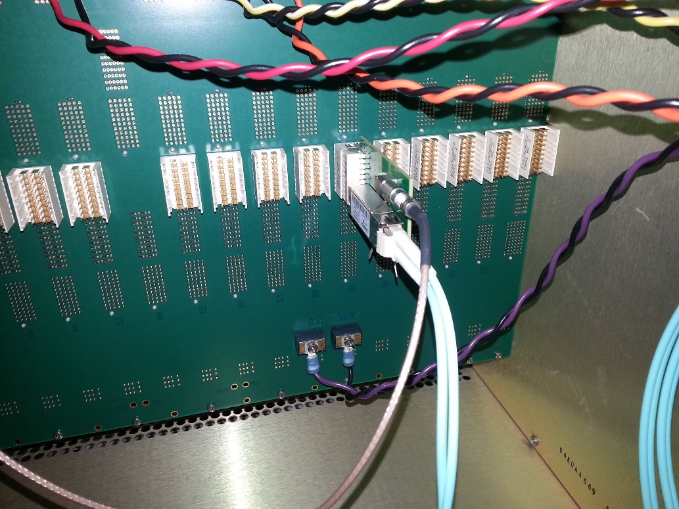
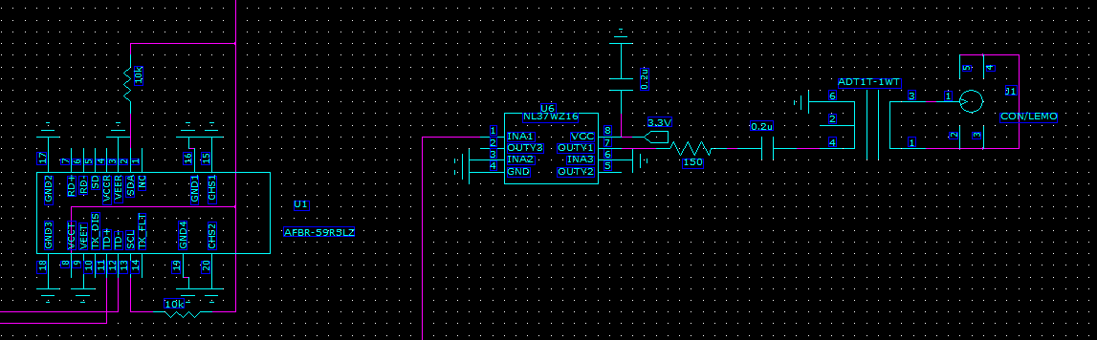
Trigger daughter plug in from the back with 2 outputs, 1 optical transceiver, 1 lemo output.
backplane
Optical transmitter output
ARRIA 5
FPGA
LVDS buffer
Lemo out
Trigger daughter card
3.3v

Slide 5
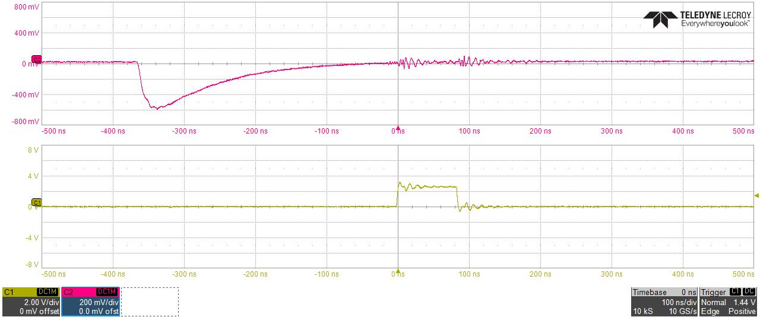
ADC board – L1 primitive latency study 1
using pulse generator board
2ft long signal cable between pulse generator board and ADC board.
AD9257 has 16 clock delay == 16.67ns * 16 ~ 266ns
There 4 deep fifo in the resync ADC data into the FPGA 60 MHz clock, (deal with phase issue)
~ 4X16.67ns ~ 67ns. Couple cycles lose in the FIFO
Observe ~ 360-340ns latch
Pulse measure at output of the pulse generator board
Bit 12 after the resync FIFO 4X128

Slide 6
Cal trigger primitive Generator (preliminary)
6X BC clock
12X BC Clock
120 MHz clock
delay
+1
+2
+1
+ 1 BC + 2 12X
4 bits trigger phase
Dual port memory
Baseline
subtraction
Lookup memory
(1024X10)
10 bits
2X2 SUM
(12 bits output)
only use
upper 8 bits
Choose one of the of of the 12X BC clock phas for trigger primitive
MUX
128 bits
To 8 16 bits
10X16 bits FIFO
Transceiver
IP
Read
Address
(upper 10 bits)
Read address = write address -delay
Load lookup
Memory from
Slow control
Sub = ADC – ADCpre
If (adcpre > adc) sub=0
64 channels
16 2X2 8 bits sum
Delay a parameter
Probably has 2 clocks offset
1 | 2 | 3 | 4 | 5 | 6 | 7 | 8 | 9 | 10
header | Mod + clock | Sum 1+2 | Sum 3+4 | Sum 5+6 | Sum 7+8 | Sum 9+10 | Sum 11+12 | Sum 13+14 | Sum 15+16
Monitor Delay dual port memory
5 events buffer
To controller
readout
Delay and
# of Sample
adjustable
L1
trigger

Slide 7
SPHENIX Beam Beam counter local level 1 algorithm conceptual diagram
PMT charge
Shaper ADC
Peak
detector
Baseline
correction
Timing Slewing correction
10X10 table
NHIT,
Average time,
charge
PMT TDC
Shaper ADC
Peak
detector
Baseline
correction
Mid-point
ADC calculation
ADC to time conversation table (10X10)
ADC is running at 6X beam crossing clock, ~16ns
64 channels per FEM board, 32 channel for TDC and 32 channel for PMT pulse measurements, 4 boards total
The TDC channels are gated within 25 – 30 ns time window. There are no constrain by the PMT charge channel shaper.
The beam beam LL1 calculation is running at 6X BC clocks.
The 10x10 table is 10 bits address inputs and 10 bit data output, preloaded through crate controller.
Unlike Calorimeter detector, the beam beam local level 1 does not require large collapsing steps. It has relative more relax time requirements.

Slide 8
Hardware spec for local level 1
RHIC clock is normally running with 9.6 MHz with some variation pending on collision species and energy.
EMCAL has 24576, =96*256, channels, 0.025 X 0.025 eta and phi coverage.
64 channel per FEM, 384 FEM.
FEM will output 16 2x2 sum which pack into 8 16 bits words + header + frame marker.
L1 trigger primitive bandwidth ~ (8+1+1)*10 MHz = 100 M words per sec = 2 Gbits/sec after 8b/10b encoding. The transceiver has 120 MHz reference crystal, i.e. 2.4 GHz bandwidth.
Outer and inner HCAL has 1536 each, =24x64 channels, 0.1 X 0.1 eta and phi coverage.
Same FEM as EMCAL, 24 FEM.
The trigger sum coverage is 0.2X.2 eta and phi coverage.
The FEM produce trigger primitives every beam crossing clock.
The Local level 1 trigger need to have beam clock input to resync all primitive data
Mode Bits from timing system are needed in Local level 1 trigger system for
system initialization, reset, receiving L1 trigger and testing.
Local Level 1 system need to able inject test pattern at input stage of each physical board.
Local Level 1 system has to able to readback samples of FEM trigger primitives. The Mode bits of the timing system should able to coordinate the readback sample of FEM trigger primitive data and Local level 1 trigger primitives data and it’s calculation result.
Local level 1 time budget need to be developed.

Slide 9
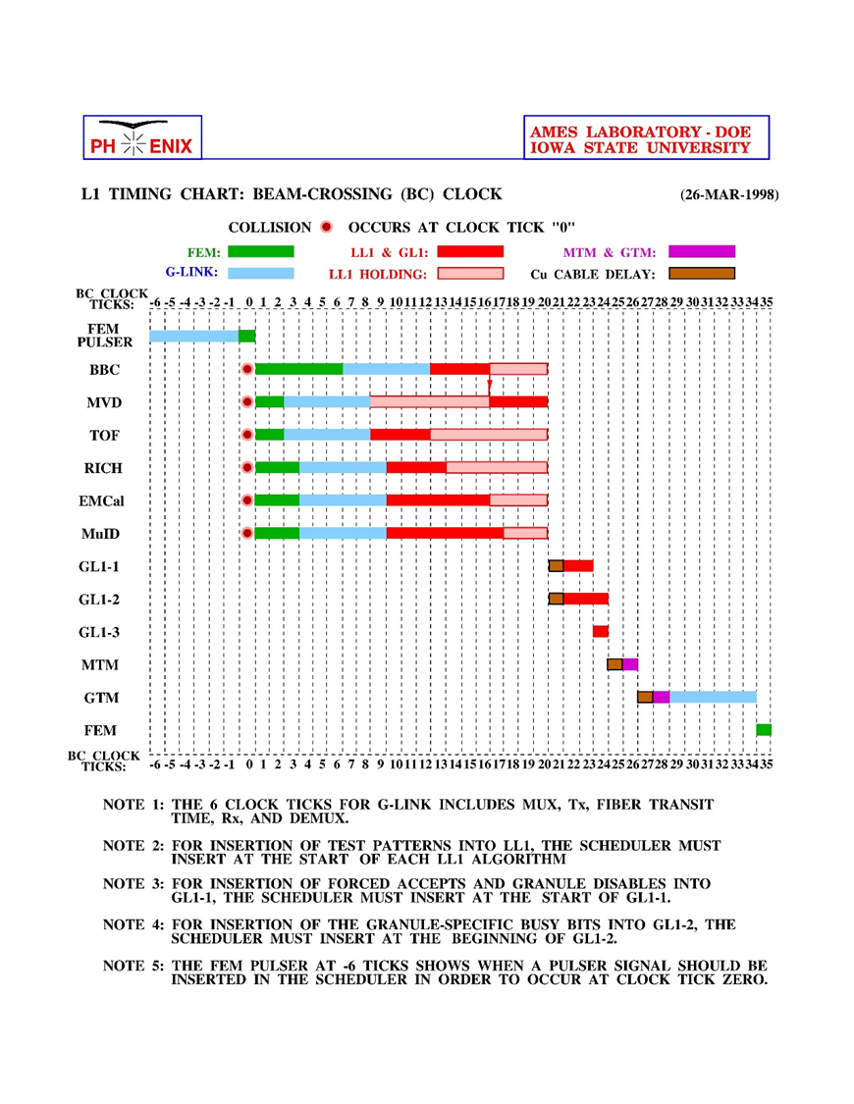
Level 1 trigger Latency diagram shows the 40 beam crossing latency, 4 us, is distribution cross varies stages, FEM, cable delay, local level, global level 1, timing system.
It has the same collision hall with similar cable delay in SPHENIX
It is unclear, we can increase Level 1 trigger latency.

Slide 10
Possible paths
3 possible way to do calorimeter local level 1 trigger hardware
1) adapter to ATLAS gFEX board
Split fiber in 2 phi regions. Each regions has 192 fibers in EM + 12 fibers in inner HCAL + 12 fibers in outer HCAL.
2) divided the region into 12 eta phi sections at stage 1.
Do EMCAL overlapping 4x4 sum, 32 fibers per sections + data needed to be copy over.
Concentrate HCAL fibers by factor of 4.
Get all the fibers data into Stage 2.
Separate different physics into to different boards
3) Multiplex fibers to higher speed fiber, factor 6 or 8.
Cut detector along the phi direction, 2 or 4 different regions. With smaller number of fibers we can get all the fibers belong to the same region into one FPGA.

Slide 11
GFEX, global feature extractor, board the part of ATLAS phase upgrade Level 1 trigger system. It is ATCA crate base system.
Lots of fiber inputs. Large FPGA, XilinX ultrascale and ZYNQ SOC processor.

Slide 12
Good and bad of the 3 solutions (1)
1) ATLAS gFEX boards
Good →
It exists and working.
It has enough fiber inputs that we get the primitives done with minimum L1 delay, mostly in transceiver transmitting and receiving delay.
Bad →
It is build for something completely different that what we want.
We have to check the clock path to made sure it is even practical. Make sure we can deal with not fixed beam clock and mode bits input. Make sure we have enough different clock inputs.
It is build on ATCA platform or one can use the existing test stand environment.
Learning curve.
Make sure it will work with existing sPHENIX trigger and DAQ frame works.

Slide 13
Good and bad of the 3 solutions (2)
About the solution 2 & 3
Good →
It will fit into sPHENIX trigger and DAQ system.
Possibly we could use EMCAL digitizer infrastructure. It will solve a) bit clock input and mode bits issue 2) readback and control path and 3) readout to DCM II .
Bad →
It is a new boards, custom build.
It will be add transceiver latency. Solution 2) will be add at least 2 cycles, Solution 3) will add at least 1 cycle.
Solution 3 will not doing anything in the concentrator except for reducing the number of fiber inputs by increase the bandwidth. All the calculation burdens will be done in the next stage.

Slide 14
Steps to determine the final solution
Work on the conceptual block diagram and FPGA code
Understand number of steps to get trigger implemented.
Estimate registers usage.
Try to match the devices availability, fibers counts etc.
Understand gFEX board to determine if it can be used is sPHENIX.
Timing inputs, fiber input bandwidth etc.….
Figuring out impact of ATCA usage or some other test setup.

Slide 15
BACUP SLIDES

Slide 16
Fibers bandwidth calculation for complete phi section
8x8 channel coverage per fem. A complete ring of Phi section will take 256/8 = 32 FEM.
8x8 channel is 4x4 of 2x2 sum
Overlapping region to next phi section is ¼ of coverage.
32 fiber in ➔ 8 fibers out with 2 Gbits/sec rate with 1.6 Gbps data -> 2 fibers of 8 Gbits/sec rate
No overlap 4x4 sum of phi section ring will be ¼ of incoming data rate
32 fiber in → 8 fiber out at 2Gbits/rate → 2 fiber of 8 Gbits/rate
No overlap 8x8 sum of phi section ring will be 1/16 of incoming data rate
32 fiber in → 2 fiber out at 2Gbits/rate → 1 fiber of 8 Gbits/rate
32 +2+2 == > 36 fibers is minimum need a region , 40 will probably be adequate.
CXP connector has 12 fibers input and about 1 inch wide
6U boards has 233 mm vertical space = 9.2 inch space.
Should be enough for 5-6 CXP connectors.
96 channel in Z → 12 phi region in Z
Assume one FPGA can handle 40- 48 fibres → 2 FPGA per boards → we need 6 boards for EMCAL LL1

Slide 17
Data input alignment with
data merger block diagram
Fake data
injector
Restore data to 16 2x2
sums
Alignment memory
Delay memory
optical receiver
unpacker
Data to
Overlapped region
Optical transmitter
Data collector
Restore data to 16 2x2
sums
Alignment memory
Delay memory
optical receiver
unpacker
Restore data
sums
Data from
Overlapped region
optical receiver
unpacker
slow control data readback

