Slide 1
Calorimeter Digitizer Electronics
Cheng-Yi Chi
Columbia University

Slide 2
Off-Detector Calorimeter Digitizer electronics
Function
Past experience
System block diagram
ADC board block diagram, differential receivers, ADC choice. Comments on trigger primitives
Progress on the Prototype
  Some measurement results
Production Flow
System cost
Status/Outlook

Slide 3
Calorimeter Digitizer electronics function
Digitizing the signal after the on-detector electronics with single scale 14 bit ADC.
  Try to maintain the best dynamic range as good we can do with single scale ADC. We are looking for 12 bits dynamic range.
Interface with SPHENIX DAQ system
  Receive beam clock, L0 timing and L1 trigger.
  Provide 40 beam crossing L1 delay.
  Provide the 4 L1 trigger events buffer.
  Provide the functionality to generate L1 trigger primitives.

Slide 4
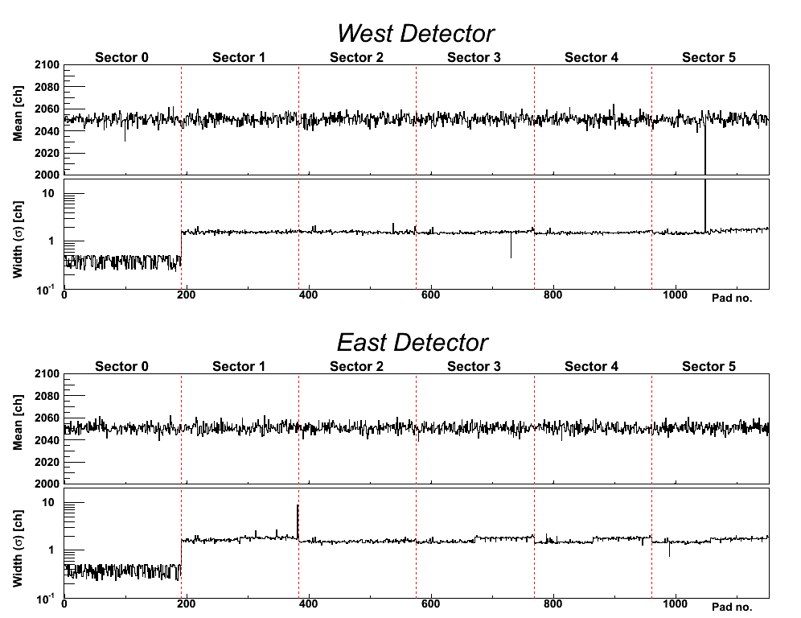
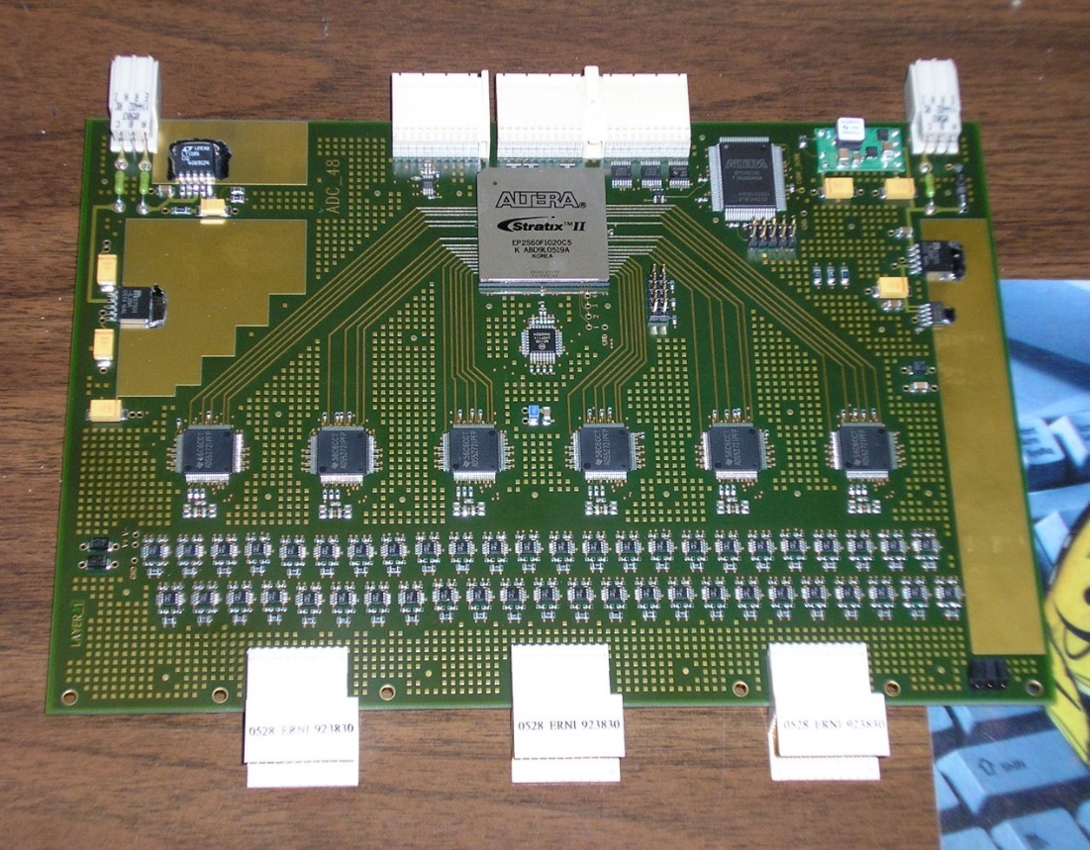
Past Experience
Built
PHENIX Hadron Blind Detector (HBD) off-detector digitizer (12 bits, ~60 MHz)
also been use for the MPC readout electronics and SPHENIX test beam readout
MicroBoone TPC readout (BNL+Nevis) and PMT readout (similar shaper+ADC like HBD, 64 MHz)
HBD Pedestal Run
HBD ADC module
ALTERA
FPGA
Mean (ch)
Width σ (ch)
ADC
(TI’s ADS5272)
Channel #
Differential
receiver
Mean (ch)
FEM Board
Width σ (ch)
Channel #

Slide 5
ADC System Block Diagram
Crate based system.
Signals are cable from the on-detector electronics.
Digitized with 14 bit ADC.
Receive timing information the PHENIX Granule Timing Module (GTM)
Generate L1 trigger primitives
(not in the reference design)
Receive L1 trigger and send out L1 triggered event data to Data Collection Module II (DCMII).
Provide buffer for both the 40 beam crossing L1 delay buffer and 4 L1 triggered events
Clock are fanout point to
point through the backplane
Trigger
out
crate
Trigger
out
Slow control/readback
bus, L0, L1 trigger
Token passing
dataway
Token passing
dataway
Controller
ADC
ADC
XMIT
4 ADC → XMIT
(rack based)
detector
clockmaster
3Gbit/sec
optical link
1.6Gbit/sec
optical link
Slow control/readback
Beam clock,
L0, L1 trigger
GTM
JSEB II
DCM II
PC
SPHENIX DAQ System

Slide 6
sPHENIX ADC Module Block Diagram
RHIC beam clock 9.6MHz
Analog
Device
AD9257
8 channel
14bits
65 MHz
ADC
7X ADC clock
+4V, -3.5V, +2.5V
Power
+- 3.5V, -2.5V
Differential
receiver power
+1.8V analog
ADC power
+1.8V digital
ADC power
F
R
A
M
E
Serialized ADC DATA
ALTERA Arria V GX
BB1D4F35
1152 pins FPGA
6x beam clock
Beam phase,
init, L1
Differential
receiver
De-serializer
D
P
U
2 mm
Hard Metric
or mini-SAS
Connector
Token
Passing
Data
two transceivers
64 channel
ADC board
Clock
Fanout
L1
Delay
Buffer
5 L1
Accepted
Event
buffer
Serialized
Token
Passing
6 X beam
clock
Serial
command
two transceivers
2 mm
Hard Metric
or min-SAS
Connector
L1 trigger primitives
transceiver out
De-serializer
command/
offline data read
Differential
receiver
F
R
A
M
E
Serialized ADC DATA
Bused command
Serial data
Analog
Device
AD9257
8 channel
14 bits
65 MHz
ADC
3.3V
LDO
3.3V
LDO
DC/DC
switch regulator
4V
+12V
Power
7X ADC clock
2.5V FPGA I/O
DC/DC
switch regulator
1.5V
LDO
1.1V
core

Slide 7
The Choice of ADC
Analog device AD9249
16 channel 14 bits ADC. Maximum sampling rate 65 MHz SNR 75db
1.8v technology. 58mw per channel at 65 MHz -> 1 W per chip.
144 pins package. 1cm X 1cm BGA
pipeline latency 16 clocks.
Analog Device AD9257
8 channel 14 bits ADC Maximum sampling rate 65 MHz SNR 75.5 db
1.8v technology. 55mw per channel at 65 MHz
65 pins LFCSP package. 0.9mm by 0.9mm.
pipeline latency 16 clocks.
Texas instrument ADS5294
8 channel 14 bits ADC. Maximum sampling rate 80 MHz SNR 75.5db
1.8v technology. Per channel 58mw at 50 MHz, 77mw at 80 MHz.
1-wire only interface only for below 50 MHz sampling
80 pins QFP package. 12mm by 12mm
included digital processing block ( only after digitization)
pipeline latency 11 clocks for 1 wire interface.
Linear Technology LTM9008-14
8 channel 14 bits ADC. Maximum sampling rate 65MHz SNR 73 db
1.8v technology. Per channel 88mw at 65 MHz.
140 pins BGA. 11.25mm X 9mm
pipeline latency 6 clocks.
The limit of ADC LVDS serializer
seems to be less than 1Gbits/sec
65 MHZ ADC
The FPGA does not have 128 LVDS
De-serializer → 1 LVDS output
per ADC channel
JSED204B’s ADC need the transceiver to receive data
→ Limits number of ADC can be connected to the reasonable price FPGA

Slide 8
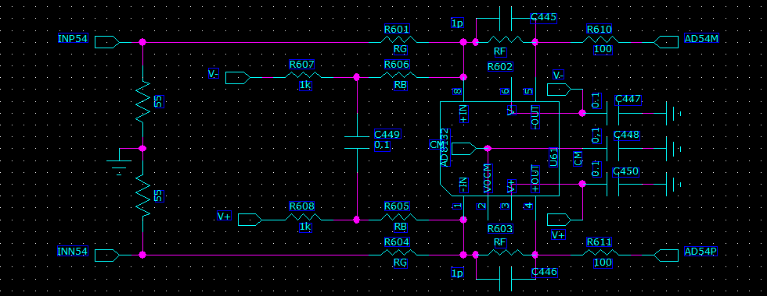
The ADC system has 14 bits output (0- 16383 ADC counts)
The ADC input is differential, need to supply both + and – inputs ( peak-peak range is 2V)
(122 μV per ADC counts)
+1V on the positive side and –1V on the negative side
8192 ADC count happened when V+, V- difference is zero
Our signal only swing one side
To get full range we need to offset the signals. → (the point to introduce the noise)

Slide 9
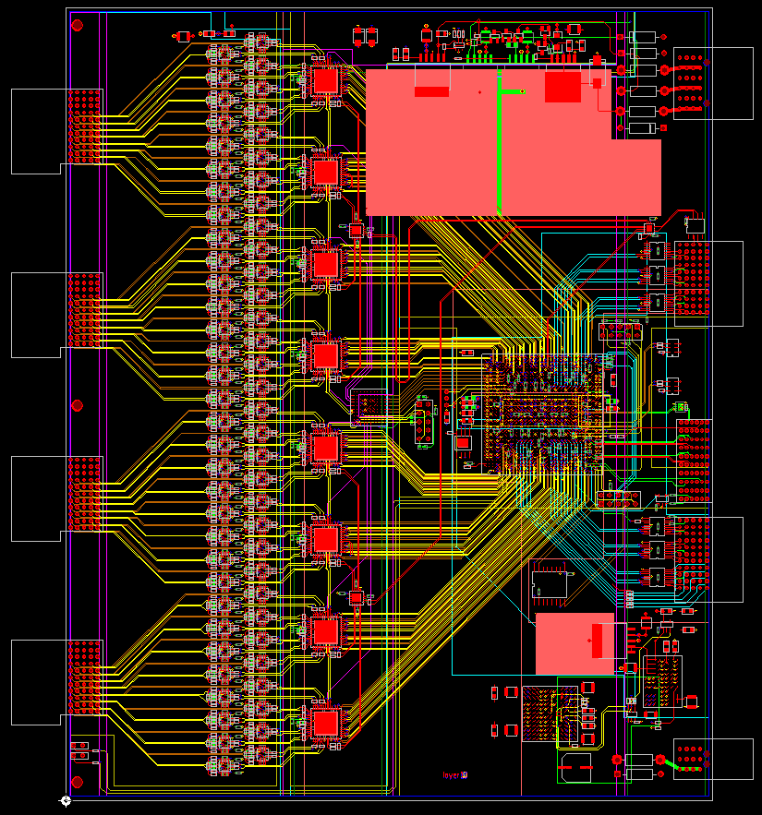
SPHENIX ADC board
Analog
Power
64 channel inputs
2mm HM connectors
160mm by 190mm (6U board)
The 8 channel 14 bits ADC will be running at 6x beam crossing rate ~ 60 MHz
Altera Arria 5GX FPGA de-serialize data, provide 4 events buffer, 40 beam crossing L1 delay, token passing data, L1 trigger primitives output
2mm HM
Input
connector
Clock in
L0/L1
Serial
Command
output
Differential
receivers
Trigger
Primitives
output
Token
Passing
Data
In/out
Analog
Device
AD9257
14 bits
ADC
Serial
Command
input
ALTERA
Arria 5GX
FPGA
Digital
Power

Slide 10
Thoughts on the Trigger Primitives.
FEM can do rough gain correction → We will do on board 2x2 sum first
If trigger primitive output will be 8 bits, for 40 Gev top scale, the least count
will be ~156 Mev if the scale is linear.
If we output 8 bits per channels, the optical bandwidth will be
10 ( 8b/10b encoding) *64 * 10 MHz = 6.4 Gbits/sec. if one only output 2X2 sum, we will only have 1.6 Gbits/sec. With formatting, the output will be 2 Gbits/sec. ( 1 frame marker + 1 header + 8* (2* 8) data words.)
if trigger sum is 10 bits, we will have ( 1 frame marker + 1 header + 10 16 bits data words.), The optical
Bandwidth will be 20 (bits)*12 words* 10 MHz = 2.4 Gbits/sec
The FPGA has a high speed transceiver port to the backplane with high speed LVDS repeater. A rear mounted optical transceiver could be used to send out L1 trigger primitives.
FPGA code is being developed to study the memory usage if correction table are used to correct the data.

Slide 11
Prototype Progress
ADC Module, Crate Controller and Backplane prototype modules have be build.
  This is enough for us to test analog function.
    Can we safely built 64 channel ADC module with reasonable performance?
    Will offset circuit introduce more noise into the system?
  The XMIT module is on the way

Slide 12
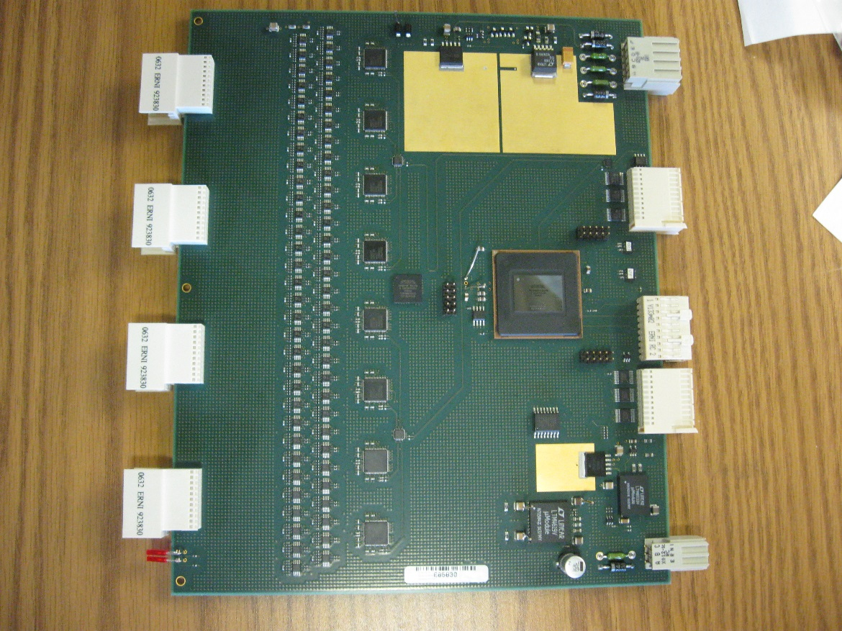
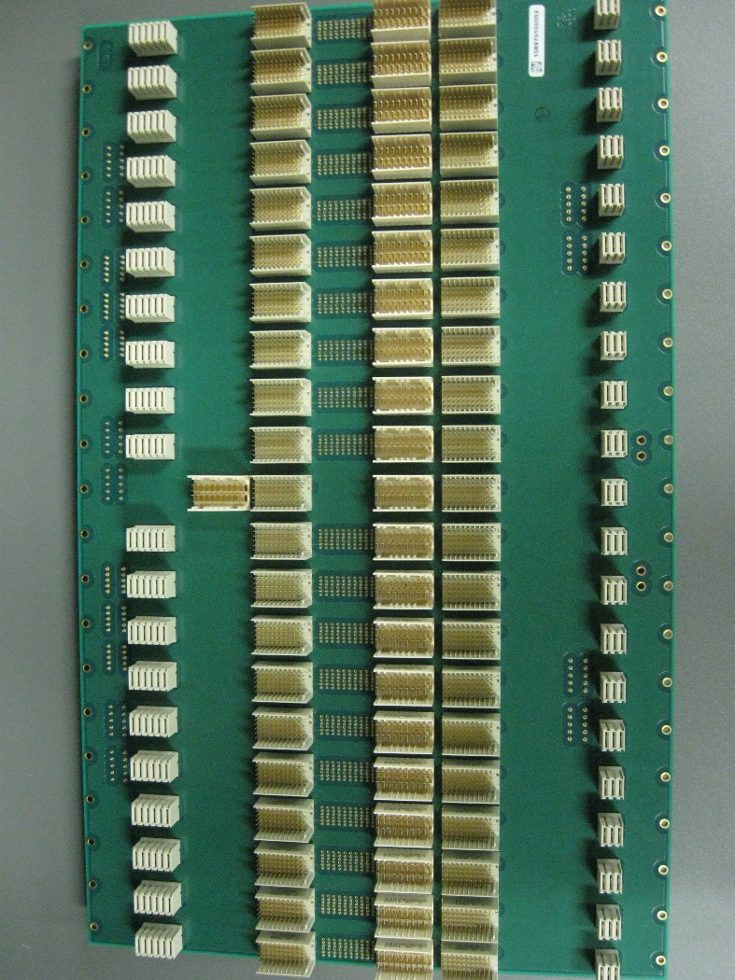
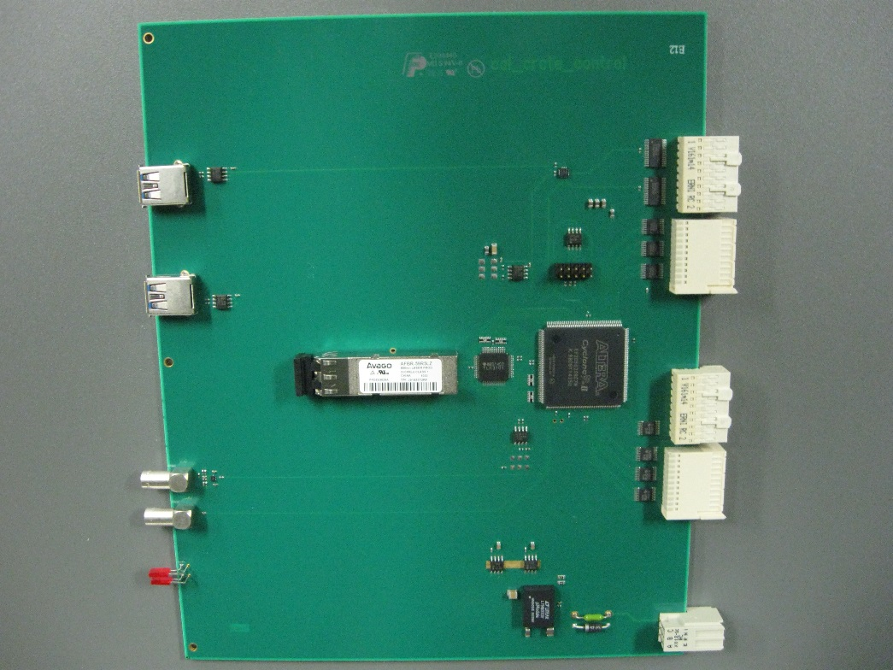
Sphenix ADC module
Sphenix crate controller
Sphenix ADC backplane

Slide 13
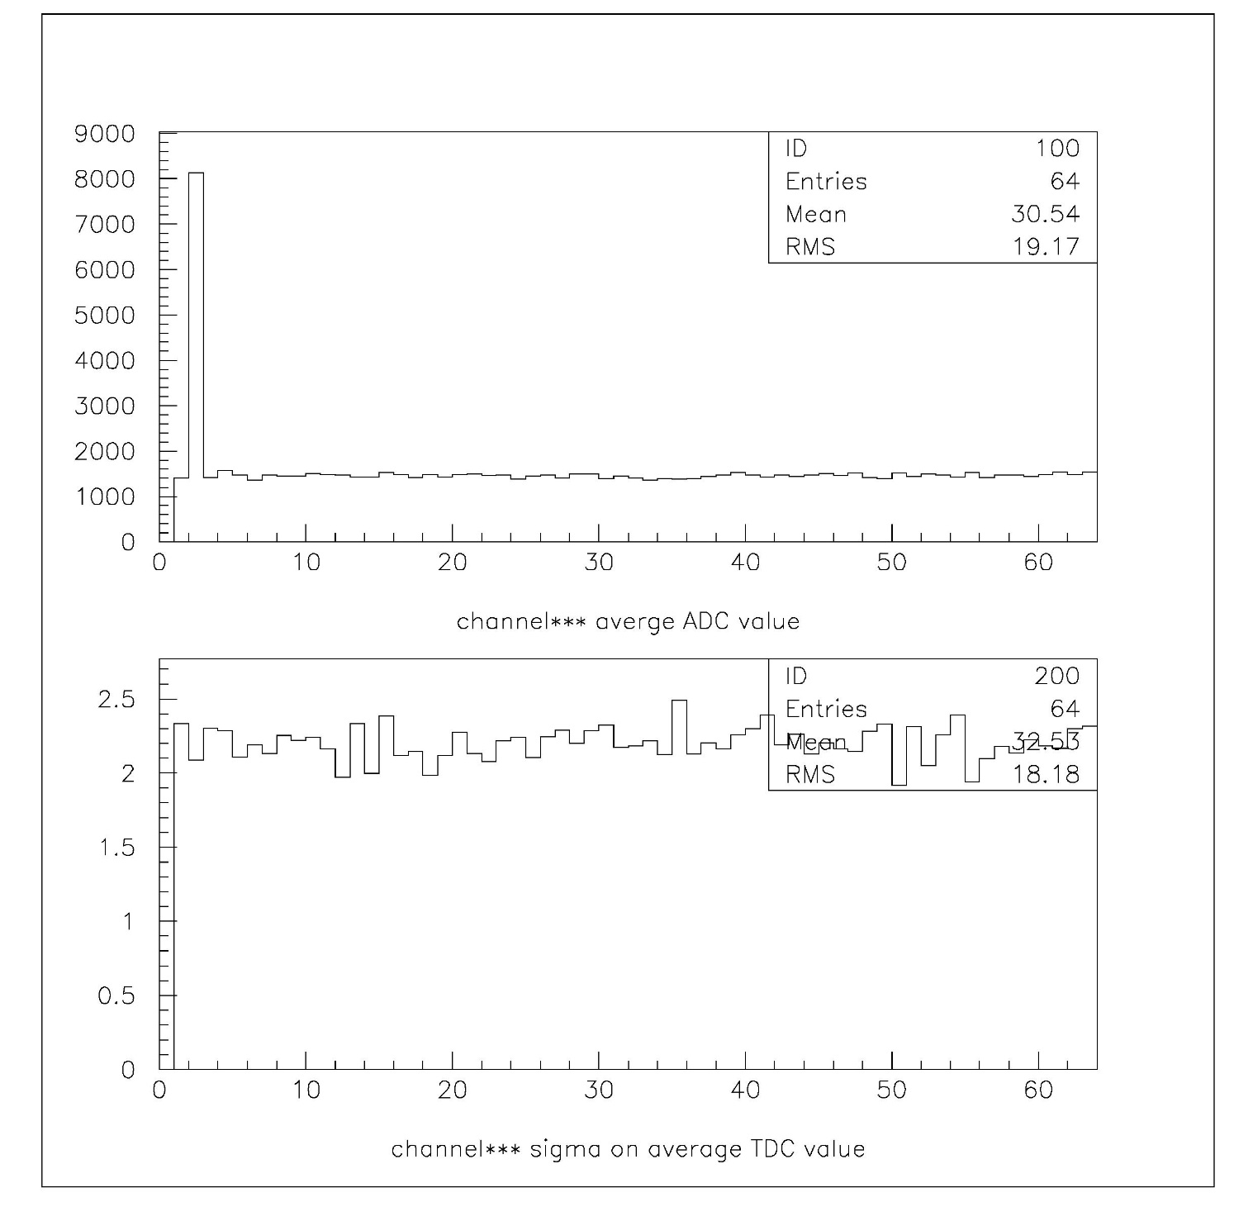
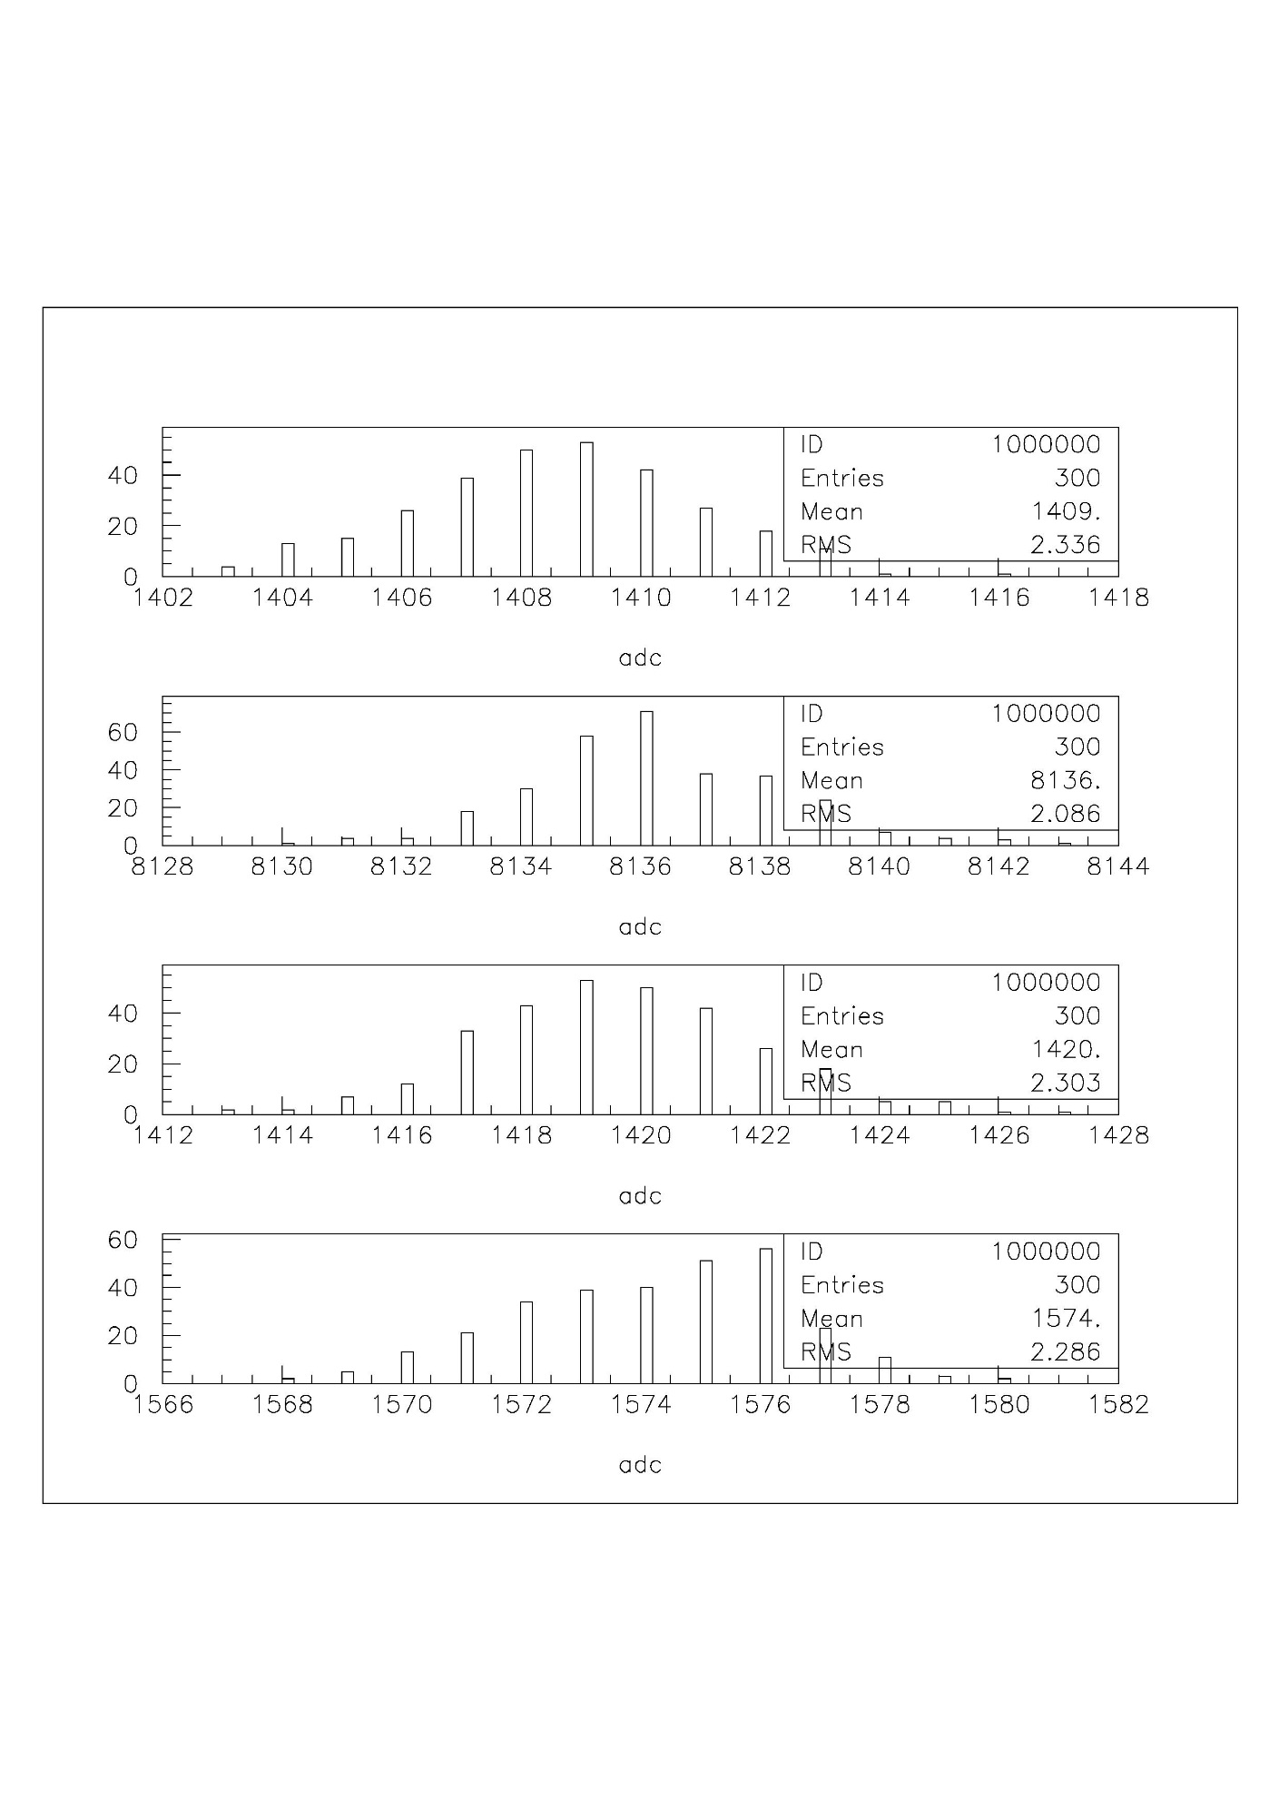
adc
ADC Board Performance
(baseline, no signal)
Channel 1 without offset
Baseline
(average ADC)
Ch 0
nhits
Channel number
adc
Ch 1
sigma
nhits
Baseline
(sigma)
adc
Ch 2
nhits
Channel number
adc
Ch 3
nhits
adc

Slide 14
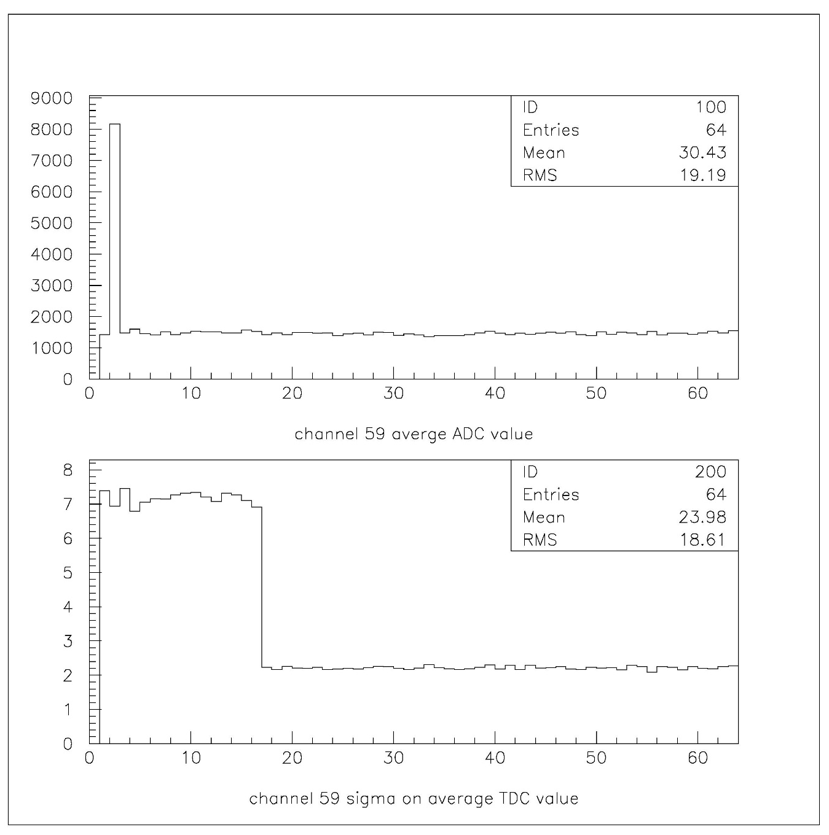
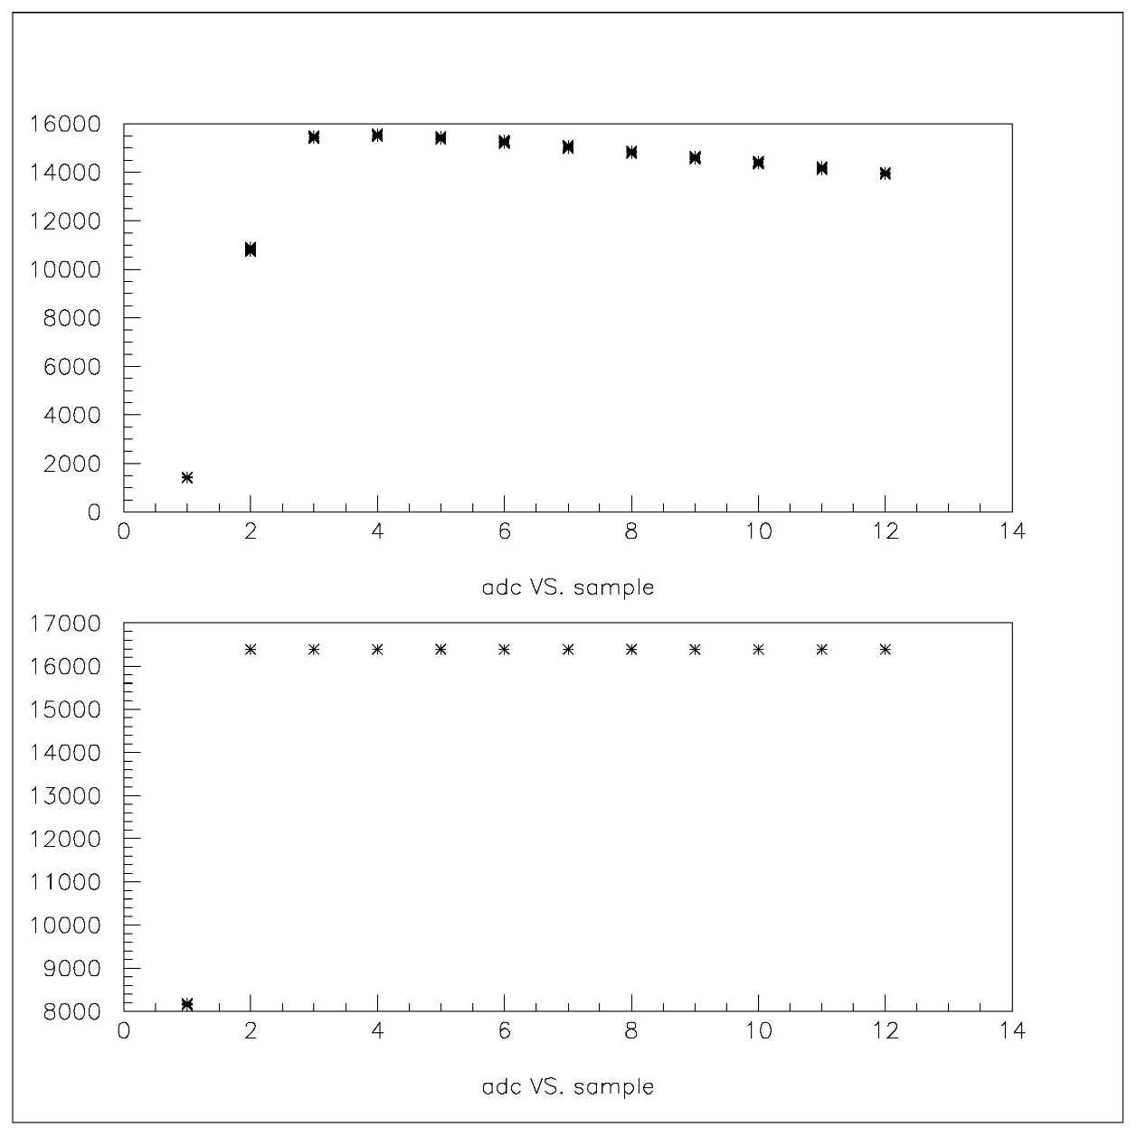
adc
ADC noise test with
existing HBD preamp
Baseline
(average ADC)
adc
Channel number
sigma
Baseline
(sigma)
Channel 0
Sample number
Channel number
Channel 1
adc
Sample number

Slide 15
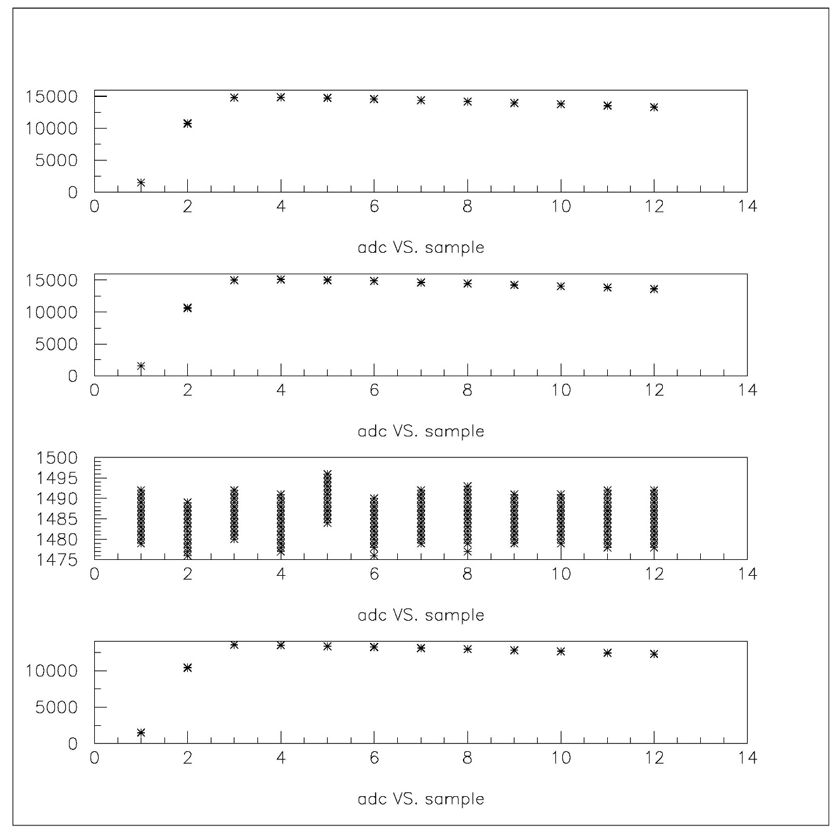
Cross Talk Study
adc
Cross talk with
existing HBD preamp
(similar rise time)
6 meters of 2mm HM cable
adc
Channel 9
Sample number
adc
Channel 10
Sample number
adc
Channel 11
Sample number
Channel 12
Sample number

Slide 16
Production Flow
Last prototype cycle of the electronics should dress production needs.
  Testing, yield etc.
Parts and Printed Circuit Boards (PCB) procurements.
  Work with distributors on getting the parts.
  Work with prototype PCB vendors.
Board assembly.
  Have a preproduction run.
  Work with prototype board assembler.
  Schedule the board delivery to match with testing flow.
    Feedback to assembler.
Testing
  Set up at least 2 test stands.
    One for testing. The other one for debugging.
  Probably can do at least 10 boards a day.

Slide 17
Cost of the system
The design of the digitizer is to minimize the cost of the system.
  Compact 6U design.
    Save space reduce the PCB cost. Saving the rack space. Easy handling.
  Use low cost FPGA to handle all ADC data, event data flow and Level 1 trigger primitives.
Except for the clock master module to interface with GTM system, we have design reset of the system excluding the trigger portion.
  We have asked our vendors for budgetary quotes.

Slide 18
Status and Outlook
Prototype modules of ADC, Controller and Backplanes have been build.
  Testing ongoing. So far it is O.K.
  XMIT module will be complete before end of the year.
Prepare to use the new system for upcoming testing beam
  readout system with 2 ADC modules, 128 channels.
Need to test trigger primitives output.
Need to address the test system for the ADC analog inputs.
Some modification to the design/layout may be necessary for the 2nd round prototype
  Enhance testing features.

Slide 19
Backup Slides

Slide 20
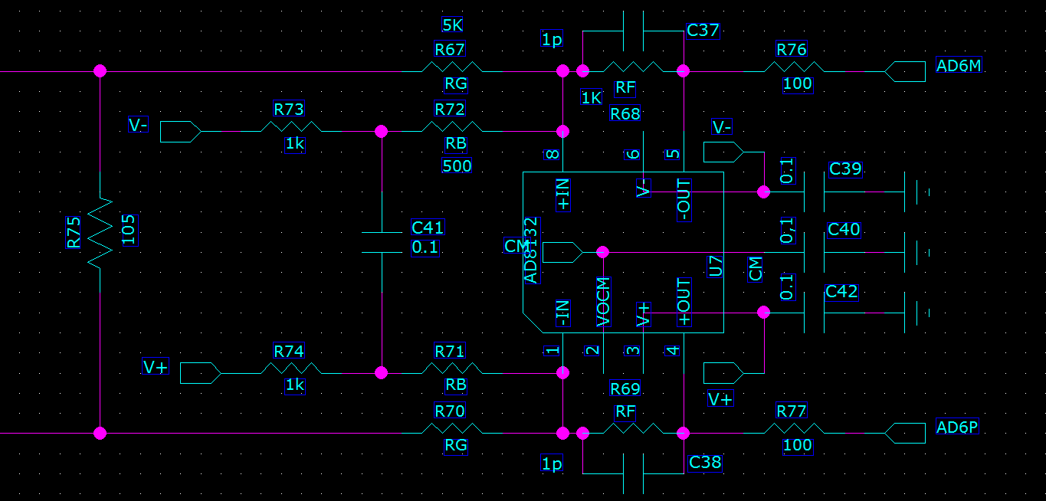
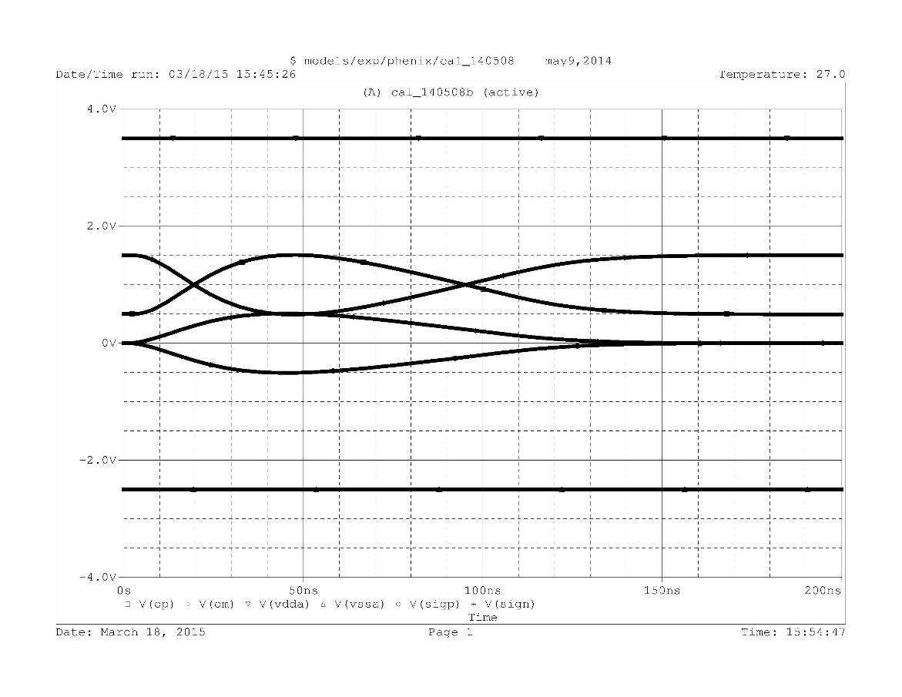
500
Differential Receiver
The ADC module will receive the signal from the
On detector module.
The signal will be AC coupled. The blocking capacitor will be on the frontend.
The ADC’s Vcommon is at 1V. With the signal swing +-0.5v among Vcommon. To get full range
of the ADC, the signal need to swing in both direction. The signal from the detector only swing in one direction.
We offset the differential receiver to push the baseline to the lower ADC range.
The resistors are discrete components. Supply voltages are adjustable through resistors.
V+
out-
out+
Input +
Input -
V-

Slide 21
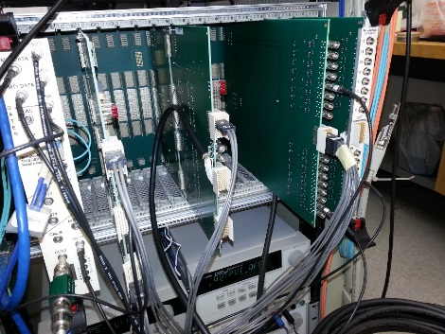
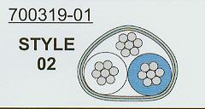
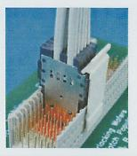
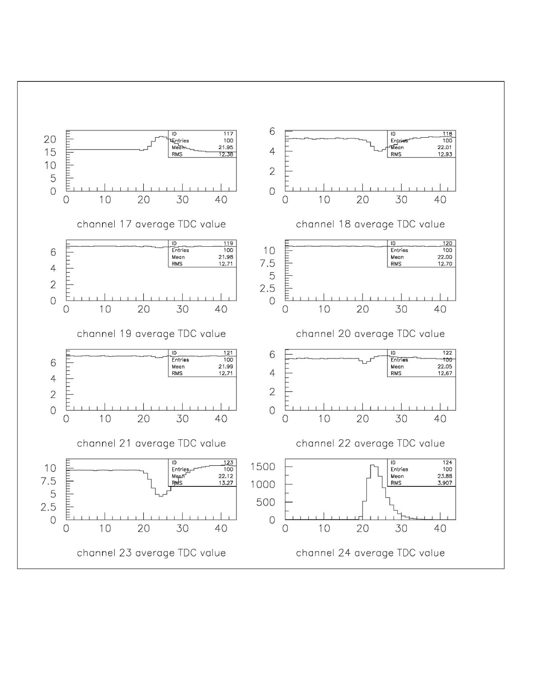
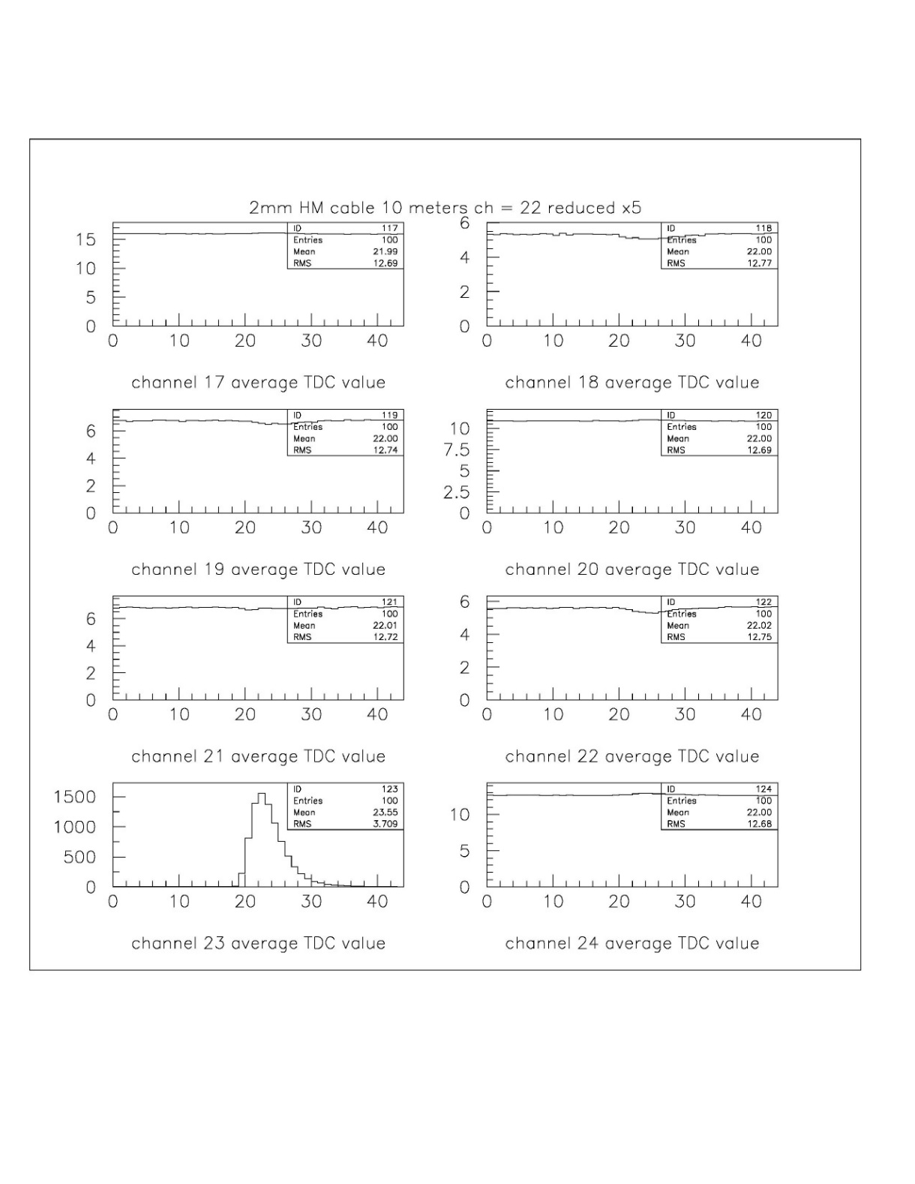
SPHENIX cable
cross talk study
10 meter Amphenol mini-SAS
extend distance cable
2mm HM cable 10 meters
~0.25%
~0.05%

Slide 22
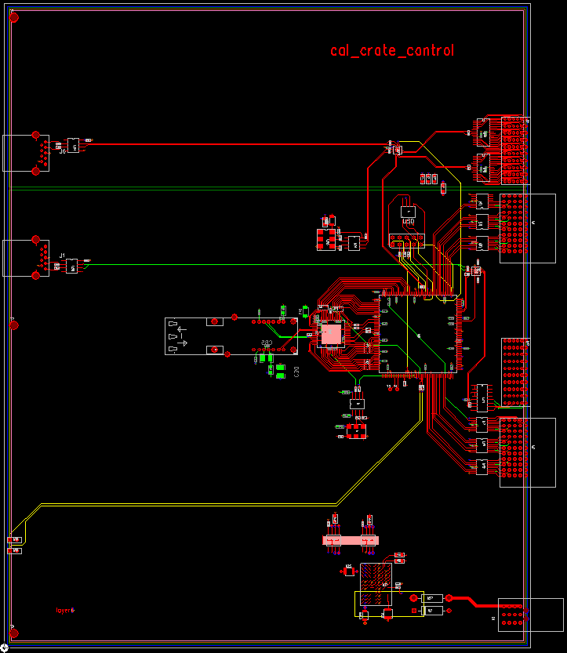
Crate Controller
Receive clock and L0 (init, test etc), L1 trigger.
Receive slowdown load from DAQ system.
Write ADC’s module FPGA boot code to the EPROM.
Write ADC, XMIT & Controller modules running parameters.
Download varies table.
Download fake data
Initialize system. Set online/offline system
Provide offline clock/L0 data, L1 trigger.
(standalone crate running)
Provide readback from ADC module to computer.
clock in
USB 3.0 connectors
readback
Serialized L0,
L1 Data in
Offline
Clock
crystal
Optical link from
JSEB II (3 Gbits/sec)
Slow control/
download
Power

Slide 23
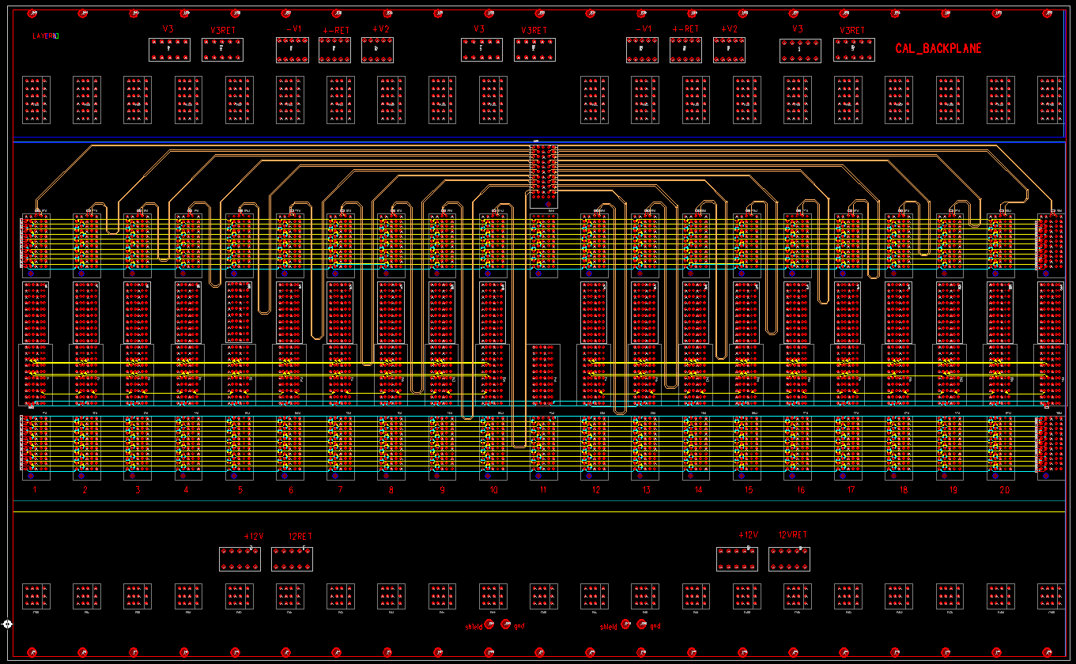
Crate Backplane
Analog Power Section (ADC power, +- differential receiverpower)
Point to Point
clock fanout
Readback bus
Crate Controller
Token Passing Dataway
Token Passing Dataway
Slow control/download bus
Digital Power Section

Slide 24
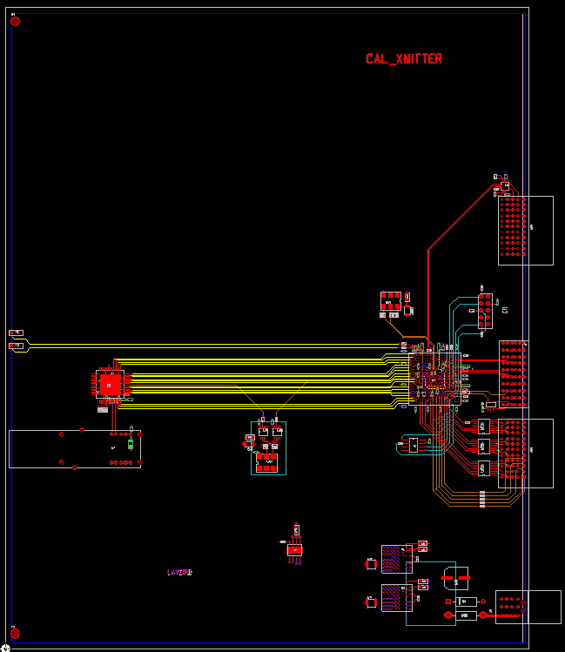
XMIT Module
Clock in
. Receive data from FEM
. Issue token after receive all data transfer
. Format FEM data ( header and checksum)
. Error handling
Altera
Cyclone IV
FPGA
Token
Passing
Data
In/out
Token
Passing
Data
In/ token out
Serial
Command
input
Optical transceiver
To DCM II
(1.6 Gbits/sec)
Digital
Power

