Slide 1
The next 7 slides is what Bill’s simulation shows.
All plots shows what ADC see, after the shaper.
  Last slide add in the subtracted ADC samples
    V(ADC)- V(ADC-delay)
The variable are
  200ns cables or very short cable
  Termination at base or no termination
  Signal strength (typical or 9x typical)
    Typical is some arbitrary defined signal used in the simulation
    9x typical is used to over drive the shaper

Slide 2
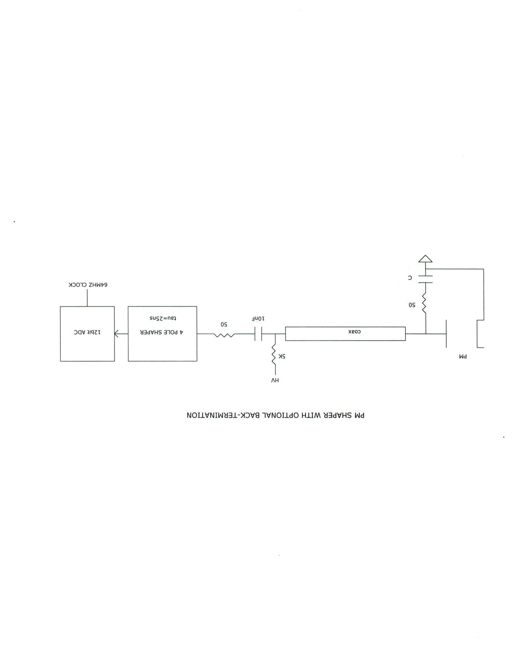

Slide 3
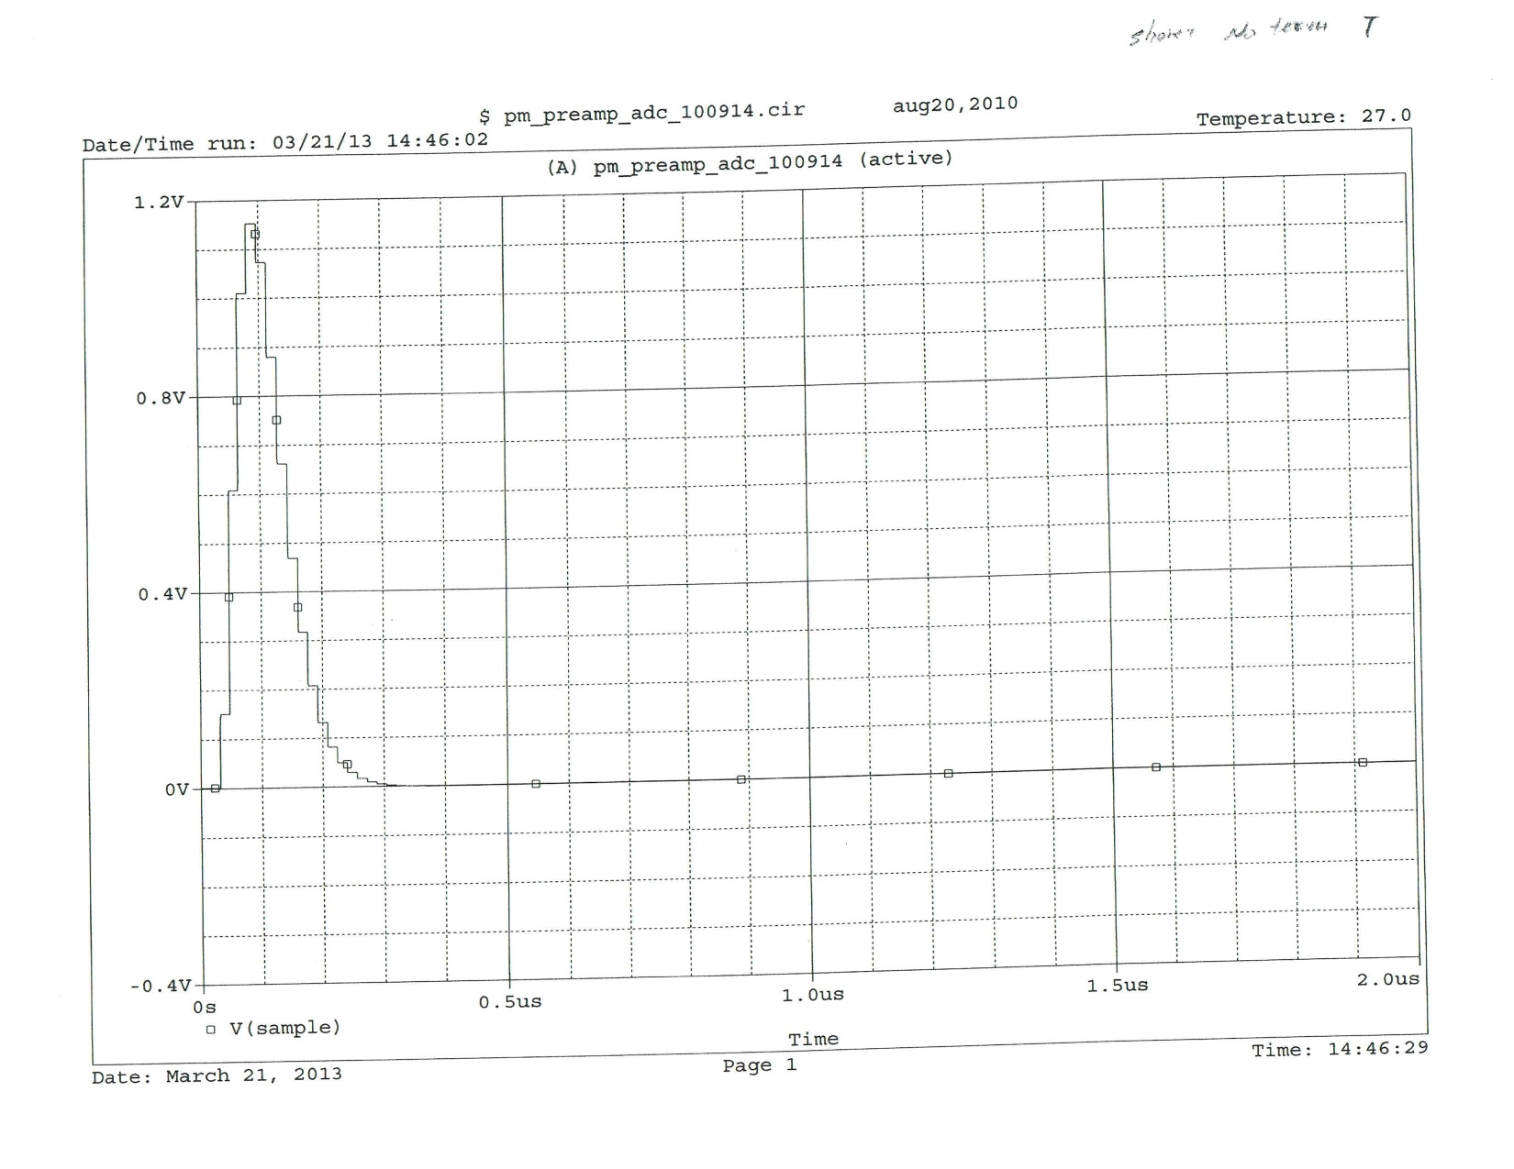
short cables, no termination, T

Slide 4
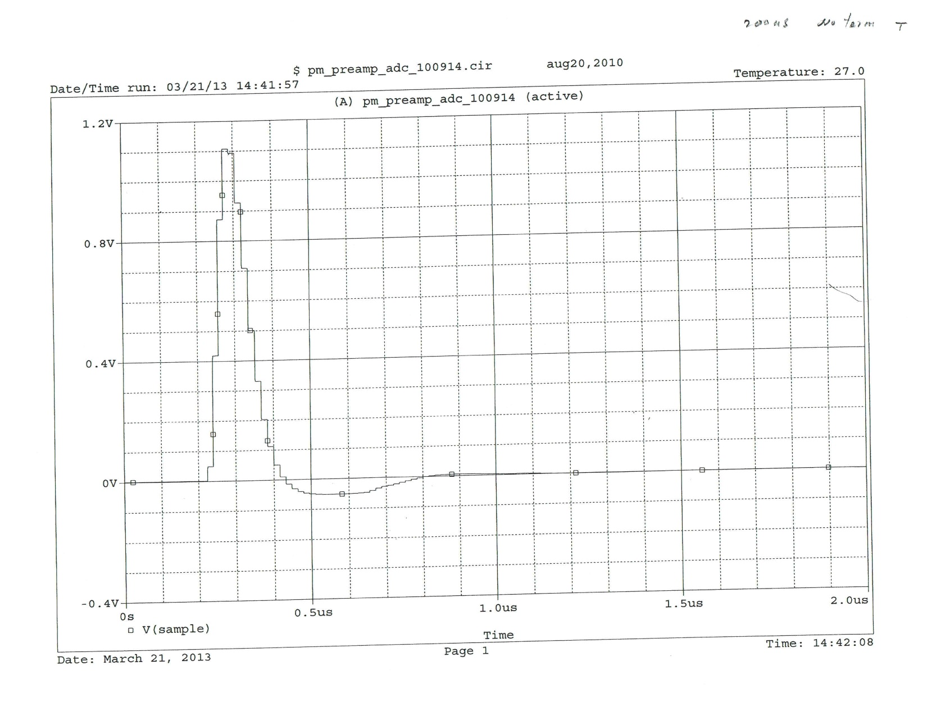
200ns cables, no termination, T

Slide 5
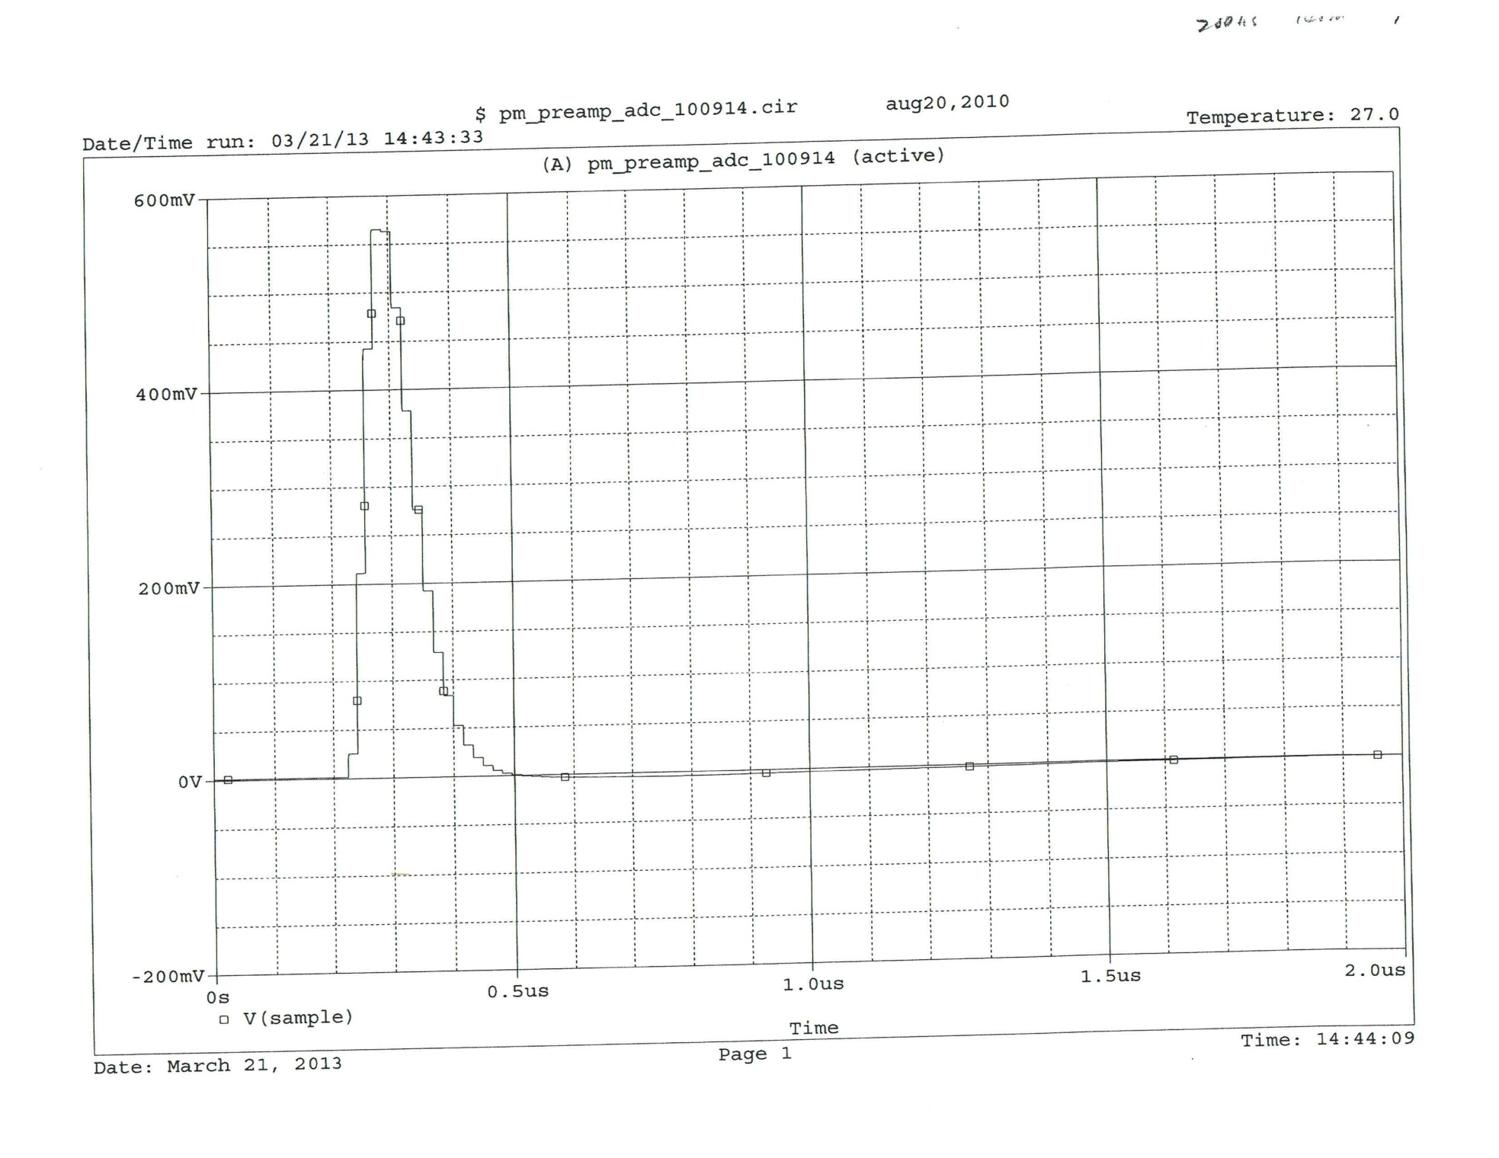
200ns cable, termination, T

Slide 6
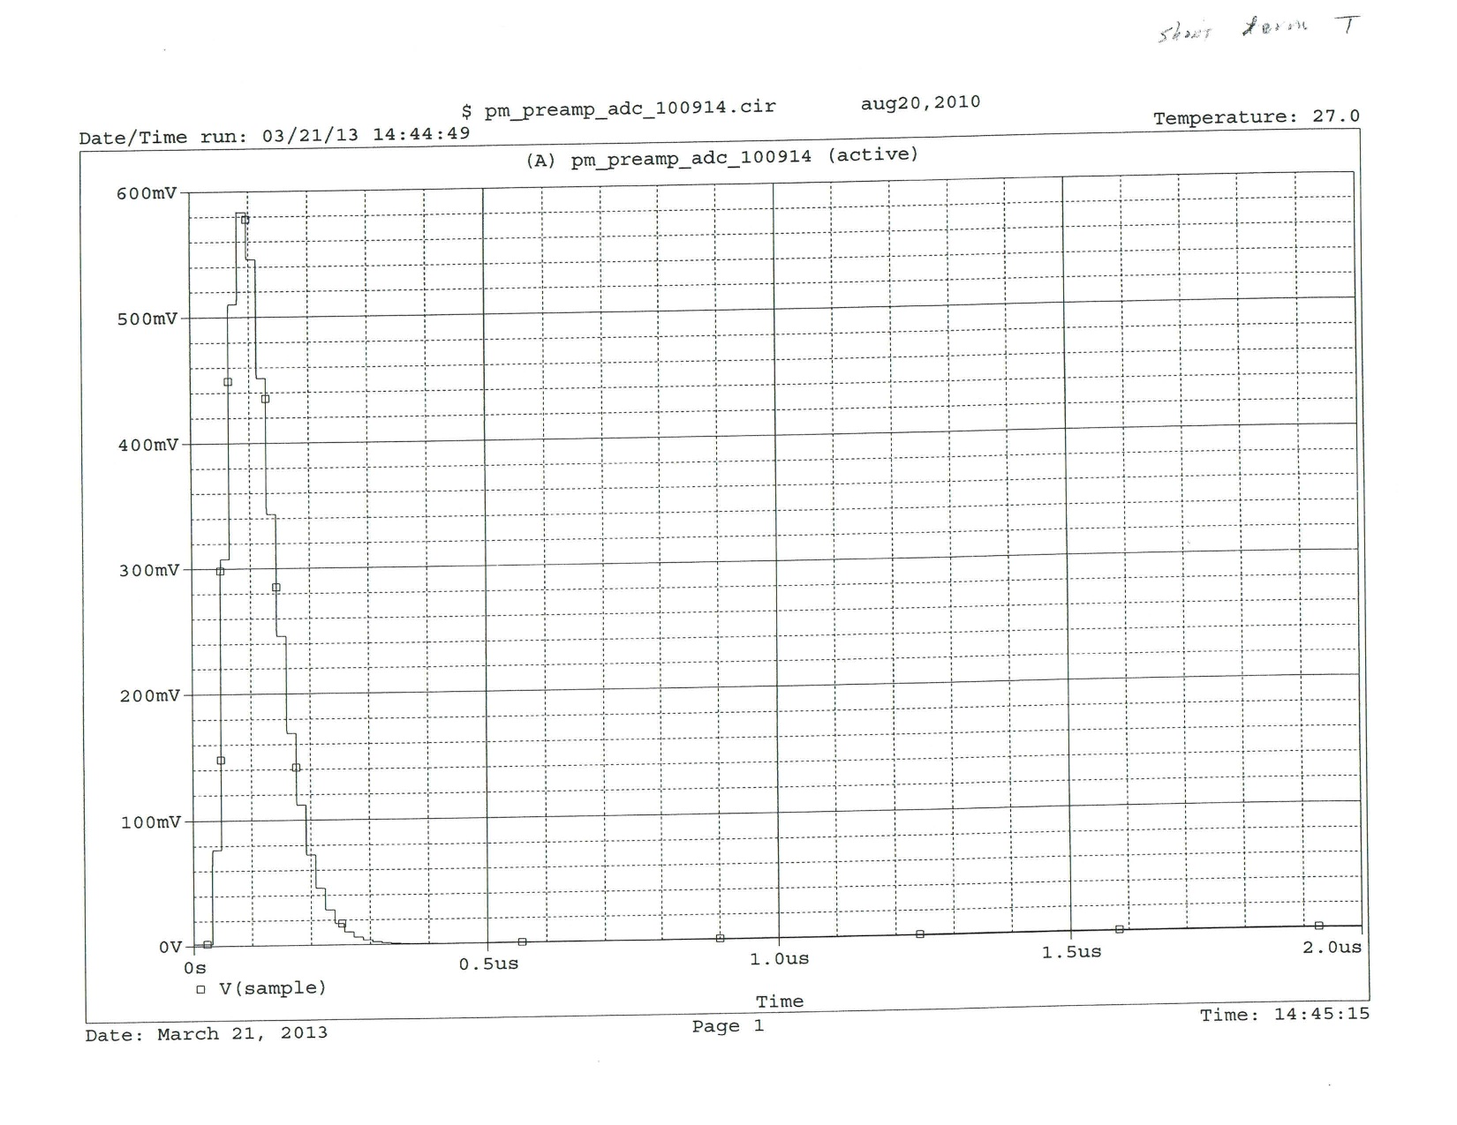
short cables, termination, T

Slide 7
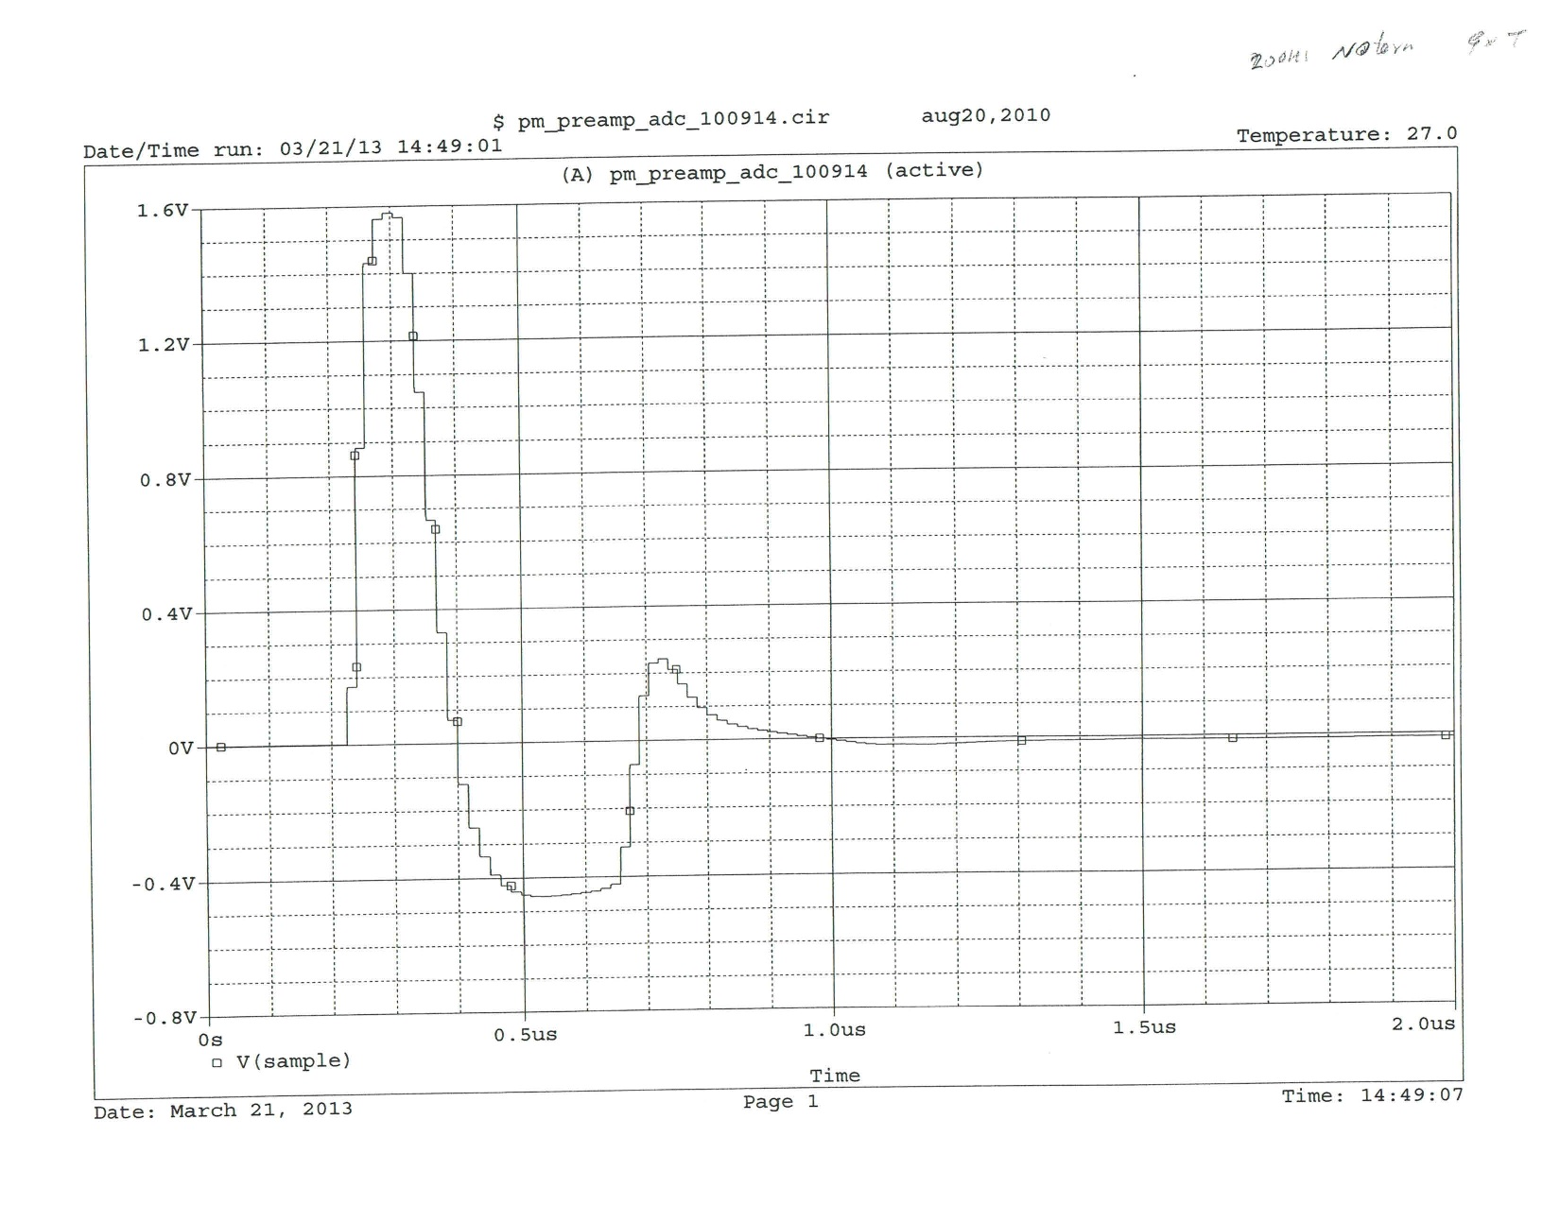
200ns cables, no termination, 9XT

Slide 8
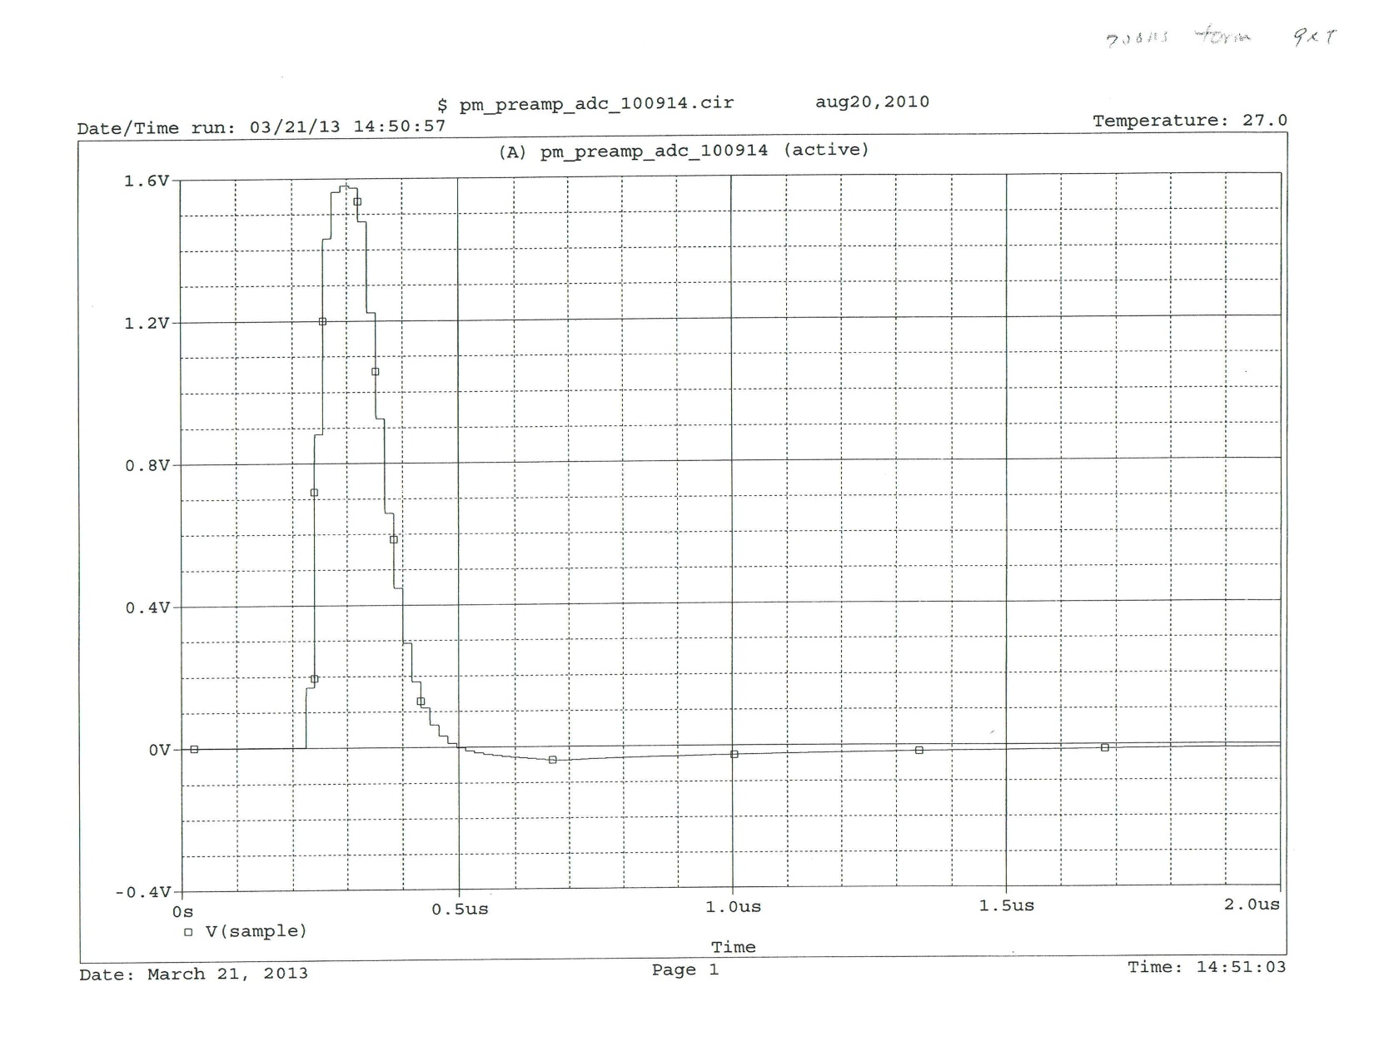
200ns cable, termination, 9X

Slide 9
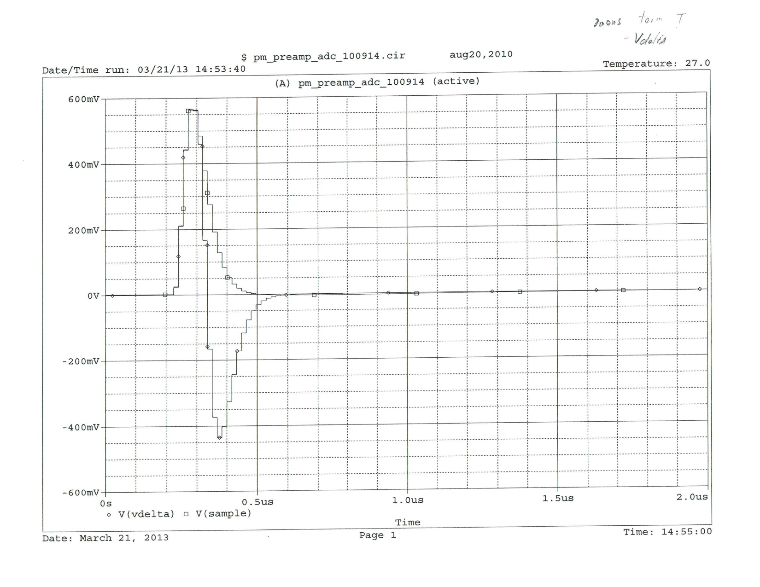
200ns cables, termination, T
Subtracted samples

Slide 10
