Slide 1
sPHENIX Local Level 1 Review
Overview
Hardware
Algorithm
EMCAL data processing, Jet, Pair
L1 latency discussion
Data Alignment issue
FPGA flash memory.
Test data/monitor
Hardware modification
More stuffs to be done.

Slide 2
Calorimeter Level 1 trigger
Receive trigger primitives from
EMCAL has 96(eta) X 256 (phi) channels, 0.025 eta and phi
HCAL 1536 each, =24x64 channels (per inner or outer HCAL) 0.1 eta and 0.1 phi
MBD 128 channel, charge and time measurements
These systems use calorimeter digitizer module (64 channel per module) as front end module.
Generate
Send possible Pair trigger, Jet trigger and interaction trigger (MBD) candidate to Global Level 1 trigger
FEMs
Local Level 1 trigger
Global Level
1 Trigger

Slide 3
Issues
Local level 1 trigger is strange system to prove it works
It is not practical to test system as whole
Too many inputs, have to test slice by slice….
Hardware
Is system design meet the running requirements??
How can we proven the system works??
Make sure input and outputs works
Firmware
Can we the FPGA design meet the 1st cut physics requirements??
Pair trigger
Jet trigger
MBD interaction trigger
Resource management
How many bits can fit into one fiber??
How many fibers one can stuffs into one FPGA.
How much resources inside FPGA…

Slide 4
HARDWARE CHOICE
FEM
The EMCAL dominates the channel counts → 24,576
overlapping sum → neighbor problem
Choose a complete z section slice, will grabbing data from neighbor slices.
Slice needs to be wide enough to reduce the cross stitching problem
Each 64 channel -> 1 optical fibers
Map 24 input fibers to 1 FPGA..
16 (phi) X 96 (z)
8x8
channel
cross
stitching
256 channel in phi
cross
stitching
96 channel

Slide 5
LL1 Block Diagram
EMCAL
GL 1
Overlap 2x2 of 2x2 sum
Peak
finder
Pair trigger
FEM
receiver
Cross stitch
8x8 sum
inner/outer HCAL
2x2 sum
JET trigger
FEM
receiver
HCAL
FEM
receiver
Interaction window / charge
MBD

Slide 6
24
24
24
24
24
EMCAL
L1 data
processor
EMCAL
L1 data
processor
EMCAL
L1 data
processor
(inner/outer)
HCAL data
Concentrator
LL1 triggered
Summary data
crate backplanes
(slow control/timing)
Shower Max
8x8 sum
non-overlapped
16 fibers
16 fibers
16 fibers
Pair Trigger
JET Trigger
LL1 data
(JSEB II)
(20 optical links)
Reduced
Trigger
Data
Reduced
Trigger
Data
Global
Level 1

Slide 7
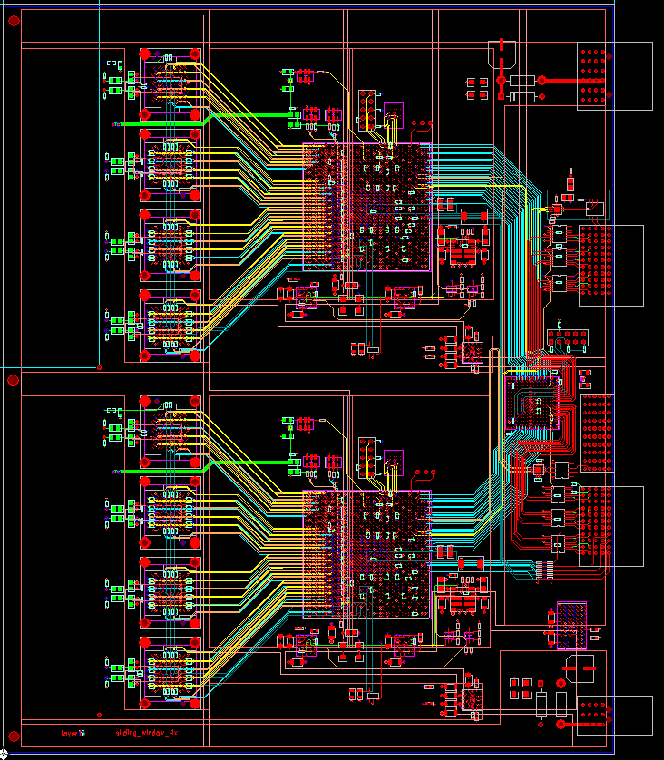
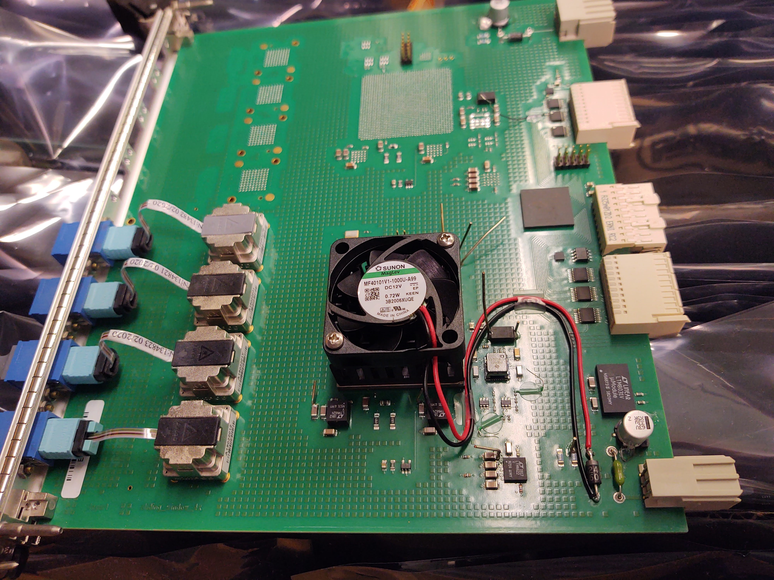
sPHENIX Trigger Board
+12V
in
Build block for local level 1 system
Hosted in the calorimeter digitizer crate
Provide slow control/readback paths
Receive 6x clocks and mode bit (L0 and L1 trigger)
Provide 12V input power
Can not be used together with digitizer board, upper 12V power.
Board size 6U X 190 mm
Supply 12V around 3A
Two reference clocks crystals.
120 MHz FEM link and 156.25 MHz for GL1 & Monitor (JSEBII).
2 building blocks
Each block
36 receivers + 12 transmitters
1 Arria 10 FPGA
2 half modules + 1 full module assembled.
6x
clock
Download
path
12 ports
transmitter
FLASH
Memory
Mode
Bit in
Reference
crystal
Readback
path
Altera
Arria 10
FPGA
3 12 ports
receivers
0.9V
0.95V
1.8V
2.5V/3.3V
optical
+12V
in
2.5V

Slide 8
Digitizer Crate
The Calorimeter digitizer crate system provides
Interface with GTM through clockmaster Module
Timing and L0, L1 timing information
Slow control download and readback
Mechanical support
Power entry…

Slide 9
The Digitizer Subsystem Technical Overview
Crate based system.
Signals are cable from the on-detector electronics.
Digitized with 14 bit ADC.
Receive timing information the SPHENIX Granule Timing Module (GTM)
Generate L1 trigger primitives
Receive L1 trigger and send out L1 triggered event data to Data Collection Module II (DCMII).
Provide buffer for both the 40 beam crossing L1 delay buffer and 4 L1 triggered events
Clock are fanout point to
point through the backplane
Trigger
out
crate
Trigger
out
Slow control/readback
bus, L0, L1 trigger
Token passing
dataway
Token passing
dataway
Controller
ADC
ADC
XMIT
3 ADC → XMIT
(rack based)
detector
clockmaster
3Gbit/sec
optical link
1.6Gbit/sec
optical link
Slow control/readback
Beam clock,
L0, L1 trigger
GTM
JSEB II
DCM II
PC
SPHENIX DAQ System

Slide 10
Arria 10 FPGA
20nm technology, 10AX570N4NF40I3G
48 transceivers, 6 Gbps upper limit.
570K logic elements → 868K registers
1800 20Kbits memory block → 35 Mbits
3000 18x19 multipliers.
Mostly useless for our application…
Core voltage → 0.9V, transceiver voltage → 0.95V, I/O voltage → 1.8V, 2.5V for optical interface.
Transceiver block is separated from core block.
Easy routing

Slide 11
Optical ports
Avago/Foxconn/Broadcom 12 port transmitter/receiver
AFBR-814/AFBR_824 (MiniPot)
Plug in module, size 21.95mmx 18.62mm
Optical wavelength 850nm – up to 150 meter with OM4 4700 Mhz-km fiber.
Up to 10 Gbits/sec
Use 2.5V and 3.3V
Use light turn connector cable → MPO outside
12 fibers
Use flat cable
Last order data 3/18/2021
No replacement alternative…

Slide 12
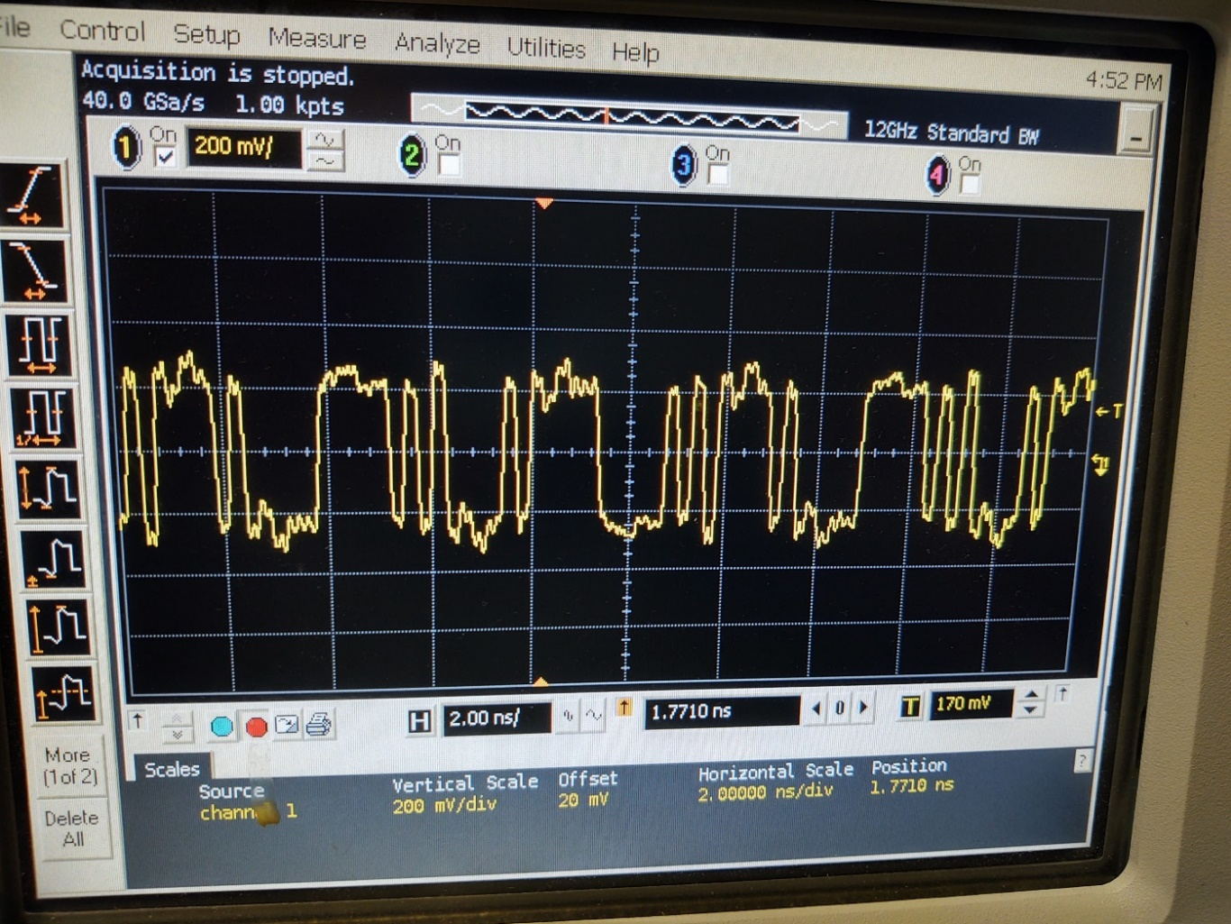
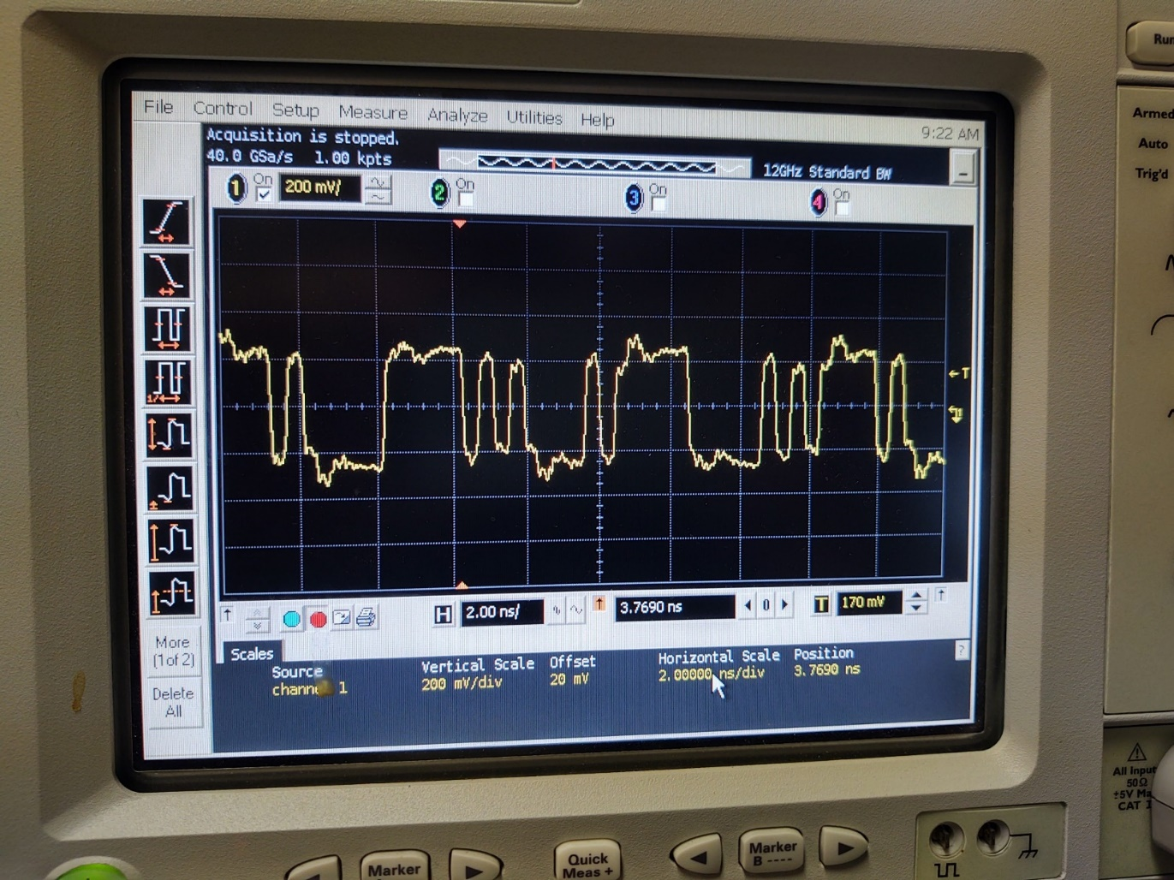
Differential probe at the receiver
100 ohms terminations
3.6 Gbps
100 ohms terminations
2.4 Gbps Gbps

Slide 13
Optical Port Test
transmitter
JSEB II
(PCIE)
controller
EPLD
ECC encoder
receiver
2.4 Gbps is done through 16 bits word Altera
Transceiver interface.
4.8 Gbps is done through 32 bits word Altera
Transceiver interface.
ECC decoder
receiver
receiver
FEM
ECC encoder
Test both 2.4 Gbps and 4.8 Gbps through Transmitter → receiver loopback
Through 1000 words packet, random number.
Over 20M+ packets on some board on full board, no error
Over 1+M packets on all the ports, no error with ECC detection
1 M packet = 10⁶X10³X16 = 1.6X10¹⁰ bits.
Tested FEM → L1 trigger prototype module
1000 words packet, random number.
Over 2+M packets, NO ECC errors (recovered or fatal error) with ECC correction.

Slide 14
EMCAL processing flow
Neighbor
slice
Optical
receiver
Stitching/
alignment
Overlap
4x4 sum
Peak
finding
Priority
encoding
sorting
Neighbor
slice
8x8 SUM

Slide 15
sPHENIX ADC Module Block Diagram
RHIC beam clock 9.6MHz
Analog
Device
AD9257
8 channel
14bits
65 MHz
ADC
7X ADC clock
+4V, -3.5V, +2.5V
Power
+- 3.5V, -2.5V
Differential
receiver power
+1.8V analog
ADC power
+1.8V digital
ADC power
F
R
A
M
E
Serialized ADC DATA
ALTERA Arria V GX
BB1D4F35
1152 pins FPGA
6x beam clock
Beam phase,
init, L1
Differential
receiver
De-serializer
D
P
U
2 mm
Hard Metric
Token
Passing
Data
two transceivers
64 channel
ADC board
Clock
Fanout
L1
Delay
Buffer
5 L1
Accepted
Event
buffer
Serialized
Token
Passing
6 X beam
clock
Serial
command
two transceivers
2 mm
Hard Metric
L1 trigger primitives
transceiver out
De-serializer
command/
offline data read
Differential
receiver
F
R
A
M
E
Serialized ADC DATA
Bused command
Serial data
Analog
Device
AD9257
8 channel
14 bits
65 MHz
ADC
3.3V
LDO
3.3V
LDO
DC/DC
switch regulator
4V
+12V
Power
7X ADC clock
2.5V FPGA I/O
DC/DC
switch regulator
1.5V
LDO
1.1V
core

Slide 16
Cal trigger primitive Generator (preliminary)
6X BC clock
12X BC Clock
120 MHz clock
delay
+1
+2
+1
+ 1 BC + 2 12X
4 bits trigger phase
Dual port memory
Baseline
subtraction
Lookup memory
(1024X10)
10 bits
2X2 SUM
(12 bits output)
only use
upper 8 bits
Choose one of the of of the 12X BC clock phas for trigger primitive
MUX
128 bits
To 8 16 bits
10X16 bits FIFO
Transceiver
IP
Read
Address
(upper 10 bits)
Read address = write address -delay
Load lookup
Memory from
Slow control
Sub = ADC – ADCpre
If (adcpre > adc) sub=0
64 channels
16 2X2 8 bits sum
Delay a parameter
Probably has 2 clocks offset
1 | 2 | 3 | 4 | 5 | 6 | 7 | 8 | 9 | 10
header | Mod + clock | Sum 1+2 | Sum 3+4 | Sum 5+6 | Sum 7+8 | Sum 9+10 | Sum 11+12 | Sum 13+14 | Sum 15+16
Monitor Delay dual port memory
5 events buffer
To controller
readout
Delay and
# of Sample
adjustable
L1
trigger

Slide 17
MBD Trigger Primitive data path (preliminary)
For 32
channels
Time
SUM
Slewing
Correction
12X9
Trigger
output
Choose
phase
Timing
Block
10X10 lookup table
9 bits
Time
channels
ADCs
Post-Pre
optics
3 bits
10X10 lookup table
Charge
SUM
2.5 Gbps
8 X16 bits words per beam crossing
charge
channels
ADCs
Post-Pre
Choose
phase
7 bits
6X beam clock
ADC clock and discriminator clock are interlock together.. So sample height is fixed for a given PMT pulse time
Beam gate is 25ns → 9 bits range will be 50ps per division.
For the timing block we can choose either fix sample relative to BC, peak finder etc…

Slide 18
Generic Optical Data Flow Diagram
Processing
clock
TX reference
clock
RX reference
clock
processing block
clock
Processed
data
Wide FIFO
Wide Register
input data
Demux
optical
Transmitter
IP
Optical
Receiver
IP
FIFO
mux
Write
(sync)
read
(!empty)
Generic Data format
lst
Fill frame
data
data
data
data
header
Fill frame

Slide 19
BC ~ 9.6 MHz
Beam clock (BC)
1
1 |  |  |  | 2 |  |  |  | 3 |  |  |  | 4 |  |  |  | 5 |  |  |  | 6
1 | 2 | 3 | 4 | 5 | 6 | 7 | 8 | 9 | 10 | 11 | 12 | 1 3 | 1 4 | 15 | 16 | 17 | 18 | 19 | 20 | 21 | 22 | 23 | 2 4
1
6 X BC
24 X BC
120 MHz
Optical
Reference
clock
24X BC (short hand as clock240) ➔ is generated from 6X BC (short hand as clock60)
Beam clock phase is derived from serialized mode bits. 6X BC is the clock from GTM.
Clock240 → system clock for trigger calculation.
Phase bit counter is the drive from the edge of BC with clock240 clock.
Slow control set phase bit counter value to generated “SYNC” bits
Slow control is driven slow control clock from the controller (~3XBC)
Trigger Module Clocks

Slide 20
Cross stitching Align data block
Read address =
Write address -delay
Sync out
sync
bc,sync
Dual port memory
(64X3081)
Alignment register
data
2x2 sums from
neighbor trigger blocks
2x2 sum data is aligned from all inputs.
data is stable for entire BC clock period.
3081 = 8 (phi) * 48 (eta) * 8 bits + BC count (8) + sync (1)

Slide 21
Calorimeter L1 trigger FPGA slide , 24 FEM cover 8 phi slice and complete eta space.
(2x2 sum map)
11 in phi
8 in phi
48 in eta

Slide 22
Peaking finding
2x2 sum
Generate over lapped 4x4 sum
From 11X 48 (phi, eta) 8 bits 2x2
➔ 10 X47 10 bits 4x4 sum
→ 8 in phi and 45 in phi peak finder cell
(valid bit high if SUM > threshold)
Peak finding
Based on
Over-lapped
4x4 sum
03 | 13 | 23 | 33
02 | 12 | 22 | 32
01 | 11 | 21 | 31
00 | 10 | 20 | 30
02 | 12 | 22
01 | 11 | 21
00 | 10 | 20
> | > | >
>= | SM | >
>= | >= | >
If SUM > threshold (common),
Valid =high
d
d
Overlapped
4x4 sum
Peak finding
2x2 SUM

Slide 23
FEM
(8X8)
64 channel
12 | 13 | 14 | 15
8 | 9 | 10 | 11
4 | 5 | 6 | 7
0 | 1 | 2 | 3
2x2 sum
ordering
FEM
(8X8)
64 channel
FEM
(8X8)
64 channel
FEM
(8X8)
64 channel
FEM
(8X8)
64 channel
11 in phi
overlapped data to
neighbor slide
8 in phi
FEM
(8X8)
64 channel
FEM
(8X8)
64 channel
FEM
(8X8)
64 channel
FEM
(8X8)
64 channel
FEM
(8X8)
64 channel
FEM
(8X8)
64 channel
FEM
(8X8)
64 channel
FEM
(8X8)
64 channel
FEM
(8X8)
64 channel
FEM
(8X8)
64 channel
FEM
(8X8)
64 channel
FEM
(8X8)
64 channel
48 in eta

Slide 24
Sorting procedure
After peak finding algorithm, a single phi slide of overlapped 4x4 sum is 45 wide array.
The tower sum pass the threshold is represented in the valid bit array, valid bit =1
Expend the 45 wide array to 48 wide array i.e.
valid[0:48] = 1’b0, valid[0:44], 2’b0
Using the Valid bit array and sum value to convert 2 dimension of tower array to a list of the peaks value through
1) priority encoding
2) sorting

Slide 25
Priority encoding method:
1) go through valid bit
1) Cut phi slide into 3 groups, each group 16 channel
2) check with group 1 to see all bits are zero.
if not empty, encode the bit location to 4 bit address start from lowest order channel
till all non zero bits are encoded
if Yes, go to group 2
4) repeat the procedure for group 2 then group 3
5) output the result as list of peak sum and address. Maximum 4 hits per slice
Priority Encoding
1 | 2 | 3 | 4 | 5 | 6 | 7 | 8 | 9 | 10 | 11 | 12 | 13 | 14 | 15 | 16
A Phi slice of
peak
1 | 2 | 3

Slide 26
Merging routine
To avoid the two peak sum value is the same. The data is shift left by one bits.
If the sum is equal add 1 to the sum, start from the top of the array
Sort 8 hits
sort
sort
Optical out
(8 (8 bits address, 10 bits sum) + 7 bits ID + 8 bit BC + 1 empty bit)
sort
8 phi slices after priority encoding
4 hits per slices
Top 4 hits
sort
sort
Optical out
(8 (8 bits address, 10 bits sum) + 7 bits ID + 8 bit BC + 1 empty bit)
sort

Slide 27
8 x 8 sum
8x8 sum ➔ optical out
12 of 12 bits sum value
7 bit header, 8 bits BC counter, 1 empty bit
(2x2 sum map)
Optical out
1
11 in phi
Optical
Out
2
48 in eta

Slide 28
slide window 10 optical port summery
24 input ports from FEM directory
2.4 Gbits/sec, 8 phi slice.
6 cross stitching input ports
3.84 Gbits/sec, 3 phi slice, 24 2x2 sum per link.
3.84 Gbits/sec. Maximum 18 16 bits words → 16 data words → 32 2x2 SUMs
6 cross stitching output ports
3.84 Gbits/sec, 3 phi slice, 24 2x2 sum per link.
2 output ports for emcal 8x8 sum
This has to be reduce to 1 port ???
24 8 bits words + 1 16 bits header words
2 output ports for show max.
Need to reduce to 1 output port.
Depend on how many candidates after sorting.

Slide 29
Jet trigger
16 optical inputs from EMCAL section
16 optical inputs from HCAL section
Data is organized as 8x8 sum from EMCAL (0.2 eta X0.2 phi)
Group into 32 (256/8) X 12 (96/8) array.
Data is organized as 2x2 sum from HCAL (0.2 eta X0.2 phi)
This is done from FEM
Concentrator is needed to pack outer HCAL 24 fibers into 16 fibers
add inner HCAL with outer HCAL.
FEM optical bandwidth 2.4 Gbps.

Slide 30
8 x 8 sum maps
when deal with overlapped 4x4 sum (0.8 eta X 0.8 phi) based on the <8X8> sum
done to find jet peak
extend 1st 3 phi columns to larger phi area → convert cylinder to 2D space.
12 in eta
32 in phi

Slide 31
Pair trigger
16 optical inputs.
Each FEM cover 16 phi X 96 eta. Further divide into 2 slice, 8X96.
The optical data is organized into 3 possible pairs per slices.
One valid indicates slice has non-zero 1st data in array (at least one data is above zero)…
8 bit address, 10 bits data
Need to find 8 bit address sub field.
4 bits phi address will be added to identify the FEM sub address.

Slide 32
Pair Search Path
Phi project view
The phi section is cut into 32 sections.
The pair search path range is +- 1 sections
A new valid bit is created with the possible search.
for example x[0] = v[0] & (v[15] | v[16] | v[17]);
v[x], x= section number.
The priority encoding is done based on the new valid bit.
it generate 12 possible match pairs.
Based the possible match pairs
for each possible pairs 3 hits per phi position X 3 possible opposite connection X 3 hits per connection => 27 possible pairs.

Slide 33
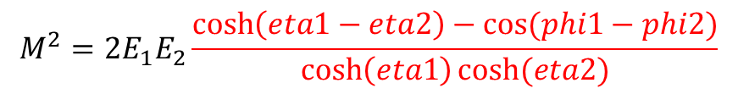
Pair mass calculation
HIT:
Energy ➔ 10 bits
Phi → 7 bits 16 fibers, 2 sub division per fiber, 8 bits address per fiber. < 2bits on phi>
Eta → 6 bits
Mass calculation use
upper 3 bits of eta
upper 3 bits of phi ( this probably a mistake) .. The important parts is phi1 – phi2
all 10 bits of energy
Look up table
12 bits address ( 2 pair’s angle ) with 8 bits output
10 bits multiplier with 20 bits output
Energy 1 X Energy 2
Square Root of E1X E2
Multiplier of 8 bits X 10 bits
Mass cut is done through upper and low mass limits. The limits is loaded by slow control.
$$M^{2}=2E_{1}E_{2}\frac{\cosh\left(eta1−eta2\right)−cos⁡(phi1−phi2)}{\cosh\left(eta1\right)cosh⁡(eta2)}$$

Slide 34
Pair trigger output
If any one of the 27 pairs, pass the mass cut. The Mass value is send out via optical data
One bit indicate mass pass the cut.
There are 12 possible hits through pair finding algorithm.
The trigger output is send out via 2nd reference clock crystal.
156.25 MHz

Slide 36
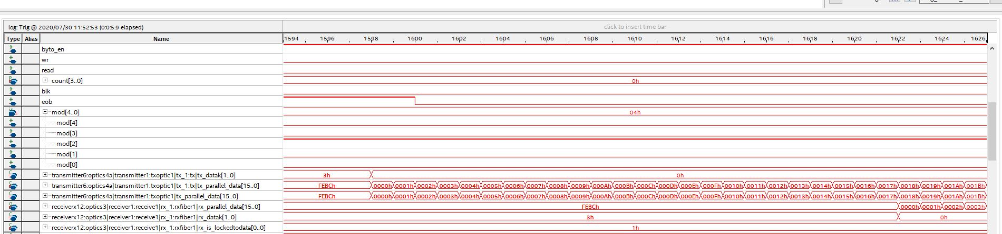
Signal Tap picture for the L1 trigger loopback test.
The transmitter start at 1598.. The receiver start at 1622. The difference is 24.
The clock is tx_out, 120 MHz. clock period 8.333ns.
The delay is ~200 ns…

Slide 37
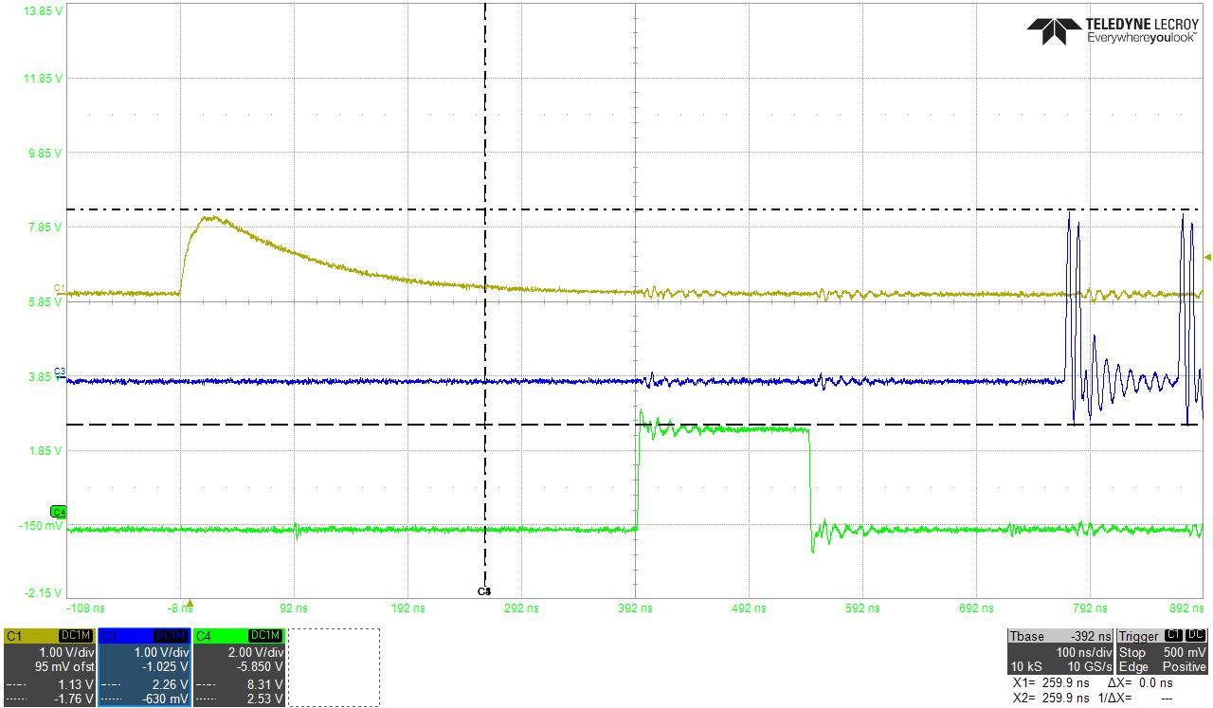
16 clocks
latency
LL1
FEM FPGA
ADC
De-serializer
FIFO
Post-pre
(ADC)
(FIFO)
10 bits X 8 lookup
2x2 channel
sum
Pick trigger
phase
Form
Trigger packet
Optical transmitter
Optical receiver
drop
Lower
4 bits
120 MHz
Crystal
Clock
FIFO
6x BC ~ 60 MHz
100ns per division.
PRELIMINARY

Slide 38
Calorimeter EMCAL cross stitching
3.84 Gbps
LL1
receiver
FIFO
Data re-Map
FIFO
Edge
Transmitter
Edge
receive
FIFO
Delay memory
24X BC ~ 240 MHz
450ns (108 counts with 240 MHz clock)
PRELIMINARY
Alignment
pulse

Slide 39
Data alignment
Three alignment stages
Data alignment on the FEMs side
In 16ns steps, 1 or 2 steps
Adjustment delay steps in the FEM. (not implemented yet)
Alignments on the EMCAL calorimeter inputs
Alignment after cross stitching.
Adjustment inside the Calorimeter trigger module
Not per FEM link

Slide 40
FEM Alignment
Beam
diamond
Sampling clock
uncertainty
Cable
delay
data
hold
Transfer
to trigger
BC
BC
BC
BC
BC
BC
BC
6x beam clock
Shower max window
Shower max window

Slide 41
Trigger FPGA Code Loading
The Trigger board FPGA is loaded through on board 512 MB Flash memory.
Arria 10X570 configuration need 255 Mbits if configuration data is not compressed.
Direct programming of flash memory is through Altera programmer.
Load FPGA factory code → read/write the flash memory through factory code.
Although it is not tested yet, the flash memory should be able to program through slow control and Altera IP core.
It is the same method as digitizer flash memory programming method.

Slide 42
Test data/Monitoring
We have two independent data paths from the trigger data flow
Slow control download/readback path.
Loading test data etc./readback system status
Readout path to JSEB II.
Untested. It use the unused transmitter, receiver(??)
It is not possible to even readout fraction of input data stream into the monitor system
We will use the slow control to issue command, then sample of data stream will be load into registers. We will read the content of the registers.
The test data can be used in the offline mode.

Slide 43
Board modification
There are few things need to be done for the next generation
The cooling heat sink + fan
System can run without cooling fan+ heat sink. But it will heat up quickly without crate fan
It will be attached standard Thermal adhesive. It is too difficult to add machinical constrain.
Add +12V Fan power entry point near the fuse.
Add one address bit for upper and lower FPGA.
Add couple LED.
Except for LED, the Fan power and address bit are already add to prototype board.

Slide 44
Things need to be done
Need confirm our optical communication with JSEB2.
Also going to be used for the GL1 Link.
Need to firm up the L1 latency.
We can use pair trigger + emcal processing block to do this measurement
Except for the optical delay, the processing cycle contribute to the L1 latency is smaller.
Firm up the LL1 to GL1 communication.
The LL1 output…

