Slide 1
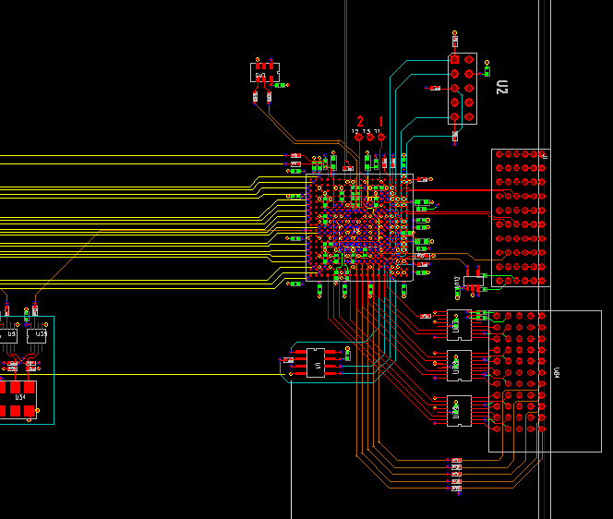
XMIT
Pin 1
J T A G

Slide 2
