Slide 1
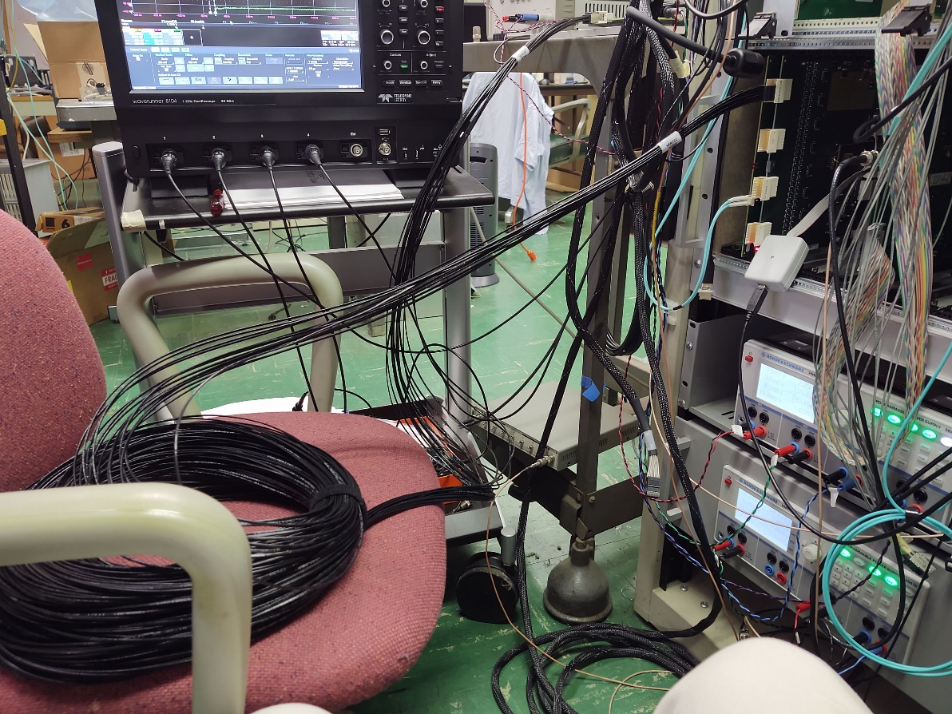
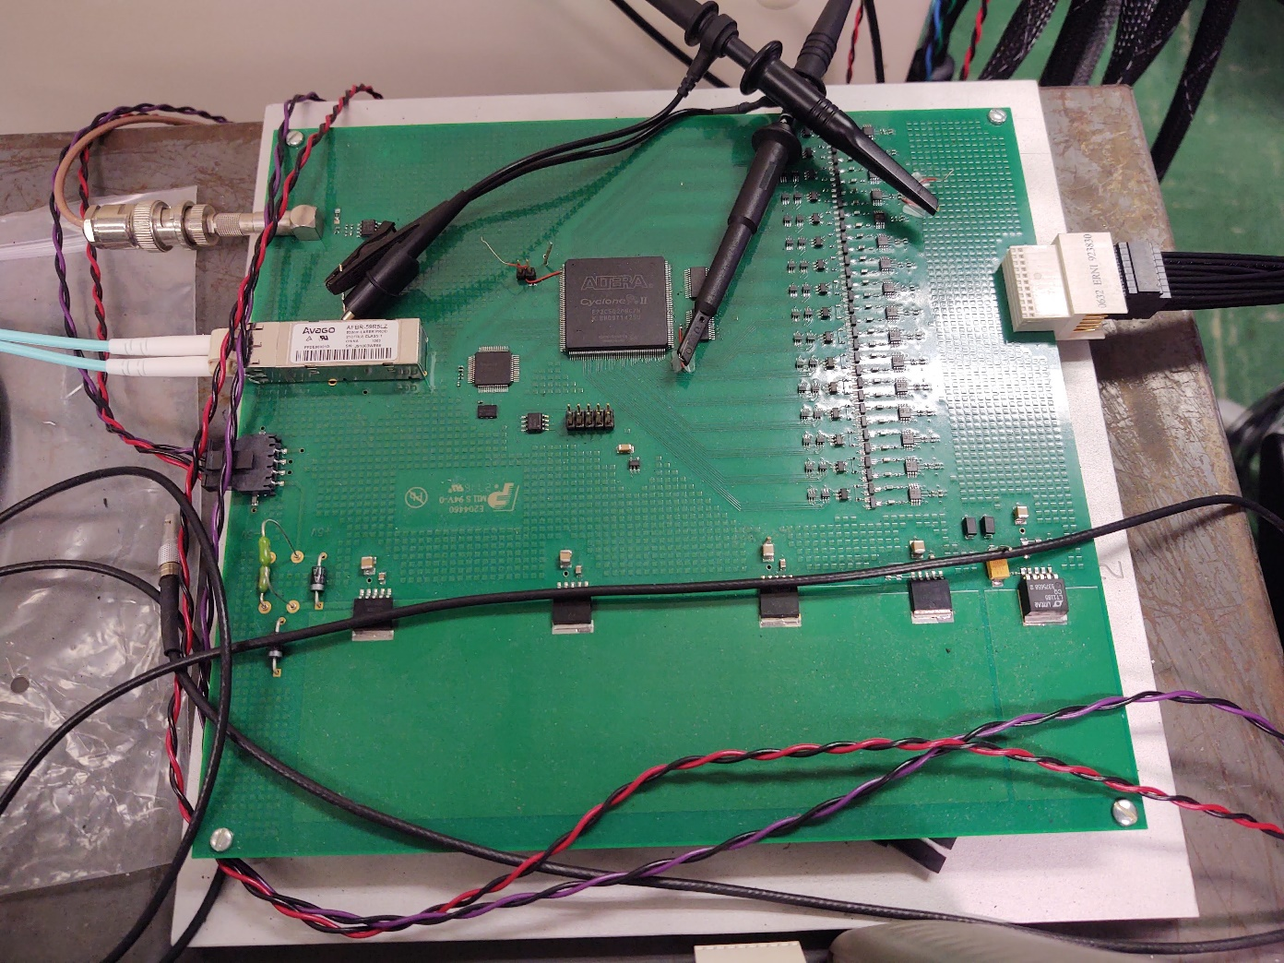
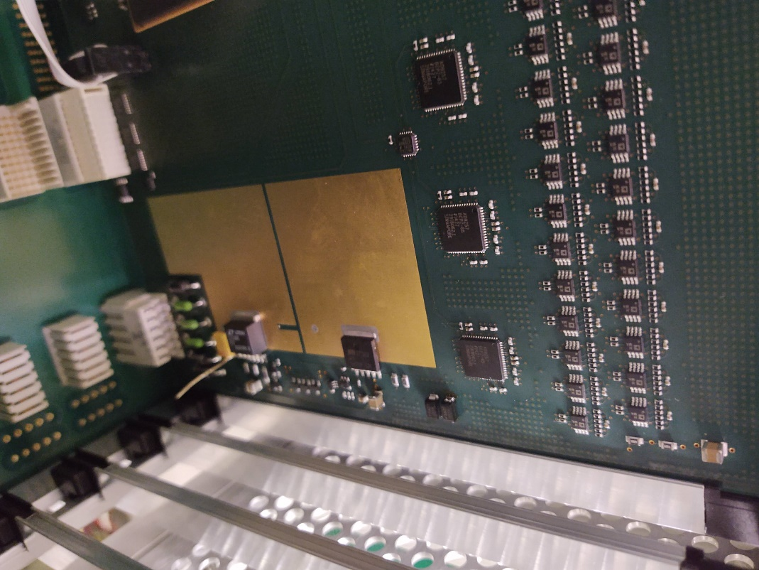
Calibration board output
18 meter signal cable
Adc board scope point
Just before ADC

Slide 2
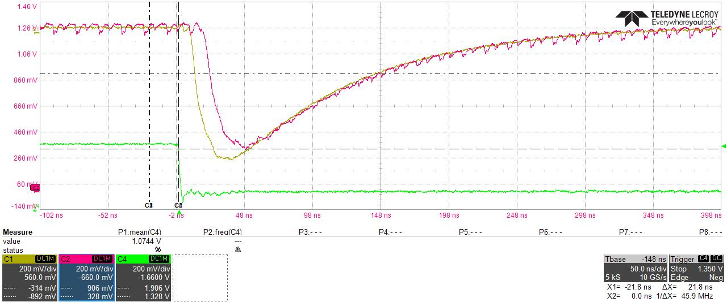
Upper channel output → resistor before ADC
Calibration output
4 feet cable

Slide 3
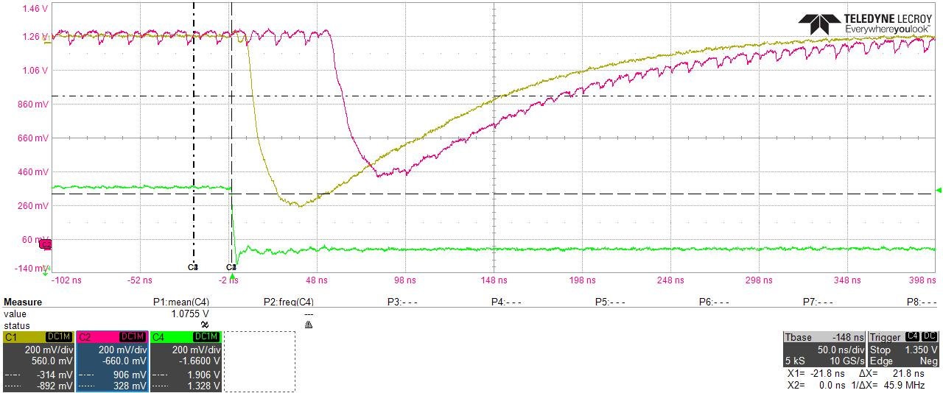
Upper channel output → resistor before ADC
Calibration output
10 meter cable

Slide 4

Upper channel output → resistor before ADC
18 meter cable -- 1

Slide 5
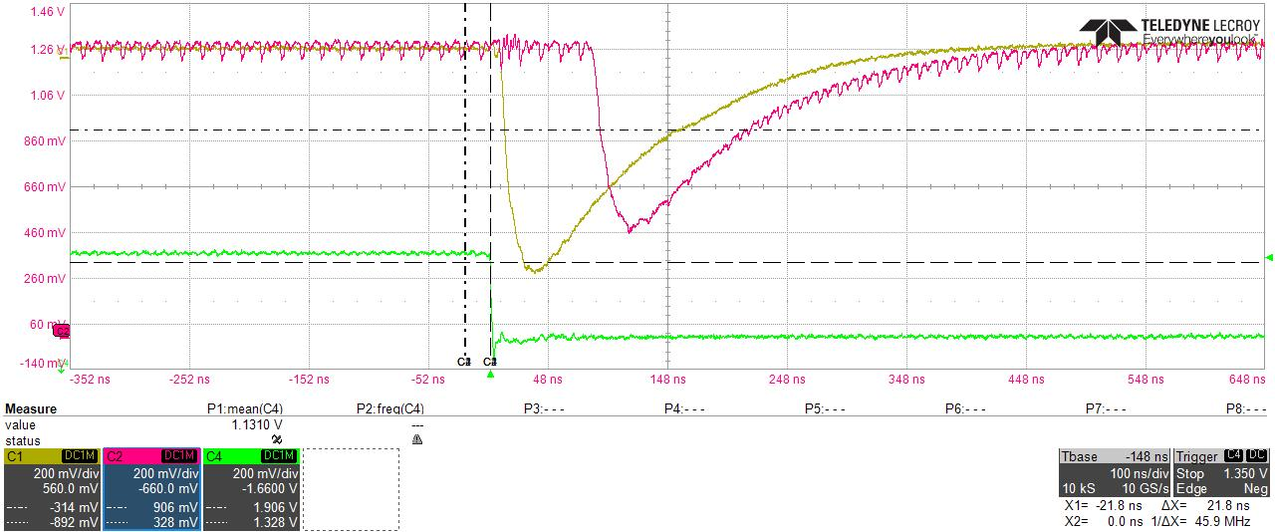
Upper channel output → resistor before ADC
18 meter cable -- 2

Slide 6
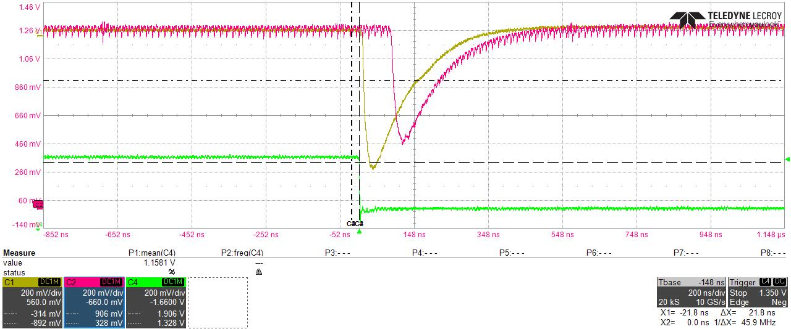
Upper channel output → resistor before ADC
18 meter cable -- 3

