Slide 1
Readout Proposals for FEB2 Radiation Test
2025-04-23

Slide 2
FEB2 Radiation Test Setup Requirements
FEB2 component radiation test requires regular voltage monitoring to measure device I-V characteristics during irradiation
~168 different voltage outputs (less with latest rad board redesign?)
Measurement rate on the order of ~Hz is sufficient
No need for synchronous or periodic readouts
FFTs are not required
12-bit ADC resolution likely sufficient
Readout must connect to radiation board through long cables
Robustness and reliability of readout and data quality most important factor
DAQ operating system or interface choice not too important, can make any option work

Slide 3
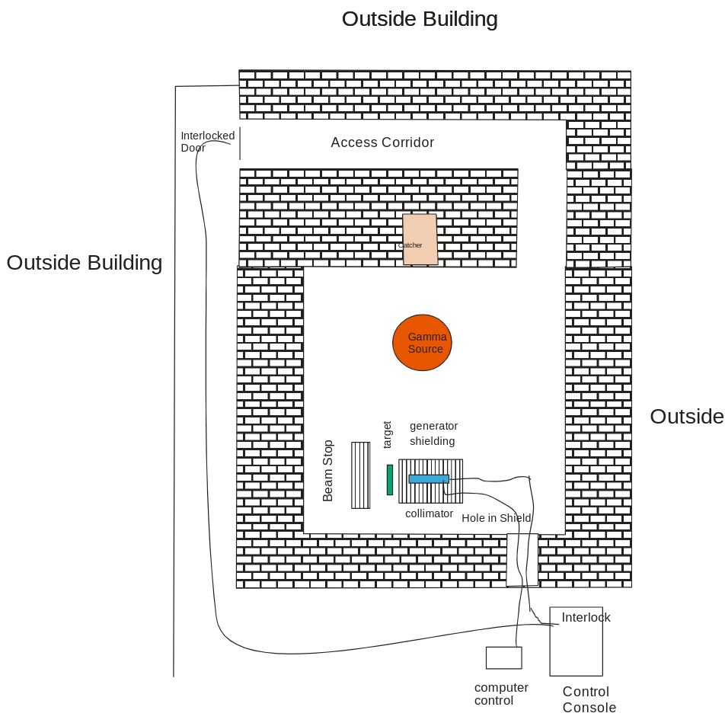
BNL Gamma Facility Layout
Need roughly 10’ cables from target (radiation board) to readout + power supplies

Slide 4
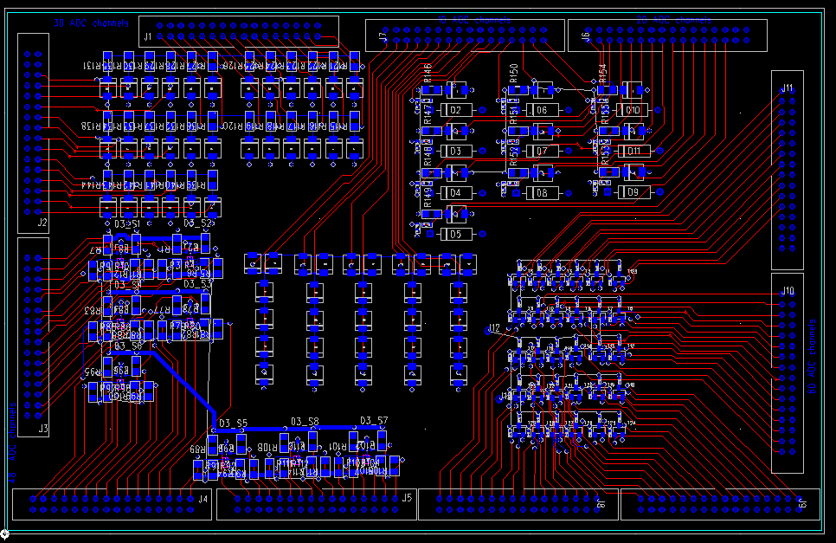
Radiation Test Board (Initial Design, UPDATE)
Radiation test board outputs 168 voltages, of several output types:
48 x PA/S input protection diode monitors
30 x power diode monitors
60 x 3904 beta-measurement monitors
10 x 48V protection diode monitors, 10 x 48V nets (discuss how to measure)
10 x 12V protection diode monitors
Eleven 16-channel connectors output these 168 voltages

Slide 5
Radiation Board to Readout Options
Commercial multichannel ADC or analog input readout
DIY Multichannel ADC readout ?
Demultiplexer to Commercial ADC or Precision Multimeter ?

Slide 6
Commercial Multichannel ADC or Analog Input Options
Surprisingly hard to find affordable options for this number of channels
National Instruments:
Test Scale TS-15100 : 32 ch for ~$500
Requires backplane TS-15000 for ~$300 or TS-15010 for ~$400
Also requires “core” module TS-15050 for ~$160
Requires DC power input via molex connector, 11V-28V
Standalone module : 32 ch for ~$2000 USB-6423, powered via USB
Refurbished modules on ebay, similar price per channel
Analog Devices:
MAX11616EVSYS+ Evaluation System : 12 channels for ~$220 , Digikey
PCI cards (will require compatible PC)
Example Avantech PCI-1713U : 32 ch for ~$500, not including PC
NI option PCIe-6320 : 16 ch for ~$760, not including PC
All options require some type of laptop or PC to co-ordinate readout
Some require Windows PC, can make it work

