Slide 1
Sbnd backplane impedance calculation based on the PCB manufacture stackup.
L3 is for 16 MHz clock line, the impedance calculator is 109.5 ohms
L5 and L7 are 112 ohms for rest of differential line
Trace space is 12 mi.
Trace width is 7.87 mil.
1 oz copper
Substrate Height is 21.6 mil
Substrate Dielectric is 3.68
Sync and L1 trigger routing is not perfect differential line

Slide 2
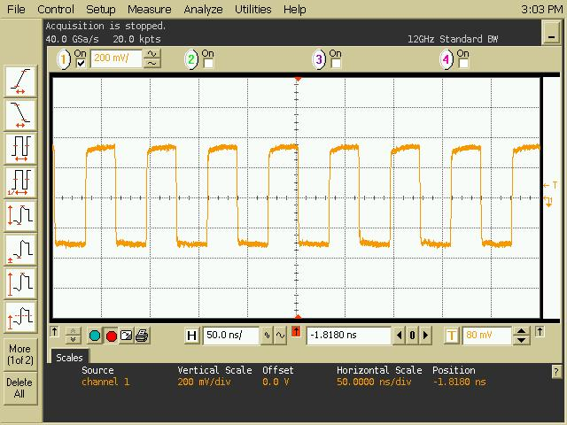
16 MHz on the backplane. – at resistor

Slide 3
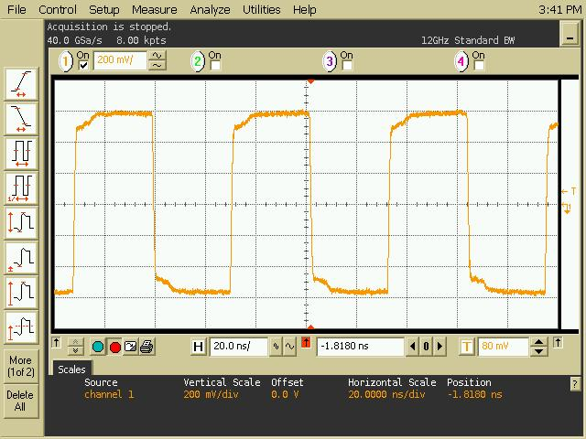

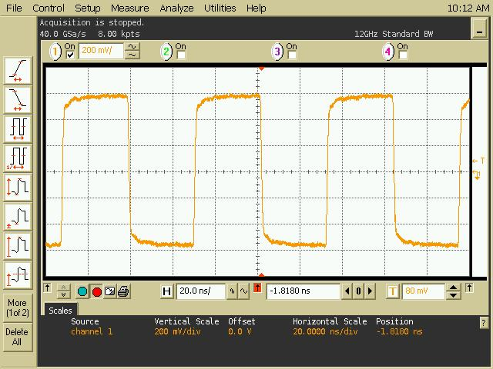
SYNC → connect to 16 MHz clock
Slot 11
Near to controller
at termination resistor
Far end to controller
at termination resistor

Slide 4
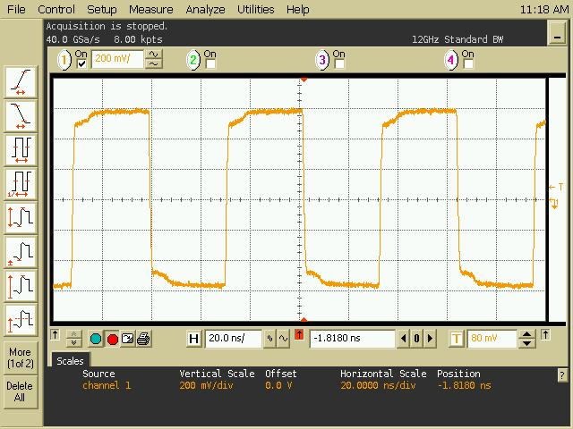
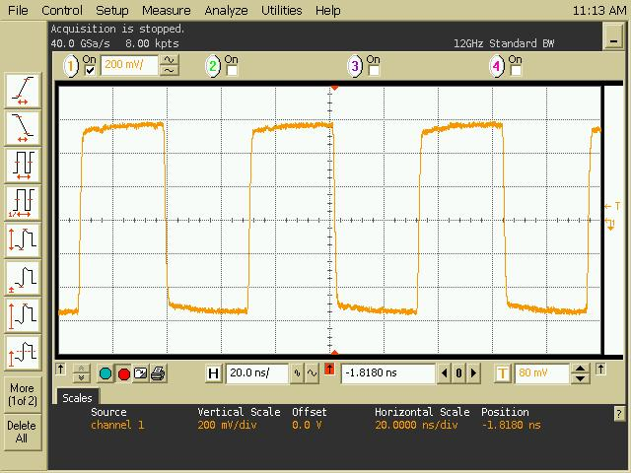

L1 trigger → connect to 16 MHz clock
Slot 11
Far end to controller
at termination resistor
Near to controller
at termination resistor

Slide 5
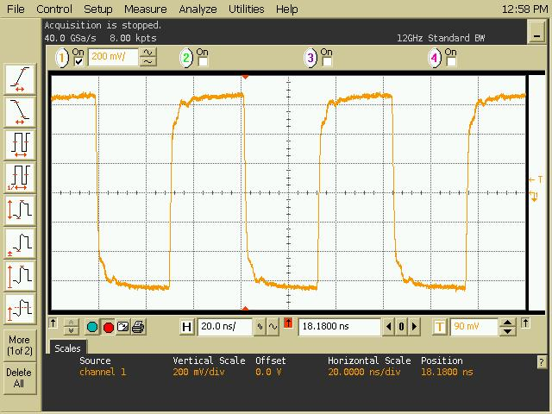

115 ohms slot 11
110 ohms slot 11

Slide 6
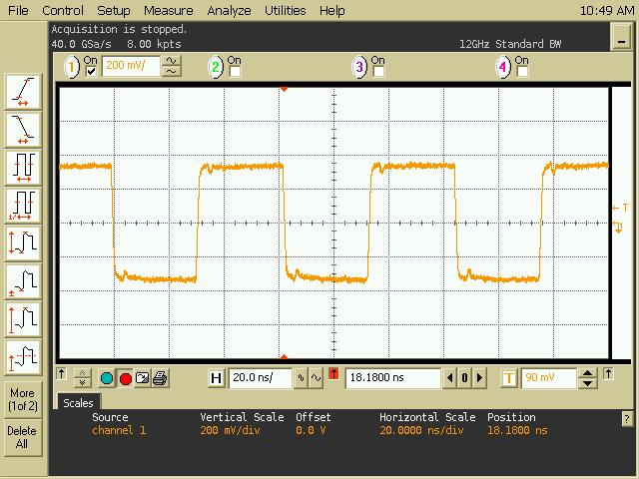
Fully load backplane (16 MHz clock)

Slide 7
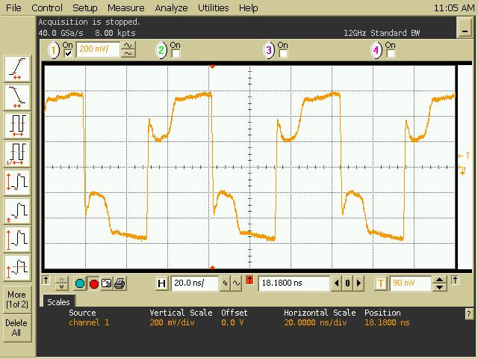


Fully load backplane --- Sync (frame)
Slot 11
Slot 16
Slot 1

