Slide 1
Calorimeter Digitizer System
Overview
System block diagram
ADC choice
Digitizer Board flow
FPGA data flow
Trigger data flow
Trigger daughter card.

Slide 2
Calorimeter Digitizer system overview
Off detector ADC system for both EM and Hadronic calorimeter.
Received the amplified signal from on-detector amplify through cables
Digitize the signal at 6x beam crossing rate, ~ 60 MHz, with 14 bits ADC
Offset the baseline to use most of the ADC range.
Provide at least 40 beam crossing of data buffers to cover L1 trigger latency
Provide Level 1 trigger primitives.
Minimum 4 Level 1 events buffer.
Maximum 31 ADC samples per channel per events, 16 samples planned.
15 KHz Level 1 trigger rate (16 Samples/channel/Event).
Send Level 1 trigger events to the DAQ system.
24576 EMCAL channel, 1536 HCAL Channel.

Slide 3
The Subsystem Technical Overview
Crate based system.
Signals are cable from the on-detector electronics.
Digitized with 14 bit ADC.
Receive timing information the SPHENIX Granule Timing Module (GTM)
Generate L1 trigger primitives
Receive L1 trigger and send out L1 triggered event data to Data Collection Module II (DCMII).
Provide buffer for both the 40 beam crossing L1 delay buffer and 4 L1 triggered events
Clock are fanout point to
point through the backplane
Trigger
out
crate
Trigger
out
Slow control/readback
bus, L0, L1 trigger
Token passing
dataway
Token passing
dataway
Controller
ADC
ADC
XMIT
3 ADC → XMIT
(rack based)
detector
clockmaster
3Gbit/sec
optical link
1.6Gbit/sec
optical link
Slow control/readback
Beam clock,
L0, L1 trigger
GTM
JSEB II
DCM II
PC
SPHENIX DAQ System

Slide 4
The Choice of ADC
Analog device AD9249
16 channel 14 bits ADC. Maximum sampling rate 65 MHz SNR 75db
1.8v technology. 58mw per channel at 65 MHz -> 1 W per chip.
144 pins package. 1cm X 1cm BGA
pipeline latency 16 clocks.
Analog Device AD9257
8 channel 14 bits ADC Maximum sampling rate 65 MHz SNR 75.5 db
1.8v technology. 55mw per channel at 65 MHz
65 pins LFCSP package. 0.9mm by 0.9mm.
pipeline latency 16 clocks.
Texas instrument ADS5294
8 channel 14 bits ADC. Maximum sampling rate 80 MHz SNR 75.5db
1.8v technology. Per channel 58mw at 50 MHz, 77mw at 80 MHz.
1-wire only interface only for below 50 MHz sampling
80 pins QFP package. 12mm by 12mm
included digital processing block ( only after digitization)
pipeline latency 11 clocks for 1 wire interface.
Linear Technology LTM9008-14
8 channel 14 bits ADC. Maximum sampling rate 65MHz SNR 73 db
1.8v technology. Per channel 88mw at 65 MHz.
140 pins BGA. 11.25mm X 9mm
pipeline latency 6 clocks.
The limit of ADC LVDS serializer
seems to be less than 1Gbits/sec
65 MHZ ADC
The FPGA does not have 128 LVDS
De-serializer → 1 LVDS output
per ADC channel
JSED204B’s ADC need the transceiver to receive data
→ Limits number of ADC can be connected to the reasonable price FPGA

Slide 5
sPHENIX ADC Module Block Diagram
RHIC beam clock 9.6MHz
Analog
Device
AD9257
8 channel
14bits
65 MHz
ADC
7X ADC clock
+4V, -3.5V, +2.5V
Power
+- 3.5V, -2.5V
Differential
receiver power
+1.8V analog
ADC power
+1.8V digital
ADC power
F
R
A
M
E
Serialized ADC DATA
ALTERA Arria V GX
BB1D4F35
1152 pins FPGA
6x beam clock
Beam phase,
init, L1
Differential
receiver
De-serializer
D
P
U
2 mm
Hard Metric
Token
Passing
Data
two transceivers
64 channel
ADC board
Clock
Fanout
L1
Delay
Buffer
5 L1
Accepted
Event
buffer
Serialized
Token
Passing
6 X beam
clock
Serial
command
two transceivers
2 mm
Hard Metric
L1 trigger primitives
transceiver out
De-serializer
command/
offline data read
Differential
receiver
F
R
A
M
E
Serialized ADC DATA
Bused command
Serial data
Analog
Device
AD9257
8 channel
14 bits
65 MHz
ADC
3.3V
LDO
3.3V
LDO
DC/DC
switch regulator
4V
+12V
Power
7X ADC clock
2.5V FPGA I/O
DC/DC
switch regulator
1.5V
LDO
1.1V
core

Slide 6
BC & L1 event
numbers
Sphenix
64 channel ADC
Data Flow Diagram
Beam clock
number
Header
512X16
Header
8 x 32
6x RHIC
clock
L1
trigger
6x RHIC
clock
14 bits ADC
serialized data
840 Mbits/sec
LVDS
De-serialize
/alignment
Input
control
L1 Delay memory
512X128
8 events buffer
256 X
1024
FIFO
2048 *
34 bits
(first, data,
Last)
Alignment
16bits
FIFO
Gbits
receiver
8b/10b
encoding
Serialized
data
from down
Stream board
1-8
16bits
FIFO
Gbits
receiver
Fake data
512X16
wadd
1-64 channels
radd = wadd
- delay
Token in
Link control
Gbits
transmitter
8b/10b
encoding
Serialized
data
L1 trigger
Primitives
generators
Token out
120 MHz
Reference
clock
80 MHz
Reference
clock
Write address
3 bits events,
5 bits samples
Gbits transmitter
read address
3 bits events,
5 bits samples
write =
valid & token
Read =
!empty
LVDS repeater
Slow control
readback
backplane
Daughter card
Optical
transceiver
Lemo out

Slide 7
Cal trigger primitive Generator (preliminary)
6X BC clock
12X BC Clock
120 MHz clock
delay
+1
+2
+1
+ 1 BC + 2 12X
4 bits trigger phase
Dual port memory
Baseline
subtraction
Lookup memory
(1024X10)
10 bits
2X2 SUM
(12 bits output)
only use
upper 8 bits
Choose one of the of of the 12X BC clock phas for trigger primitive
MUX
128 bits
To 8 16 bits
10X16 bits FIFO
Transceiver
IP
Read
Address
(upper 10 bits)
Read address = write address -delay
Load lookup
Memory from
Slow control
Sub = ADC – ADCpre
If (adcpre > adc) sub=0
64 channels
16 2X2 8 bits sum
Delay a parameter
Probably has 2 clocks offset
1 | 2 | 3 | 4 | 5 | 6 | 7 | 8 | 9 | 10
header | Mod + clock | Sum 1+2 | Sum 3+4 | Sum 5+6 | Sum 7+8 | Sum 9+10 | Sum 11+12 | Sum 13+14 | Sum 15+16
Monitor Delay dual port memory
5 events buffer
To controller
readout
Delay and
# of Sample
adjustable
L1
trigger

Slide 8
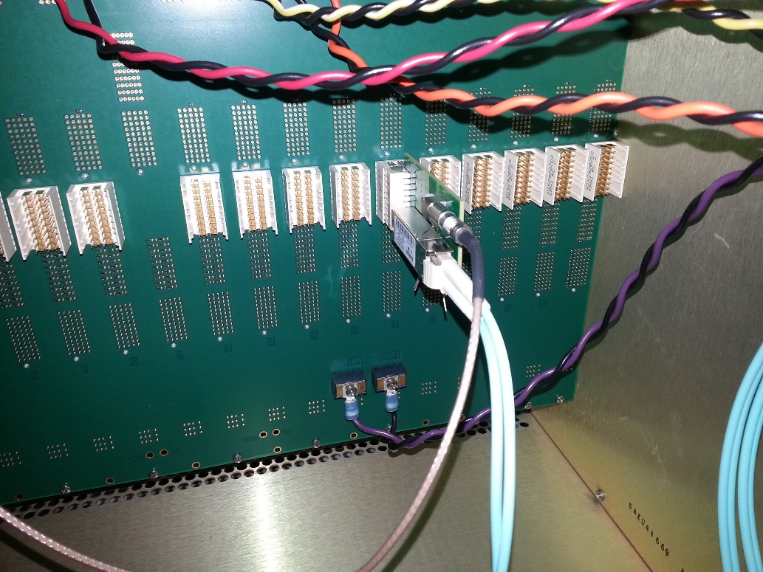
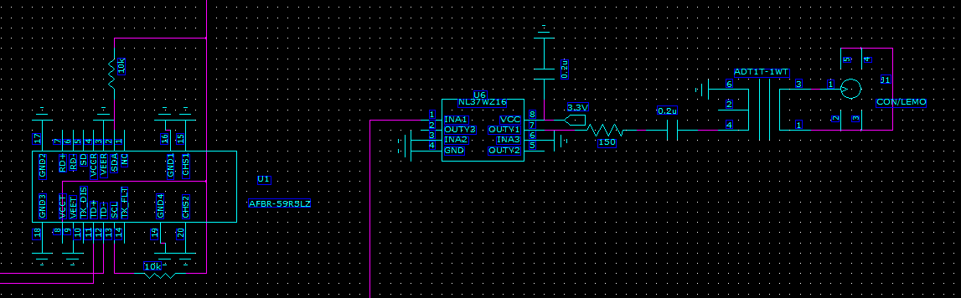
Trigger daughter plug in from the back with 2 outputs, 1 optical transceiver, 1 lemo output.
backplane
Optical transmitter output
ARRIA 5
FPGA
LVDS buffer
Lemo out
Trigger daughter card
3.3v

Slide 9
Calorimeter Local Level 1 Trigger
A difficult project
  Lots of data with limit amount of resources
  Organize the data flow
Understand the Inputs
  Lots of inputs → few outputs
  What we try to do
Calorimeter Sum
  Deal with geometry.. Over lapping sum → neighbor problem
Clocks and L0 timing
Go through proposed solution as an example
Alternative hardware choices
What we done so far
Next steps

Slide 10
Inputs
Total emcal channel = 96*256 = 24576.
  Phi and eta coverage is 0.025 *0.025
HCAL has 24576/16 = 1536 channel (outer only)
  Phi and eta coverage is 0.1*0.1 ➔ after 2X2 sum => 0.2 *0.2 coverage
2x2 sum are done in FEM. Each sum has 8 bits.
  Finest element we could send out in the FEM, constrained by the bandwidth of the system.
So we have 384 L1 primitives fibers from EMCAL and 24 from HCAL.
If we can not bring all fibers into one FPGA, we are dealing with processing data in subset of the detectors.

Slide 11
Physics goals
Hadronic jets
  SUM over EMCAL + Hadronic towers
    With 0.2 eta X 0.2 phi tower overlapping 2x2 sum.
    Threshold apply over the 2x2 sum. Isolation cuts.
Pair trigger
  With EMCAL 4x4 overlapping sum
  SUM threshold applied, isolation cut applied
  10 bits energy (??) with both eta and phi angle
  3 bits eta and phi address will be enough to reconstruct the mass.
    May be a look up table??

Slide 12
4x4 sum require data from neighbor 2x2 cells
Simple isolation cuts will required data from neighbor 4x4 sum.
Overlapped 4x4 sum mean we have as many 4x4 sum as input 2x2 sum .
For example as
4x4 matrix of 2x2 sum will require data from 2 top rows, 2 left columns, 1 bottom rows and 1 right columns.
Bring in more data from neighbor region.
Constrains building “trigger processing blocks” either in complete phi or complete eta.
  So we only have deal cross stitching from two edge only
➔ Trigger block should at least cover 8 2x2 width
  Limit the bring the neighbor data to less than 3/8 of input bandwidth.
4x4 sum (2x2 of <2x2> sum)
05
05
15
25
35
45
55
04
14
24
34
44
54
4x4 overlapped sum
03
13
23
33
43
53
02
12
22
32
42
52
01
11
21
31
41
51
Simple
Isolation cut
00
10
20
30
40
50
>=
>
>
>=
41
>
>=
>=
>

Slide 13
Data division
The EMCAL data have 256 channel phi and 96 channels in eta.
Assume
  Each fiber cover 64 channel in square form (8x8) for each cable mapping
  2 layers of 8x8 channels
If complete phi coverage ➔ 64 fibers, For complete eta coverage ➔ 24 fibers per trigger processing blocks.
  Plus sending and receiving of cross stitching fibers from neighbor region. Ignore end of the detector effect.

Slide 14
Clock Domain
The collider beam interaction is driven by the RHIC beam clock, ~9.6 MHz
  The calorimeter digitizer is driven by 6X beam clock.
  The L0 timing signal, like RESET, INIT, TEST, RUN etc., carries action associate with beam clock.
The L1 trigger primitives optical transmitter is driven by 120 MHz crystal clock
  For the clock stability. Use local crystal…
The L1 trigger block needs
  1) beam clock is needed to clock the collision data
  2) reference clock is needed to receive the data.
  3) FPGA operation could be drive by multiple of the reference clock.
    Simplify the optical interface coupling…
    Per reference frequency, several possible optical speed can be achieved.

Slide 15
Data input alignment with
data merger block diagram
Fake data
injector
Restore data to 16 2x2
sums
Alignment memory
Delay memory
optical receiver
unpacker
Data to
Overlapped region
Optical transmitter
Data collector
Restore data to 16 2x2
sums
Alignment memory
Delay memory
optical receiver
unpacker
Restore data
sums
Data from
Overlapped region
optical receiver
unpacker
slow control data readback

Slide 16
Proposed system
Using existing calorimeter digitizer system infrastructure
  Beam clock distribution
  Slow control/offline read back system
  Power distribution
    2 sets of 2 12V 50A power bug ensure enough DC power distribution.
    Use only every other slots
  Mechanical support

Slide 17
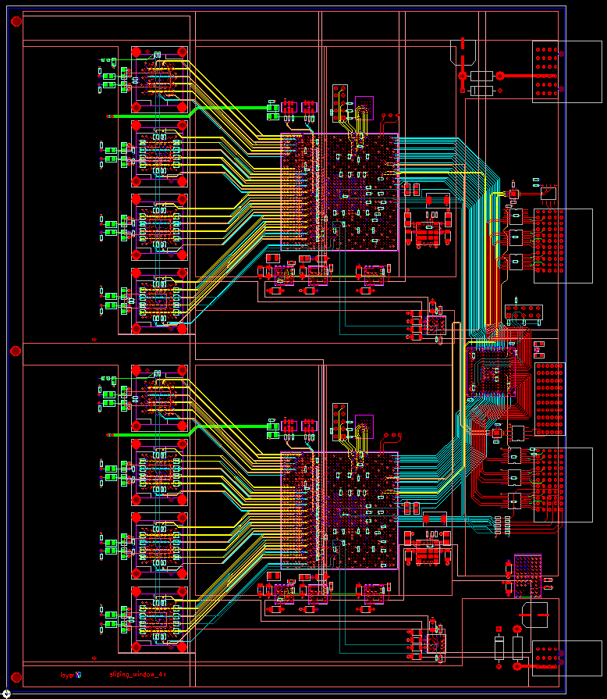
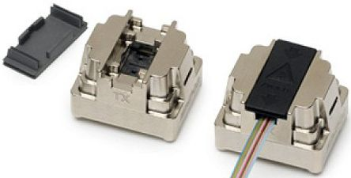
SPHENIX calorimeter Level 1 Trigger
Conceptual design
Borrow Calorimeter Digitizer infrastructure.
Receive digitizer trigger primitives
Provide cross stitching between tiles.
Generate trigger primitives for global level 1 trigger
Boards consists of two building blocks
Each block has 36 optical receivers and
12 optical transmitter
Altera Arria 10 20 nm FPGA as the computing engine
1517 pin package. 0.95V core.
Optical speed up to 6.5Gbps
570K logic element →
600K, 900K, 1150K
The cost should be around $1K-$2K per FPGA.
Need to be reconfirmed.
Trans-
mitter
R
E
C
E
I
V
E
R
6A,
0.9V
4A,
0.95V
4A,
1.8V
4A,
1.8V
2A each,
2.5V & 3.3V
12V in

Slide 18
EMCAL Section (1)
L1 trigger Arria 10 GX block.
  Assume we will do the trigger data along the eta direction.
    24 fibers will cover 96 channel in eta and 16 channel in phi direction.
  Need 48 2x2 sum from the bottom block and 2 set of 48 sums from the top block.
    The fundamental is 48 8 bits data. ➔ 24 16 bits data + 1 header + 1 beam clock + 1 space → 27 data words → bandwidth need to be at least 5.4 Gbits
  The same thing hold true to copy data over to neighbors block.
  This will call for 3 transmitters and 3 receivers for cross stitching
    Or more lower bandwidth with more fibers.

Slide 19
EMCAL Section (2)
Need to do non-overlapping sum for Hadronic jets→
  Mapping is not uniform in eta and uniform in phi.
  For bandwidth calculation use 8x8 non-overlapping which over 0.2 in phi.
  Trigger block holds 24*16 2x2 sums => 384 2x2 sums => 24 8x8 sum.
    This is about the same as single cross stitching data bandwidth requirement
    1 transmitter required.
For pair trigger,
  set threshold on overlapping 4x4 sum.
  Maximum 4 peak outputs. 6 bits address (eta, phi), 10 bits energy
  This will require 1 transmitter.

Slide 20
Pair Trigger
16 inputs
From EMCAL
Shower max
Jet Trigger
24 fibers
Outer HCAL
HCAL
Level 1
Trigger primitives concentrator
16 inputs
From EMCAL
8X8 sum
8 fibers
output
24 fibers
inner HCAL
8 inputs
From HCAL
2x2 sum
0.2X0.2 eta and phi

Slide 21
FPGA Resource Usage
use example like proposed system
  It deal with 96 channel in phi and 16 channel in phi → 384 2x2 sum and generate equal amount 4x4 overlapped sum
  Assume each of the sum has 10 bits.
  This imply ~400 *2 *10 = 8K registers are needed per pipeline stage.
  Assume we have 20 pipeline stages → 160K.
  This is not memory buffer intensive operation.
The FPGA logic cell size more or less match with number of optical transceivers
  Comes with small feature, 20nm, 16nm, 14nm…

Slide 22
Alternative choice
Possible choice
  Commercial solution –Hitech
  ATLAS gFEX (Global Feature Extractor) board
  ATLAS FELIX board
Questions to be asked
  Does it meets the minimum choice ??
  Is it practical ???
    What are system design for?? Can it adapted for sphenix trigger??
  Can we handle it??
    The complexity of the system?? The infrastructure to operate it?? Man power to deal with it??

Slide 23
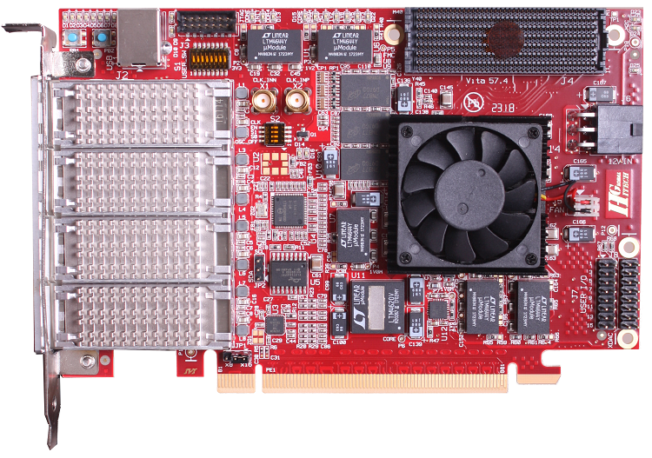
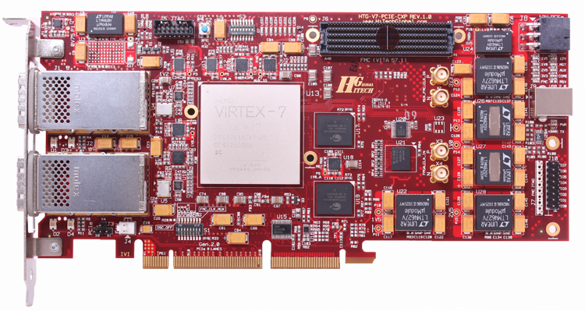
HiTech Global provide boards that similar to the ALTERA or XILINX evaluation board
Have some boards with optical interface with CXP, QSFP etc.
Optical → FPGA interface tend to one side of FPGA.
CXP has 12 port transceiver. QSFP(4 SFP) really for higher optical speed than 10 Gbits/sec than channel count.
It is does not offer number of ports we are looking for..
FELIX is far better choice than Hitech if we are going through PCIE environment
QSFP
CXP

Slide 24
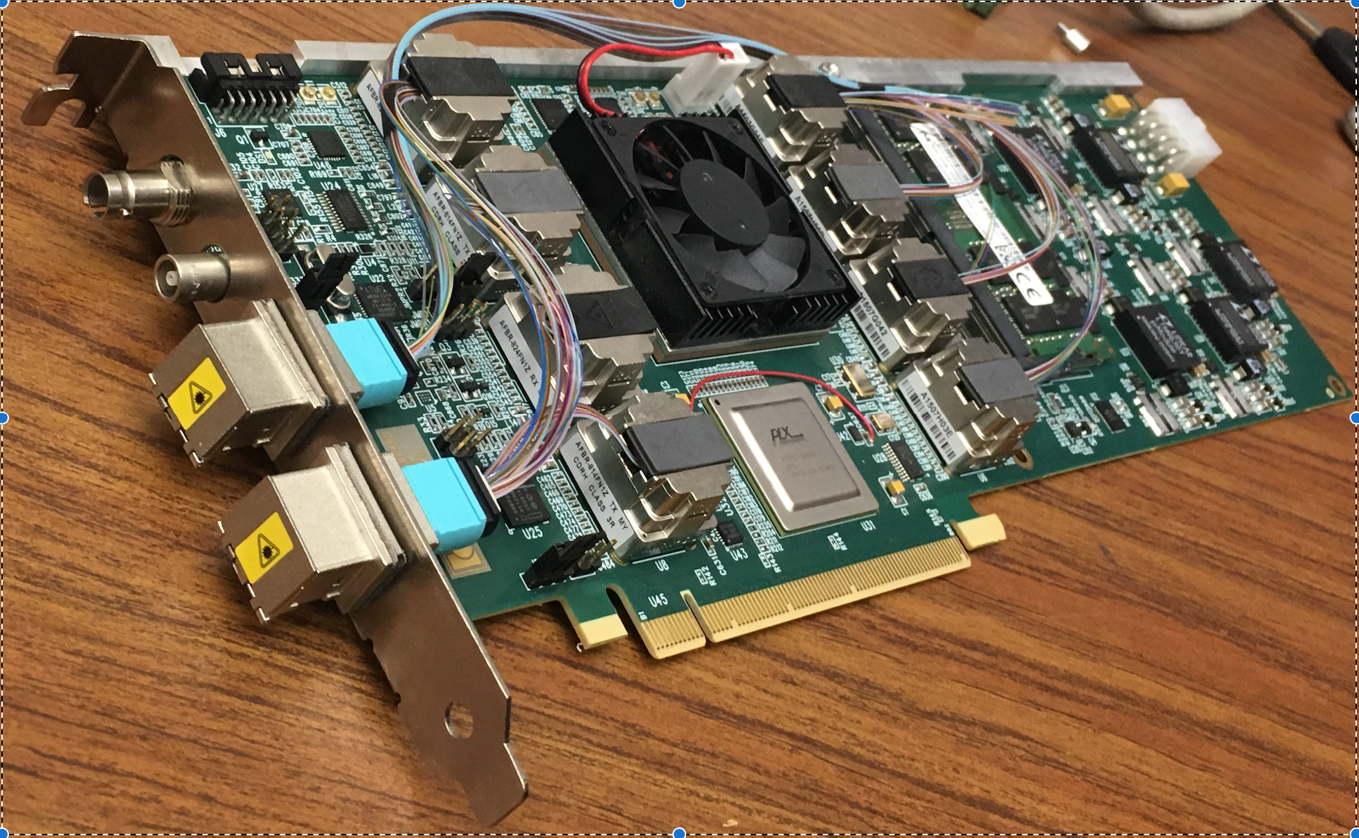
ATLAS/FELIX BNL-711 PCIe Card
Credit: Kai Chen (BNL), https://indico.bnl.gov/conferenceDisplay.py?confId=2653
BNL-711 Board chosen for ATLAS FELIX project, and used in ATLAS phase I upgrade, which is projected to complete before sPHENIX.
Readout for ATLAS Phase-I sub-system of Liquid Argon Calorimeter, Level-1 calorimeter trigger, New small wheel of the muon spectrometer

Slide 25
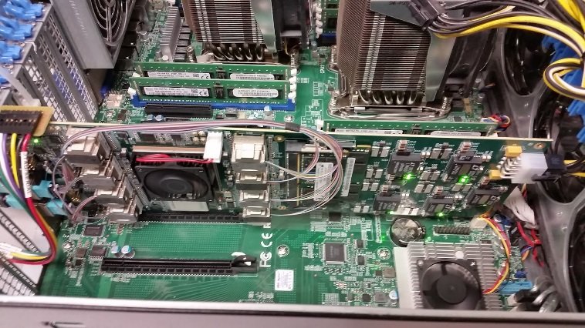
ATLAS/FELIX BNL-711 PCIe Card
Credit: Kai Chen (BNL), https://indico.bnl.gov/conferenceDisplay.py?confId=2653
Main features for FELIX PCIe Card
  Design: BNL/Omega group, Layout: BNL/Instrumentation, multiple users.
  A large Kintex Ultrascale FPGA, 1.5 M LC
  48 bi-directional GBT link, PCIex16 Gen3, 101 Gbps demonstrated
  2x DDR4 memory slots (v1.0, v1.5), removed v2.0
  TTC-timing input (v1.0, v1.5), allow timing mezzanine card (v2.0) – provide help design sPHENIX GTM mezzanine card
Current version: v1.5 prototype, can be ordered
Next version: v2.0 pre-production, design starts now, expect available Oct 2017
BNL/Omega group, Local expert expressed willing for help us to adapt FELIX in sPHENIX
  Boards for initial evaluation test, support firmware software development, timing mezzanine card design
  The team is also help in possible use of FELIX card in protoDune.
  The FELIX team is open for inputs in guiding the design to be more generic to various users.
FELIX v1.5 Card in server, BNL ATLAS Group

Slide 26
Why not FELIX card
Good
  It has 48 by directional optical/ Large FPGA.
  It works as readout interface, like the old DCM, DCM II, JSEB and JSEB II
For our case
  The 48 pair transceiver may be possible one to get slightly more eta space.
  If multiple Level 1 board reside in the PC environment, the power distribution will be quite limited or cost effective
    Add PC cost…
  In ATLAS, L0 timing is brought through TTCRX fiber. Possible adding daughter card to resolve the problem
  Cost is much higher than our current solution.
    FPGA, XCKU115 XLINK Kintex UltraScale, size match the optical choice. But it too large for us.
    It has ~1.5 M flip flops.

Slide 27
gFEX board
Based on ATCA crate
Optical speed up to 12.8 Gb/sec
100 optical input FPGA. 3 set of XLINK FPGA
(Ultra scale XCVU160 series, 2 M logic cells)
Up to 300+W of power consumption

Slide 28
gFEX board choice
It is designed for making L1 trigger
With 300 fibers inputs we will need only 2 cards.
Problems
  Large infrastructure just to get started.
  Complexity of the board is hard to manage.
    We have much simpler problems.
  Does not match with our expertize or equipment's

Slide 29
What we done so far
Layout a possible system solutions
Coded up optical portion of receiver and transmitter.
Create code for
  1) overlapping 2x2 sums for 16 2x2 sums
  2) isolation cuts
  3) priority encoding method for output
  4) sorting for highest shower energy
  5) possible loop back code for testing optical transmitters and receivers.

Slide 30
Critical Steps need to happen soon
We should get prototype board build
  Have something to test digitizer board trigger codes
  Get optical portion works
  Understand the error rate.
Understand the L1 latency
Get EMCAL portion code working..
  A) understand the logical cell & interconnect usage
  B) understand trouble shooting/monitors steps.
  C) set up simulations environments etc…

Slide 31
Backup slides

Slide 34
ATCA stand for
“Advanced Telecom Computing Architecture “
Normally 14 slots per crate.
Provide better cooling more power per module
$5K

