Slide 1
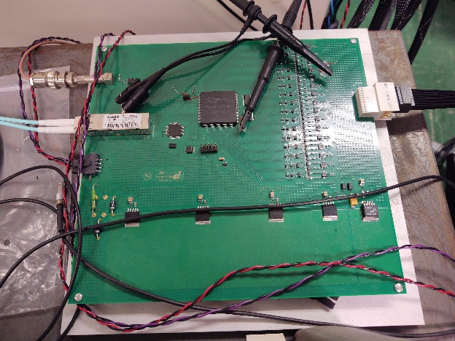
We have calibration board. 16 channels. Each channel has 12 bits DAC.
DAC connect to the capacitor. The discharge of DAC become test pulse.
We try both 18 meter signal cable and 10 meter signal cable
We run 60 event per DAC step, 40 steps and 100 counts per DAC step.
30 samples per L1 trigger, Level 1 trigger delay is adjust to compensate the signal cable length
Two L1 setting per cable. 1st L1 delay setting is adjust to see the signal peak. The 2nd L1 delay is adjust to 20 additional counts to catch the tail of the signal. 60 Mhz sampling clock.
The 2nd L1 delay is used to see the tail effect of signal cable.
Firing pattern 0xaaa.
DAC setting, trigger
Calibration
board
Signal
cable
FEM

Slide 2
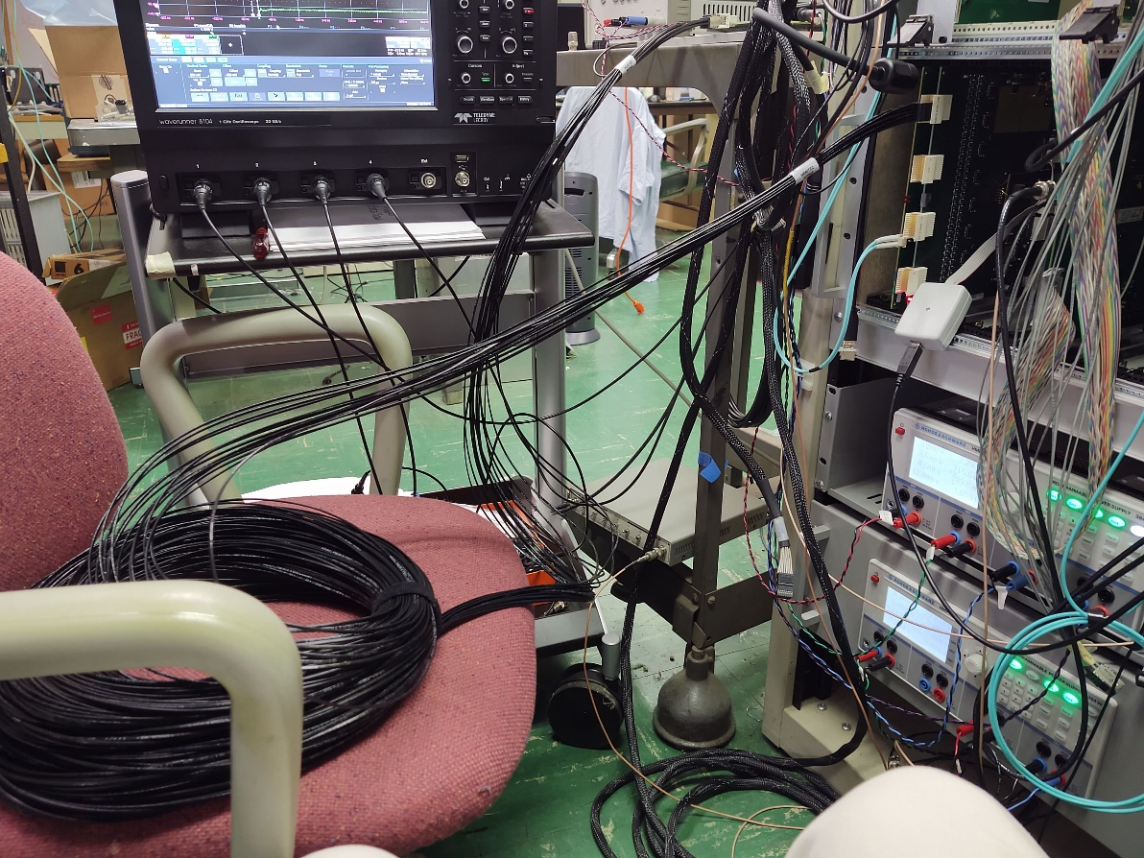

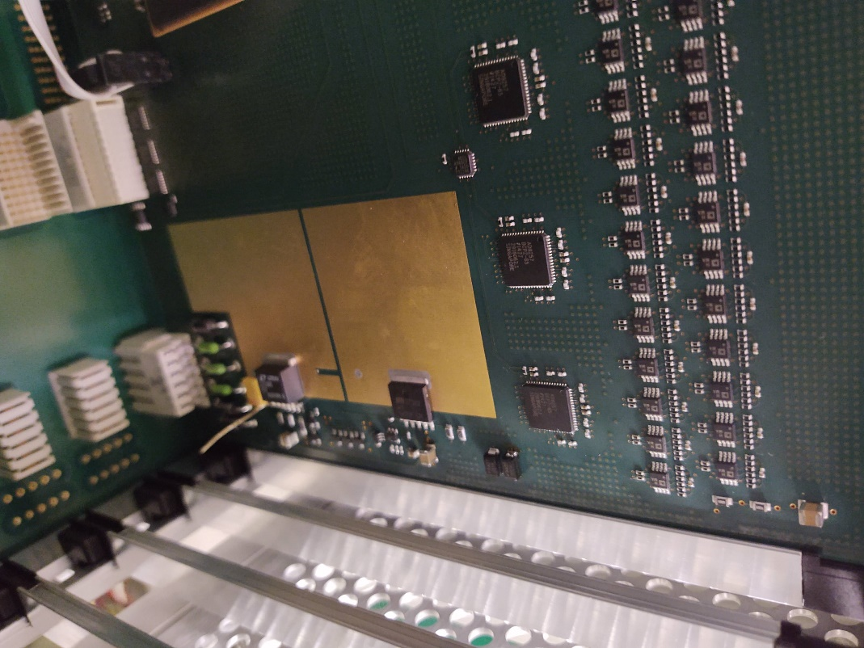
Calibration board output
18 meter signal cable
Adc board scope point
Just before ADC

Slide 3
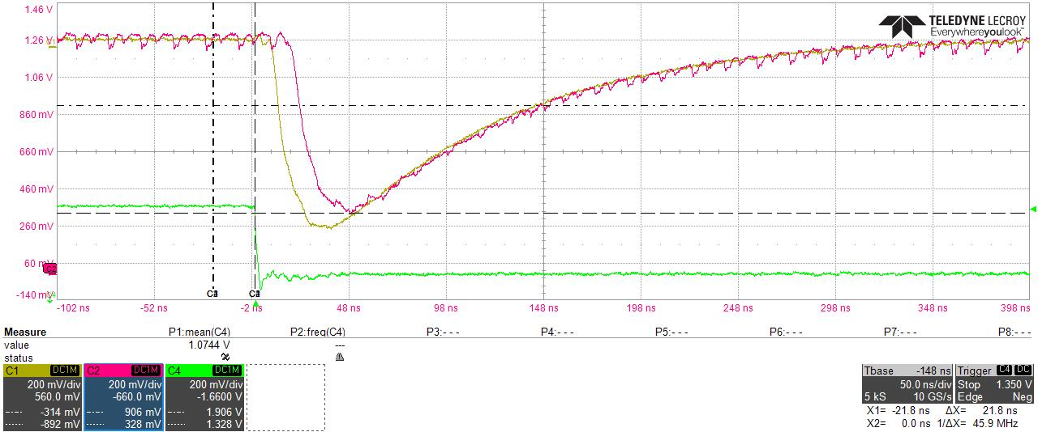
Upper channel output → resistor before ADC
Calibration output
4 feet cable

Slide 4
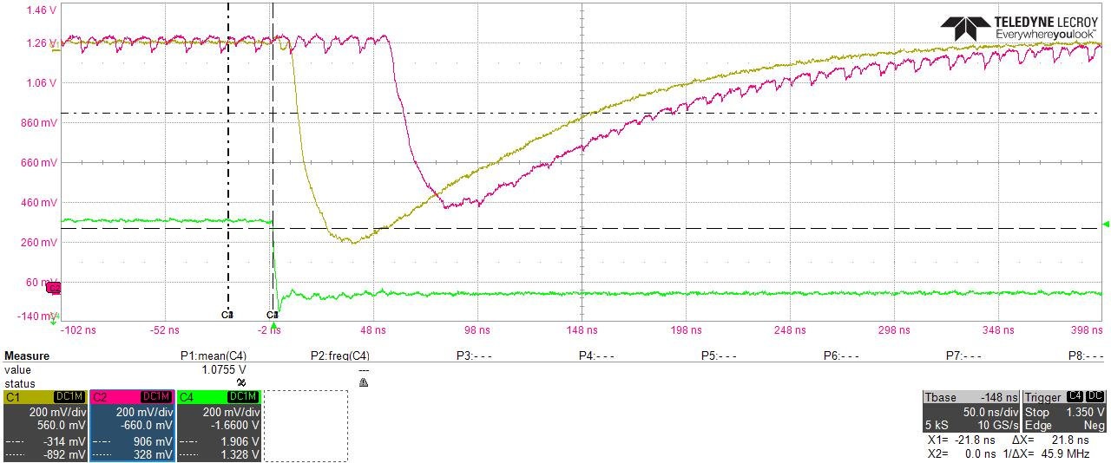
Upper channel output → resistor before ADC
Calibration output
10 meter cable

Slide 5

Upper channel output → resistor before ADC
18 meter cable -- 1

Slide 6
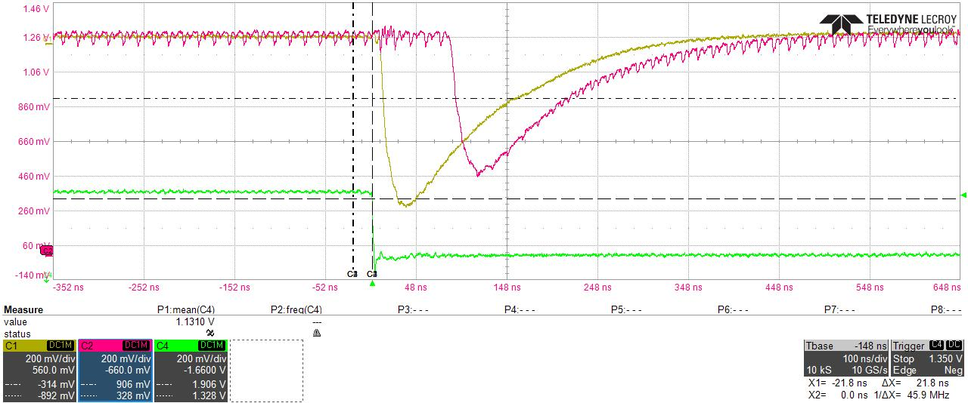
Upper channel output → resistor before ADC
18 meter cable -- 2

Slide 7
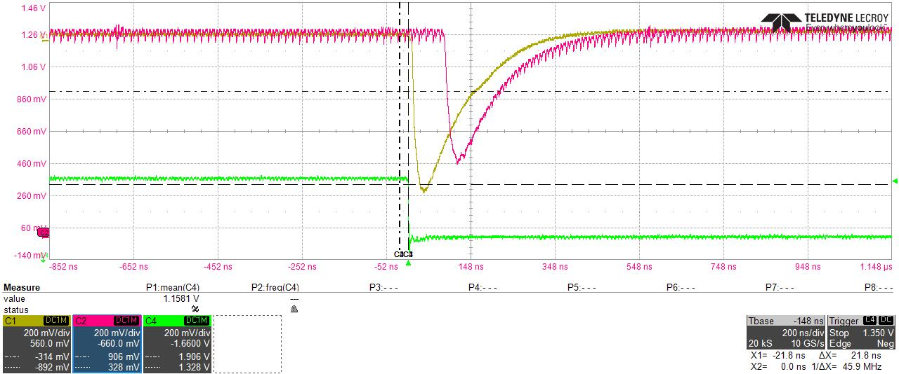
Upper channel output → resistor before ADC
18 meter cable -- 3

Slide 8
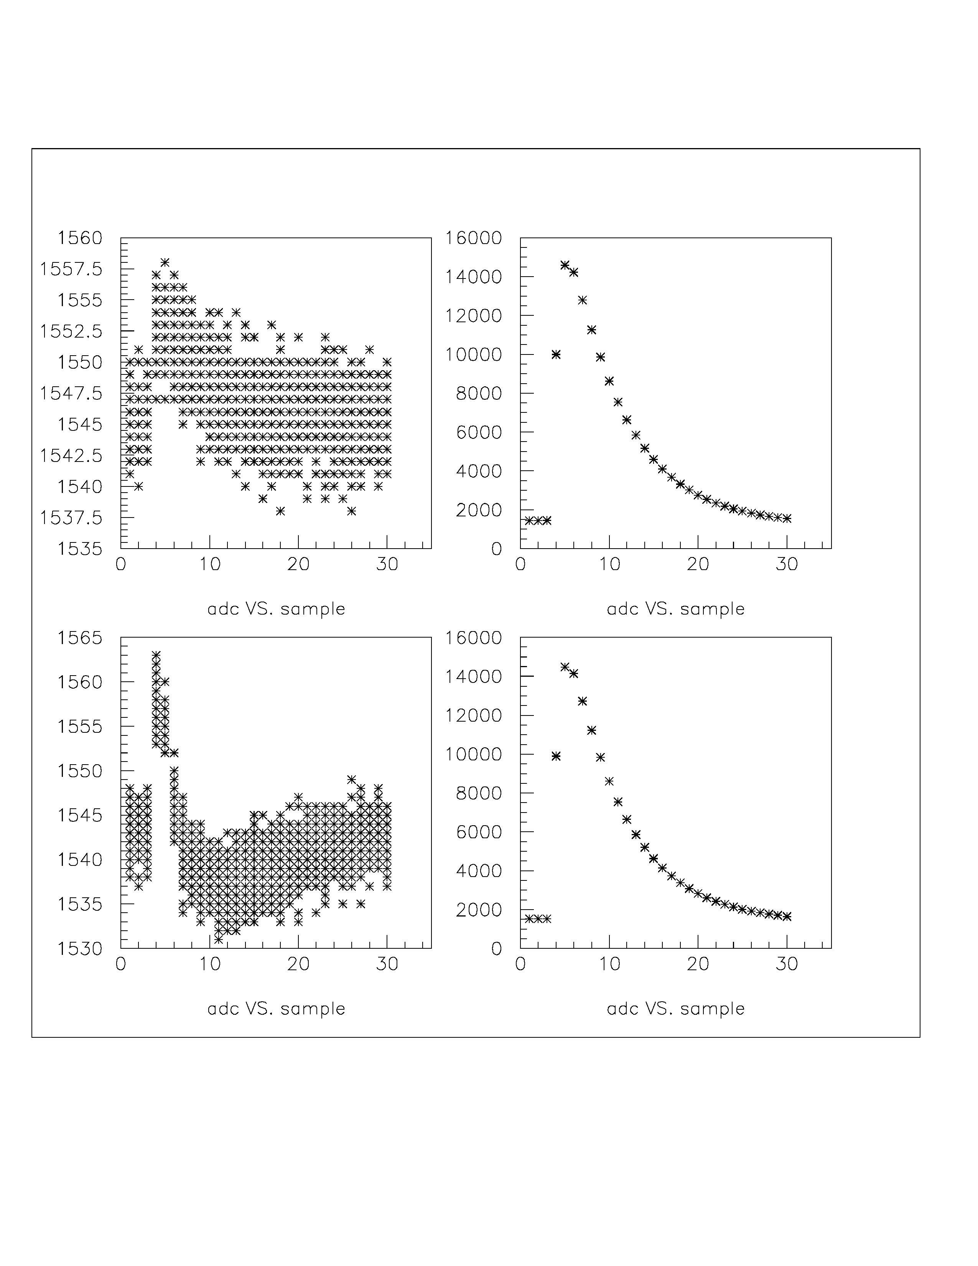
10 meter cable
L1 delay 38
adc
Ch 62
Ch 61
DAC steps
Ch 63
Ch 64

Slide 9
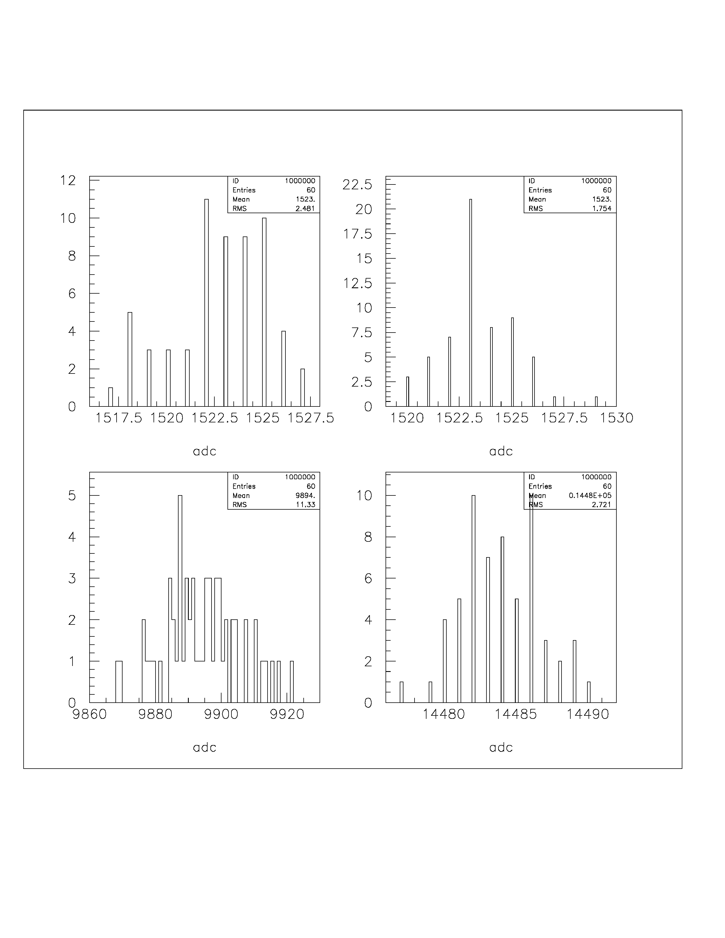
smpl =1
10 meter cable
L1 delay 38
smpl =2
# events
adc
smpl =4
smpl =5

Slide 10
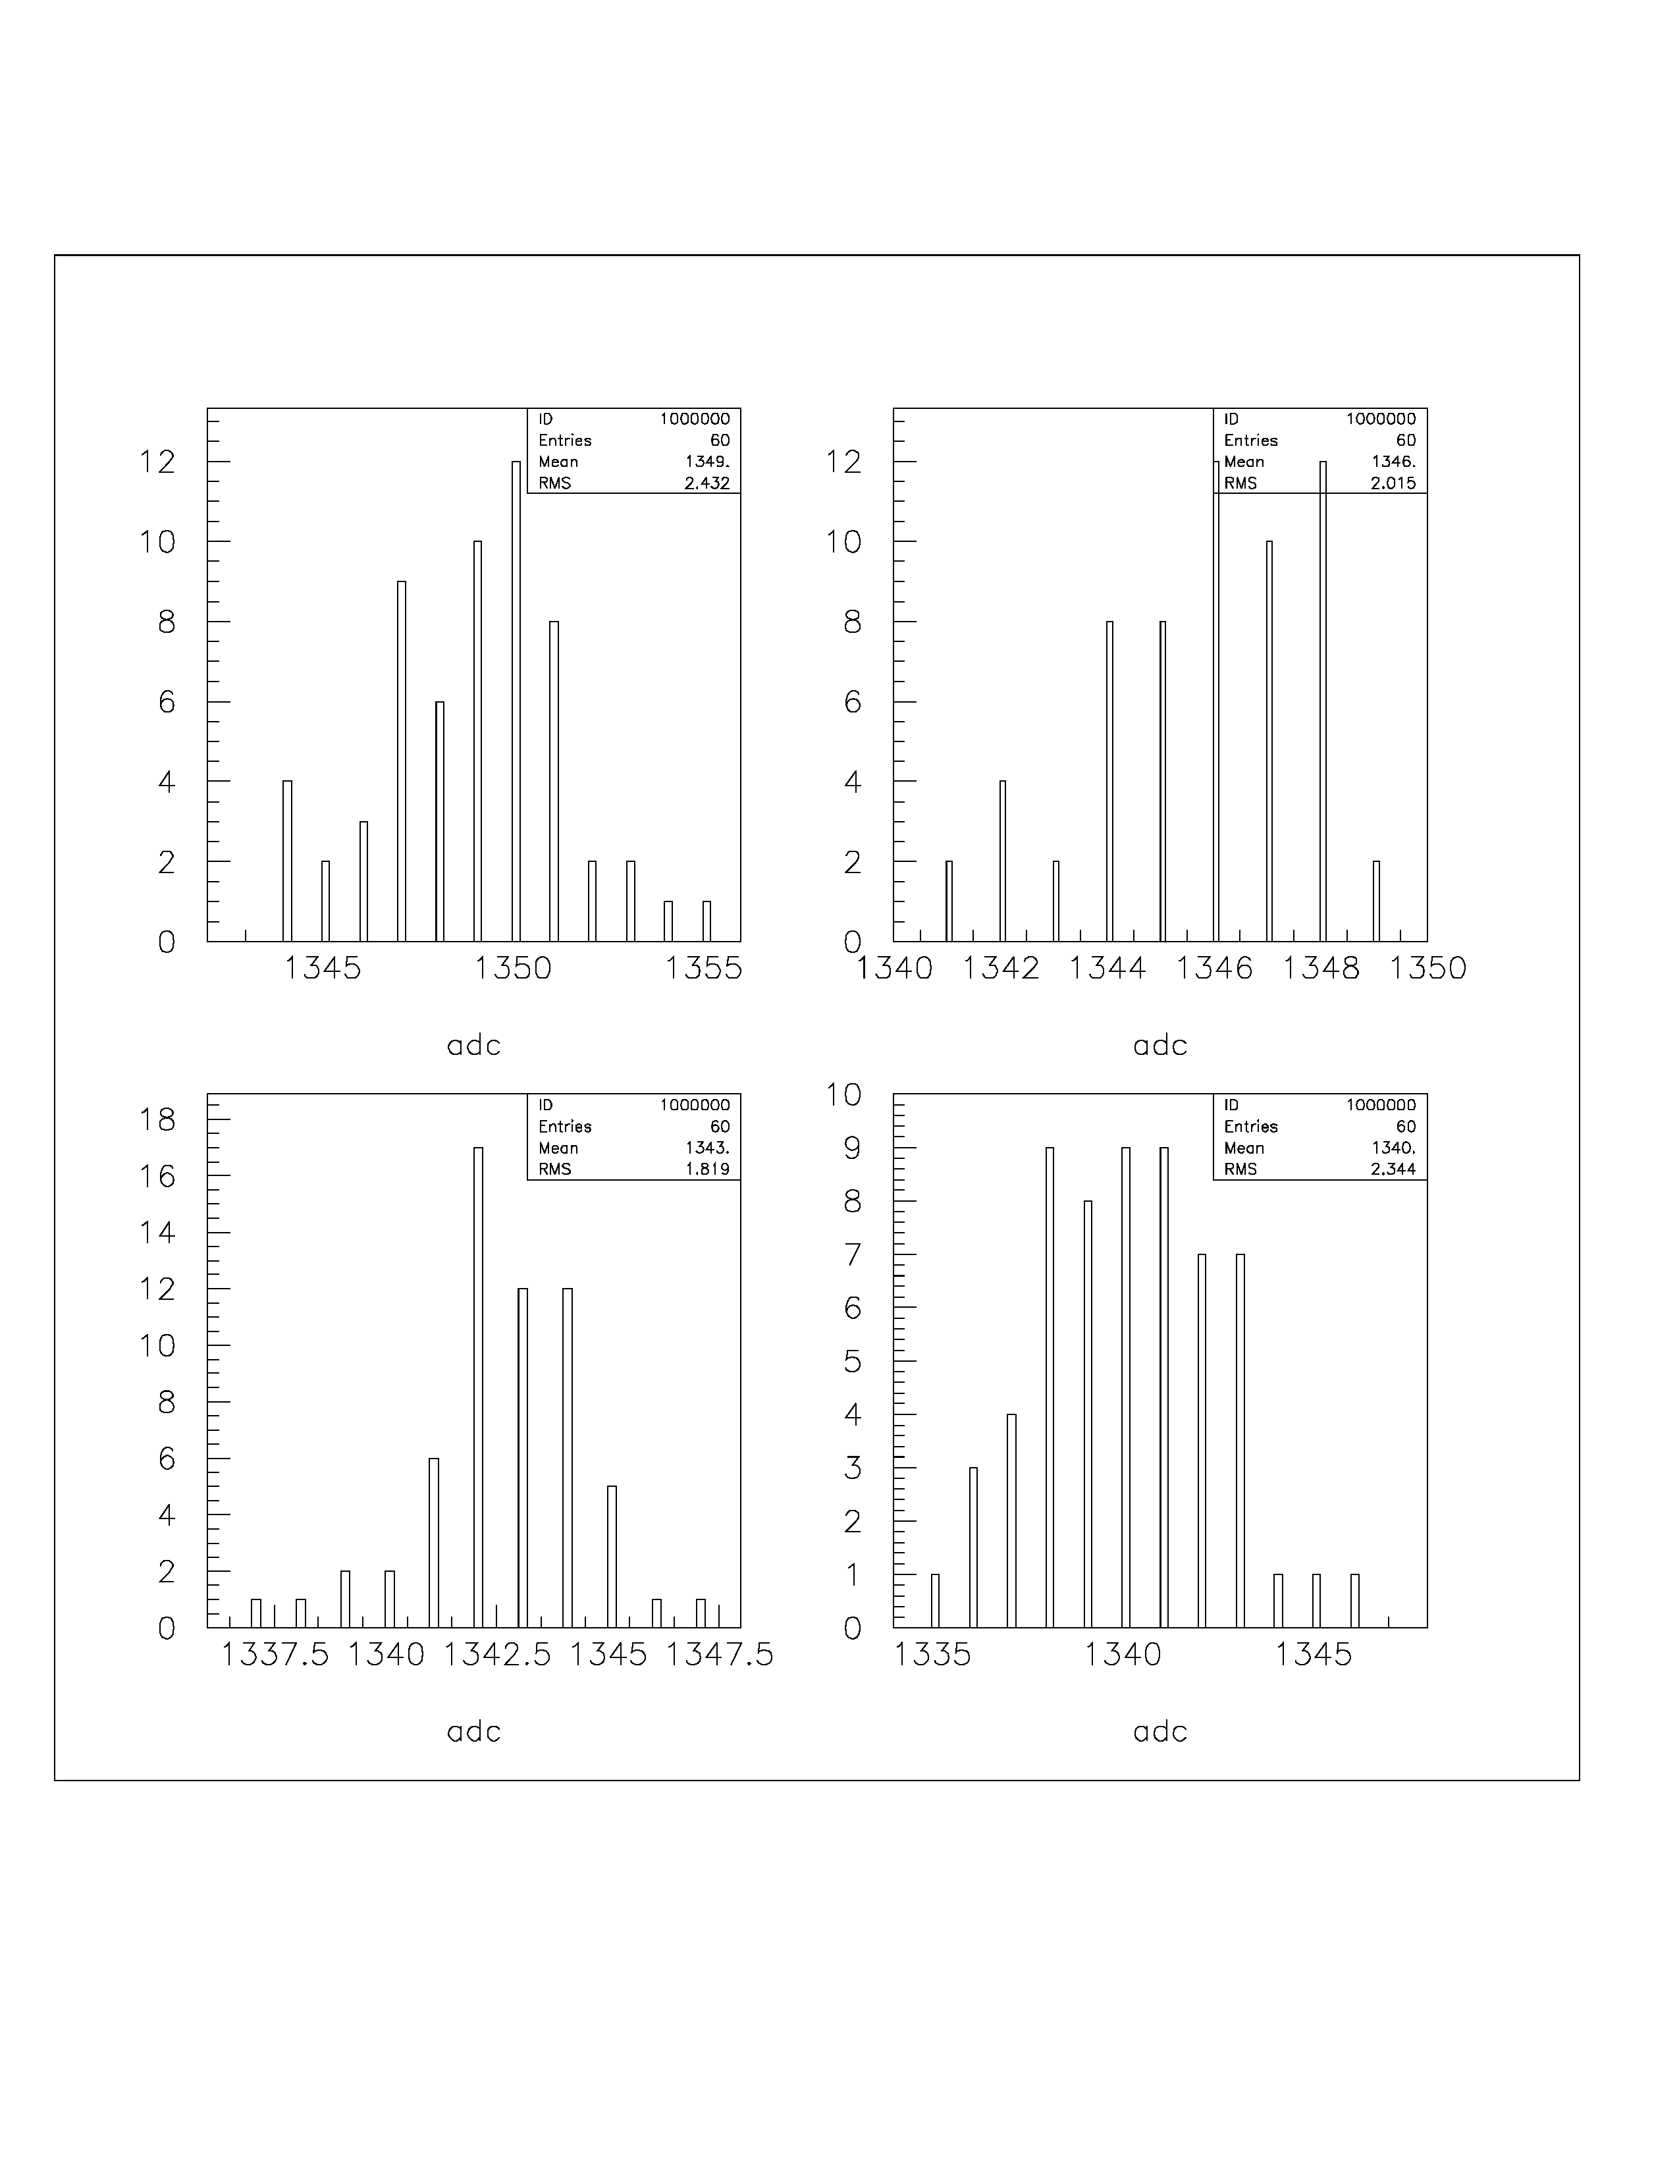
10 meter cable
L1 delay 18
smpl =27
smpl =28
smpl =29
smpl = 30

Slide 11
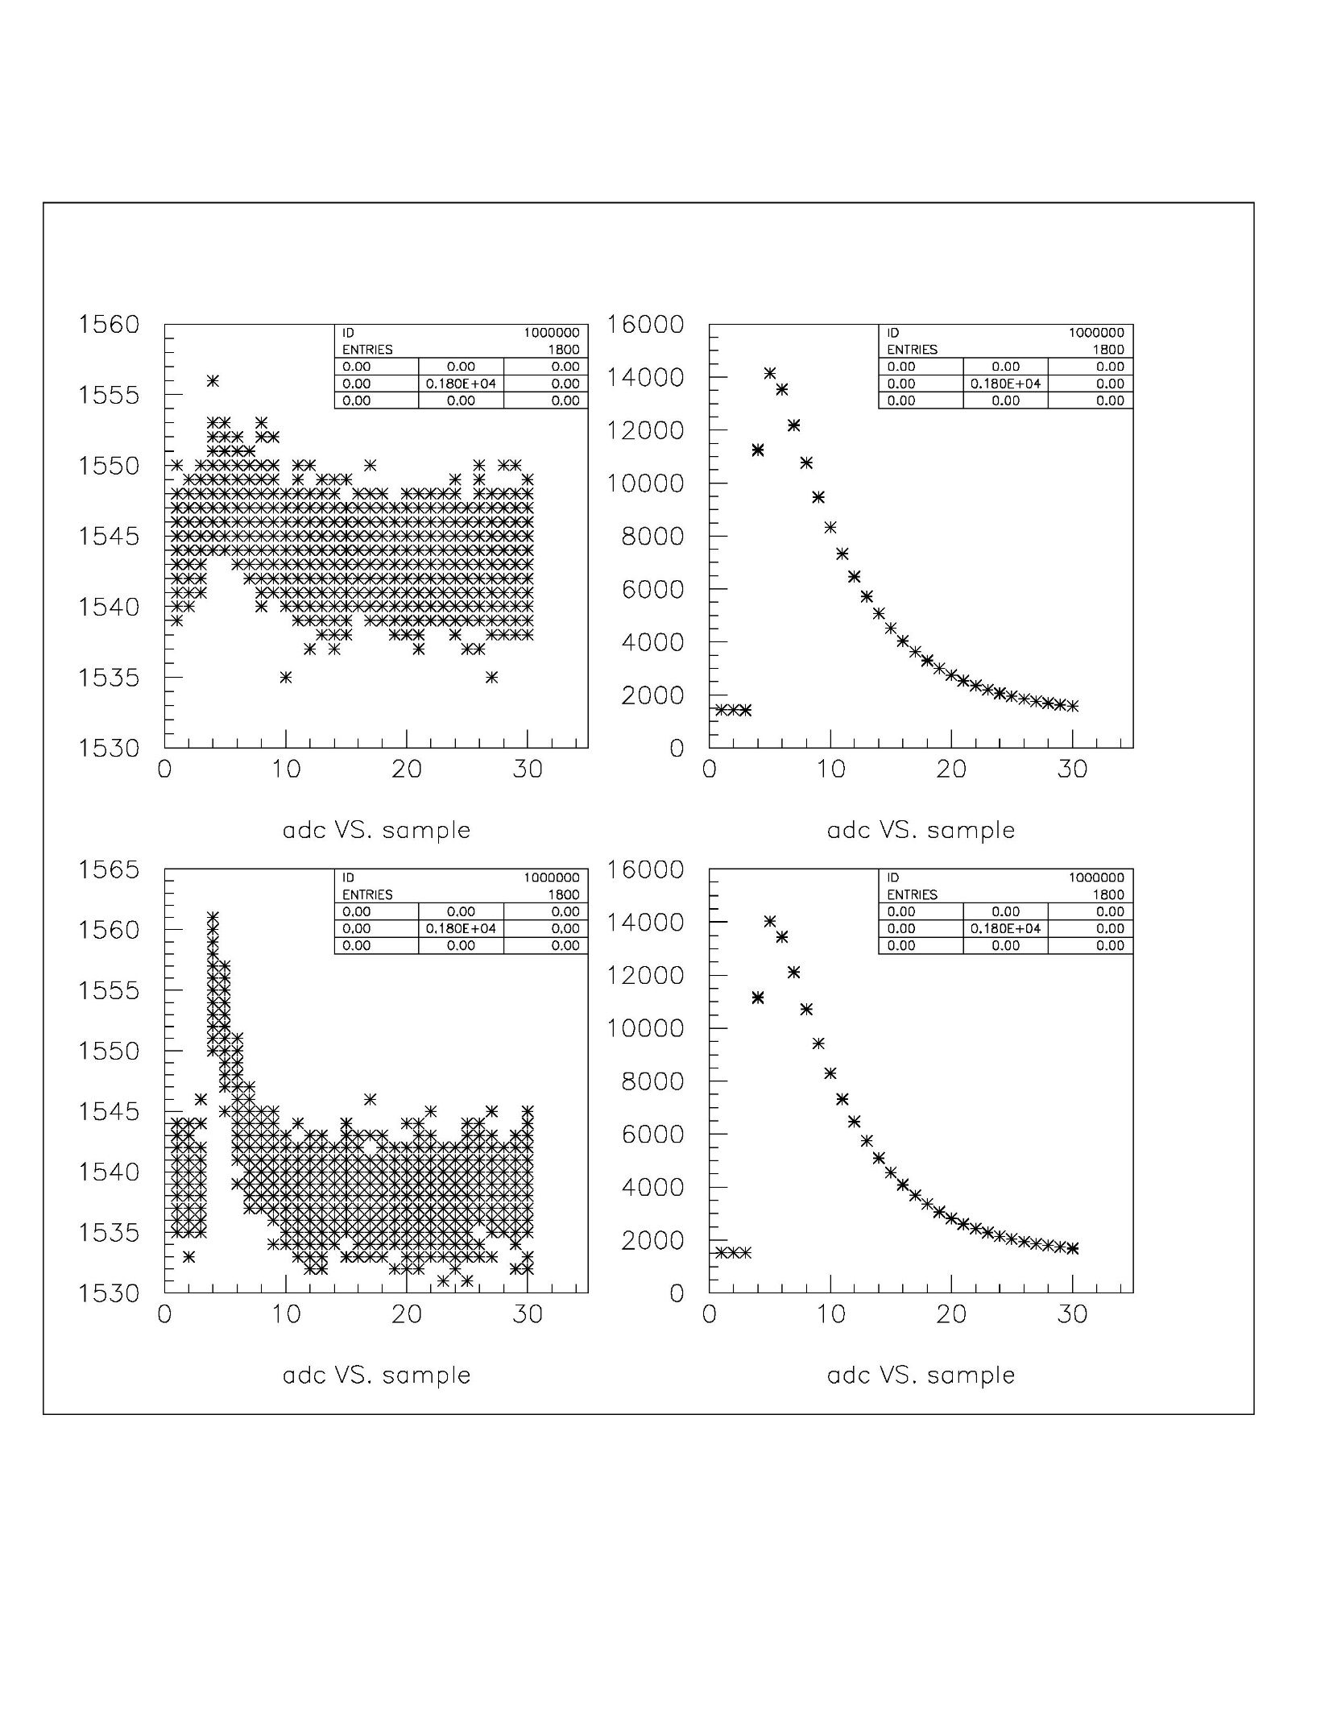
18 meter cable
L1 delay = 36
adc
Ch 62
Ch 61
DAC steps
Ch 63
Ch 64

Slide 12
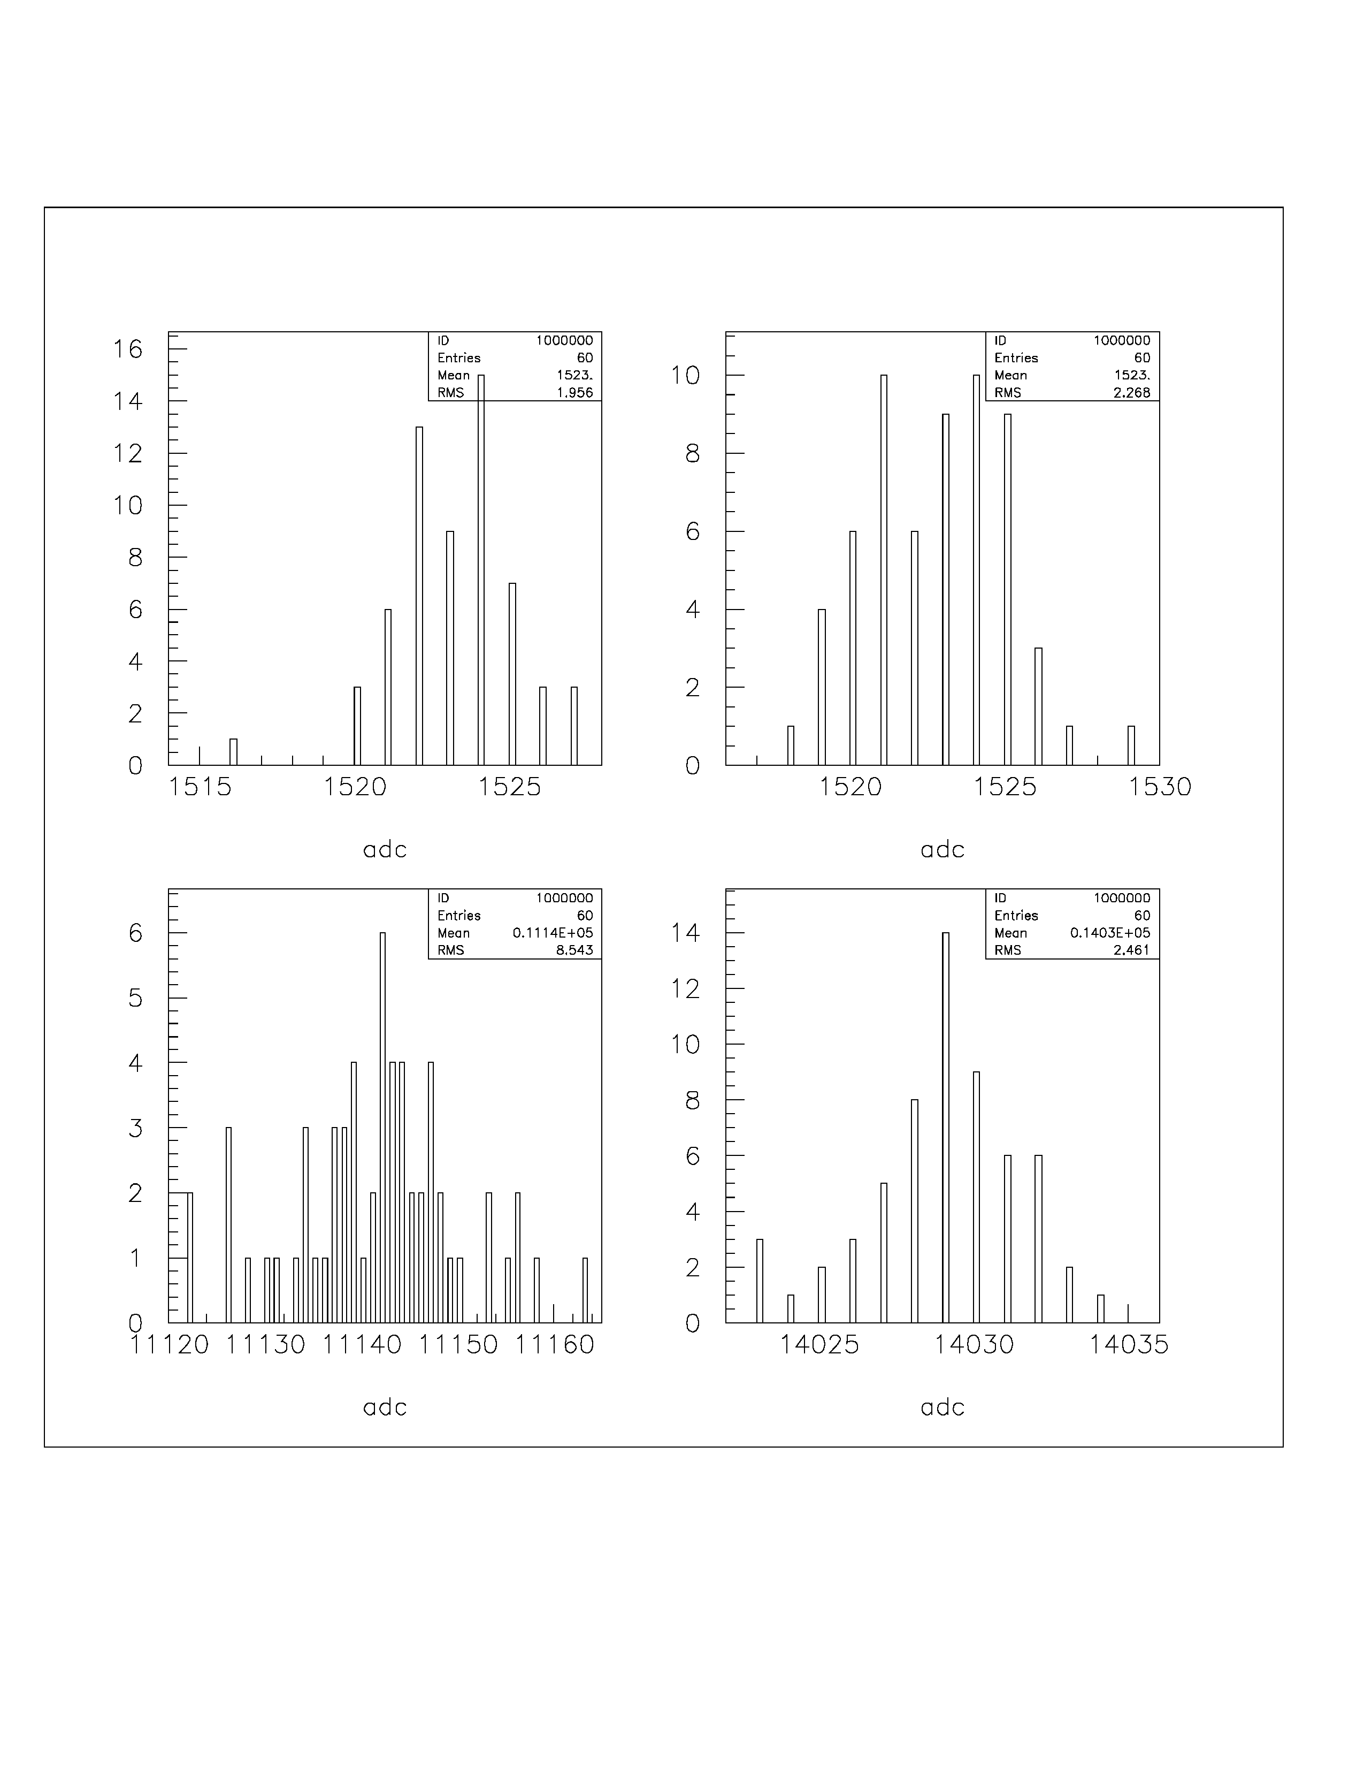
smpl =1
smpl =2
18 meter cable
L1 delay 36
# events
adc
smpl =4
smpl =5

Slide 13
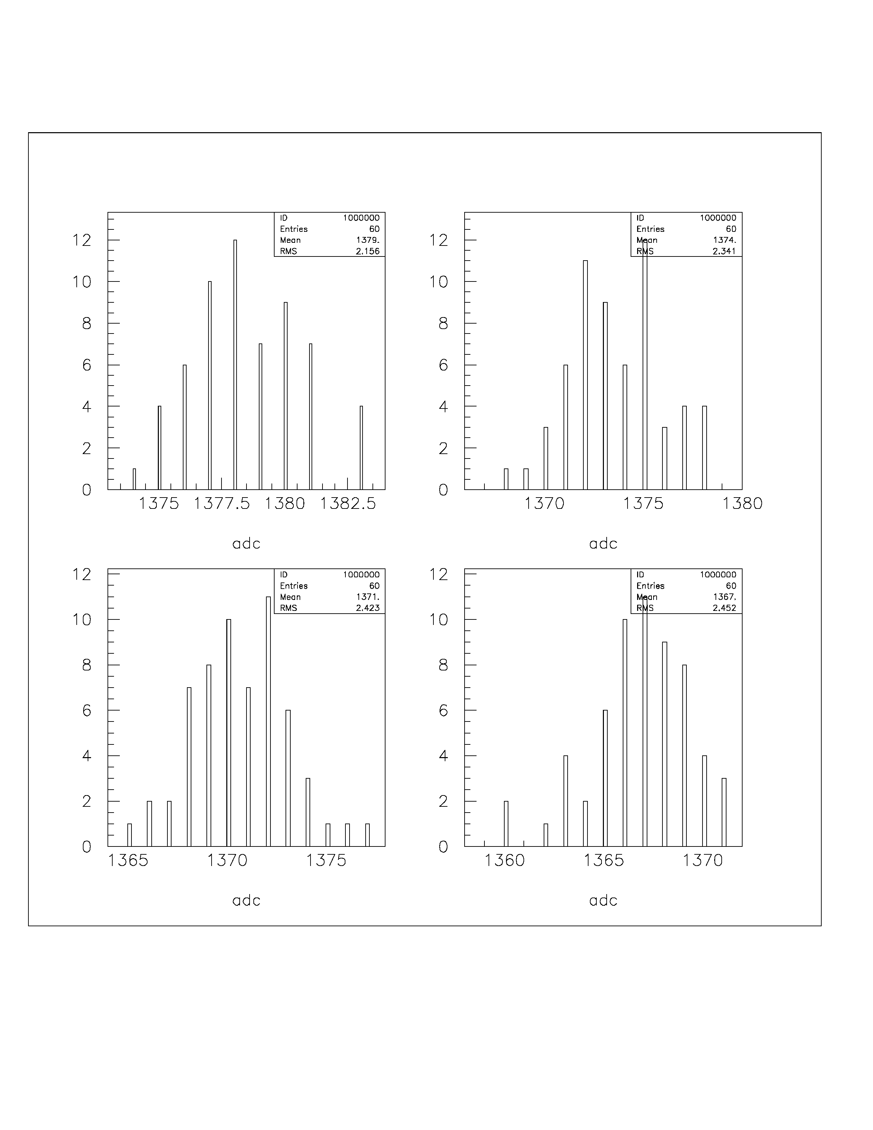
18 meters
L1 delay 16
smpl =27
smpl =28
smpl =29
smpl =30

