Slide 1
Inputs
Total emcal channel = 96*256 = 24576.
  Phi and eta coverage is 0.025 *0.025
HCAL has 24576/16 = 1536 channel (outer only)
  Phi and eta coverage is 0.1*0.1 ➔ after 2X2 sum => 0.2 *0.2 coverage
2x2 sum are done in FEM. Each sum has 8 bits.
  Finest element we could send out in the FEM, constrained by the bandwidth of the system.
So we have 384 L1 primitives fibers from EMCAL and 24 from HCAL.
If we can not bring all fibers into one FPGA, we are dealing with processing data in subset of the detectors.

Slide 2
Physics goals
Hadronic jets
  SUM over EMCAL + Hadronic towers
    With 0.2 eta X 0.2 phi tower overlapping 2x2 sum.
    Threshold apply over the 2x2 sum. Isolation cuts.
Pair trigger
  With EMCAL 4x4 overlapping sum
  SUM threshold applied, isolation cut applied
  10 bits energy (??) with both eta and phi angle
  3 bits eta and phi address will be enough to reconstruct the mass.
    look up table to deal with the math associate with angles.

Slide 3
4x4 sum require data from neighbor 2x2 cells
Simple isolation cuts will required data from neighbor 4x4 sum.
Overlapped 4x4 sum mean we have as many 4x4 sum as input 2x2 sum .
For example as
4x4 matrix of 2x2 sum will require data from 2 top rows, 2 left columns, 1 bottom rows and 1 right columns.
Bring in more data from neighbor region.
Constrains building “trigger processing blocks” either in complete phi or complete eta.
  So we only have deal cross stitching from two edge only
➔ Trigger block should at least cover 8 2x2 width
  Limit the bring the neighbor data to less than 3/8 of input bandwidth.
4x4 sum (2x2 of <2x2> sum)
05
05
15
25
35
45
55
04
14
24
34
44
54
4x4 overlapped sum
03
13
23
33
43
53
02
12
22
32
42
52
01
11
21
31
41
51
Simple
Isolation cut
00
10
20
30
40
50
>=
>
>
>=
41
>
>=
>=
>

Slide 4
Data division
The EMCAL data have 256 channel phi and 96 channels in eta.
Assume
  Each fiber cover 64 channel in square form (8x8) for each cable mapping
  2 layers of 8x8 channels
If complete phi coverage ➔ 64 fibers, For complete eta coverage ➔ 24 fibers per trigger processing blocks.
  Plus sending and receiving of cross stitching fibers from neighbor region. Ignore end of the detector effect.

Slide 5
Proposed system
Using existing calorimeter digitizer system infrastructure
  Beam clock distribution
  Slow control/offline read back system
  Power distribution
    2 sets of 2 12V 50A power bug ensure enough DC power distribution.
    Use only every other slots
      For heat and power
  Mechanical support

Slide 6
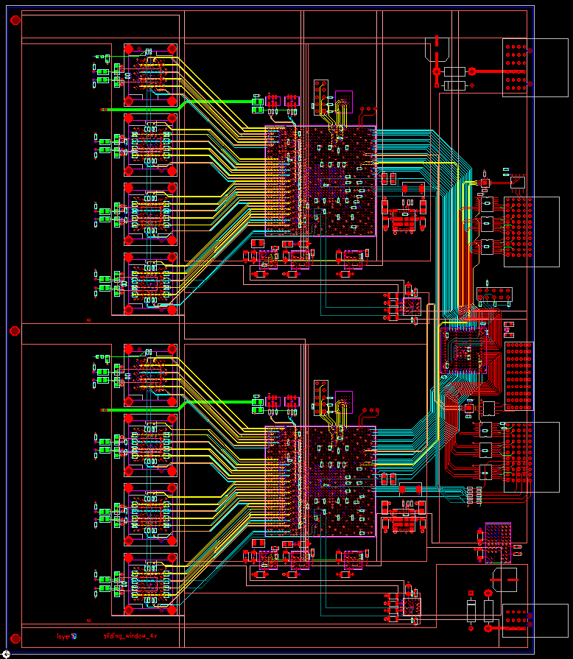
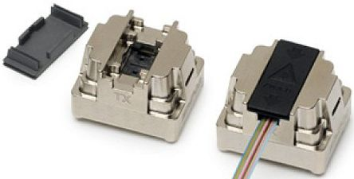
SPHENIX calorimeter Level 1 Trigger
Conceptual design
Borrow Calorimeter Digitizer infrastructure.
Receive digitizer trigger primitives
Provide cross stitching between tiles.
Generate trigger primitives for global level 1 trigger
Boards consists of two building blocks
Each block has 36 optical receivers and
12 optical transmitter
Altera Arria 10 20 nm FPGA as the computing engine
1517 pin package. 0.95V core.
FPGA Optical speed up to 6.5Gbps
570K logic element →
600K, 900K, 1150K
The cost should be around $1K-$2K per FPGA.
Need to be reconfirmed.
Fuse and Zener
Trans-
mitter
R
E
C
E
I
V
E
R
6A,
0.9V
4A,
0.95V
4A,
1.8V
4A,
1.8V
2A each,
2.5V & 3.3V
12V in
Fuse and Zener

Slide 7
EMCAL Section (1)
L1 trigger Arria 10 GX block.
  Assume we will do the trigger data along the eta direction.
    24 fibers will cover 96 channel in eta and 16 channel in phi direction.
  Need 48 2x2 sum from the bottom block and 2 set of 48 sums from the top block.
    The fundamental is 48 8 bits data. ➔ 24 16 bits data + 1 header + 1 beam clock + 1 space → 27 data words → bandwidth need to be at least 5.4 Gbits
  The same thing hold true to copy data over to neighbors block.
  This will call for 3 transmitters and 3 receivers for cross stitching
    Or more lower bandwidth with more fibers.

Slide 8
EMCAL Section (2)
Need to do non-overlapping sum for Hadronic jets→
  Mapping is not uniform in eta and uniform in phi.
  For bandwidth calculation use 8x8 non-overlapping which over 0.2 in phi.
  Trigger block holds 24*16 2x2 sums => 384 2x2 sums => 24 8x8 sum.
    This is about the same as single cross stitching data bandwidth requirement
    1 transmitter required.
For pair trigger,
  set threshold on overlapping 4x4 sum.
  Maximum 4 peak outputs. 6 bits address (eta, phi), 10 bits energy
  This will require 1 transmitter.

Slide 9
Pair Trigger
16 inputs
From EMCAL
Shower max
GL1
Jet Trigger
24 fibers
Outer HCAL
HCAL
Level 1
Trigger primitives concentrator
16 inputs
From EMCAL
8X8 sum
8 fibers
output
24 fibers
inner HCAL
GL1
8 inputs
From HCAL
2x2 sum
0.2X0.2 eta and phi

Slide 10
Module count
Each trigger processing block cover 16 channel in phi,
  16 (256/16) trigger blocks will cover EMCAL section
1 Trigger blocks for HCAL concentrator
1 trigger processing block for the pair trigger
1 for jet physics.
So we are talking about around 10 Modules to do the whole L1 trigger
  1 crate for the moment

Slide 11
Alternative choice
Possible choice
  Commercial solution –Hitech
    Not enough optical inputs ports.
  ATLAS gFEX (Global Feature Extractor) board.
    A very complex system. Over-killed for us. No expertise
  ATLAS FELIX board
    Designed for DAQ system. Not suitable for cooling and Power distribution.

Slide 12
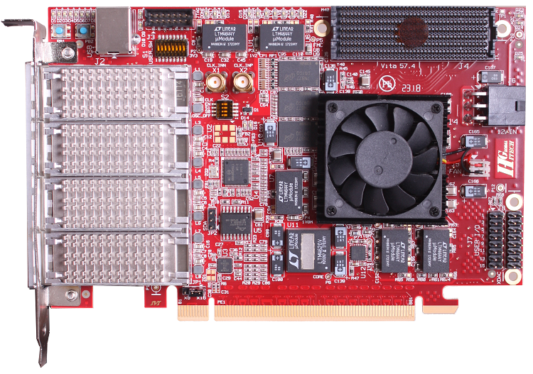
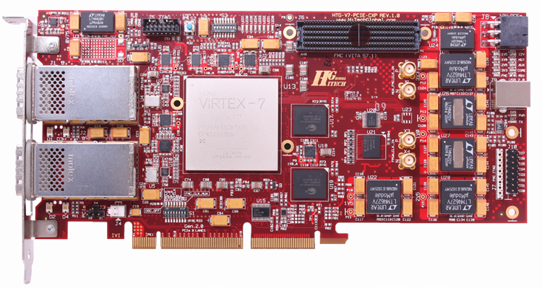
HiTech Global provide boards that similar to the ALTERA or XILINX evaluation board
Have some boards with optical interface with CXP, QSFP etc.
Optical → FPGA interface tend to one side of FPGA.
CXP has 12 port transceiver. QSFP(4 SFP) really for higher optical speed than 10 Gbits/sec than channel count.
It is does not offer number of ports we are looking for..
FELIX is far better choice than Hitech if we are going through PCIE environment
QSFP
CXP

Slide 13
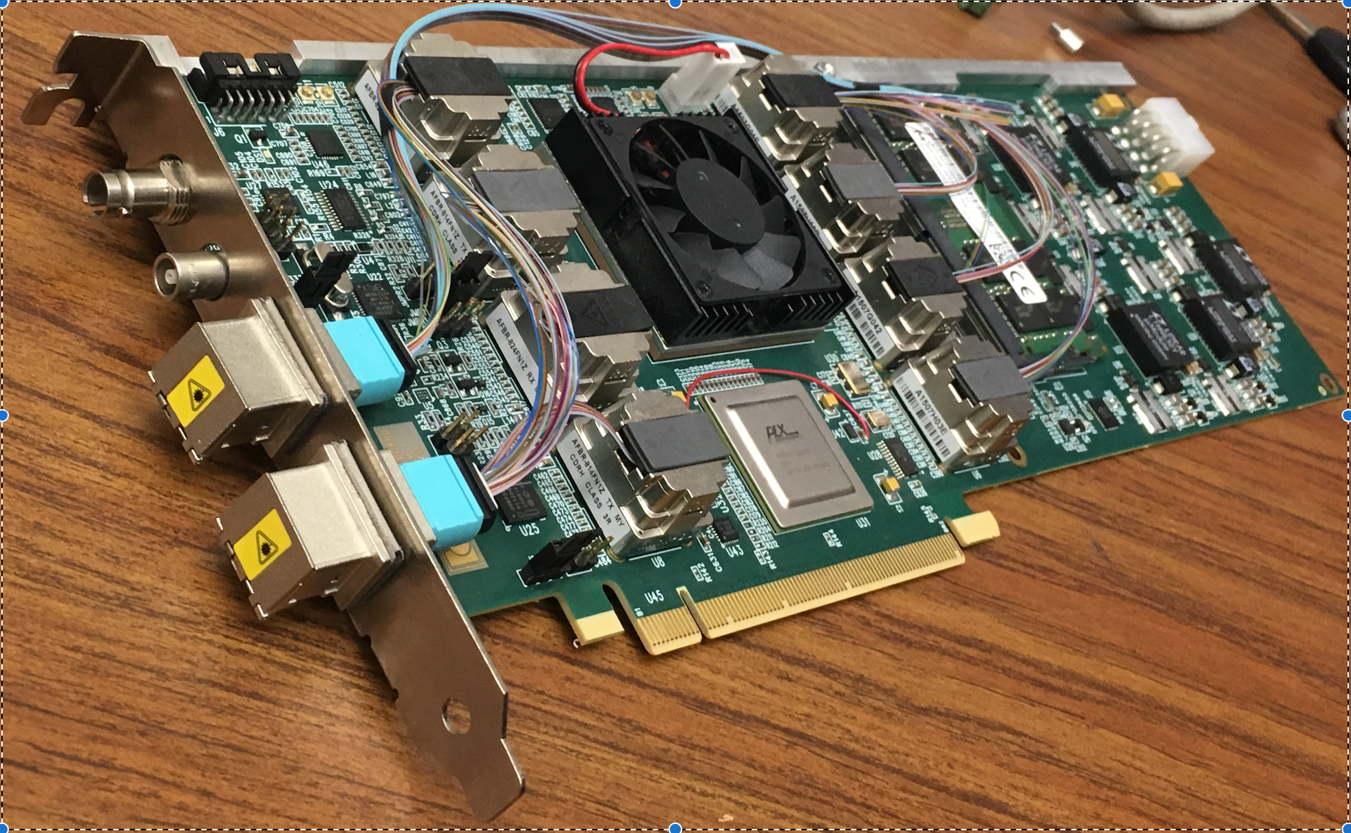
ATLAS/FELIX BNL-711 PCIe Card
Credit: Kai Chen (BNL), https://indico.bnl.gov/conferenceDisplay.py?confId=2653
BNL-711 Board chosen for ATLAS FELIX project, and used in ATLAS phase I upgrade, which is projected to complete before sPHENIX.
Readout for ATLAS Phase-I sub-system of Liquid Argon Calorimeter, Level-1 calorimeter trigger, New small wheel of the muon spectrometer

Slide 14
gFEX board
Based on ATCA crate
Optical speed up to 12.8 Gb/sec
100 optical input FPGA. 3 set of XLINK FPGA
(Ultra scale XCVU160 series, 2 M logic cells)
Up to 300+W of power consumption

Slide 15
Status
We are a 1st cut of EMCAL FPGA code
  24 receivers + cross stitching fiber in/out + output transmitter + 2X2 overlapping sums + peaks finding + slow controls etc
    (30 optical receiever + 10 optical transmitter)
  We have some estimate of the power usage.
    Looks reasonable for the proposing regulators
We brought 4 Altera Arria 10 FPGA, roughly 4.8K, plus some optical receiver and transmitter.
Looking for building a test system for the coming summer period.

