Slide 1
MBD Local Level 1 trigger status
MBD trigger block diagram.
MBD Local level 1 trigger block diagram.
Preliminary MBD timing measurement
Trigger data monitor/setup
Use L1 trigger to readout FEM and LL1 data

Slide 2
MBD Trigger Primitive data path (preliminary)
For 32
channels
Time
SUM
Bit 9 (hit)
Slewing
Correction
12X8
Trigger
output
Choose
phase
Timing
Block
10X10 lookup table
9 bits
Time
channels
ADCs
Post-Pre
optics
3 bits
10X10 lookup table
Charge
SUM
2.4 Gbps
8 X16 bits words per beam crossing
charge
channels
ADCs
Post-Pre
Choose
phase
7 bits
6X beam clock
ADC clock and discriminator clock are interlock together.. So sample height is fixed for a given PMT pulse time
Beam gate is 25ns → 9 bits range will be 50ps per division.
For the timing block we can choose either fix sample relative to BC, peak finder etc…
ADC correction table for time is constructed as 10X10 bit memory block → bit 9 is used for yes/no NHIT

Slide 3
 | MBD FEM → LL1 Data Packet
Bit 8 - 0 | Charge Sum channel 3-0
Bit 17 - 9 | Charge Sum channel 7-4
Bit 26 - 18 | Charge Sum channel 11 - 8
Bit 35 - 27 | Charge Sum channel 15 - 12
Bit 44 - 36 | Charge Sum channel 19 - 16
Bit 53 - 45 | Charge Sum channel 23 - 20
Bit 62 - 54 | Charge Sum channel 27 - 24
Bit 71 - 63 | Charge Sum channel 31 - 28
Bit 79 - 72 | 2’b0, nhit(5:0)
Bit 91 - 80 | Time Sum channel 7 - 0
Bit 103 -92 | Time Sum channel 15 - 8
Bit 115 - 104 | Time Sum Channel 23 - 16
Bit 127 - 116 | Time Sum channel 31 - 24
Bit 143 - 128 | Header word
8 16 bits words

Slide 4
120 MHz
Optical clock
24X beam clock (adjustable)
156.25 MHz
Optical clock
Preliminary MBD
LL1 trigger
Algorithm
last
cnt
Q
sum
Divide
Function
(4 cycle delay)
FEM
optics
De-serializer
FIFO
Packet
16x8
Re-map
NHIT
Time
SUM
average
time
Fake GL1 receiver
loopback
rxclk
24x bc
BC
Time diff
Time sum
transmitter
optical
Receiver
Optical
Re-clocked
Into BC space
de-serialize the MBD trigger optical data (2.4 Gbps)
Re-aligned the data to beam clock space based last word from the data packet.
Calculate the time average from 2 ADCs from each side of the ADC ( a divide function)
Calculate time difference and average time.
Send data out through 3.125 Gbps link.
Delayed
sync

Slide 5
Fake ADC data
We can load test data into the ADC test memory. It could replace the ADC data under software control.
The test memory depth is 480 deep. With 6x beam clock, the test memory will cycle through every 60 beam clock.
We are using this test data to perform the timing latency and data checking.

Slide 6
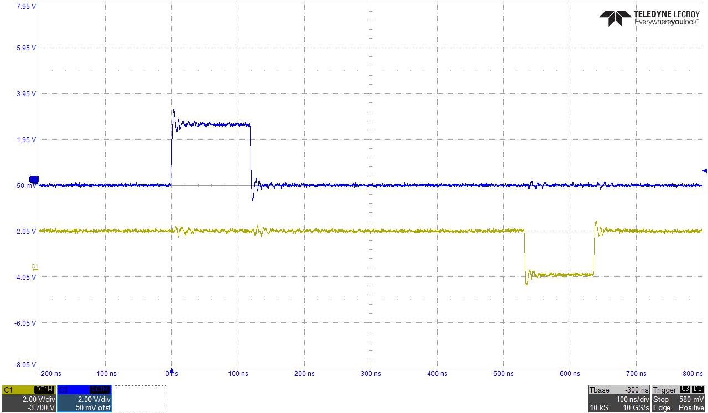
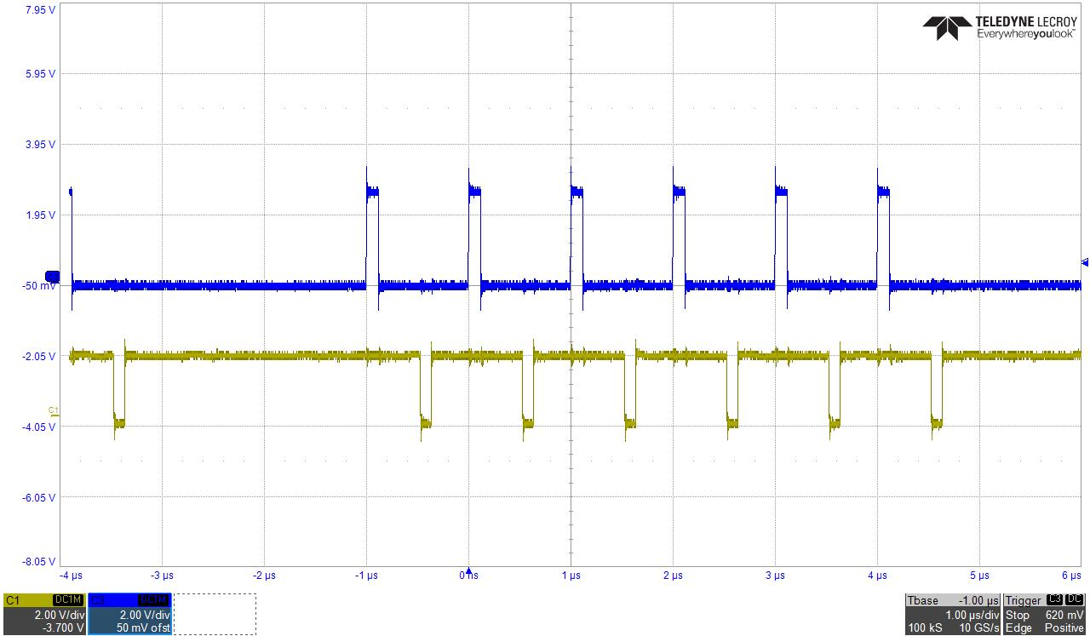
ADC to MBD Latency
ADC fake data --> LL1
De-serialized
Data in
ADC FPGA
5 test patterns
Data show
up in LL1
(NHIT >0)

Slide 7
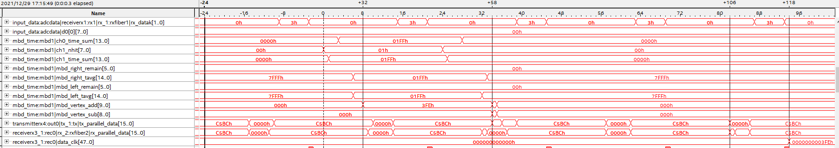
Simulated
GL1
Receiver
LL1 internal data flow timing diagram
Sampling clock 24X bc
Optical
data
Vertex
Add
Data out
to optical
Optical
data
receive
Receive
data
Re-clocked

Slide 8
Startup and Monitor (1)
The questions on how we will check/monitor the LL1 trigger inputs/outputs are important.
The FEM data contains data packet + header (trailer)
The header word, contain 8 bits module address and 8 bits beam clock numbers.
We can watch the optical receivers lock status with slow control readback
We can readout the headers words from input fiber vs trigger module clock number.
There is an offset between trigger module clock number vs FEM clock numbers
Depend when is the readout strobe, the offset could move slightly.

Slide 9
Startup and Monitor (2)
We also need to get samples of the LL1 data and it’s calculation for
a) knowing the FEM data and
b) get sample of LL1 calculation in trigger events.
Get samples of data before and after trigger event
This large data samples can be readout through controller or through JSEB II.
The controller readout will be easier in standalone condition. The readout through JSEB II will be able to match the final data taking trigger rate.
For each fiber input, we will need 128 bits wide and 128, 32 samples * 8 events, deep dual port memory.
4 channel ➔ 32 channel of ADC data, 24 channels → 192 channel of ADC data (or 3 ADC modules equivalent)
Can choose delay setting and number of samples (32 samples max)
Can we combine two JSEBII optical channels into one DMA transfer in JSEB II ???

Slide 10
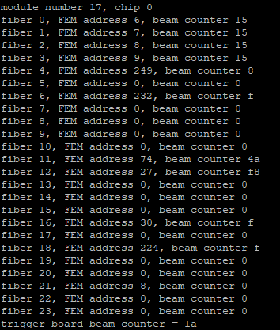
The last word of the FEM → LL1 data packet contains module address and 8 bit beam clock counter
The beam counters, FEM & LL1, are reset together from GTM mode bits, except for difference in the mode bits data path.
The difference of beam counters between FEM/LL1 should remain the same except the uncertainty between the strobe and beam clock phase
One can readout the beam counter through slow control.
Additional alignment check is done with event by event check.
Beam clock status word read

Slide 11
MBD LL1 Data Monitor Path
Beam Clock number
Receiver
FEM trigger data
Calculation
result
BC (clock)
Delay FIFO
Dual port
Dual port memory
Wren
(sync)
Read
(L1 trig)
5 EVENTS
BUFFER
Write FEM trigger data/beam clock to the monitor dual port memory – adjustable delay parameter
Receiver L1 trigger → write data into multiple event buffer ( adjustable number of sample)
Multiple events buffer can be readout through JSEB II or crate controller
Can compare L1 data from FEM.
Provide data alignment check, data monitor.
To Monitor path
via either
Crate controller or JSEB II

Slide 12
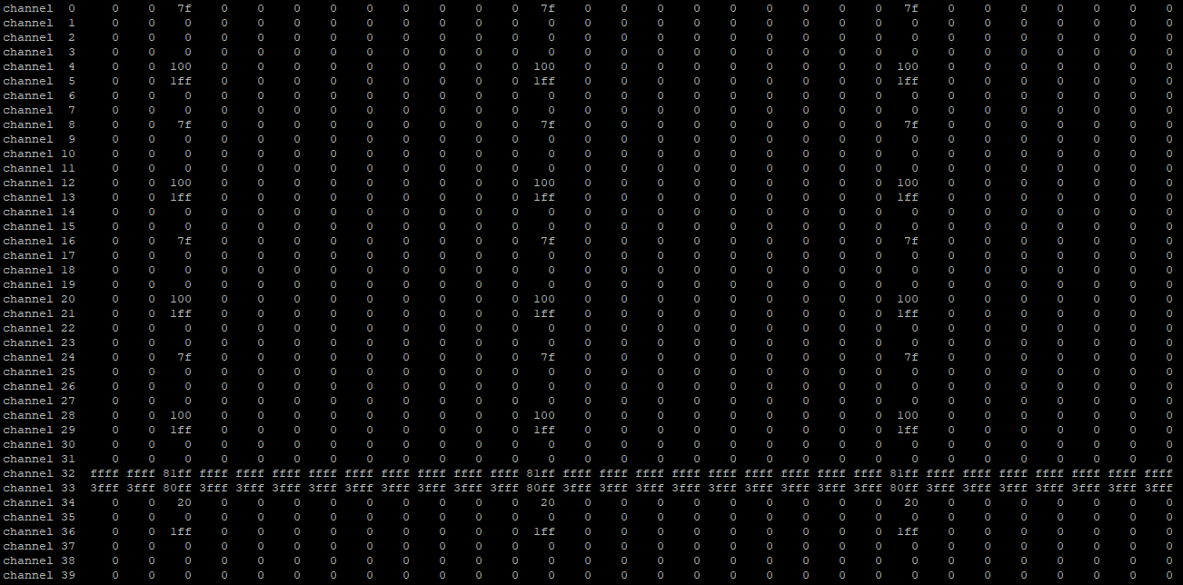
MBD LL1 monitor output
Optical fiber 1 data
Fiber data
Optical fiber 4 data
MBD LL1 calculation
Beam crossing

Slide 13
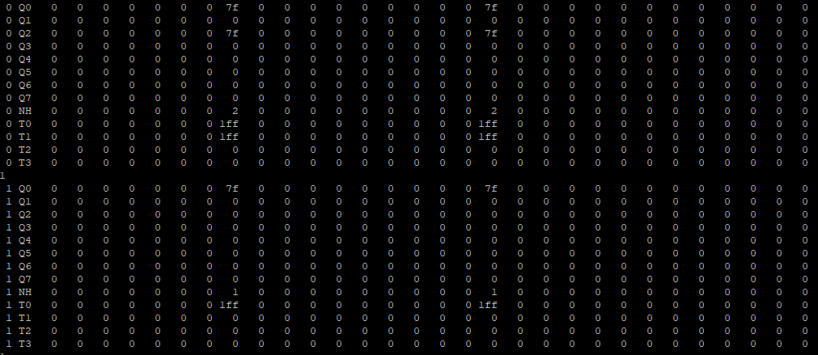
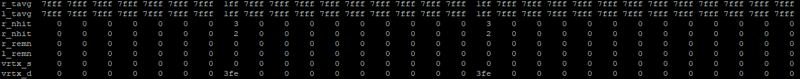
FIBER DATA
Translate FEM LL1 Monitor data into
MBD trigger format
Beam Crossing

Slide 14
Translate FEM LL1 Monitor data into MBD trigger format

Slide 15
Backup Slide

Slide 16
24
24
24
24
24
EMCAL
L1 data
processor
EMCAL
L1 data
processor
EMCAL
L1 data
processor
(inner/outer)
HCAL data
Concentrator
LL1 triggered
Summary data
crate backplanes
(slow control/timing)
Shower Max
8x8 sum
non-overlapped
16 fibers
16 fibers
16 fibers
Pair Trigger
JET Trigger
LL1 data
(JSEB II)
(20 optical links)
Reduced
Trigger
Data
Reduced
Trigger
Data
Global
Level 1

