Slide 1
MBD electronics Design
Measurements
Scope, block diagram etc.
Timing measurement, charge measurement.
Clock Fanout module, backplane & controller.
ADC block diagram, Level 1 trigger discussion.
Test pulse issue
Production

Slide 2
MBD electronics measurements
The electronics need to measure PMT charge and time and participate local level 1 trigger.
  Measurement window ~25ns
Development cost is high for standalone system.
  We will use calorimeter digitizer system to handle the analog to digital conversion.
  The MBD electronics will do the analog portion of the system, discriminator and charge integrator.
We spilt the PMT pulse into
  1) shaped pulse to be digitizing by 6x BC (~ 60 MHz) 14 bits ADC
  2) converted gated discriminator pulse to shaped pulse and digitized by the same ADC
    Integrated the “ discriminator pulse (rise) and beam gate (falling)” current pulse.
  We are looking at the difference between PMT time.

Slide 3
Electronics Scope
Small system (128 channels)
  Discriminator+ shaper → Calorimeter digitizer → Local Level 1 trigger
Discriminator system – 128 channels
  8 channel discriminator board
  Backplane + clock fanout board
Calorimeter digitizer system deal with DAQ requirements.
Local Level 1 board is identical to Calorimeter Local level 1 board
  FPGA code change

Slide 4
MBD Electronics Overview
~25ns
beam gate
Calorimeter
Clock and Mode Bit
fanout
test
pulse
sPHENIX
timing system
GTM
Clock
master
Beam
Clock
MBD
Clock fanout
slow
control
Digitizer
Crate controller
6x BC clock, mode bits
6x BC
MBD
PMT
shaper
64 channelCalorim-eter digitizer
Local
Level 1
Trigger
splitter
disc
shaper
8 channels
~25ns
beam gate
test
pulse

Slide 5
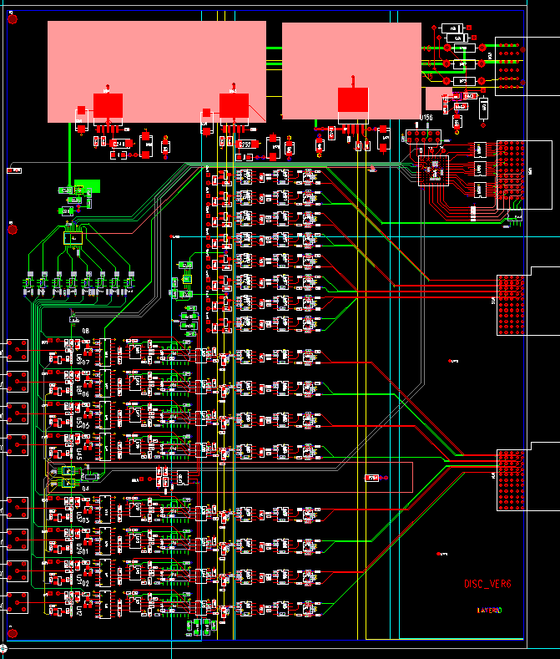
MBD Discriminator Module
Fuse
Zener
diode
8 channels of “Discriminator + shaper” < timing> +
“Shaper” <charge>
Passive splitter between timing + charge measurement
Diodes are used to protect input circuits
Comparator is the same one as used in PHENIX beam beam
Electronics.
Shaper is 3 poles shaping, 20ns shaping time
(discrete components)
12 bits DAC to set threshold – one per channel
Charge injector DAC per channel → control through test
Pulse. (EVEN or ODD channels firing)
FPGA are ALTERA MAX series (EPLD)
Slow
Control
in
Test
pulse
Threshold DAC
PMT pulse
shaper
2mm
HM
connector
MBD Discriminator
Charge
Injector
DAC
2mm
HM
connector
Beam Gate input
discriminated
Pulse shaper
discriminator

Slide 6
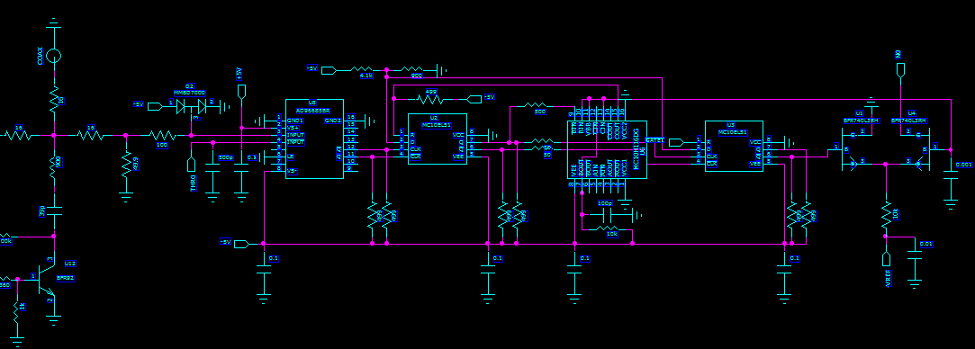
Discriminator Schematic
Beam
Gate
input
Standardize
pulse
Interface
with shaper
comparator
Pulse width
Charge
Injector
Even /odd channel
Firing control

Slide 7
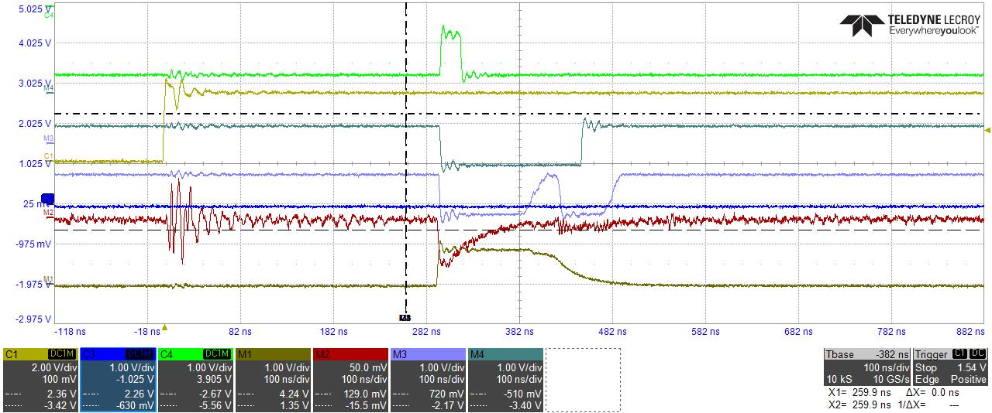
Test Pulse → charge injector → Discriminator
After gated with
beam window
Test pulse enable
from clock fanout module
Standardized pulse
Comparators out
Charge injector
signal pulse
Charge gate

Slide 8
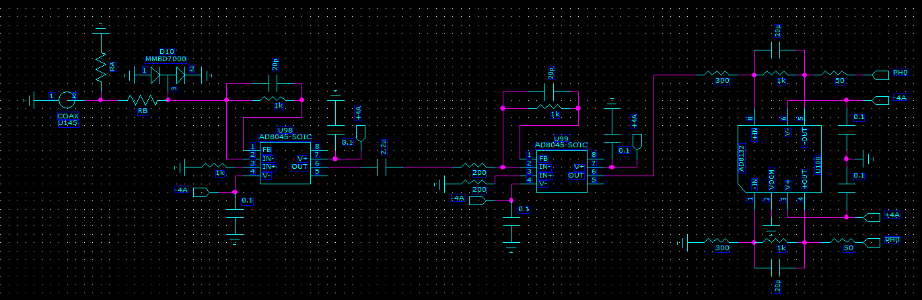
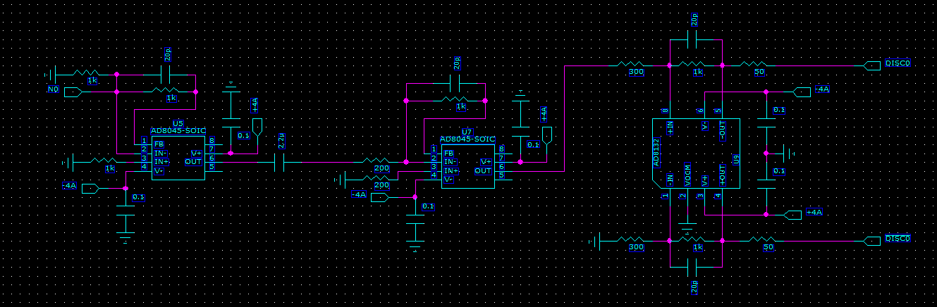
Charge shaper
circuit
Time shaper
circuit

Slide 9
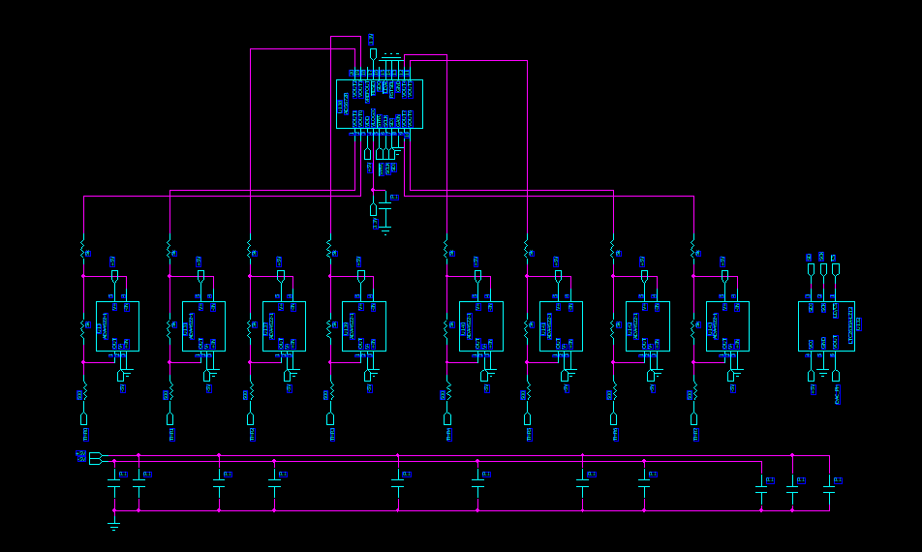
Discriminator DAC
8 channel 12 bits DAC
Charge Injector
12 bits DAC
Threshold Circuits
Channel by channel

Slide 10
Shaping function as function of shaper input
(2ns, 5ns, 10ns, 20ns)
Shaping function is 3 20ns shaper.
Width are define as the discriminator comparator (leading edge) vs beam gate (falling edge)
disc
2V full scale
gate
Shaper input
200ns full scale

Slide 11
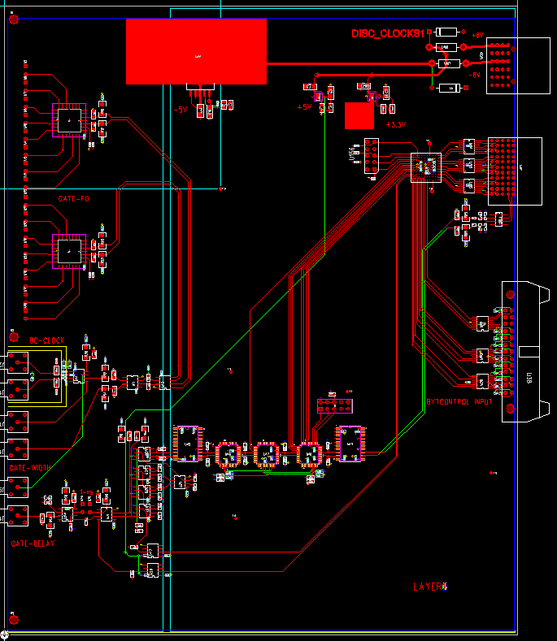
MBD Clock Module
Receiver clock from Clock Mater module
Generate Beam Gate ( ~25ns)
“AND” operation between clock and /Clock delay
Coaxially fanout all the beam gate pulse to discriminator modules.
Generate 2 test pulse options, test pulse or test pulse + ~1ns (cable delay)
Test pulse delay are set by cables and by 3 set of delay chips (MC100EP196FAG), 80ps per step, 10ns per chip, 30ns range.
Receive slow control from digitizer crate controller
Slow control set
threshold DAC, charge injector DAC
test pulse firing, delay steps,
test pulse option (with or without 1ns delay)
FPGA are ALTERA MAX series (EPLD)
Beam Gate Fanout
Slow
Control
out
TP
out
Input from
Calorimeter
Crate controller
Clock
input
Fine delay
adjustments
Beam
Gate
Delay chips
Fix delay
jumper
30ns range
TP delay
Test pulse
MBD clock module

Slide 12
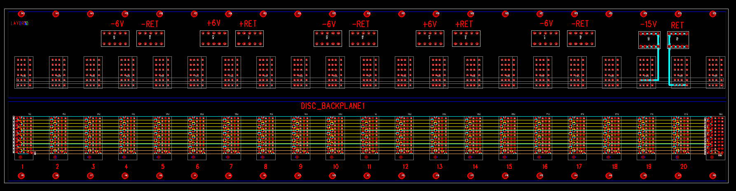
MBD backplane
Provide Power, slow control
Partial backplane in height. Require modification on the crate side panels. (2 holes).
Estimate power usage -6V ~50A, +6V ~40A, -15V ~ 1A
ERNI 2mm HM power connector 254927 for Power 10.8A current capacity.
+6, -6V use Molex Z power 76001-0010, 50A capacities. -15 V used for TVC only low current, Use Tyco 9-55556-0 25A each

Slide 13
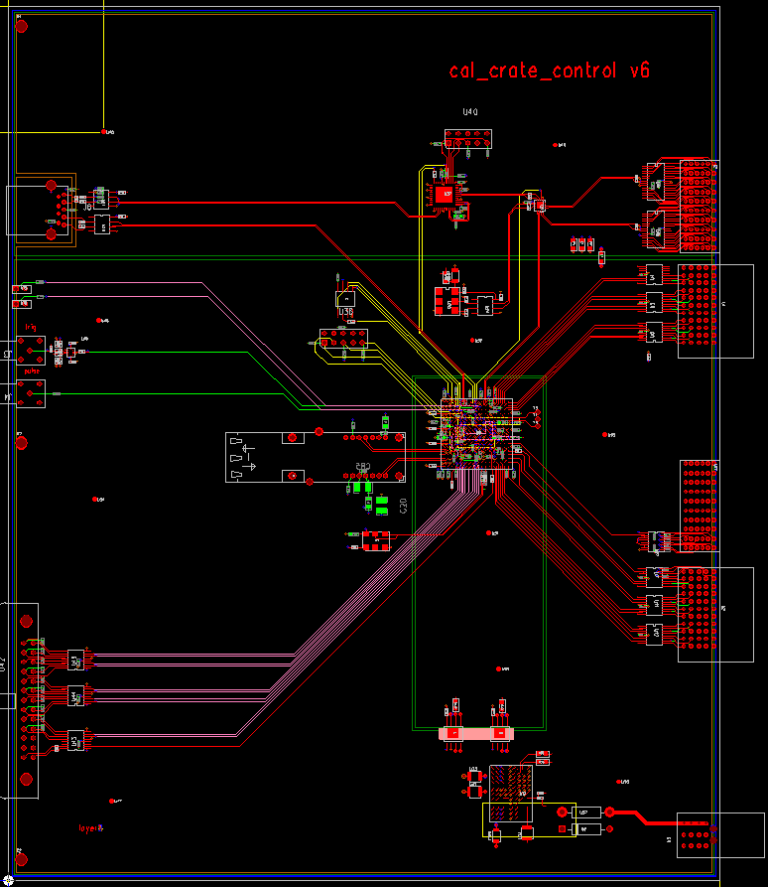
Calorimeter
Crate controller
Through PCIe board, the controller send command to ADC module, XMIT Module and MBD clock fanout modules. It also provide readback path for the ADC modules.
Receive 6x beam clock, mode bits from clock master module.
Fanout 6x beam clock to ADC and XMIT modules
6x clock out
6x Clock,
mode bits
Input
Slow control
readback
Mode Bit
fanout
Download/readback
Optical connection
JSEB II
Slow control
download
MBD command
output

Slide 14
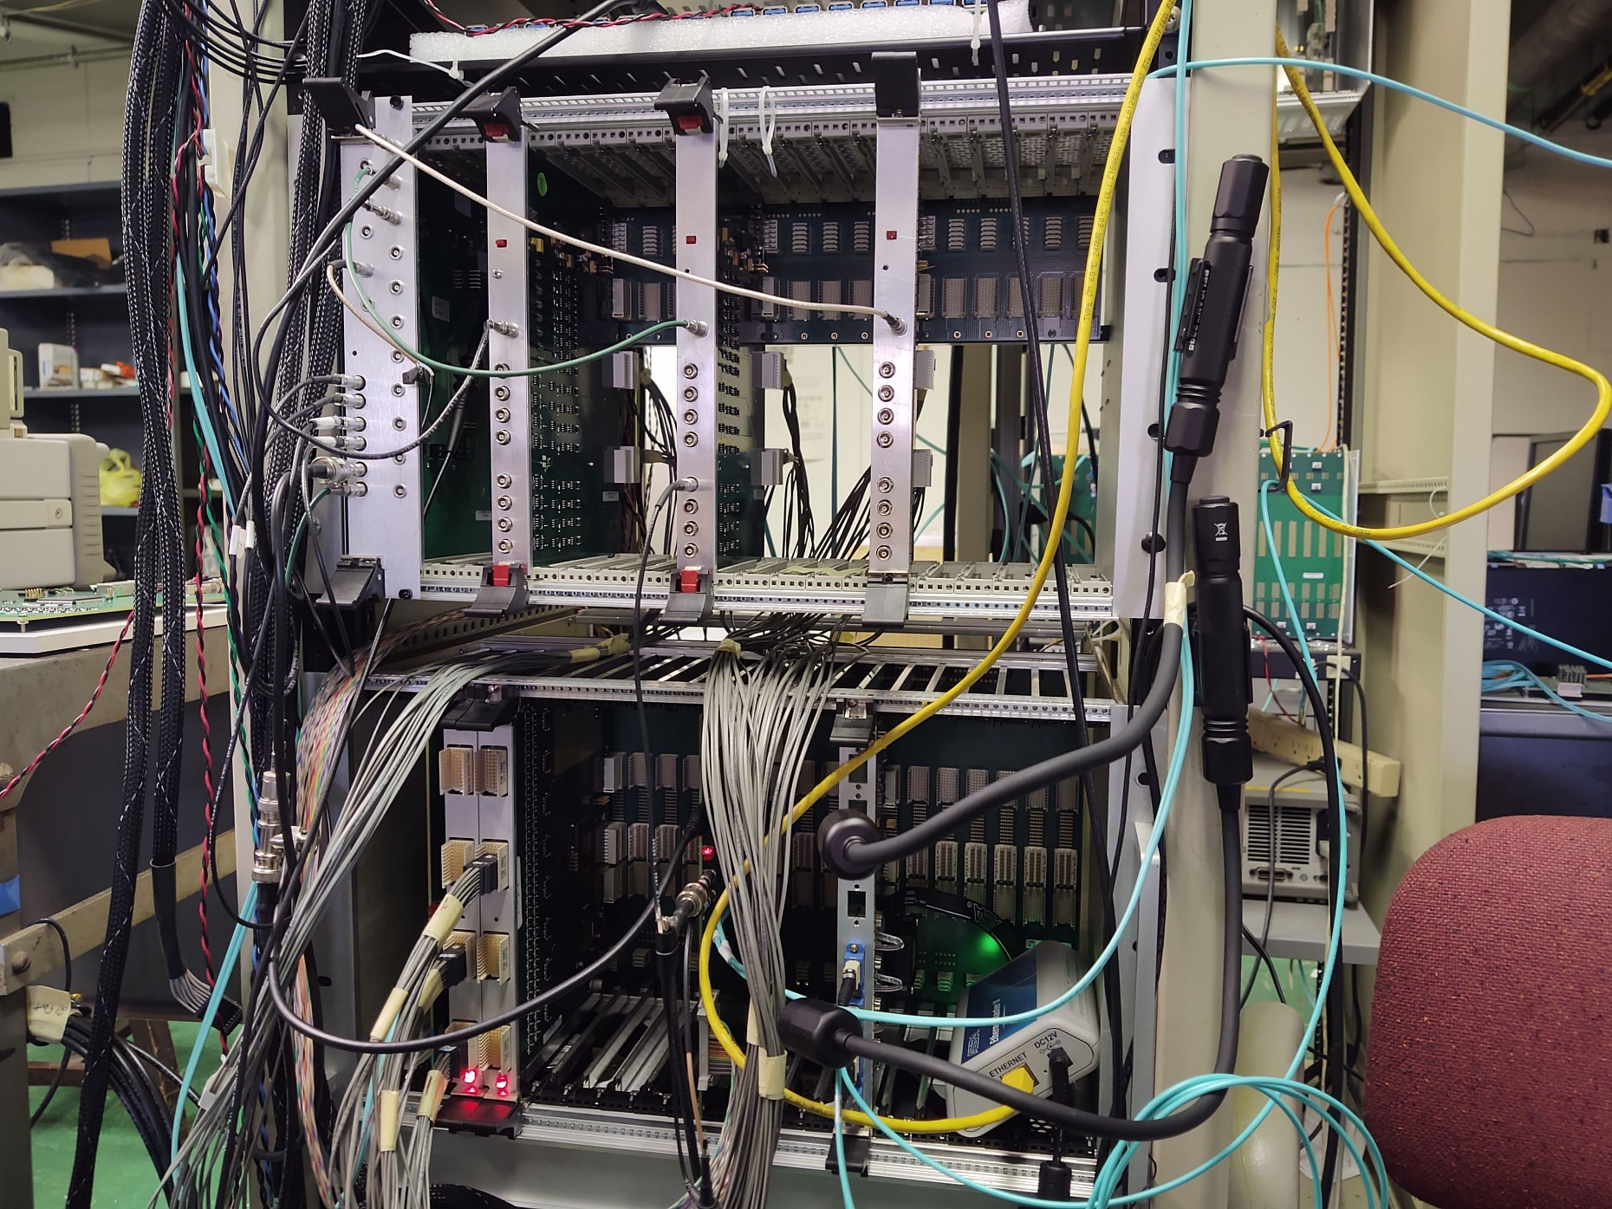
Test Stand
Clock fanout module
Discriminator module
INPUTS
ADC module
Signal cables
Trigger modules

Slide 15
sPHENIX ADC Module Block Diagram
RHIC beam clock 9.6MHz
Analog
Device
AD9257
8 channel
14bits
65 MHz
ADC
7X ADC clock
+4V, -3.5V, +2.5V
Power
+- 3.5V, -2.5V
Differential
receiver power
+1.8V analog
ADC power
+1.8V digital
ADC power
F
R
A
M
E
Serialized ADC DATA
ALTERA Arria V GX
BB1D4F35
1152 pins FPGA
6x beam clock
Beam phase,
init, L1
Differential
receiver
De-serializer
D
P
U
2 mm
Hard Metric
Token
Passing
Data
two transceivers
64 channel
ADC board
Clock
Fanout
L1
Delay
Buffer
5 L1
Accepted
Event
buffer
Serialized
Token
Passing
6 X beam
clock
Serial
command
two transceivers
2 mm
Hard Metric
L1 trigger primitives
transceiver out
De-serializer
command/
offline data read
Differential
receiver
F
R
A
M
E
Serialized ADC DATA
Bused command
Serial data
Analog
Device
AD9257
8 channel
14 bits
65 MHz
ADC
3.3V
LDO
3.3V
LDO
DC/DC
switch regulator
4V
+12V
Power
7X ADC clock
2.5V FPGA I/O
DC/DC
switch regulator
1.5V
LDO
1.1V
core

Slide 16
BC & L1 event
numbers
Sphenix
64 channel ADC
Data Flow Diagram
Beam clock
number
Header
512X16
Header
8 x 32
6x RHIC
clock
L1
trigger
6x RHIC
clock
14 bits ADC
serialized data
840 Mbits/sec
LVDS
De-serialize
/alignment
Input
control
L1 Delay memory
512X128
8 events buffer
256 X
1024
FIFO
2048 *
34 bits
(first, data,
Last)
Alignment
16bits
FIFO
Gbits
receiver
8b/10b
encoding
Serialized
data
from down
Stream board
1-8
16bits
FIFO
Gbits
receiver
Fake data
512X16
wadd
1-64 channels
radd = wadd
- delay
Token in
Link control
Gbits
transmitter
8b/10b
encoding
Serialized
data
L1 trigger
Primitives
generators
Token out
120 MHz
Reference
clock
80 MHz
Reference
clock
Write address
3 bits events,
5 bits samples
Gbits transmitter
read address
3 bits events,
5 bits samples
write =
valid & token
Read =
!empty
LVDS repeater
Slow control
readback
backplane
Daughter card
Optical
transceiver
Lemo out

Slide 17
Cal trigger primitive Generator (preliminary)
6X BC clock
12X BC Clock
120 MHz clock
delay
+1
+2
+1
+ 1 BC + 2 12X
4 bits trigger phase
Dual port memory
Baseline
subtraction
Lookup memory
(1024X10)
10 bits
2X2 SUM
(12 bits output)
only use
upper 8 bits
Choose one of the of of the 12X BC clock phas for trigger primitive
MUX
128 bits
To 8 16 bits
10X16 bits FIFO
Transceiver
IP
Read
Address
(upper 10 bits)
Read address = write address -delay
Load lookup
Memory from
Slow control
Sub = ADC – ADCpre
If (adcpre > adc) sub=0
64 channels
16 2X2 8 bits sum
Delay a parameter
Probably has 2 clocks offset
1 | 2 | 3 | 4 | 5 | 6 | 7 | 8 | 9 | 10
header | Mod + clock | Sum 1+2 | Sum 3+4 | Sum 5+6 | Sum 7+8 | Sum 9+10 | Sum 11+12 | Sum 13+14 | Sum 15+16
Monitor Delay dual port memory
5 events buffer
To controller
readout
Delay and
# of Sample
adjustable
L1
trigger

Slide 18
MBD Trigger Primitive data path (preliminary)
For 32
channels
Time
SUM
Slewing
Correction
12X9
Trigger
output
Choose
phase
Timing
Block
10X10 lookup table
9 bits
Time
channels
ADCs
Post-Pre
optics
3 bits
10X10 lookup table
Charge
SUM
2.5 Gbps
8 X16 bits words per beam crossing
charge
channels
ADCs
Post-Pre
Choose
phase
7 bits
6X beam clock
ADC clock and discriminator clock are interlock together.. So sample height is fixed for a given PMT pulse time
Beam gate is 25ns → 9 bits range will be 50ps per division.
For the timing block we can choose either fix sample relative to BC, peak finder etc…

Slide 19
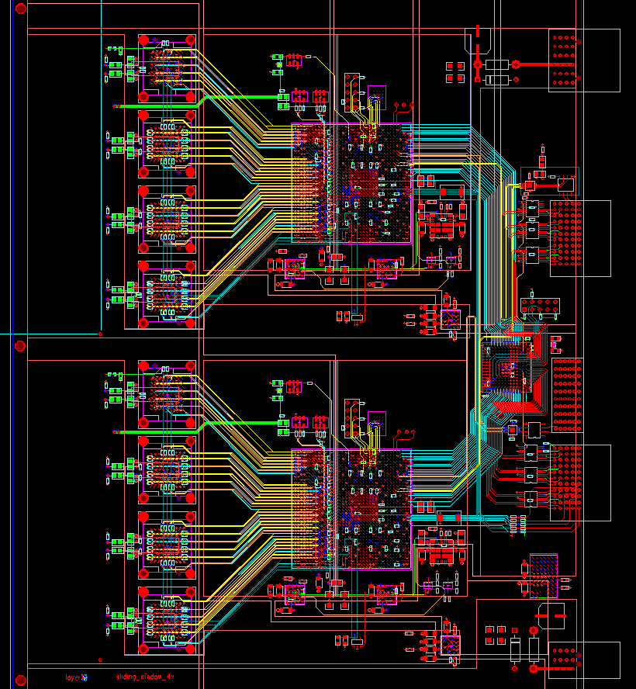
LOCAL LEVE1 Board
. Receive MBD FEM optical data
. Process the data FPGA
. Send Process data to Global Level 1
To Global
Level 1
12 optical
transmitter
Altera Arria 10
FPGA
36 optical
receivers
From FEM

Slide 20
LL1 Block Diagram
EMCAL
GL 1
Overlap 2x2 sum
Peak
finder
Pair trigger
receiver
Cross stitch
8x8 sum
inner/outer HCAL
2X2 sum
JET trigger
receiver
HCAL
receiver
Interaction window / charge
MBD
The domain factor of L1 Latency on the optical transmitter/receiver
We have preliminary codes for calorimeter portion of the trigger
The MBD portion of the code is straight forward (hopefully??)

Slide 21
Measurement clocks
Beam Gate is fanout from one module centrally.
  All measurement is relative to this clock.
Digitizer board clock are fanout differentially from crate controller to each module, point to point.
  ADC clock are fanout to individual ADC.
The timing measurements is the difference between channels.

Slide 22
Possible issue
The test pulse is fanout through the backplane.
  It is mostly designed to be used for initial calibration (single module).
    by walking through delay chips steps and fix delay insertion.
  We don’t know exactly the effect of the test pulse propagation on fully loaded backplane.
    the added jitters and time shift.
    The final calibrations will be done through the beam data.

Slide 23
Discriminator Test Pulse
Propagation
100 ohms
termination
100 ohms
termination
LVDS receiver
LVDS receiver
LVDS receiver
LVDS receiver
PECL->
LVDS driver
LVDS -> CMOS
LVDS -> CMOS
LVDS -> CMOS
LVDS -> CMOS
8 channel fanout
(clock)
8 channel fanout
(clock)
8 channel fanout
(clock)
8 channel fanout
(clock)
Test pulse
generator
8 channel charge injectors
8 channel charge injectors
8 channel charge injectors
8 channel charge injectors
Clock
module
Discriminator
module
Discriminator
module
Discriminator
module
Discriminator
module
16 discriminator modules in the system, 8 modules per sides
0.8 inch space between modules
The discriminator modules will act like stubs
4mm trace length between LVDS receiver and backplane connector

Slide 24
What need to be done for production
On the prototype system
  We built 3 backplanes, 3 discriminator modules and 3 clock fanout modules
For discriminator board
  We need to swap the power ground pins on one of the chip
  Add more ground connection on the power connectors
  These two changes are done on the prototype module
  Add additional bypass capacitor per comparator.
    Did not seen much effect on the prototype modules but recommended by manufacture.
We will test all the discriminator modules in Nevis.

Slide 25
Backup slides

Slide 26

Beam
window

Slide 27
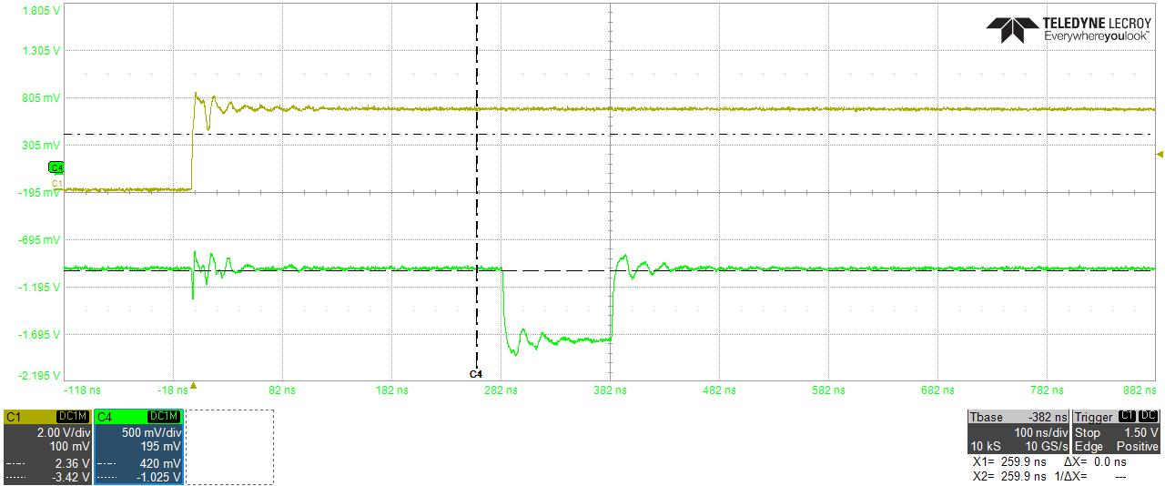
Test pulse enable
from slow control
Test Pulse

