Slide 1
Calorimeter Electronics Digitizer System Design Review
Digitizer overview
Block diagram
Digitizer board discussion
Input cable
trigger daughter card
XMIT, Controller and Clock Master module
Mode bits discussion
Power
Obsoleted parts
Major Components cost
Status

Slide 2
Calorimeter Digitizer system overview
Off detector ADC system for both EM and Hadronic calorimeter.
Received the amplified signal from on-detector amplify through cables
Digitize the signal at 6x beam crossing rate, ~ 60 MHz, with 14 bits ADC
Offset the baseline to use most of the ADC range.
Provide at least 40 beam crossing of data buffers to cover L1 trigger latency
Provide Level 1 trigger primitives.
Minimum 4 Level 1 events buffer.
Maximum 31 ADC samples per channel per events, 16 samples planned.
15 KHz Level 1 trigger rate (16 Samples/channel/Event).
Send Level 1 trigger events to the DAQ system.
24576 EMCAL channel, 1536 HCAL Channel.

Slide 3
The Subsystem Technical Overview
Crate based system.
Signals are cable from the on-detector electronics.
Digitized with 14 bit ADC.
Receive timing information the SPHENIX Granule Timing Module (GTM)
Generate L1 trigger primitives
Receive L1 trigger and send out L1 triggered event data to Data Collection Module II (DCMII).
Provide buffer for both the 40 beam crossing L1 delay buffer and 4 L1 triggered events
Clock are fanout point to
point through the backplane
Trigger
out
crate
Trigger
out
Slow control/readback
bus, L0, L1 trigger
Token passing
dataway
Token passing
dataway
Controller
ADC
ADC
XMIT
3 ADC → XMIT
(rack based)
detector
clockmaster
3Gbit/sec
optical link
1.6Gbit/sec
optical link
Slow control/readback
Beam clock,
L0, L1 trigger
GTM
JSEB II
DCM II
PC
SPHENIX DAQ System

Slide 4
sPHENIX ADC Module Block Diagram
RHIC beam clock 9.6MHz
Analog
Device
AD9257
8 channel
14bits
65 MHz
ADC
7X ADC clock
+4V, -3.5V, +2.5V
Power
+- 3.5V, -2.5V
Differential
receiver power
+1.8V analog
ADC power
+1.8V digital
ADC power
F
R
A
M
E
Serialized ADC DATA
ALTERA Arria V GX
BB1D4F35
1152 pins FPGA
6x beam clock
Beam phase,
init, L1
Differential
receiver
De-serializer
D
P
U
2 mm
Hard Metric
Token
Passing
Data
two transceivers
64 channel
ADC board
Clock
Fanout
L1
Delay
Buffer
5 L1
Accepted
Event
buffer
Serialized
Token
Passing
6 X beam
clock
Serial
command
two transceivers
2 mm
Hard Metric
L1 trigger primitives
transceiver out
De-serializer
command/
offline data read
Differential
receiver
F
R
A
M
E
Serialized ADC DATA
Bused command
Serial data
Analog
Device
AD9257
8 channel
14 bits
65 MHz
ADC
3.3V
LDO
3.3V
LDO
DC/DC
switch regulator
4V
+12V
Power
7X ADC clock
2.5V FPGA I/O
DC/DC
switch regulator
1.5V
LDO
1.1V
core

Slide 5
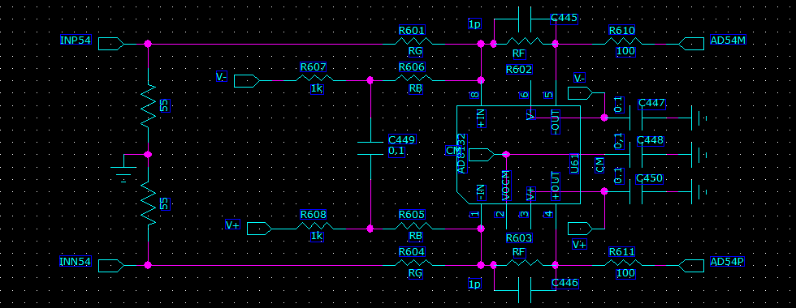
The ADC system has 14 bits output (0- 16383 ADC counts)
The ADC input is differential, need to supply both + and – inputs ( peak-peak range is 2V)
(122 μV per ADC counts)
+1V on the positive side and –1V on the negative side
8192 ADC count happened when V+, V- difference is zero
Our signal only swing one side
To get full range we need to offset the signals. → (the point to introduce the noise)
0.1% close match resistors

Slide 6
Signal input cable
Put as much signals into the small space as possible
Match the 8 channel ADC foot print.
That also match the FPGA foot print
High packing density also mean lower cost for the reset of the system components
Crate, controller, XMIT etc.
Want to keep signal cross talk as low as possible.
Individually shield cable are the best.
2 MM hard metric has low cable volume, shield cable and high packing density
2mm for 2 sets differential signals.

Slide 7
The Choice of ADC
Analog device AD9249
16 channel 14 bits ADC. Maximum sampling rate 65 MHz SNR 75db
1.8v technology. 58mw per channel at 65 MHz -> 1 W per chip.
144 pins package. 1cm X 1cm BGA
pipeline latency 16 clocks.
Analog Device AD9257
8 channel 14 bits ADC Maximum sampling rate 65 MHz SNR 75.5 db
1.8v technology. 55mw per channel at 65 MHz
65 pins LFCSP package. 0.9mm by 0.9mm.
pipeline latency 16 clocks.
Texas instrument ADS5294
8 channel 14 bits ADC. Maximum sampling rate 80 MHz SNR 75.5db
1.8v technology. Per channel 58mw at 50 MHz, 77mw at 80 MHz.
1-wire only interface only for below 50 MHz sampling
80 pins QFP package. 12mm by 12mm
included digital processing block ( only after digitization)
pipeline latency 11 clocks for 1 wire interface.
Linear Technology LTM9008-14
8 channel 14 bits ADC. Maximum sampling rate 65MHz SNR 73 db
1.8v technology. Per channel 88mw at 65 MHz.
140 pins BGA. 11.25mm X 9mm
pipeline latency 6 clocks.
The limit of ADC LVDS serializer
seems to be less than 1Gbits/sec
65 MHZ ADC
The FPGA does not have 128 LVDS
De-serializer → 1 LVDS output
per ADC channel
JSED204B’s ADC need the transceiver to receive data
→ Limits number of ADC can be connected to the reasonable price FPGA

Slide 8
BC & L1 event
numbers
Sphenix
64 channel ADC
Data Flow Diagram
Beam clock
number
Header
512X16
Header
8 x 32
6x RHIC
clock
L1
trigger
6x RHIC
clock
14 bits ADC
serialized data
840 Mbits/sec
LVDS
De-serialize
/alignment
Input
control
L1 Delay memory
512X128
8 events buffer
256 X
1024
FIFO
2048 *
34 bits
(first, data,
Last)
Alignment
16bits
FIFO
Gbits
receiver
8b/10b
encoding
Serialized
data
from down
Stream board
1-8
16bits
FIFO
Gbits
receiver
Fake data
512X16
wadd
1-64 channels
radd = wadd
- delay
Token in
Link control
Gbits
transmitter
8b/10b
encoding
Serialized
data
L1 trigger
Primitives
generators
Token out
120 MHz
Reference
clock
80 MHz
Reference
clock
Write address
3 bits events,
5 bits samples
Gbits transmitter
read address
3 bits events,
5 bits samples
write =
valid & token
Read =
!empty
LVDS repeater
Slow control
readback
backplane
Daughter card
Optical
transceiver
Lemo out

Slide 9
Cal trigger primitive Generator (preliminary)
6X BC clock
12X BC Clock
120 MHz clock
delay
+1
+2
+1
+ 1 BC + 2 12X
4 bits trigger phase
Dual port memory
Baseline
subtraction
Lookup memory
(1024X10)
10 bits
2X2 SUM
(12 bits output)
only use
upper 8 bits
Choose one of the of of the 12X BC clock phas for trigger primitive
MUX
128 bits
To 8 16 bits
10X16 bits FIFO
Transceiver
IP
Read
Address
(upper 10 bits)
Read address = write address -delay
Load lookup
Memory from
Slow control
Sub = ADC – ADCpre
If (adcpre > adc) sub=0
64 channels
16 2X2 8 bits sum
Delay a parameter
Probably has 2 clocks offset
1 | 2 | 3 | 4 | 5 | 6 | 7 | 8 | 9 | 10
header | Mod + clock | Sum 1+2 | Sum 3+4 | Sum 5+6 | Sum 7+8 | Sum 9+10 | Sum 11+12 | Sum 13+14 | Sum 15+16
Monitor Delay dual port memory
5 events buffer
To controller
readout
Delay and
# of Sample
adjustable
L1
trigger

Slide 10
ADC board FPGA Image Storage
ADC board use EPCQ256, 256 Mbits, as ARRIA V FPGA boot eprom.
The ARRIA V B1 need 137 Mbits of space if data is not compressed.
Compressed version use lot less than full capacity.
If one used compressed images, The EPROM space can be divided into 2 spaces, the “default” image and “running” image.
The default image will be the one used when system power up.
The running image will be boot up with serial command from controller with timer enable.
If timer expired, the board will be fall back to the default image.
Timer need to disable after reboot.
The default image allow us to reprogram the running image.
The programming time can be long because long EPROM write cycle

Slide 11
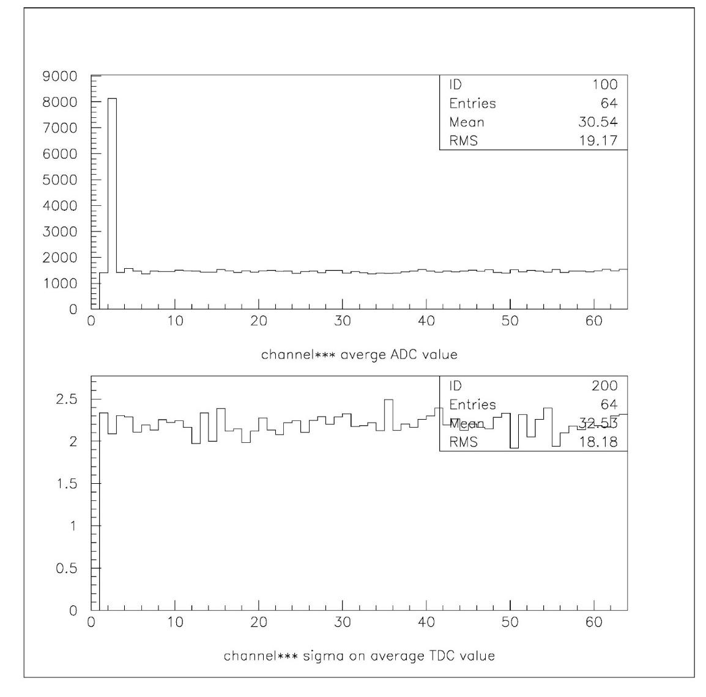
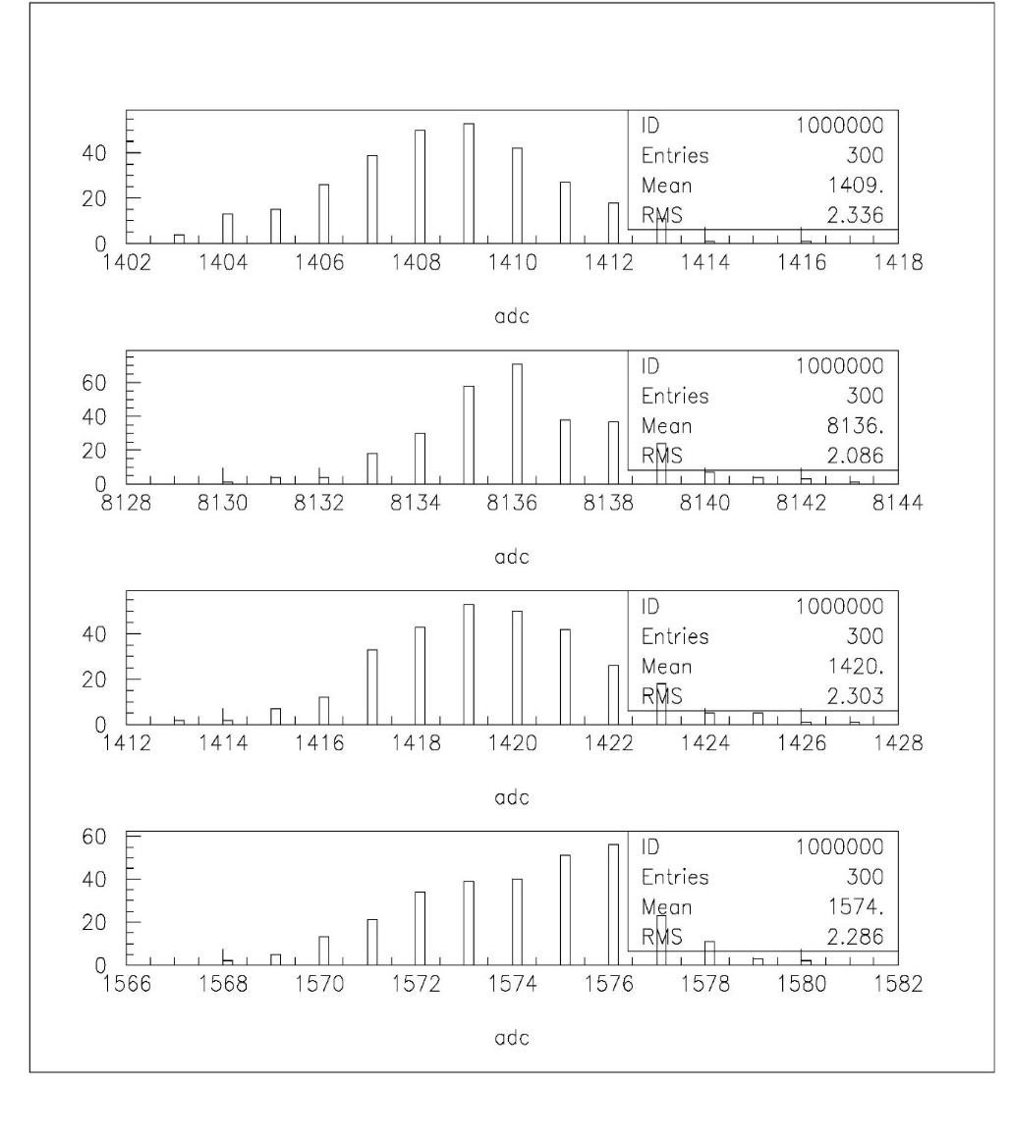
adc
ADC Board Performance
(baseline, no signal)
Channel 1 without offset
Baseline
(average ADC)
Ch 0
nhits
Channel number
adc
Ch 1
sigma
nhits
Baseline
(sigma)
adc
Ch 2
nhits
Channel number
adc
Ch 3
nhits
Rohde & Schwarz HMP4040
Power supply
adc

Slide 12
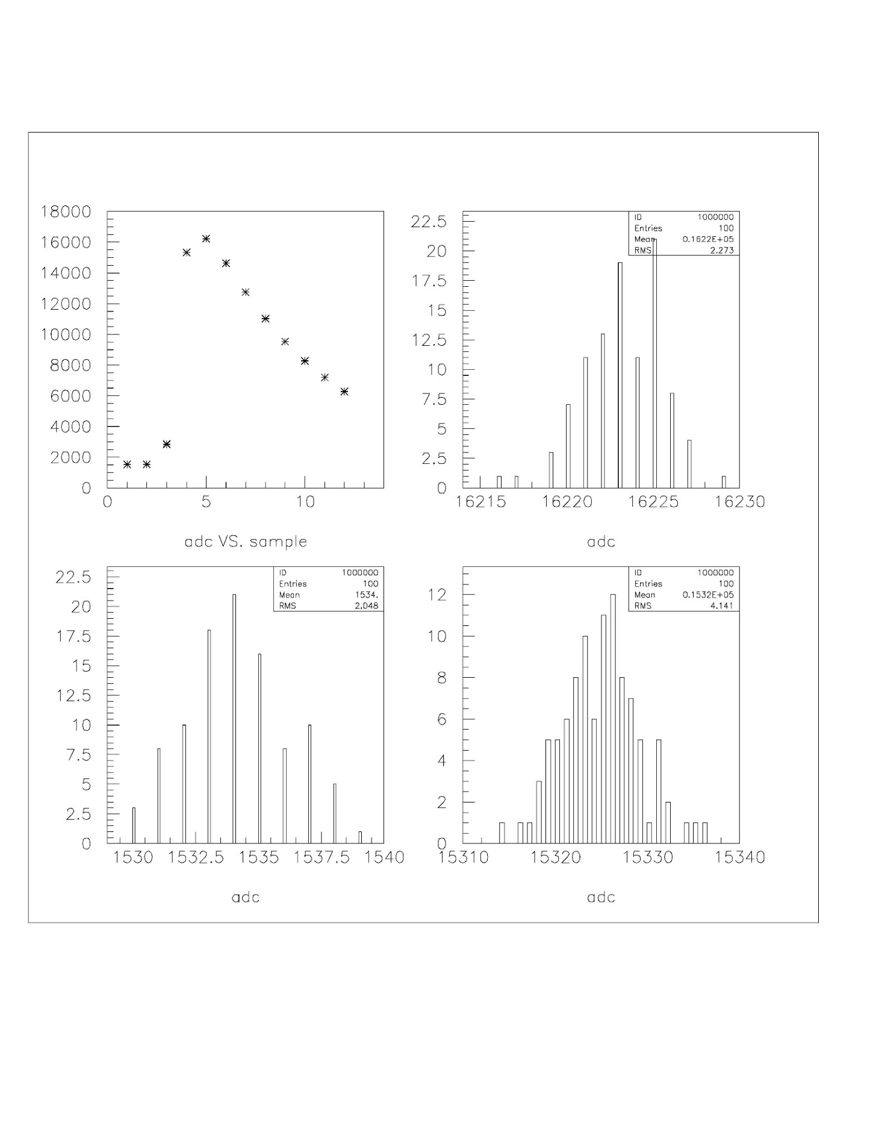
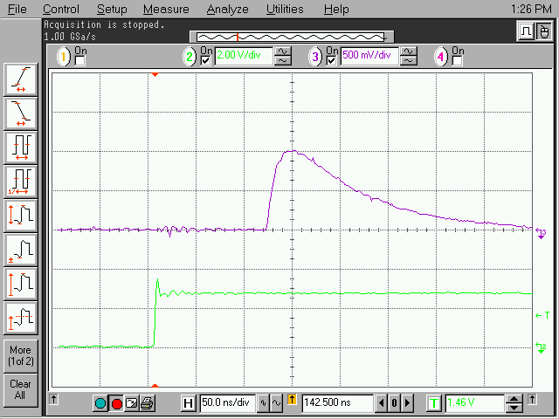
Pulse shape channel 40
rms
Digitalized pulse from Charge injector triggered by the FEM and trigger daughter card
ADC
Sample number
ADC
FEM
Trigger daughter card
Charge injector
rms
ADC
ADC

Slide 13
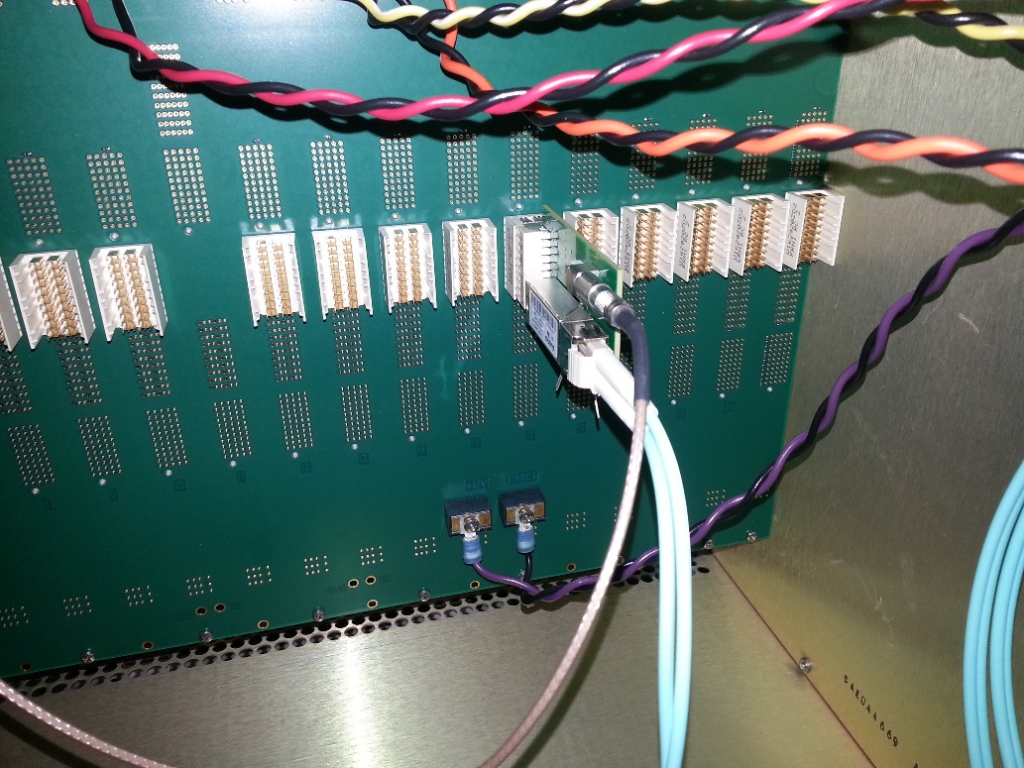
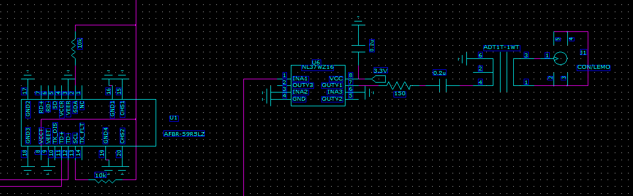
Trigger daughter plug in from the back with 2 outputs, 1 optical transceiver, 1 lemo output.
backplane
Optical transmitter output
ARRIA 5
FPGA
LVDS buffer
Lemo out
Trigger daughter card
3.3v

Slide 14
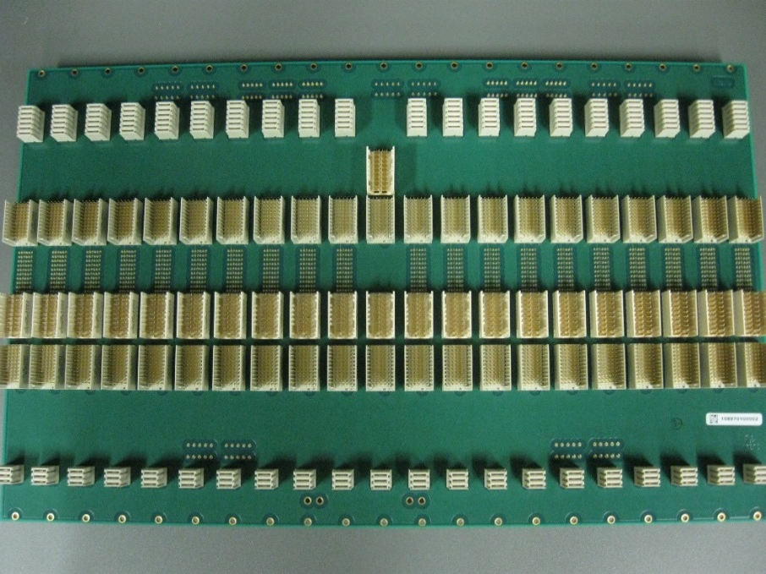
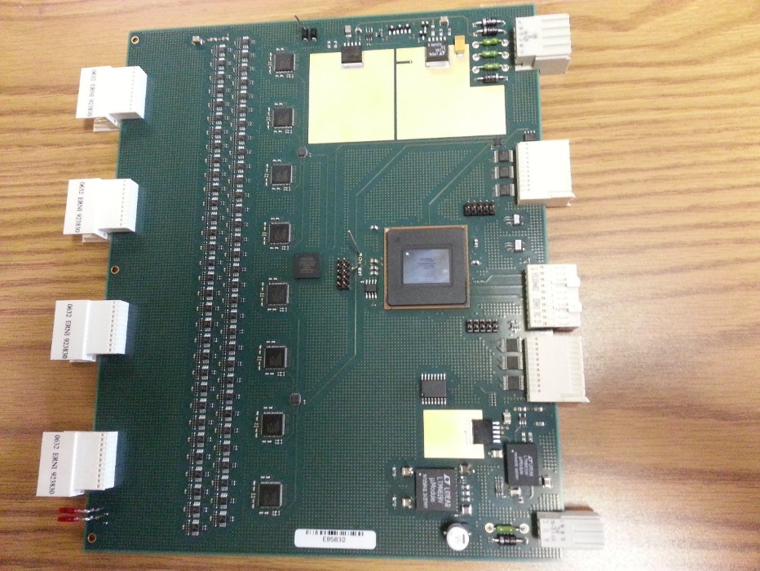
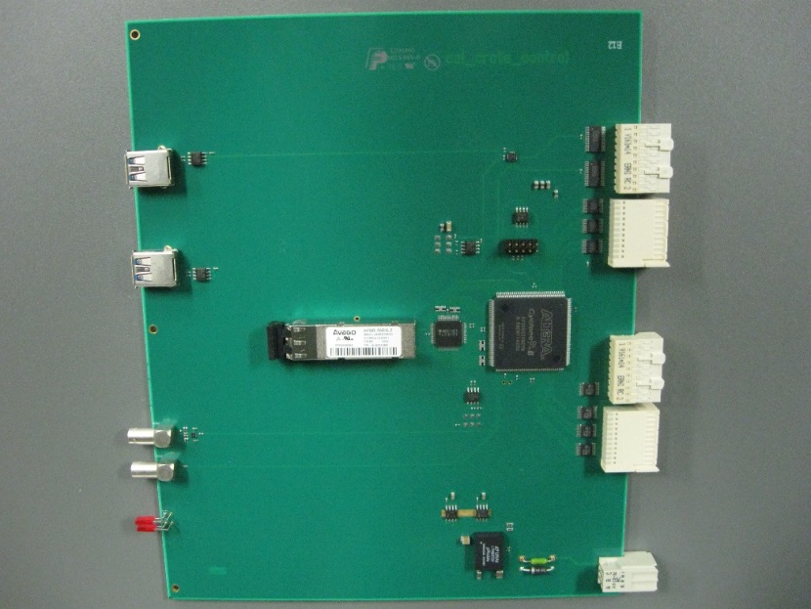
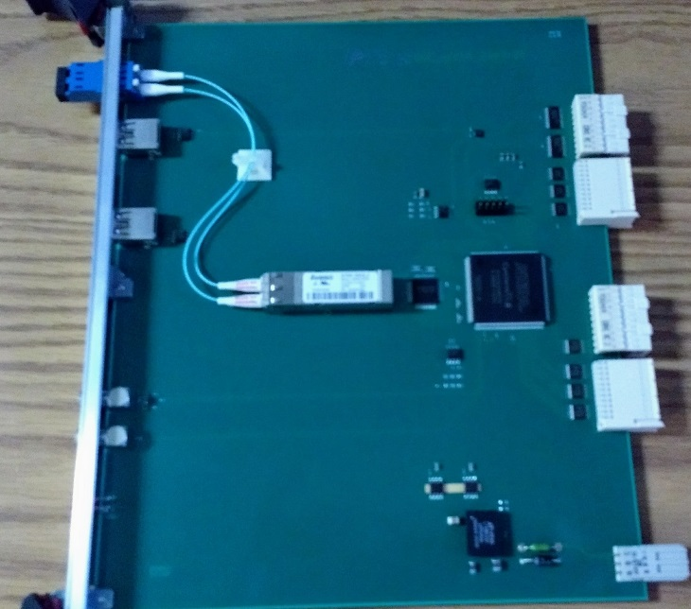
Prototype Boards
ADC board
Custom ADC system backplane
ADC XMIT board
ADC crate controller

Slide 15
SPHENIX ADC backplane
Block Diagram
6X
Clock
fancout
Slow read-
back
Slow read-
back
10 bits 2 frame+ 8 bits
Slow read-
back
10 bits 2 frame+ 8 bits
Slow read-
back
2mm
HM
3V
power
3V
power
Rear mount
Trigger board
Rear mount
Trigger board
Rear mount
Trigger board
2mm
ZD
Trigger
Primitives +
single trigger
bits out
Serialized
Trigger data
Trigger/evwnt data/ l0 timing
Serialized
Triggered data
2mm
ZD
Token
in
Token out
L0 timing
Running 6X beam rate
6 bits per beam crossing
2 links per side
(even, odd modules)
Slow control
Down-load
Slow control
Down-load
Slow control
Down-load
2mm
HM
10 bits 2 frame+ 8 bits
Slow control clock
(1.5X beam clock)
XMIT
ADC
controller

Slide 16
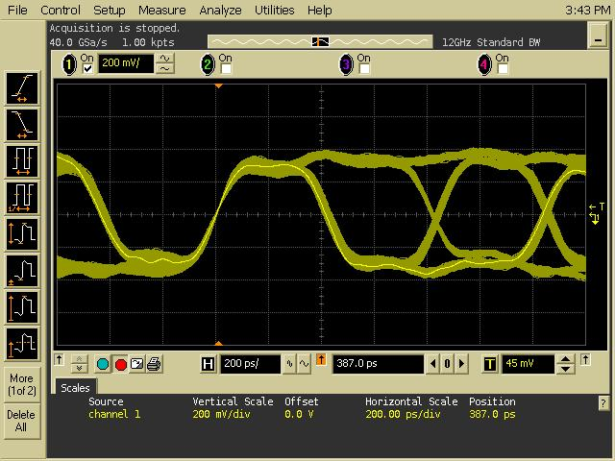
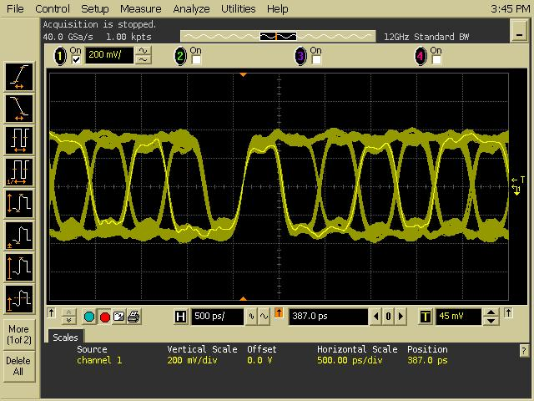
Trigger board waveform
Agilent scope 12 GHz 40G samples/sec
Agilent 3.5GHz 1131A differential probe
Persistence display
Measure at Trigger daughter card transceiver input
Signal speed 2.4 Gbps
200ps per division
500ps per division

Slide 17
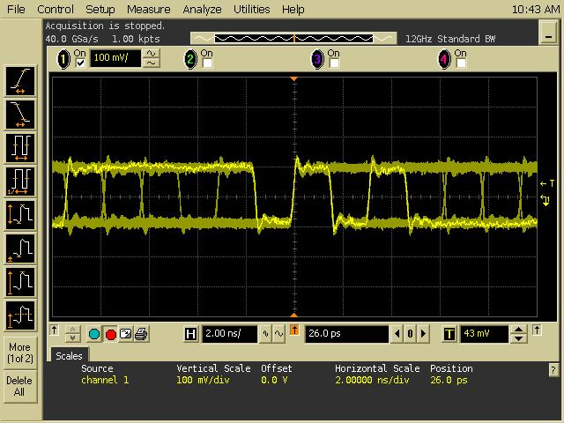
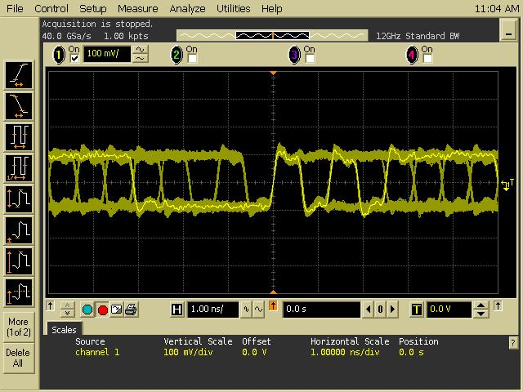
ADC board token passing data waveform
ADC L1 event data has 2 token passing links.
Each link has pair transceiver channel. The transceiver has 80 MHz reference clocks. The transceiver can be run at 640 Mbps , 800 Mbps or 1.2800 Mbps.
The XMIT data links speed to DCM II is 1.6 Gbps.
640 Mbps per links
1.6 Gbps per link
2ns/division
1ns/division
Token passing receiver side on the backplane

Slide 18
XMIT MODULE
Receive ADC module L1 triggered event through 2 token passing link.
The link composes by 2 transceiver links. Each links speed can be run 640 Mbps, 800 Mbps and 1.28 Gbps.
The L1 triggered events data will be send to DCM II. The DCM link speed is 1.6 Gbps.
Token get generate when receive L1 trigger and previous events transferred is finished. Otherwise token will be generated when current transmission is done.
A up and down counter provide multiple L1 triggers. Increment by 1 when receive L1 trigger. Down count by 1 when data are send.
1 events has 2304 16 bits data words = 3 ADC module * 64 channel *12 samples per channel.
2 640 Mbps links will transfer 16 bits data word every 16ns. 2304 words will takes 37us.
DATA FLOW
6x
CLOCK
RCV
ALTERA
CYCLONE
4 GX
F
I
F
O
RECEIVERS
OPTICAL
TRANSCEIVER
TLK 2501
(SERIALIZER)
TOKEN CONTROL
REFERENCE CLOCK
Mode Bits
Slow download/control

Slide 19
sPHENIX Digitizer Crate Controller
Receive 6x beam clock and Mode bits information (L0, L1 timing) through single USB 3 connection.
Provide offline clock and offline mode bits generator
Provide slow control & download path and offline readback function through JSEB II interface via optical cable.
JSEB II → PCI interface.
Di-directional link.
Control and download path to the MBD discriminator and pulse shaper electronics.
Second generation board.
Previous board does not have clock master input.
Optical link to the PCI express will only run at 2.5Gbits/sec
Default to offline mode when power up and JSEB II optical link is down,
Will provide status readback on the clock input status
Beam
Clock
diff.
receiver
PLL
mux
Clk
fanout
clk
USB 3
connector
Offline
clock
60 MHz
clk
Slow
Control
readback
Mode
bits
diff.
receiver
on line/
off line
Altera
Cyclone 4 GX
Mode bits out
From
JSEB 2
Optical
transceiver
Ref
clk
125 MHz
Slow
Control
send
pulse
Ext trig in
Twist
Flat
cable
Slow
Control to MBD

Slide 20
sPHENIX Digitizer Clock Master
Interface to the sPHENIX Timing system.
6x recovered beam clock, receiving mode bit → serialized to 6x beam clock (BC phase included)
provide beam clock for the MBD FEM.
output mode bits, 6x clock via USB 3 cable.
TLK1501, configured as receiver only, has a narrow frequency to lock incoming data. A plug in module with reference frequency is used for difference collision spec.
TLK1501 uses 8b/10 encoding method, need either <K28.5, D5.6> or <K28.5, D16.2> to lock or relock to the link.
No external control. It will serve as dumb interface.
MBD
Beam clock
Diff. PECL
Driver
Pair-Of
LEMO
1:4
fanout
Altera
Cyclone 3
TLK
1501
6X
Beam clock
1:4
fanout
Optical transceiver
GTM
1:4
fanout
Ref
clk
1:4
fanout
LVDS
USB 3
Plug in
module
1:4
fanout
Mode
Bits
1:4
fanout
LVDS
USB 3

Slide 21
Mode Bit Discussion
The GTM Link will serve for clock and L0, L1 timing information
The recovered clock will be 6x beam clock.
16 bits data field will have mode bits (init, reset, test etc) BC phase, L1 trigger etc.
The 8b/10 encoding need to have a) frequency lock, date phase bit lock and serial to parallel conversion.
Need to deal with lock and re-locked the link
For TLK chip, 3 fill frame is necessary for that.
Most us need only one data word out of 6 data from 6x beam crossing.
Suggest we send 3 fill frames per beam crossing.
No special stated needed to lock on both side to start the link.
Automatic recovery if the link ever lose lock.
Does not know about the recovered clock during loss lock and relock period.

Slide 22
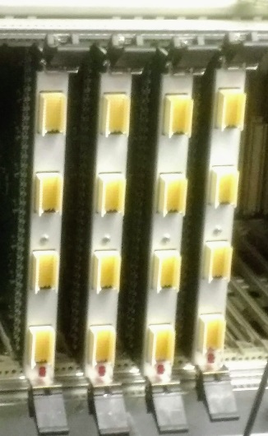
Digitizer Mechanical
All module is 6U height and 190 mm long.
190mm is not standard depth. But the ADC module layout requires longer depth.
The mechanical spec follow IEEE 1101.10.
The backplane are custom. But mounting holes, width and length follow 1101 standard.
Because we use 2mm HM cable for signal cable inputs. Front panels have to shift by 0.153 inch from the normal mounting position. Injector/ejector position unchanged.
The crate is custom design by ELMA.
Move backplane mounting position.

Slide 23
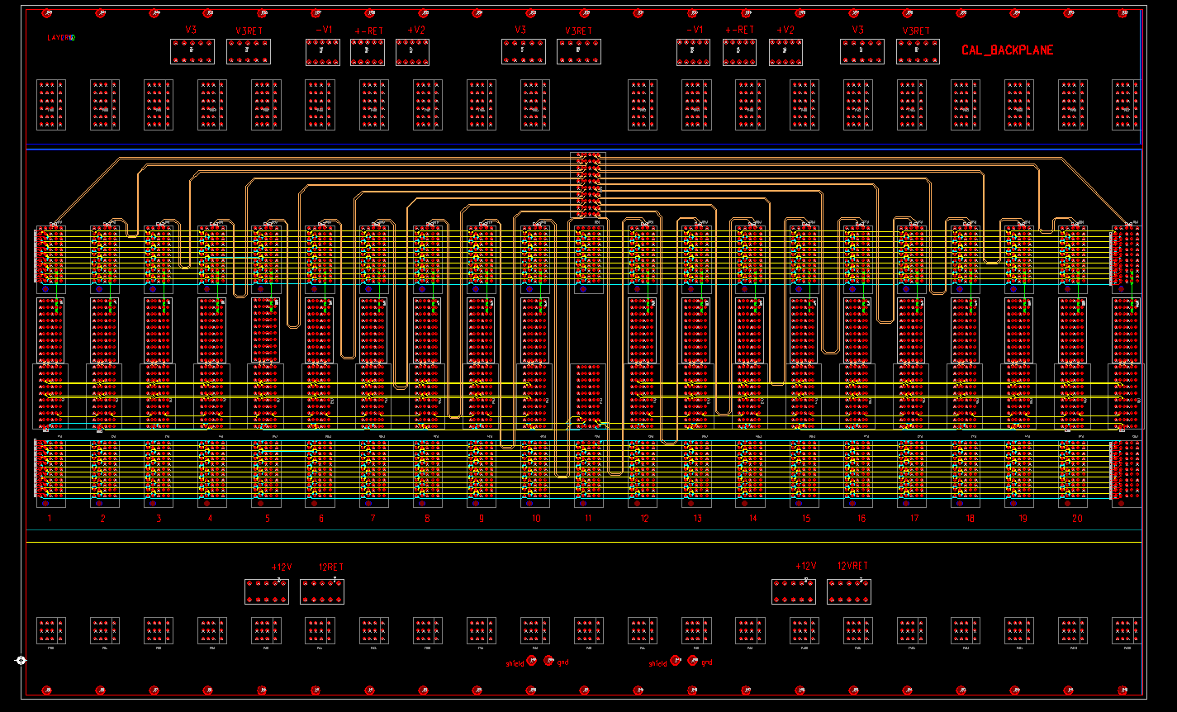
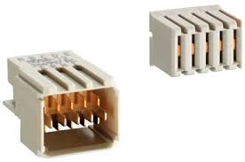
sPHENIX Calorimeter Digitizer Backplane (power)
+2.5V & +12 V power
Use Molex Z power 76001-0010
50A capacities.
-3.5V and +4V power
Use Tyco 9-55556-0
25A each
ERNI 2mm HM power connector
114404 for digital power
(+12V, Ground, +12V)
254927 for analog Power
(G, +2.5V, G, +4V, G, -3.5V)
10.8A current capacity.
Fit 1101.10 6U backplane
mechanical size
+2.5V, +2.5V return
+2.5V, +2.5V return
+2.5V, +2.5V return
-3.5V, return, +4V
-3.5V, return, +4V
Analog Power
+12V, +12V return
+12V, +12V return
Digital Power

Slide 24
Power
We have +12V for digital power, -3.5V, +2.5V, +4V for analog power supplies.
Only ADC board use analog power
All modules has fuses and Zener diodes.
Fuses are plug in through Amp 2-5331272-7 socket.

Slide 25
Obsolete Parts
Altera has discontinuation of their EPCQ and EPCS components:
We have brought Winbond W25Q256 NOR flash memory to replace EPCS16.
Package and pin compatible.
W25Q256 is also obsoleted. We have plenty of the Winbond chip.
EPCS are used in the XMIT module.
The new Micro serial NOR memory, MT25QL256 is compliable wit EPCQ256.
Altera has app note about the replacement.
The new NOR memory has considerable faster than EPCQ256 with much lower cost.

Slide 26
Major cost of the system
The cost drivers are on the ADC board, 276 production boards.
The 8 channel Analog Device ADC AD9257 ($84 per chip)
64 channel board → 8 ADCs per board
The Altera Arria 5 FPGA ($322.10 per chip)
receive the ADC data and data manipulation, L1 delay, 5 events buffer and generating trigger primitives.
The differential receiver, AD8132 ($2.10 per chip)
Receiver the differential signals from the cable. One per channel.
The PCB board ($210 per board)
The PCB assembly ($285 per board)

Slide 27
Status
The digitizer board, XMIT board, crate backplanes, crate controller (v1) has been build and tested in both BNL and Nevis.
It is also been used in the Fermi Lab test beam effort
The Crate Controller (v2) and Clock Master board has been fabricated.
Testing in progress.
Work reasonable well

Slide 28
Backup Slides

Slide 29
Digitizer board power
2.5 V 2A to start. After ADC reset, PLL The power is 2.3A.
-4V 0.8A
-3.6V 0.73A
Trigger daughter card
AFBR_59RLZ 760mw max. 3.3V power
NL37WZ16 100ma max 3.3V
Power through ADC board with 3 ERNI 2mm HM pins ( 1.5A per pin, to backplane) & 3 ZD connector pins (0.9A per pin, backplane to trigger boards)

Slide 30
+12V power
1 crate controller + 1 XMIT + 1 ADC board
+12 V is 1.152A
1 crate controller + 1 XMIT
+12 V is 0.64A
1 crate controller
+12V is 0.48A
Clockmaster module is
+12V is 0.44A

Slide 31
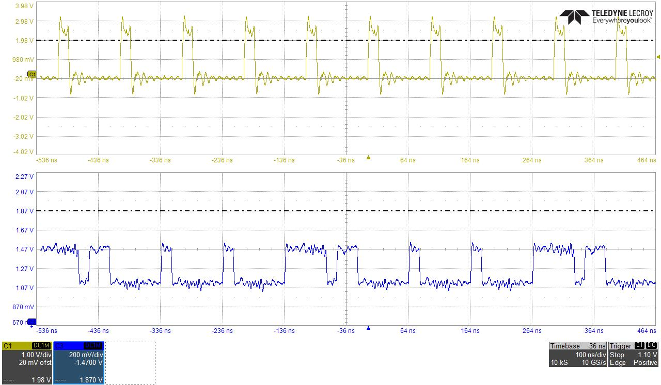
if (!locked) count <= 3'b0;
else if (sr==6'b100000) count <= 3'b0;
else if (count==5) count <= 3'b0;
else count <= count + 3'b1;
Clock Master output
100 ns
Beam phase (clock Master)
Serialized Mode bit (after USB 3 cable)
Beam phase bits

